Slide 1

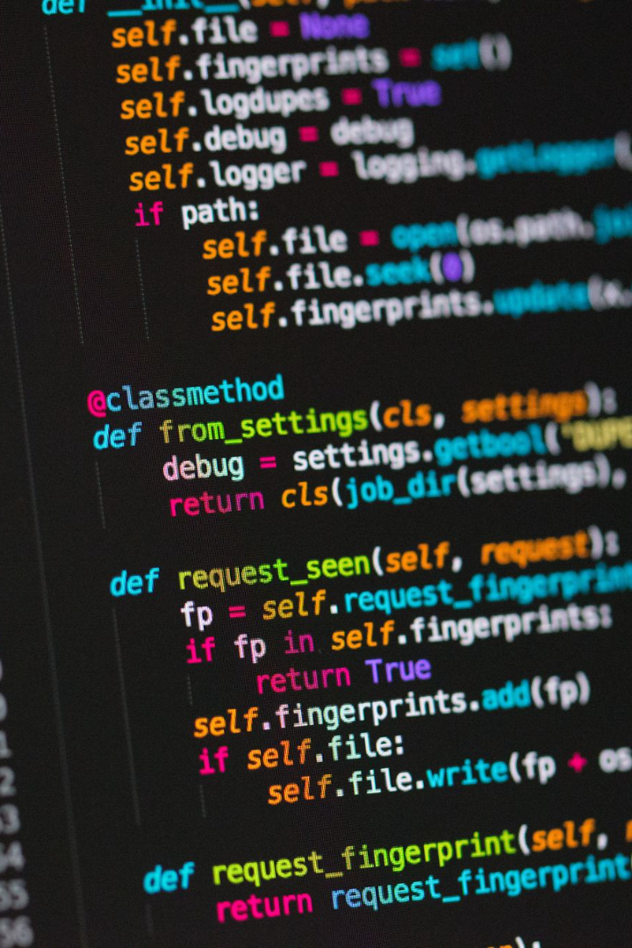

Python Installation in Windows
Welcome to the world of Python programming! In this presentation, we'll guide you through the process of installing Python in Windows, step-by-step.
by Anik Acharjee

Slide 2
Introduction to Python
High-level language 💻
Popularity 🌟
Used across industries 🔍
It ranks as one of the most popular programming languages, thanks to its efficient and effective syntax, dynamic typing, and high level of readability.
Python is an interpreted, high-level, general-purpose programming language that emphasizes code readability.
Python is used for web development, software development, data science, artificial intelligence, and more.

Slide 3
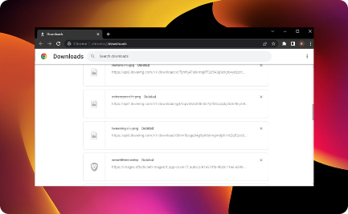
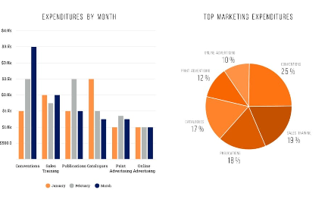
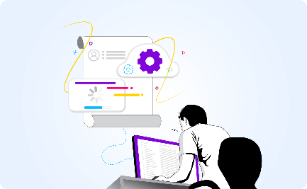
Download Python Installer
Latest Version
System Requirements
Installing Python
Download the latest Python version from python.org/downloads/.
Check if your system meets the requirements
Run the downloaded file, and follow the steps in the Python installer.

Slide 4
Steps to Install Python in Windows
Run the installer
Installation Complete
Run the Python installer by double-clicking the downloaded file and following the instructions on the screen.
Python will be installed in a few minutes. Check "Disable path length limit" if applicable.
1
2
3
4
Download
Select Components
Download the Python installer from the official website.
Choose the components that you want to install. Make sure to select the "Add Python to PATH" option.

Slide 5
Verification of Successful Installation
Open Command Prompt
Check Version
Check PATH Variable
Type "python -version" to check the Python version that you installed.
Open Command Prompt and type "python" to confirm that the installation was successful.
Check if the PATH variable includes the Python installation directory.

Slide 6

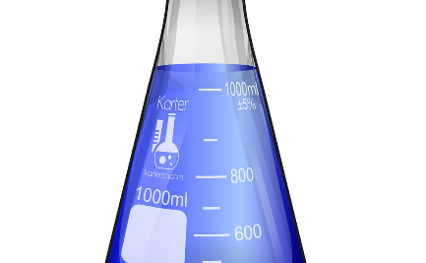
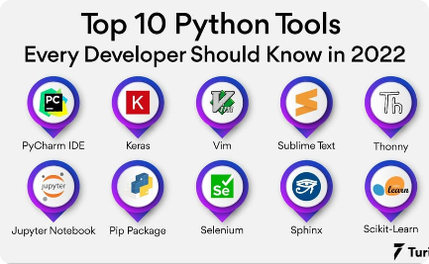
Installing Python Packages Using PIP
Open Command Prompt
Install Packages for Data Science
Virtual Environments
Use virtual environments to manage package dependencies and isolate the development environment.
Type "pip install" followed by the package name to install a package via pip.
Popular data science libraries like numpy and pandas need to be installed manually via pip.

Slide 7
Setting Up A Python Development Environment
1
IDE vs. Text Editor
Choose between an Integrated Development Environment or a text editor to write your code.
2
Popular IDEs
Use popular IDEs such as PyCharm, Spyder, Jupyter Notebook, Visual Studio Code.
3
Configure IDE
Add syntax highlighting features and key bindings to optimize the developer experience.

Slide 8

Conclusion: Benefits of Python Installation in Windows
1
Easy to Install 🎉
2
High-level Language 🎓
Python is easy to install in Windows and beginners can easily get started with programming.
Python is a high-level language that can be used across industries, from web development to data science.
3
Efficient and Effective 🚀
Python has a concise and readable syntax that makes coding efficient and effective.

