Slide 1
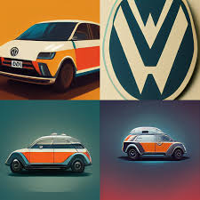
New Technology Demonstrations (Gen AI)
Overview:
Volkswagen is developing advanced automotive technologies aimed at enhancing the driving experience and safety.
Objectives:
Adaptive Learning System:
Goal: Adjust vehicle responses (acceleration, braking, steering) based on individual driving habits.
Key Feature: Learns from driving patterns over time, improving user experience and safety.
Emotion-Aware Cabin Environment:
Goal: Utilize facial recognition and biometric sensors to adjust in-cabin settings.
Key Feature: Modifies lighting, music, and climate based on driver emotions (happy, stressed, relaxed).
Introduction & Objectives
Volkswagen's Adaptive Learning System & Emotion-Aware Cabin Environment

Slide 2
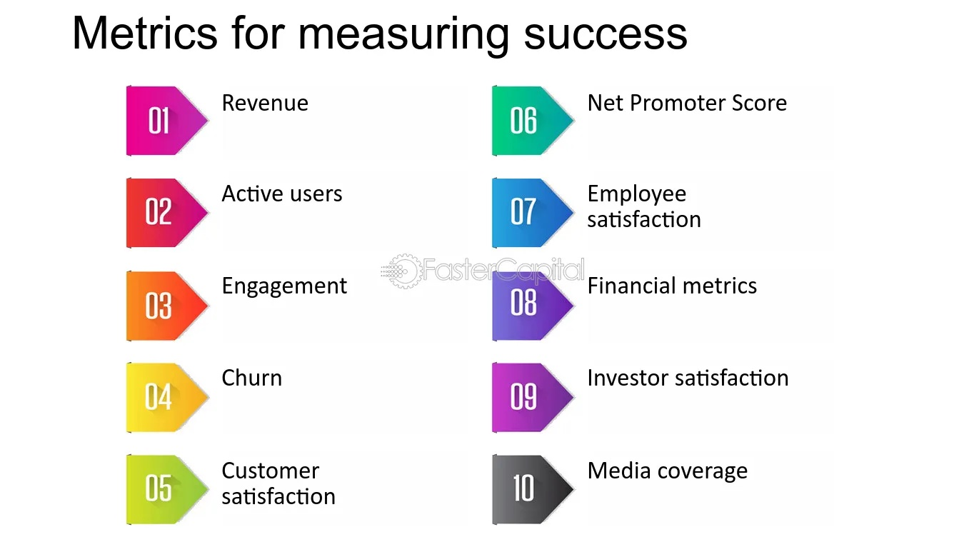
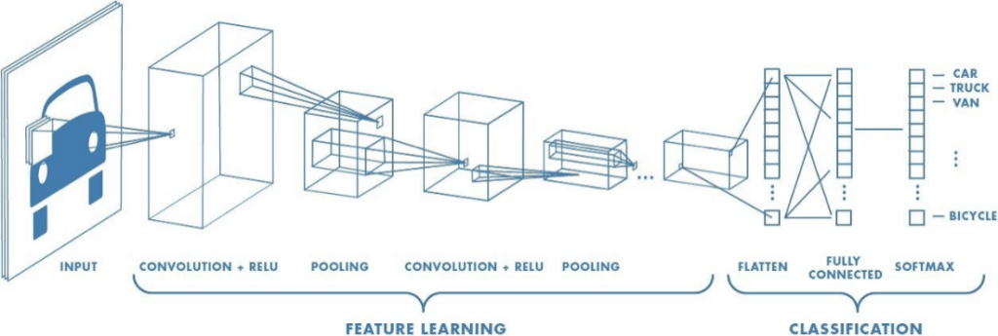
Development Approach:
Data Collection:
Driving Behaviour Data: Collected via accelerometers, gyroscopes (analyses speed, braking patterns).
Biometric Sensors: Facial recognition and heart rate monitors for emotion detection.
Machine Learning Models:
Driving Behaviour Model: Achieve 95% accuracy in recognizing driving styles.
Emotion Detection Model: Classify emotions with 90% accuracy using biometric data.
Testing Phases:
Controlled Environment Testing: Simulate different driving styles.
User Trials: Conduct trials with 50+ drivers to gather feedback on responsiveness and comfort.
Success Metrics:
User Experience:
Net Promoter Score (NPS): Target 60 or above.
Customer Satisfaction Score (CSAT): Aim for an average of 8.5 out of 10.
Safety:
Accident Rate Reduction: Target a 20% decrease in accidents among vehicles equipped with these technologies.
Adoption Rate:
Technology Adoption Rate: Aim for 70% adoption within the first year of launch.
Active Usage Rate: Target 60% of users actively using adaptive features weekly.
Development Approach & Success Metrics

