Slide 1
An Error-based Investigation of Statistical and Neural Machine Translation Performance on Hindi-to-Tamil and English-to-Tamil
CSE431- Natural Language Processing
Group Members:
Adiba Haque - 17201113
Anika Nahian Binte Kabir - 18101249
Mayesha Monjur – 18101411
Group number-10

Slide 2
Experimental Setup
Phrase Based SMT
Moses toolkit
5-gram language model
Some log-linear features include: (a) 4 translation features (b) 8 lexical reordering probabilities (c) 5-gram LM probabilities (d) 5 OSM features (e) Word count and distortion penalties
Neural MT
Open NMT toolkit
Hyperparameter tuning : (a) The BPE vocabulary size - 8000 (b) The sizes of encoder and decoder layers - 4 and 6 respectively (c) Learning rate - 0.0005 (d) Batch size - 4000 (e) Transformer head size - 4

Slide 3
Dataset and Choice of Language
From a less infected language to highly infected- English to Tamil
Between two morphologically complex and inflected languages - Hindi to Tamil
Sources of data:
OPUS -(Tiedemann, 2012)
WikiMatrix3 (Schwenk et al., 2019)
PMIndia4 (Haddow and Kirefu, 2020)

Slide 4


Results and Evaluation
Metric:
BLEU- bilingual evaluation understudy algorithm
Mixed setup:
IT Setup:

Slide 5
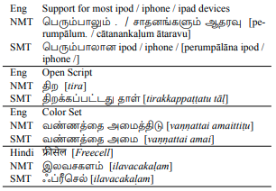
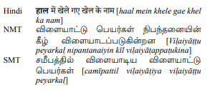
Error Analysis
Terminology Handling-OOV terms
Incorrect translation or dropping by MT systems
Handling of polysemous words
Omission of certain words and reordering

Slide 6
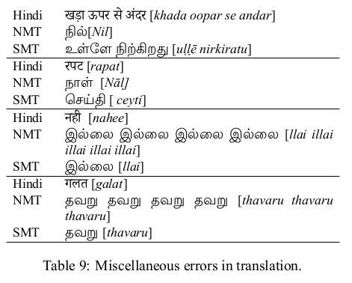
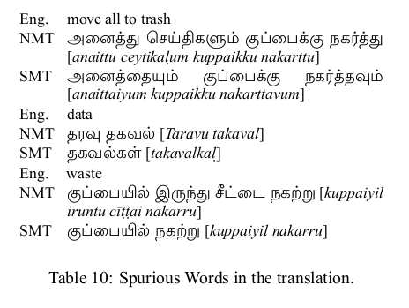
Miscellaneous Errors
Strange unrelated words
Repetition of other translated words
Appearance of one or more unexpected words
Transliterations of translated words themselves

Slide 7
BPE segmentation on the Hindi to Tamil Translation
Conclusion
In-domain data positively impacts translation.
Morphological complexity of source and target languages can result in poor performance of MT systems.
Error analysis done on translations of dual systems reveal both positive and negative sides.
BPE-based segmentation can change underlying semantic agreements between two languages with greater morphological complexity.
May result in syntactic and morphological disagreements.
May violate underlying semantic agreements.

