Slide 1

EN-HU Translation
Anika Duffus

Slide 2

Introduction
Developed a model that translates English to Hungarian text.
Determine how well a seq2seq model can perform this translation despite the difference in syntactic structure

Slide 3

Previous Solution

Slide 4

English to French Translation
Keras code example: Character-level recurrent sequence-to-sequence model (https://keras.io/examples/nlp/lstm_seq2seq/)
Translating short English sentences into short French sentences

Slide 5

My Solution

Slide 6

Dataset
Tab separated files containing collection of sentences and translations
ManyThings.org http://www.manythings.org/anki/hun-eng.zip
Tatoeba.org https://tatoeba.org/en/downloads

Slide 7
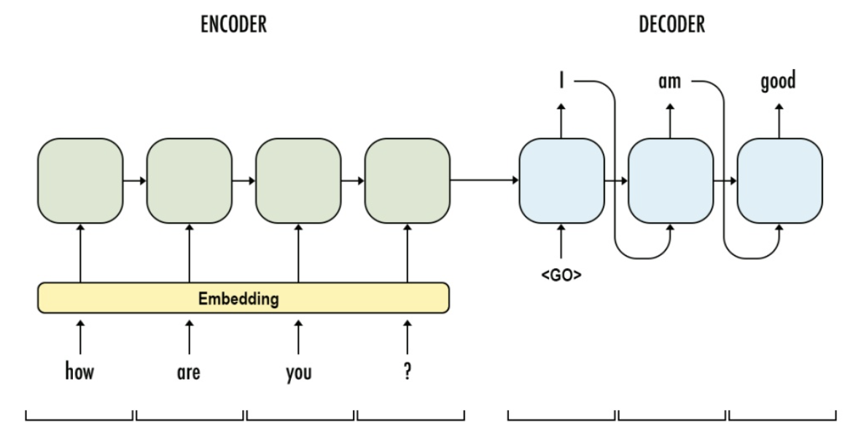
Proposed Method
Seq2Seq modelling + LSTM encoder and decoder.
Merge Datasets
70% for training, 20% for validation and 10% for testing.

Slide 8
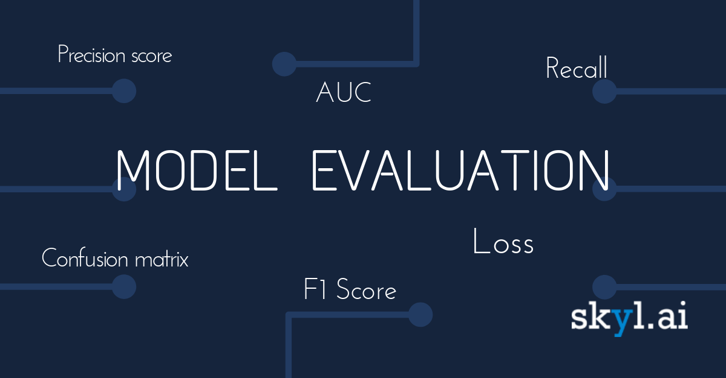

Evaluation Method
Metric: accuracy
Model().evaluate
Bilingual Evaluation Understudy (BLEU)

Slide 9

Results

Slide 10
Results

Slide 11
Results
The corpus_bleu() is the BLEU score for multiple sentences such as a paragraph or a document.
The score was 0.0.
The sentence_bleu() is the BLEU score for evaluating a candidate sentence against one or more reference sentences.
All scores were 0.0.
The sentence_bleu() 1-gram score is the evaluation of just matching grams of single words.
Examined first word
All scores were 0.0

Slide 12
Discussion
The corpus_bleu() score indicates that there is a perfect mismatch between target test data and the decoded sentences.
Input text is not a collection of related sentences like a paragraph
The sentence_bleu() scores indicates that there is a perfect mismatch between target test data and the decoded sentences.

Slide 13
Thank You!

