Slide 1

Book Exchange
Anika Duffus

Slide 2


Project Idea

Slide 3

Motivation
Other students at my school want to sell their books.
How do I know who is selling what?

Slide 4
App Solution
Browse list of books without filter
Can claim book without expiration
View seller contact information

Slide 5

High Level Architecture

Slide 6
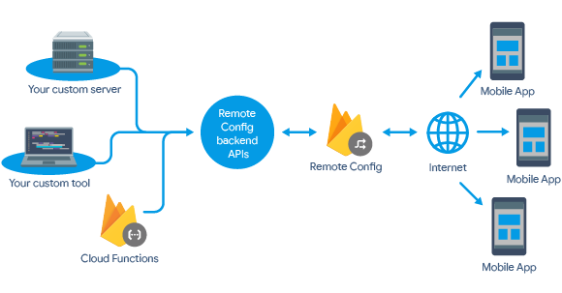
Cloud Database - Firebase

Slide 7
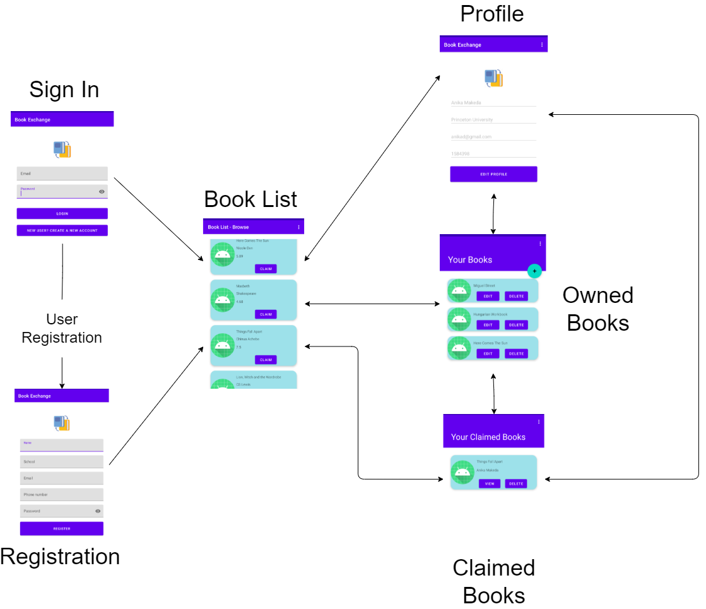
Navigation

Slide 8

Implementation

Slide 9
Data
data class Book(
var user_id: String = "",
var author: String = "",
var title: String = "",
var condition: Int = NEW,
var price: Float = 0f,
var imgUrl: String = "",
var isClaimed: Boolean = false,
var claimedBy: String = ""
)
data class User(
var user_id: String = "",
var name: String = "",
var email: String = "",
var phone: Int = 0,
var school: String = ""
)

Slide 10
Implementation details
Features

Slide 11
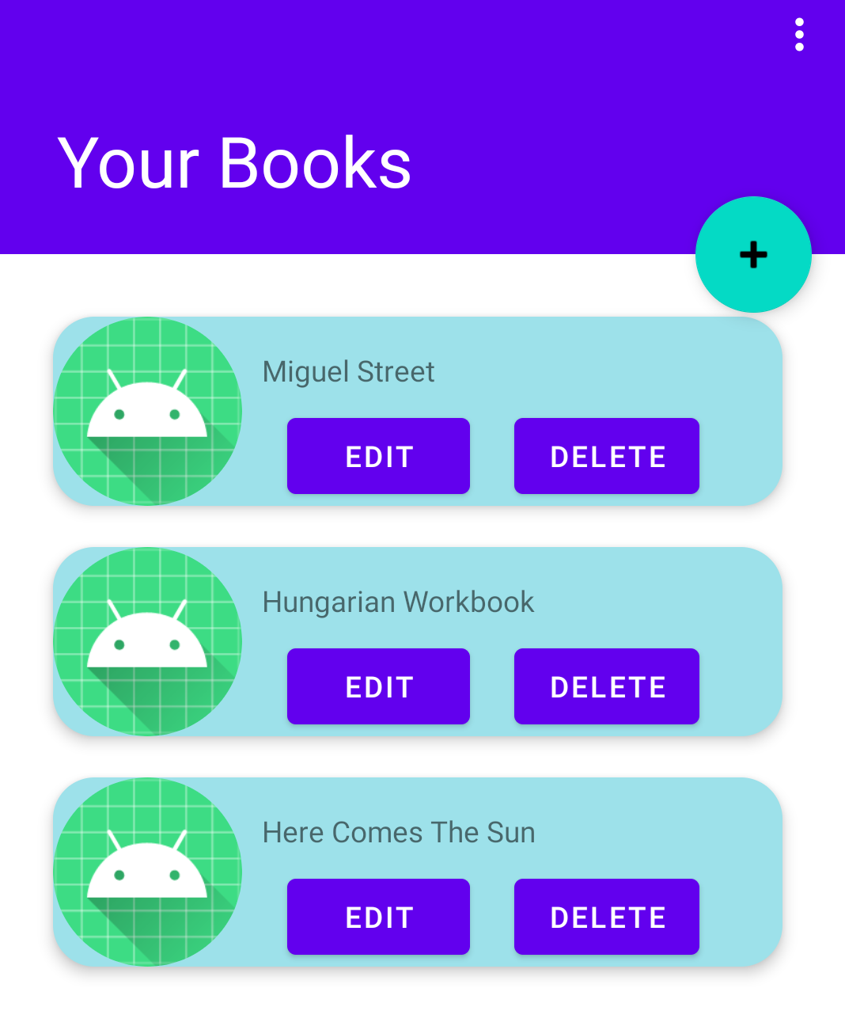
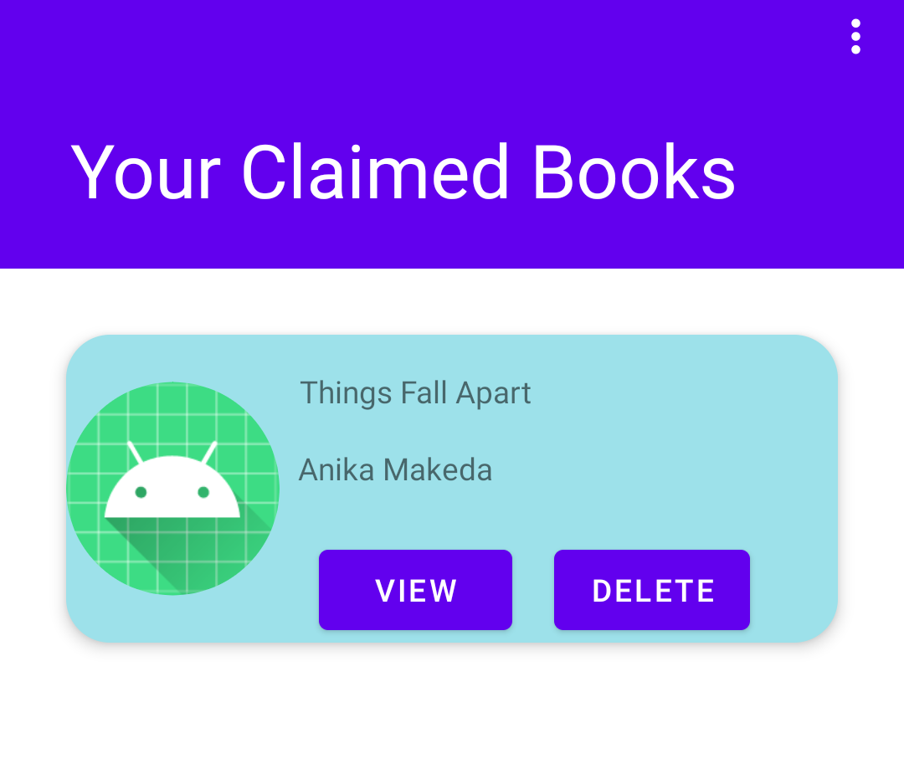
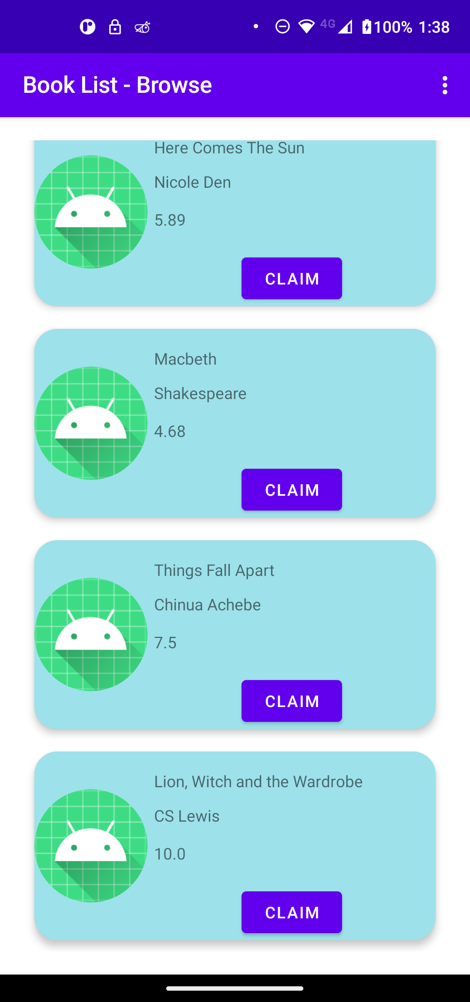
RecyclerView, CardView

Slide 12
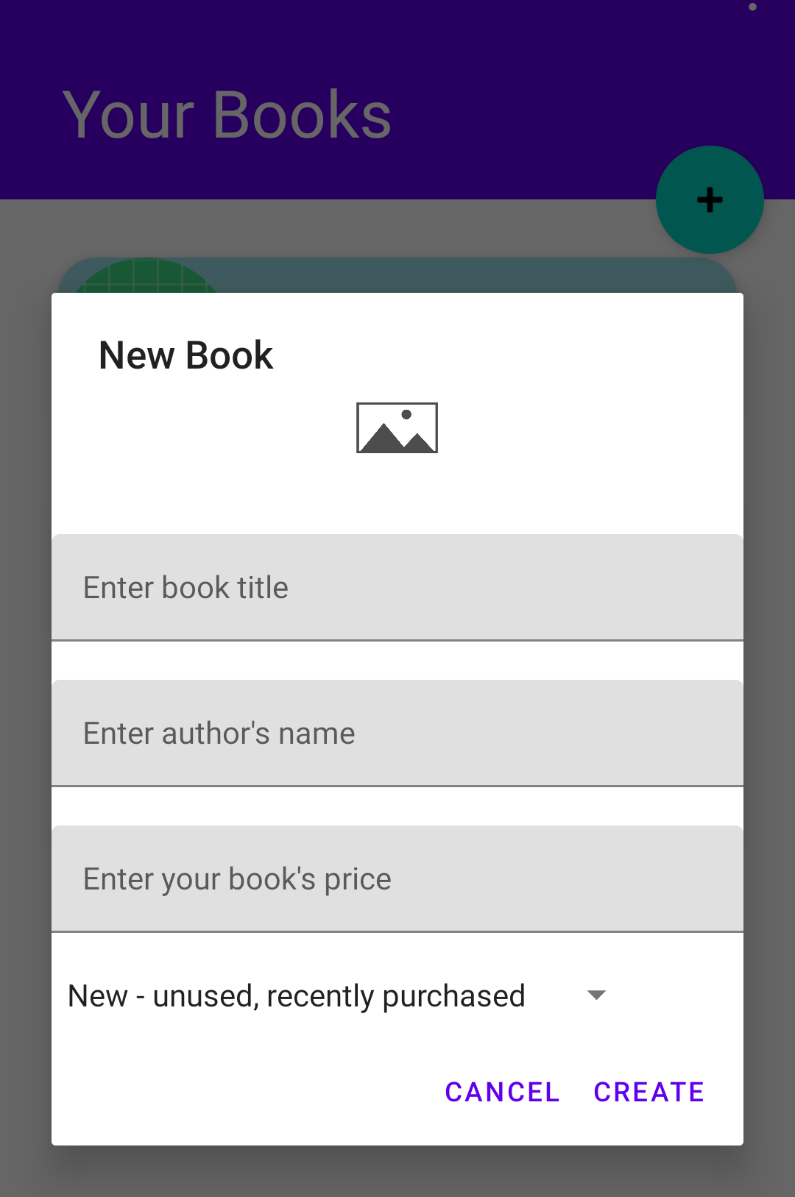
Spinner, Image from Camera

Slide 13
Future Features
Filtering, AutoCompleteTextView
UI library
Claim Expiration

Slide 14
Implementation Details
Querying from Firebase

Slide 15
Displaying Book List
val queryRefBooks = FirebaseFirestore.getInstance().collection(COLLECTION_BOOKS)
.whereNotEqualTo("user_id", FirebaseAuth.getInstance().currentUser!!.uid)
.whereEqualTo("claimed", false)

Slide 16
Implementation Details
Reading from Firebase

Slide 17
Getting User Profile Information
val userCollection = FirebaseFirestore.getInstance().collection(COLLECTION_USERS)
userCollection.whereEqualTo(
"user_id", FirebaseAuth.getInstance().currentUser!!.uid).get()
.addOnSuccessListener { documents ->
for (document in documents) {
var user = document.data
doc_key = document.id
binding.tvName.setText(user.get("name").toString())
binding.tvEmail.setText(user.get("email").toString())
binding.tvPhone.setText(user.get("phone").toString())
binding.tvSchool.setText(user.get("school").toString())
}
}
.addOnFailureListener { exception ->
Toast.makeText(this, "Error getting profile information", Toast.LENGTH_LONG)
}

Slide 18
Demo!

Slide 19

Thank You!

