Slide 1
Course: Web Eengineering 01.Requirement engineering for web application
Anca Ion

Slide 2

CSE 615 – Web Engineering
A. H. M. Sajedul Hoque
Assistant Professor
Computer Science & Engineering
University of Chittagong

Slide 3
Week 4
Requirement engineering for web application

Slide 4
Contents
Web engineering
Categories of Web Applications
Characteristics of the Web Applications
Product-related
User-related
Development-related
Evolution
Requirements Engineering for Web Application
RE Specifics in Web Engineering
Principles for RE
RE methods
Requirement types
Notations
Tools

Slide 5
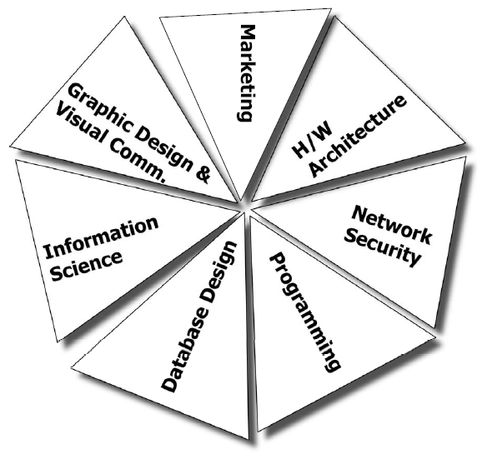
Disciplines required to develop Web Systems

Slide 6
Web Engineering…
Web engineering is body of knowledge consisting of Technologies, Architectures, Design Methodologies and Development Processes, that will enable us to develop Complex and Maintainable Web Systems;
Web Engineering-Based on Software Engineering, Web Engineering comprises the use of systematic and quantifiable approaches in order to accomplish the specification, implementation, operation, and maintenance of high quality Web applications.
A Web application is a software system based on technologies and standards of the World Wide Web Consortium (W3C) that provides Web specific resources such as content and services through a user interface, the Web browser.

Slide 7
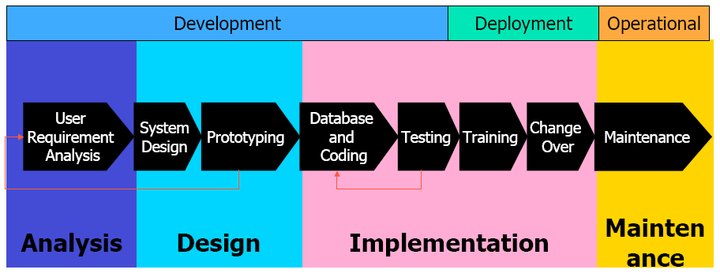
Typical life cycle

Slide 8
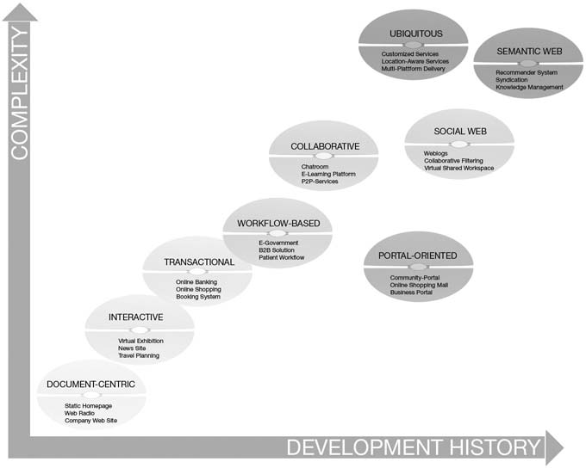
Categories of Web Applications

Slide 9
Document centric Web sites
Precursor to Web applications
Stored on a Web server as ready-made, i.e. static, HTML documents and sent to the Web client in response to a request
Contents are frequently represented redundantly on several Web pages
simplicity and stability
short response time

Slide 10
Interactive Web applications
web pages and links to other pages are generated dynamically according to user input
uses CGI, ASP, PHP and HTML form
e.g., virtual exhibitions, news sites, or timetable information

Slide 11
Transactional Web applications
provide more interactivity
performing updates on the underlying content
efficient and consistent handling of the increasing amount of content
offer the possibility of structured queries
e.g., online banking, online shopping, and booking systems

Slide 12
Workflow-based Web applications
handling of workflows between different companies, public authorities, and private users
availability of appropriate Web services to guarantee interoperability
e.g., Business-to-Business solutions (B2B solutions) in e-commerce, e-government applications,

Slide 13
Collaborative Web applications
especially for cooperation purposes in unstructured operations (groupware)
communication between the cooperating users
support shared information and workspaces
e.g, wiki, Weblogs, scheduling systems, e-learning platforms

Slide 14
Portal-oriented Web applications
provide a single point of access to separate, potentially heterogeneous sources of information and services
e.g., online shopping malls, community portals

Slide 15
Ubiquitous Web applications
provides customized services anytime anywhere and for any device
facilitating ubiquitous access
either personalization or location-aware services or multi-platform delivery

Slide 16
Semantic Web
present information on the Web
not merely for humans,
but also in a machine readable form
facilitate knowledge management on the Web
linking and reuse of knowledge (content syndication)
locating new relevant knowledge
interoperation on the semantic level and the possibility of automating tasks (via software agents)

Slide 17
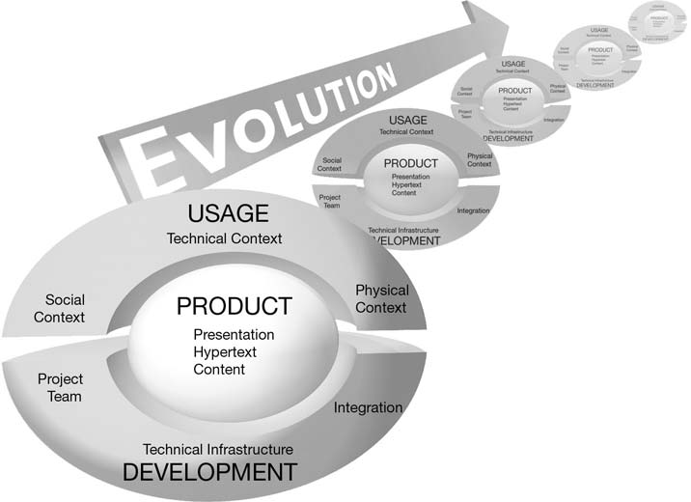
Characteristics of Web Applications
Dimensions according to ISO/IEC 9126-1 for the categorization of characteristics of Web applications

Slide 18
Product-related Characteristics
These characteristics consist of
Content
Hypertext structure
Presentation
Content
Document-centric character and multimediality
Depending on the structuring, content is provided as tables, text, graphics, animations, audio or video.
Document Character- documents are generated that present information in an appropriate way for certain user groups
Content is generated and updated dynamically
Quality demands
Contents should be up to date, exact, consistent and reliable

Slide 19
Product-related Characteristics
Hypertext
Basic Elements of Hypertext Model
Node :
a Self-contained uniquely identifiable information unit
An HTML document which can be reached via a URL
Link : A path from one node to another
Anchor : the area within the content of a node that is the source or destination of a link
The essential feature of hypertext paradigm
Non-linearity of hypertext document :
users may move freely through the information space, depending on their interests and previous knowledge
Two fundamental problems of hypertext paradigm
Disorientation :
The tendency to lose one’s bearing in a non-linear document
cognitive overload
Additional concentration required to keep in mind

Slide 20
Product-related Characteristics
Two special features of web applications at Presentation level
Aesthetics
The visual presentation of web pages is subject to fashion trends
Self-explanation
It should be possible to use a Web application without documentation

Slide 21
Usage-related Characteristics
Social Context: Users
Spontaneity :
Users can visit a web application whenever they want and leave it
Users can not expected to be loyal to any content provider
Multiculturality :
Adapting the components of the applications to users
Regular customers might be given special discounts
New customers might receive a guided tour through the web application
Users with visual impairments might be aided by appropriate font sizes
Technical Context: Relate to Network and Devices
Quality of Service :
the characteristics of transmission medium such as bandwidth, reliability varying stability of the connections
Multi-platform delivery :
Web applications usually offer services not only to a specific type of device but rather any increasingly mobile, devices with different specifications
Natural Context: Location and Time
Globality :
Web application can be accessed globally regarding regional, cultural, and linguistic differences
Global availability increases the demands on security of web applications
Availability :
The application is immediately available
Permanent availability 24/7 also increases the demands on the stability of web applications

Slide 22
Development -related Characteristics
Development Team
Multidisciplinary :
It requires knowledge and expertise from different areas
IT expert : for the technical implementation of the system
Hypertext expert : to design hypertext and presentation
Domain experts : responsible for the content
Young average age :
They usually live up to the stereotype of the technology freak
They are very interested in new tools and technologies
Community development
Open source community
Technical Infrastructure
Inhomogeneity :
The development of Web applications depends on two external components : server and browser
Web server can usually be configured and operated as desired by the application programmers
There is no way to influence the users’ browsers and individual preferences
Immaturity :
Components used in Web applications are often immature
They either have bugs or lack the desired functionality

Slide 23
Development -related Characteristics
Process
Flexibility to changing conditions
Due to the necessity for short development time many Web Applications are developed in parallel by various subgroups of the development team
Integration
Internal Integration
Web application has to be integrated with existing legacy systems when existing component are to be made available through a web application
External Integration
The integration of content and services of external web applications
Database system and functionalities

Slide 24
Requirements Engineering for Web Applications
covers activities that are critical for the success of Web engineering
deals with principles, methods, and tools for eliciting, describing, validating, and managing requirements
has special challenges
unavailable stakeholders,
volatile requirements and constraints,
unpredictable operational environments
inexperience with Web technologies
particular importance of quality aspects such as usability, or performance

Slide 25
Requirements Engineering for Web Applications [2]
Important principles to adopt existing RE methods
Involvement of important stakeholders
Iterative identification of requirements
Awareness of the system architecture when defining requirements
Consequent risk orientation

Slide 26
Where Do Requirements Come From?
The individual objectives and expectations of stakeholders are the starting point of requirement elicitation process
The Web application shall be available online by September 1, 2006 (customer constraint).
The Web application shall support a minimum of 2500 concurrent users (quality objective of customer).
J2EE shall be used as development platform (technology expectation of developer).
All customer data shall be securely submitted (quality objective of user).
The user interface shall support layouts for different customer groups (quality goal of customer).
An arbitrary user shall be able to find a desired product in less than three minutes (usability objective of customer).
A user shall be able to select an icon to display articles included in the shopping cart at any given time (capability objective of user).

Slide 27
Requirement
Requirement
Describes a property to be met or a service provided by a system
IEEE 610.12 defines a requirement as
(1) a condition or capability needed by a user to solve a problem or achieve an objective;
(2) a condition or capability that must be met or possessed by a system or system component to satisfy a contract, standard, specification, or other formally imposed documents;
(3) a documented representation of a condition or capabilities in (1) or (2).
Requirement categorized as
functional requirements : System’s Capabilities and Services
non-functional requirements: levels of quality (How Secure? How usable?)
Constraints : non-negotiable conditions affecting a project
the skill-level of the development team, the available budget, the delivery date or the existing computer infrastructure in the deployment environment

Slide 28
Requirements Engineering Activities
Requirements covers
Elicitation, documentation, verification, validation and management of requirements throughout the development process
Requirements Elicitation and Negotiation
Communication among the stakeholders is essential as only their shared expertise can lead to acceptable solutions
scenario-based methods, multicriteria decision processes, facilitation techniques, interviews, or document analysis
Requirements Documentation
Informal descriptions such as user stories, and semi-formal descriptions such as use cases are particularly relevant
Requirements Verification and Validation
Did we specify the right things? Did we specify things correctly?
Conventional methods : Reviews, Inspections or Prototyping
Requirements Management
Continuous changes of requirements and constraints are a major characteristic
integration of new requirements and changes to existing requirements

Slide 29
RE Specifics in Web Engineering
Multidisciplinarity
Requires the participation of experts from different disciplines
Multimedia experts, content authors, software architects, usability experts, database specialists, or domain experts
Unavailability of Stakeholders
stakeholders (potential Web users) still unknown during RE activities
project management needs to find suitable representatives that can provide realistic requirements
Volatility of Requirements and Constraints
properties of deployment platforms or communication more difficult in RE for Web Application
new development platforms and standards, or new devices for end users

Slide 30
RE Specifics in Web Engineering [2]
Unpredictable Operational Environment
e.g., changing bandwidths affect the response time of mobile applications
Impact of Legacy Systems
integration of existing software components
Web developers have to be aware of the system architecture and architectural constraints
Significance of Quality Aspects
performance
security
availability, or usability

Slide 31
RE Specifics in Web Engineering [3]
Quality of the User Interface
IKIWISI (I Know It When I See It) phenomenon :
users will not be able to understand and evaluate a web application just looking the abstract models and specification
They need to experiment with it
adding prototypes of important application scenarios
Quality of Content
developers have to consider the content, particularly its creation and maintenance
Important quality characteristics include accuracy, objectivity, relevance, actuality, completeness and clarity
Content management systems (CMS) - separating content from layout
Developer Inexperience
technologies development tools, standards, languages rapidly developed
wrong estimates when assessing the feasibility and cost of implementing requirements
Firm Delivery Dates
all activities and decisions have to meet a fixed final project deadline
negotiation and prioritization of requirements are particularly crucial

Slide 32
Principles for RE of Web Applications
Understanding the System Context
analyzing and describing existing business processes
What are we doing this for?
Involving the Stakeholders
their active and direct cooperation in identifying and negotiating requirements is important in each project phase
identification of success-effective stakeholders
understanding of stakeholders’ objectives and expectations
negotiation of different expectations, experiences, and knowledge

Slide 33
Principles for RE of Web Applications [2]
Iterative Definition of Requirements
necessary in environment with volatile requirements and constraints
Focusing on the System Architecture
Twin-Peaks model suggests to concurrently refine both requirements and the system architecture
Risk Orientation
Undetected problems, unsolved issues, and conflicts among requirements represent major project risks
integration of existing components
prediction of system quality aspects
inexperience of developers
Prototyping - to avoid the IKIWISI problem
releases of a Web application to collect user feedback
early incorporation of external components to avoid late and severe integration problems

Slide 34
Adapting RE Methods to Web Application Development
Different aspects during adaptation process
Which types of requirements are important for the Web application?
How shall requirements for the Web application be described and documented? What are useful degrees of detail and formality?
Shall the use of tools be considered? Which tools are suited for the particular project needs?

Slide 35
Requirement Types
Functional requirements describe a system’s capabilities and services
e.g., "The user can select an icon to view articles in the shopping cart at any given time."
Non-functional requirements describe the properties of capabilities and the desired level of services
e.g., "The Web application shall support at least 2500 concurrent users.“
Other non-functional requirements refer to project constraints and system interfaces

Slide 36
Requirement Types [2]
Functional requirements are frequently described using use case scenarios and formatted specifications
Contents Requirements
Quality Requirements
security, performance, or usability
System Environment Requirements
how a Web application is embedded in the target environment
ubiquitous web - environment requirements have to specify the details
User Interface Requirements : to use web application without formal training, self-explanatory, intuitive guidance of users
Evolution Requirements
future capabilities, future security requirements
Project Constraints
budget and schedule, technical limitations, standards, mandated development technology, deployment rules, maintenance aspects, operational constraints, legal, or cultural aspects affecting

Slide 37
Stories
story is formulated by a customer in her/his language and terminology
A user checks the products she put in the online shopping cart. The input is validated as soon as the user clicks <Continue>. If no error is found, then the order will be accepted and a confirmation e-mail will be sent to the user.

Slide 38
Tools
Requirements Elicitation
EasyWinWin - groupware-supported approach that guides a team of stakeholders
electronic brainstorming, categorizing, polling
review and expand negotiation topics
brainstorm stakeholder interests
converge on win conditions
capture a common glossary of terms
prioritize win conditions
reveal issues and constraints
identify issues, options
negotiate agreements
Requirements Validation
e.g., Internet users can be invited to participate in Web surveys to communicate their satisfaction with a Web application
Requirements Management
Requirement management systems are important for change management and traceability of requirements

Slide 39
Thank you!
Any questions?

