Slide 1

CSE 615 – Web Engineering
A. H. M. Sajedul Hoque
Assistant Professor
Computer Science & Engineering
University of Chittagong

Slide 2
Web application architecture

Slide 3
Summary of the previous lecture
System modeling
Requirement Modeling
use-case diagram, activity diagram
Content modeling
class diagram, state machine diagram
Navigation modeling
Presentation modeling

Slide 4
Outline
Software system architecture
Specifics of web application architecture
Layered web architecture
2-layered architecture
3-layered architecture
N-layered architecture

Slide 5
1. Software system architecture
The architecture of a computer system is the high-level (most general) design on which the system is based
Architectural features include:
Components
Collaborations (how components interact)
Connectors (how components communicate)

Slide 6
1. Software system architecture…
Key attributes of an architecture
architecture describes structure
The decomposition into components and their interfaces and relationships
architecture forms the transition from analysis to implementation
different viewpoints
Conceptual: identifies entities of the application domain and relationships
Runtime: describes the component at runtime
Process : describes processes at runtime
Implementation : describes system’s artifacts
makes a system understandable

Slide 7
1. Software system architecture…
Factors influence the system architecture
Functional Requirements
Clients
Users
Other Stakeholders
Quality considerations with
Performance
Scalability
Reusability
Other?
Architecture

Slide 8
1. Software system architecture…
Factors influence the system architecture
Architecture
Experience with
Existing Architecture
Patterns
Project Management
Other?
Technical Aspects
Operating System
Middleware
Legacy Systems
Other?

Slide 9
2. Specifics in web application architecture
A number of architectures for specific requirement in several application domain have been developed
For web application architecture, usually we consider
layering aspect: to implement the principle of ‘separation of concerns’
data aspects: to support processing of structured and non-structured data

Slide 10
2. Specifics in web application architecture…
For web applications quality requirements are more demanding as compared to desktop applications
performance, security, scalability, and availability etc.
Need specific technical infrastructures both for the development and the operation of web applications

Slide 11
2. Specifics in web application architecture
we have to consider
Web Platform Architecture (WPA)
Web Application Architecture (WAA)
Web application architecture (WAA) depends on the problem domain of the application, therefore we focus on web platform architecture (WPA)

Slide 12
2. 1 Components of a web application architecture
Client:
generally a browser (user agent) is controlled by a user to operate the web application
the client’s functionality can be expanded by installing plug-ins and Applets
Firewall:
a piece of software regulating the communication between insecure networks(e.g., the Internet) and secure networks (e.g., corporate LANs)
this communication is filtered by access rules

Slide 13
2. 1 Components of a web application architecture
Proxy:
A proxy is typically used to temporarily store web pages in a cache
Web server:
A Web server is a piece of software that supports various Web protocols like HTTP, and HTTPS, etc., to process client requests

Slide 14
2. 1 Components of a web application architecture
Database server:
this server normally supplies data in structured form, e.g., in tables
Legacy application:
A legacy application is an older system that should be integrated as an internal or external component

Slide 15
2. 1 Components of a web application architecture
Media server:
This component is primarily used for content streaming of non-structured bulk data (e.g., audio or video)
Application server:
An application server holds the functionality required by several applications
Content Management Server:
It holds contents to serve an application
These contents are normally available in the form of semi-structured data, e.g., XML documents

Slide 16
2. 1 Components of a web application architecture
Client
Firewall
proxy
Web-server
CGI support
Browser
HTML, XML
Plug -In
Database server
Application server
Media server
Legacy application

Slide 17
3. Layered architecture for web applications
Presentation tier:
Every web application needs to communicate with external entities, human users or other computers
allows these entities to interact with the system
implemented as a GUI interface
How the data should appear to the user

Slide 18
3. Layered architecture for web applications
Application tier:
Web applications do more than information delivery, they perform data processing (Business Logic & calculation) behind the results being delivered
This tier is often referred to as
Services
Business logic

Slide 19
3. Layered architecture for web applications
Data layer:
Web applications needs data to work with
Data can reside in databases or other information repositories
Deals with and implements different data sources of Information Systems

Slide 20
3.1 two-layer web architecture
Presents architecture in two layers:
Layer 1: Client platform, hosting a web browser
Layer 2: server platform, hosting all server software components
Also called client/server architecture
Client directly send request to the server
Server respond to the client request
Static or dynamic requests

Slide 21
3.1 two-layer web architecture
Client
Client
Server
Web/App Server
Services
Database
Dynamic HTML
Static HTML

Slide 22
3.1 two-layer web architecture
Advantage:
Inexpensive (single platform)
Disadvantages:
Interdependency (coupling) of components
No redundancy
Limited scalability
Typical application:
10-100 users
Small company or organization

Slide 23
3.2 three-layer web architecture
Usually implemented in 3 layers
Layer 1: Data
Layer 2: Application
Layer 3: presentation
Additionally, security mechanism (Firewall) and caching mechanism (Proxies) can be added

Slide 24
3.1 three-layer web architecture
Client
Firewall
Proxy
Web Server
Presentation Layer
Application Server
(Business Logic, Connectors,
Personalization, Data Access)
Business Layer
Backend
(Legacy Application,
Enterprise Info System)
DBMS
Data Layer

Slide 25
3.2 three-layer web architecture
Advantages:
Improved performance
Decreased coupling of software components
Improved scalability
Disadvantages:
No redundancy
Typical Application:
100-1000 users
Small business or regional organization, e.g., specialty retailer, small college

Slide 26
3.3 N-layer web architecture
A multitier (N-layer) architecture is an expansion of the 3-layer architecture, in one of several different possible ways
Replication of the function of a layer
Specialization of function within a layer

Slide 27
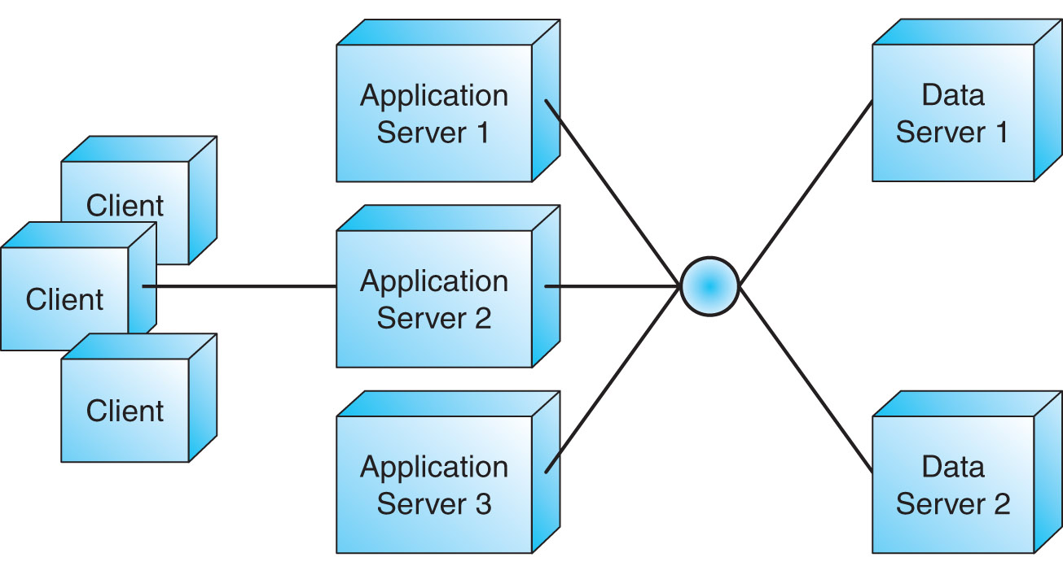
3.3 N-layer web architecture…
Replication:
Application and data servers are replicated
Servers share the total workload

Slide 28
3.3 N-layer web architecture…
Specialization:
Servers are specialized
Each server handles a designated part of the workload, by function

Slide 29
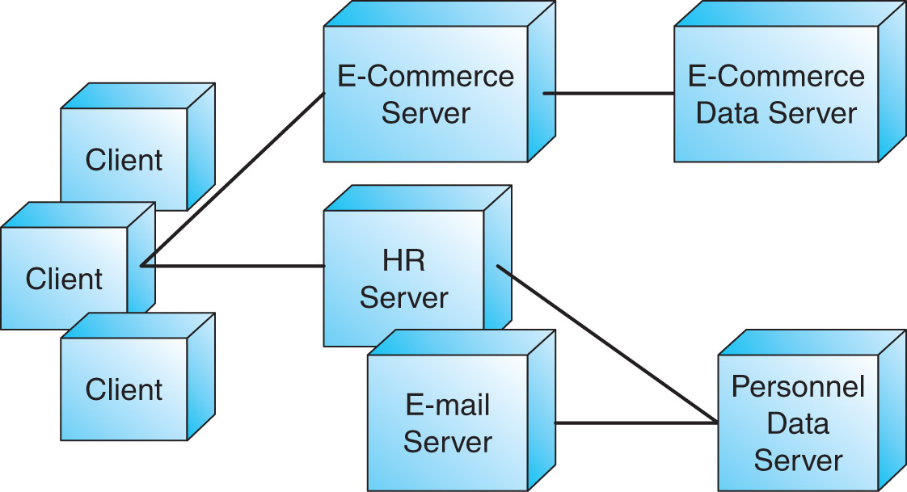
3.3 N-layer web architecture…

Slide 30
3.3 N-layer web architecture…
Advantages:
Decoupling of software components
Flexibility to add/remove platforms in response to load
Scalability
Redundancy
Disadvantages:
Higher costs (maintenance, design, electrical load, cooling)
Typical Application:
1000+ users
Large business or organization

Slide 31
3.4 Comparison of layered architecture
large e-commerce, business, or organization
small e-commerce, regional business or organization
local business or organization
N-Tier
1000
3-Tier
users
100
2-Tier
10
capacity
scalability
redundancy
cost

Slide 32
3.5 example
Client
Web Server
Presentation Layer
Application Server
(Business Logic, Connectors,
Personalization, Data Access)
Business Layer
Media
Server
DBMS
Data Layer

Slide 33
Summary
Software system architecture
Specifics of web application architecture
Layered web architecture
2-layered architecture
3-layered architecture
N-layered architecture

Slide 34
References
Chapter 4, Kappel, G., Proll, B. Reich, S. & Retschitzegger, W. (2006). Web Engineering, Hoboken, NJ: Wiley & Son
Web-based application development,
Ralph F Grove , J and B publishers,
(www.jbpub.com)

