Slide 1
Computability Theory
Turing Machine
CSC3113: Theory of Computation
14
9
Spring 2024-2025
Dr. Afroza Nahar
Professor, Department of Computer Science,
Faculty of Science & Technology.
afroza@aiub.edu

Slide 2
Turing Machine
    Formal Definition
    Transition Function
    Configuration of TM
    Example with High, Implementation, and Low level description.

Slide 3
Understand the construction of Turing Machine for a given language with different level of machine descriptions.

Slide 4
All outcome are represented with examples
Students will be able to design Turing machine with description.
Use configuration to test any given input string.

Slide 5
Formal Definition: Turing Machine (TM)
A Turing machine M is defined by a 7-tuple
(Q, Σ, Γ, δ, q₀, q_{accept}, q_{reject})
Q finite set of states
Σ finite input alphabet (without blank symbol “⌴”)
Γ finite tape alphabet with {⌴} ∪ Σ ⊆ Γ
δ the transition function
δ: Q\{q_{accept}, q_{reject}} × Γ → Q × Γ × {L,R}
q₀ start state ∈ Q
q_{accept} accept state ∈ Q
q_{reject} reject state ∈ Q
  q_{accept} ≠ q_{reject}

Slide 6
TM Transition Function
δ: Q × Γ → Q × Γ × {L, R}
p
Next State
Move left
Move right
a → b, R
Current State
q
Tape Symbol pointed (read) by the head
Symbol written by head on to the tape
Transition function for above transition
δ(p, a) = (q, b, R)
In the current tape position or tape position where head is pointing - Replace a with b or READ a, WRITE b.
Transit from state p to state q.
Move the head to one space right (R) position of the current tape position.

Slide 7
State Diagram: Turing Machine
WRITE
READ
MOVE
0 → 0, R
0 → R
0 → 1, R
0 → ×, R
q₀
q₁
q_{A}
q_{A} = q_{ACCEPT}.
q_{R} = q_{REJECT}.
⌴ → 0, L
1 → 0, R
Label Conventions:
∑ = {⍺, β, γ}, D = {L, R} = left or right
If READ ⍺, MOVE to D or MOVE to D while ⍺ or skip ⍺ to D
⍺ → ⍺, D written as ⍺ → D
MOVE to D until γ or Find γ to D or skip all {⍺, β} except γ to D
⍺ →D, β → D written as ⍺, β → D
q_{R}
0, 1 → L
0 → 0, L
1 → 1, L

Slide 8
State Diagram: Turing Machine
B = { w#w | w ∈ {0,1}* }
(find #) MOVE right until READ #, If ⌴ found REJECT
(skip X) MOVE right while READ X,
if current alphabet = stored alphabet, WRITE X, MOVE left to ⌴ , else REJECT
(skip X) MOVE right while READ X
READ (store) current alphabet, if alphabet is not #, then continue step 2
READ (store) 1st alphabet, WRITE X,
If alphabet is #, (skip X) MOVE right while READ X,
If current alphabet ⌴ then ACCEPT otherwise REJECT
REJECT example: ⌴XXX#XXX1⌴
REJECT example: ⌴XX01#XX11⌴
⌴XXX#XX⌴
REJECT example: ⌴X10110⌴
0, 1, X→R
q1
#→ # , R
X→X, R
⌴→ ⌴, L
q2
X→ X, R
0→X,R
X→ X, R
q6
0→X,L
0, → 1, L
1, ⌴→L
0, 1, #, X→ L
q0
#→ #, R
⌴→ ⌴, L
qR
q5
qA
1→X, R
⌴→⌴, L
0, ⌴→L
1→X, L
⌴→ ⌴, R
q3
q4
#→ # , R
0, 1, X→R
X→ X, R

Slide 9
Example: A = { 0^{j} | j=2^{n} }
High level description: Algorithm
  If j = 0 then REJECT;
  While j > 1 do
  if j mod 2 = 1 then REJECT; // if j is odd then REJECT;
  otherwise j ← j/2; // if j is even then half j;
  End do
  If j = 1 then ACCEPT; // if j is a power of 2, j will be 1 after the loop ends
Implementation level description:
Replace the leftmost zero by ⌴
Cross (×) every second 0 from left to right. Skip ⌴ from left, cross next 0, skip next 0, cross next 0, skip next 0, cross next 0, … and so on. Every skip must be followed by a cross.
If there is no 0 to cross after skipping a 0 (means odd number of 0s), REJECT.
If there is no 0s remained to skip (means 2^{N} number of 0s), ACCEPT.
Otherwise MOVE to the left ⌴, continue step 2

Slide 10
Testing 1: A = { 0^{j} | j=2^{n} }
Implementation level description:
Replace the leftmost zero by ⌴
Cross (×) every second 0 from left to right. Skip ⌴ from left, cross next 0, skip next 0, cross next 0, skip next 0, cross next 0, … and so on. Every skip must be followed by a cross.
If no 0s are found to skip and cross in step 3 (means 2^{N} number of 0s), ACCEPT.
If there is no 0 to cross after skipping a 0 (means odd number of 0s), REJECT.
Otherwise MOVE to the left ⌴, continue step 2.
Implementation level simulation:
0 | 0 | 0 | 0 | 0 | 0 | 0 | 0 | ⌴
⌴ | 0 | 0 | 0 | 0 | 0 | 0 | 0 | ⌴
⌴ | × | 0 | 0 | 0 | 0 | 0 | 0 | ⌴
⌴ | × | 0 | × | 0 | 0 | 0 | 0 | ⌴
⌴ | × | 0 | × | 0 | × | 0 | 0 | ⌴
⌴ | × | 0 | × | 0 | × | 0 | × | ⌴
⌴ | × | × | × | 0 | × | 0 | × | ⌴
⌴ | × | × | × | 0 | × | × | × | ⌴
⌴ | × | × | × | 0 | × | × | × | ⌴
⌴ | × | 0 | × | 0 | × | 0 | × | ⌴
⌴ | × | 0 | × | 0 | × | 0 | × | ⌴
⌴ | × | × | × | × | × | × | × | ⌴
⌴ | × | × | × | 0 | × | × | × | ⌴
⌴ | × | × | × | × | × | × | × | ⌴
⌴ | × | × | × | × | × | × | × | ⌴
ACCEPTED
 | Previous Head Position
 | Current Head Position

Slide 11
Testing 2: A = { 0^{j} | j=2^{n} }
Implementation level description:
Replace the leftmost zero by ⌴
Cross (×) every second 0 from left to right. Skip ⌴ from left, cross next 0, skip next 0, cross next 0, skip next 0, cross next 0, … and so on. Every skip must be followed by a cross.
If no 0s are found to skip and cross in step 3 (means 2^{N} number of 0s), ACCEPT.
If there is no 0 to cross after skipping a 0 (means odd number of 0s), REJECT.
Otherwise MOVE to the left ⌴, continue step 2.
Implementation level simulation:
0 | 0 | 0 | 0 | 0 | 0 | 0 | 0 | 0 | 0 | 0 | 0 | ⌴
REJECTED
⌴ | × | 0 | × | 0 | × | 0 | × | 0 | × | 0 | × | ⌴
⌴ | × | 0 | 0 | 0 | 0 | 0 | 0 | 0 | 0 | 0 | 0 | ⌴
⌴ | × | 0 | × | 0 | 0 | 0 | 0 | 0 | 0 | 0 | 0 | ⌴
⌴ | × | 0 | × | 0 | × | 0 | 0 | 0 | 0 | 0 | 0 | ⌴
⌴ | × | 0 | × | 0 | × | 0 | × | 0 | 0 | 0 | 0 | ⌴
⌴ | × | 0 | × | 0 | × | 0 | × | 0 | × | 0 | 0 | ⌴
⌴ | × | 0 | × | 0 | × | 0 | × | 0 | × | 0 | × | ⌴
⌴ | × | × | × | 0 | × | 0 | × | 0 | × | 0 | × | ⌴
⌴ | × | × | × | 0 | × | × | × | 0 | × | 0 | × | ⌴
⌴ | × | × | × | 0 | × | × | × | 0 | × | × | × | ⌴
⌴ | × | × | × | × | × | × | × | 0 | × | × | × | ⌴
⌴ | 0 | 0 | 0 | 0 | 0 | 0 | 0 | 0 | 0 | 0 | 0 | ⌴
⌴ | × | 0 | × | 0 | × | 0 | × | 0 | × | 0 | × | ⌴
⌴ | × | × | × | 0 | × | × | × | 0 | × | × | × | ⌴
⌴ | × | × | × | 0 | × | × | × | 0 | × | × | × | ⌴
 | Previous Head Position
 | Current Head Position

Slide 12
State Diagram: A = { 0^{j} | j=2^{n} }
Implementation level description:
Replace the leftmost zero by ⌴
Cross (×) every second 0 from left to right. Skip ⌴ from left, cross next 0, skip next 0, cross next 0, skip next 0, cross next 0, … and so on. Every skip must be followed by a cross.
If no 0s are found to skip and cross in step 3 (means 2^{N} number of 0s), ACCEPT.
If there is no 0 to cross after skipping a 0 (means odd number of 0s), REJECT.
Otherwise MOVE to the left ⌴, continue step 2.
Low level Description: State Diagram
0, × → L
q_{A}
q₄
⌴ →⌴, R
⌴ → ⌴, R
⌴ → ⌴, L
q₀
0 → ⌴, R
q₁
0 → ×, R
q₂
× → x, R
⌴ → ⌴, R
× → ×, R
0 → ×, R
0→0, R
q_{R}
q₃
× →x, R
⌴ → ⌴, R

Slide 13
Example 2: Idea
T = {a^{i}b^{j}c^{k} | i × j = k and i, j, k ≥ 1}
a | a | b | b | b | c | c | c | c | c | c
For every a
replace a by X
for every b
replace b by Y
replace next c by Z
end for
for every Y
replace Y by b
end for
end for
X | a | b | b | b | c | c | c | c | c | c
X | a | Y | b | b | Z | c | c | c | c | c
X | a | Y | Y | b | Z | Z | c | c | c | c
X | a | Y | Y | Y | Z | Z | Z | c | c | c
X | a | Y | b | b | Z | Z | Z | c | c | c
X | a | b | b | b | Z | Z | Z | c | c | c
X | a | Y | Y | b | Z | Z | Z | c | c | c
X | X | Y | Y | b | Z | Z | Z | Z | Z | c
X | X | Y | Y | Y | Z | Z | Z | Z | Z | Z
X | X | Y | b | b | Z | Z | Z | Z | c | c

Slide 14
Example 3: Idea
T = {w | w is binary string and number of 0s and 1s are equal}
0 | 1 | 1 | 0 | 1 | 0 | 0 | 1
For every 0
replace next 0 from left by X
replace next 1 from left by Y
End for
X | 1 | 1 | 0 | 1 | 0 | 0 | 1
X | Y | 1 | 0 | 1 | 0 | 0 | 1
X | Y | 1 | X | 1 | 0 | 0 | 1
X | Y | Y | X | 1 | 0 | 0 | 1
X | Y | Y | X | 1 | X | 0 | 1
X | Y | Y | X | Y | X | 0 | 1
X | Y | Y | X | Y | X | X | 1
X | Y | Y | X | Y | X | X | Y

Slide 15
Example 4: Idea
T = {ww^{R} | w is a binary string}
0 | 1 | 1 | 0 | 0 | 1 | 1 | 0
For each leftmost alphabet (means not X)
if alphabet is 0
replace 0 by X
if the rightmost alphabet is 0 replace by X
else {alphabet is 1}
replace 1 by X
if the rightmost alphabet is 1 replace by X
End for
X | 1 | 1 | 0 | 0 | 1 | 1 | 0
X | 1 | 1 | 0 | 0 | 1 | 1 | X
X | X | 1 | 0 | 0 | 1 | 1 | X
X | X | 1 | 0 | 0 | 1 | X | X
X | X | X | 0 | 0 | 1 | X | X
X | X | X | 0 | 0 | X | X | X
X | X | X | X | 0 | X | X | X
X | X | X | X | X | X | X | X

Slide 16
Turing machines founds applications in
    Algorithmic information theory and complexity studies,
    Software testing
    High performance computing
    Machine learning
    Software engineering
    Computer networks and
    Evolutionary computations.

Slide 17
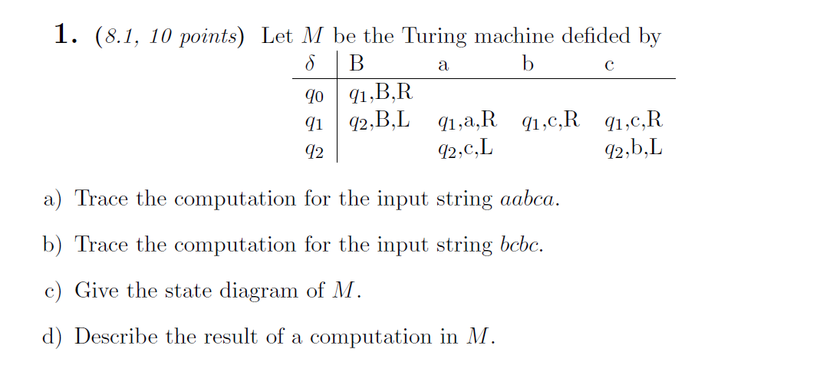
Class Work

Slide 18
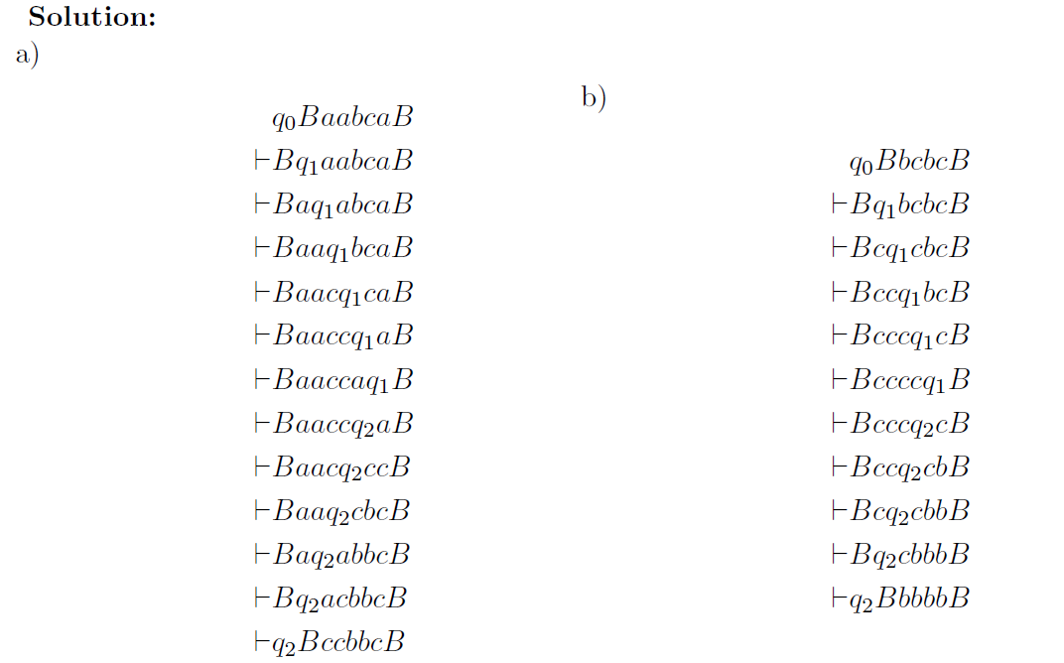

Slide 19
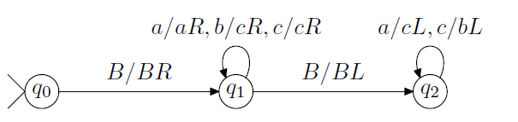

Slide 20
Computability Theory
Introduction to Theory of Computation, Sipser, (3rd ed),
Turing Machine.

