Slide 1
Deterministic Finite Automaton (DFA)
CSC3113: Theory of Computation
2
1
Fall 2024-2025
Dr. Afroza Nahar
Professor, Department of Computer Science,
Faculty of Science & Technology.
afrozar@aiub.edu

Slide 2
Finite Automata (FA).
  Example and Simulation of FA.
  Finite state machine models.
  Definition
Deterministic Finite Automata (all with examples)
  Terminologies & State Diagram
  Formal Mathematical Definition
  Formal Computational Definition

Slide 3
Understand, learn & practice with example
  Finite Automata (FA)
  FA Machine Models
  Finite State Machine
  Deterministic Finite Automata (DFA)
  Formal Definition of DFA
  Computational Definition of DFA

Slide 4
All outcome are represented with examples
Know all the components of a finite state machine.
Learn the terminologies, conditions, and representation of the machine models.
How to define a machine model, along with its characteristics, using mathematical structure.
How to define the computation perform by the machine model using mathematical structure.
Understand the mathematical model for DFA
Students will be able to
  Formally define a given DFA machine model
  Run the machine for given input and determine if it is accepted or rejected.

Slide 5

Finite Automata
We will use several different models, depending on the features we want to focus on. Begin with the simplest model, called the finite automaton.
Good models for computing device with an extremely limited amount of memory. For example, various household appliances such as dishwashers and electronic thermostats, as well as parts of digital watches and calculators.
The design of such devices requires keeping the methodology and terminology of finite automata in mind.
Next, we will analyze an example to get an idea.

Slide 6
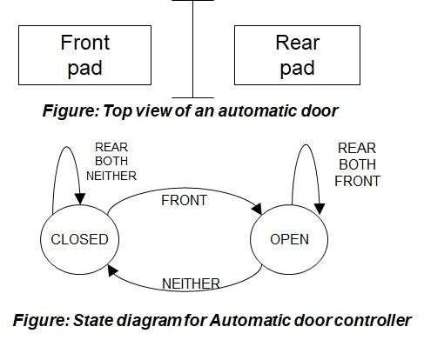
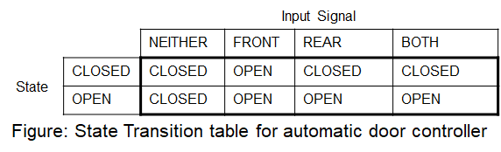
Automatic Door
Automatic doors swing open when sensing that a person is approaching.
An automatic door has a pad in front to detect the presence of a person about to walk through the doorway.
Another pad is located to the rear of the doorway so that –
  The controller can hold the door long enough for the person to pass all the way through.
  The door does not strike someone standing behind it as it opens.
Front
pad
Rear
pad
An Example

Slide 7
Simulation – Automatic Door
Input Example:
Initial State: CLOSED
Input Signal Sequence: FRONT, REAR, NEITHER, FRONT, BOTH, NEITHER, REAR, NEITHER.
Present State:
CLOSED
OPEN
Input Signal:
REAR
FRONT
NEITHER
BOTH
REAR
REAR
BOTH
BOTH
NEITHER
FRONT
FRONT
CLOSED
OPEN
Front
pad
Rear
pad
NEITHER
Figure: Top view of an automatic door
Figure: State diagram for Automatic door controller

Slide 8
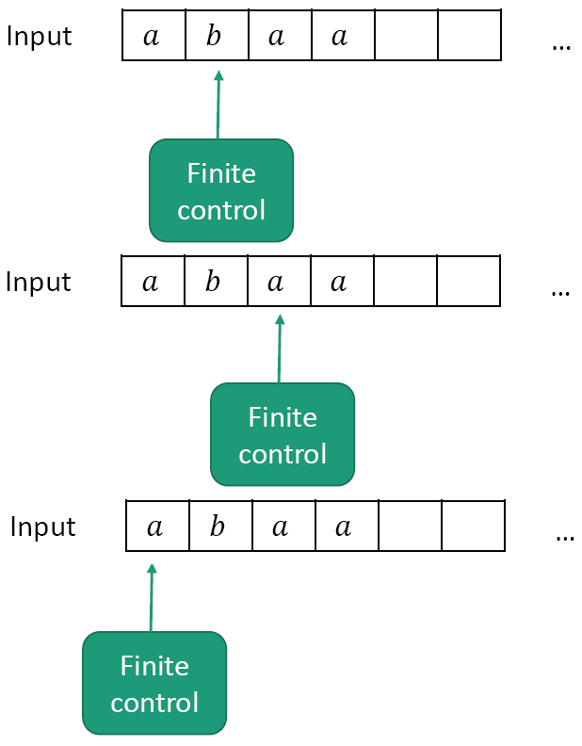
Machine Models
Abstraction: We don’t care how the control is implemented.
We just require it to have a finite number of states, and to transition between states using fixed rules.
Computation is the processing of information by the unlimited application of a finite set of operations or rules.

Slide 9
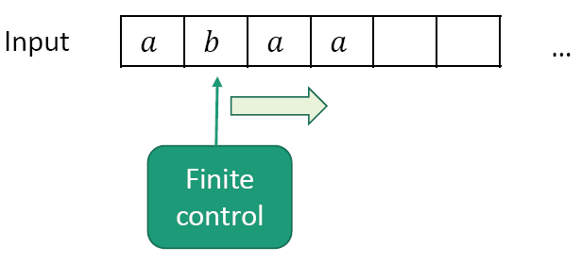
Machine Model
Finite Automata (FA)
Machine with a finite amount of unstructured memory.
  Control scans left-to-right
  Can check simple patterns
  Can’t perform unlimited counting
Useful for modeling chips, simple control systems, adventure games…

Slide 10
Finite Automata – definition
A finite automata has several parts –
  Set of states (the auto door has close and open states).
  Rules for going from one state to another (if door is in CLOSED state and [rule] someone is only on the front pad, then the door will go to OPEN state) based on input (FRONT). Also known as transition rules.
  It has a precise set of inputs (FRONT, REAR, BOTH, NEITHER).
  Initial (start) state must be defined (CLOSED in the door example).
  May have one or more state(s) as goal to reach from start state. Also known as set of final/accept states (CLOSED as the last input signal is NIETHER in the door example).

Slide 11
FINITE STATE MACHINE (FSM)
Finite Automaton (FA)
FA with output
FA without output
Moore Machine
Mealy Machine
DFA
NFA
e-NFA

Slide 12
Deterministic Finite Automata (DFA)
Every step of a computation follows in a unique way from the preceding step (deterministic computation).
When the machine is in a given state and reads the next input symbol, we know the next state will be – it is determined.
The transition rules are of the form –
  Each state must have exactly one transition for each input from the input set to any individual state (including itself).
  If there are n number of inputs, then each state must have exactly n transitions to any states including itself.
  There may be zero (no transition) or more transition from one state to another; each transition for different input.
Let us go through –
  a precise definition of a deterministic finite automaton,
  terminology for describing and manipulating DFA,
  theoretical results that describe their powers and limitations.
Let us now investigate the terminology through an example.

Slide 13
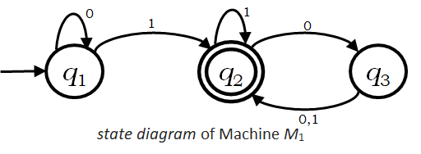
Terminologies
Deterministic Finite Automata (DFA)
State Diagram
This state diagram has three states, labeled q₁, q₂, and q₃.
The start state is q₁, indicated by the arrow pointing at it from no where.
The accept state, q₂, is the one with a double circle.
The arrow going from one state from another are called transitions.
The symbol(s) along the transition is called label.
Each label is from input set {0,1}.
From each state there are exactly one transition for each input 0 and 1.
M₁ works as follows –
  The automaton receives the symbols from the input string one by one from left to right.
  After reading each symbol, M1 moves from one state to another along the transition that has the symbol as its label.
  When it reads the last symbol, M1 produces the output.
  The output is ACCEPT if M1 is now in an accept state and REJECT if it is not.

Slide 14
Simulation – How it works?
0
1
1
0
q₁
q₂
q₃
ε
1101
1101
101
1
01
Figure: Finite Automaton M₁.
0,1
After feeding the input string 1101 to the above machine, the processing proceeds as follows –
  Start in state q₁;
  Read 1, follow transition from q₁ to q₂;
  Read 1, follow transition from q₂ to q₂;
  Read 0, follow transition from q₂ to q₃;
  Read 1, follow transition from q₃ to q₂;
  Accept, as the machine M₁ is in an accept state q₂ at the end of the input string.

Slide 15
Formal Definition - DFA
A Deterministic Finite Automaton (DFA) is a
5-tuple (Q, Σ, δ, q₀, F), where
  Q is a finite set called the states,
  Σ is a finite set called the alphabet,
  δ : Q × Σ → Q is the transition function,
  q₀ ∈ Q is the start state,
  F ⊆ Q is the set of accept (final) states.
If A is the set of all strings that a machine M accepts, we say that A is the language of machine M and write L(M)=A, M recognizes A or M accepts A.

Slide 16
Example
Formal Definition for Machine M₁.
M₁ = (Q, Σ, δ, q₀, F), where –
  Q = {q₁ , q₂ , q₃} ,
  Σ = {0, 1},
  q₀ = q₁ ,
  F = {q₂},
  δ is describe as –
δ | 0 | 1
q₁ | q₁ | q₂
q₂ | q₃ | q₂
q₃ | q₂ | q₂
δ(q₁,0) = q₁, δ(q₁,1) = q₂,
δ(q₂,0) = q₃, δ(q₂,1) = q₂,
δ(q₃,0) = q₂, δ(q₃,1) = q₂.
OR
Transition Function
Transition Table

Slide 17
Formal Definition of DFA Computation
Now we formalize the Deterministic Finite Automaton’s computation, mathematically.
Let,
  M = (Q, Σ, δ, q₀, F) be a DFA,
  w = w₁w₂…w_{n} ∈ Σ* (a string over the alphabet Σ), where each w_{i} ∈ Σ.
Then M accepts w if a sequence of states r₀,r₁,…,r_{n} exists in Q with the following three conditions –
  r₀=q₀,
  δ(r_{i}, w_{i+1}) = r_{i+1}, for i = 0, 1, 2, … , n-1, and
  r_{n} ∈F.
M recognizes language L if L = {w : M accepts w}.

Slide 18
Simulation – DFA Computation
0
1
1
0
q₁
q₂
q₃
ε
1101
1101
101
1
01
Figure: Finite Automaton M₁.
0,1
M=(Q, Σ, δ, q₀, F)=({q₁ , q₂ , q₃}, {0, 1}, δ , q₁, {q₂}) and
δ = {δ(q₁,0)=q₁, δ(q₁,1)=q₂, δ(q₂,0)=q₃, δ(q₂,1)=q₂, δ(q₃,0)=q₂, δ(q₃,1)=q₂.}
Input string w = w₁w₂w₃w₄ = 1101 to M₁ gives a sequence of states r₀,r₁,r₂,r₃,r₄ in the following computation (here n = 4) –
  Start in state r₀ = q₁; → r₀=q₀,
  δ(r₀,w₁) = δ(q₁,1) = q₂ = r₁; → δ(r_{i}, w_{i+1}) = r_{i+1}, for i = 0, 1, 2, … , n-1,
  δ(r₁,w₂) = δ(q₂,1) = q₂ = r₂; → δ(r_{i}, w_{i+1}) = r_{i+1}, for i = 0, 1, 2, … , n-1,
  δ(r₂,w₃) = δ(q₂,0) = q₃ = r₃; → δ(r_{i}, w_{i+1}) = r_{i+1}, for i = 0, 1, 2, … , n-1,
  δ(r₃,w₄) = δ(q₃,1) = q₂ = r₄; → r_{n} ∈F.
  Accept, as the machine M₁ is in an accept state q₂ at the end of the input string.
  M₁ recognizes language L if L = {w : M₁ accepts w}.

Slide 19
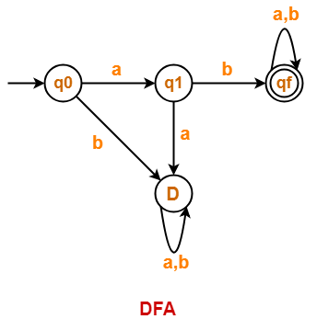
Class Work
1. abaaaba
2. aabaaaba

Slide 20
Practice the exercises
Introduction to Theory of Computation, Sipser, (3rd ed),
  DFA; All Exercises;
Elements of the Theory of Computation, Papadimitriou (2nd ed), Chapter 1.

