Slide 1
Regular Expressions (RE)
CSC3113: Theory of Computation
7
4
SPRING 2024-2025
Prof. Dr. Afroza Nahar
Department of Computer Science
Faculty of Science & Technology.
afroza@aiub.edu

Slide 2
Formal Definition of Regular Expression (RE)
Equivalence with Finite Automaton
Conversion from NFA to RE
Conversion from DFA to RE.
Closure under regular operations.

Slide 3
Mathematical model of Regular Expression (RE)
Understand the uniformity of RE and FA.
Conversion Techniques from NFA to RE.
The strength of RE.
Techniques to convert DFA to RE
Closure under different regular operations.

Slide 4
All outcome are represented with examples
Understand the mathematical interpretation of Regular Expression (RE)
Learn the rules for equivalence of RE with Finite Automaton
Apply the conversion rules from RE to NFA
Apply the techniques to convert DFA to RE
Identify the closure under different regular operations.

Slide 5
Regular Expression
Regular expression is used to describe languages.
Regular expression is specific, standard textual syntax (combined with alphabets and regular operators) for representing patterns for matching strings.
Regular expression can be built up using regular operations.
Precedence order: * • ∪
Example:
  (0∪1)0* = ({0}∪{1})•{0}* = {0,1}•{0}*
  A = {w | string w starts with a 0 or a 1 followed by zero or more 0’s}
  (0∪1)* = ({0}∪{1})* = {0,1}*
  A = {all possible string with 0s and/or 1s}.

Slide 6
Formal Definition of Regular Expression
R is a regular expression if R is –
  a for some a ∈ Σ, represents the language {a}.
  ε, represents the language {ε} containing a single string, namely, the empty string.
  φ, represents the empty language that doesn’t contain any string. L(φ*) = {ε}.
  (R₁∪R₂), where R₁ and R₂ are regular expressions,
    R ∪ φ = R, but R ∪ ε may not be equal to R.
  (R₁•R₂), where R₁ and R₂ are regular expressions,
    R • ε = R, but R • φ may not be equal to R.
  (R₁*), where R₁ is a regular expressions,

Slide 7
Equivalence with finite automata
Let convert regular language R into an NFA considering the six cases in the formal definition of regular language.
  R = a, a∈Σ. Then L(R)={a}, and the NFA that recognizes L(R) is –
  R = ε. Then L(R)={ε}, and the NFA that recognizes L(R) is –
  R = φ. Then L(R)= φ, and the NFA that recognizes L(R) is –
a

Slide 8
Equivalence with finite automata
  R = R₁∪R₂. Then L(R)={R₁,R₂}, and the NFA that recognizes L(R) is –
  R = R₁•R₂. Then L(R)={R₁R₂}, and the NFA that recognizes L(R) is –
  R = R₁*. Then L(R)={R₁}*, and the NFA that recognizes L(R) is –
ε
R₂
ε
R₁
R₁
R₂
ε
ε
ε
ε
R₁
ε

Slide 9
Converting a regular expression to an NFA
ε
a
a
ε
ε
(a∪b)*
(a∪b)*aba
a∪b
ε
ε
b
b
ε
ε
ε
aba
a
ε
b
ε
a
Building an NFA from regular expression: (a∪b)*aba

Slide 10
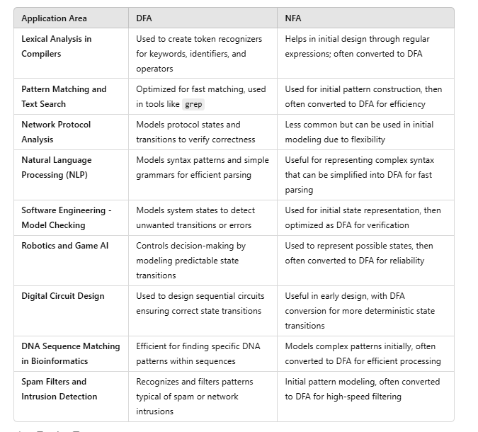
applications of DFA and NFA across different fields

Slide 11
Regular Expression: Part-1
Introduction to Theory of Computation, Sipser, (3rd ed),
Regular Expression.

