Slide 1
Natural Language Processing Project Presentation
Title: Counterspeech
Group Members:
Anant Kaushal (2022067)
Anikait Agrawal (2022072)
Ansh Varshney(2022083)

Slide 2
Introduction and Motivation
Aims to improve counterspeech using intent-specific responses.
Generic replies often miss the tone and context of hate speech - new method adapts responses based on the underlying intent.
Uses five styles: informative, denouncing, questioning, positive, humorous.
Offers a scalable, user-driven, non-censorious solution - helps de-escalate conflict and engage bystanders meaningfully.

Slide 3
Literature Review
Multilingual Counterspeech with Human-in-the-loop
Builds diverse, high-quality datasets across languages
Ensures contextual and cultural relevance
Limitation: Labor-intensive and hard to scale
Evaluation with METEOR Metric
Offers better alignment with human judgment than BLEU
Considers synonyms, stems, and word order
Limitation: Not designed for dialogue; misses tone and empathy
Sequence Level Training with Recurrent Neural Networks
Improves sequence generation quality in tasks like translation and summarization
Optimizes task-specific metrics like BLEU using REINFORCE
Limitation: MIXER relies on high-variance policy gradient methods; make training unstable

Slide 4
Dataset Description
We have used IntentCONAN Dataset of 6831 counterspeechs across 5 intents.
It classifies the intent behind Counterspeech responding to hate speech.
Each Hatespeech instance has each with 2 counterspeeches , each with different intents.
Intent Categories: Informative, Denouncing, Question, Positive and Humour.

Slide 5
Methodology - Baseline 1 & 2
Baseline 1: BART (Intent-Conditioned Seq2Seq)
Fine-tuned BART on input: intent: [INTENT] hatespeech: [TEXT]
Captures meaning well (BERTScore: 0.87), but low lexical overlap (BLEU: 0.02)
Strength: Strong semantic alignment
Limitation: Limited stylistic fidelity and token-level match
Baseline 2: QUARC (Two-Stage Framework)
Phase 1: Learns intent vectors via codebook (CLIME)
Phase 2: Fuses hate speech with intent (COGENT + PerFuMe)
Strengths: High diversity, strong intent alignment
Limitations: Slightly more toxic outputs; struggles with humor

Slide 6
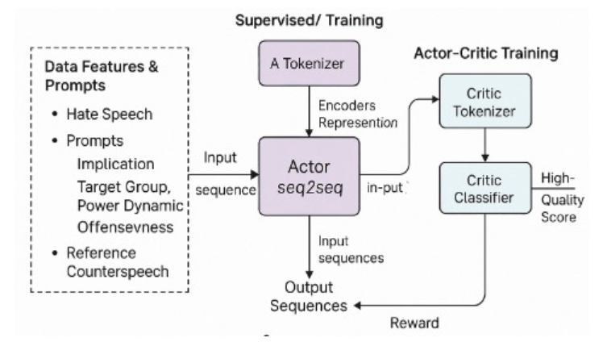
Methodology - R3 QUARC
R3-QUARC: Combines supervised learning with reinforcement learning (RL)
Actor: BART model generates counterspeech
Critic: DistilBERT model scores response quality
Training: – Supervised fine-tuning on counterspeech data – RL phase uses PPO to refine generation via critic feedback
Evaluation: ROUGE + critic-based metrics
Result: Produces higher-quality, intent-aligned counterspeech

Slide 7
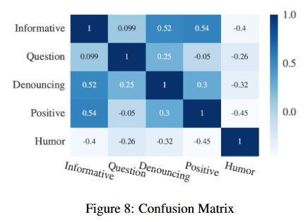
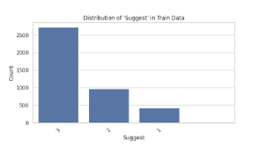
Observations and Results
Sample EDA plot from the dataset

Slide 8
Conclusion
Progression of Approaches:
Baseline 1 (BART): Simple seq2seq model, high semantic similarity (BERTScore), low lexical overlap (BLEU)
Baseline 2 (QUARC): Divides style and content (CLIME + COGENT), improves diversity and intent alignment
R3-QUARC: Adds RL with actor-critic framework, refining generation with policy gradients
Key Advancement: Improved counterspeech quality, context responsiveness, and intent alignment
Future Directions: Integrate external knowledge and refine lexical characteristics for better moderation

Slide 9
Contributions
Anant Kaushal: Data Collection and Preprocessing, BART Model Implementation, QUARC Architecture (CLIME Module), Evaluation Metrics (BLEU, BERTScore), Observations and Figures (EDA), PPT Preparation.
Ansh Varshney: Literature Survey and Related Work, QUARC Architecture (COGENT Fusion), Dataset Annotation and Splitting, Evaluation (METEOR, Human Evaluation), Final Report Writing and Editing.
Anikait Agrawal: Data Preprocessing and Visualization, R3-QUARC Actor-Critic Model Implementation, Reinforcement Learning Integration (PPO), Feature Tokenization and Critic Evaluation, ROUGE and Policy Loss Tracking, PPT Preparation.

Slide 10
THANK YOU! 😎💪🏻

