Slide 1

Enhancing Top Quark Detection Through Deep Learning

Slide 2
Fundamentals of machine learning

Slide 3
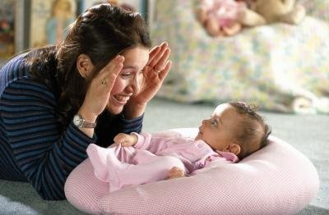
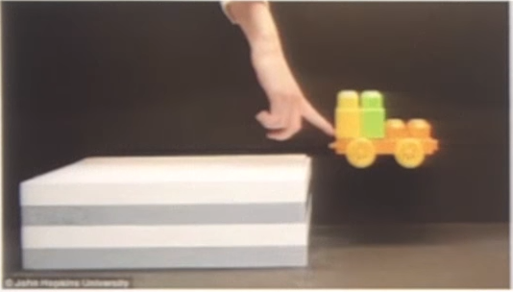
Data
Humans learn by observation and unsupervised learning
  model of the world /
  common sense reasoning
Machine learning needs lots of (labeled) data to compensate

Slide 4
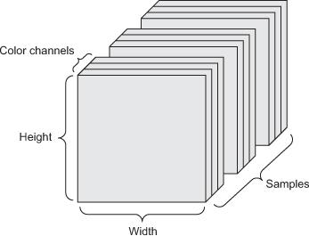
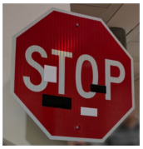
Data
Tensors: generalization of matrices
to n dimensions (or rank, order, degree)
  1D tensor: vector
  2D tensor: matrix
  3D, 4D, 5D tensors
  numpy.ndarray(shape, dtype)
Training – validation – test split (+ adversarial test)
Minibatches
  small sets of input data used at a time
  usually processed independently
Image from: https://arxiv.org/abs/1707.08945

Slide 5
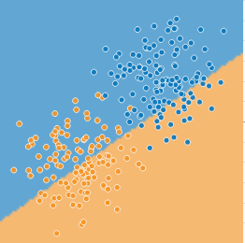
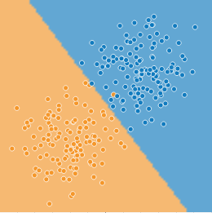
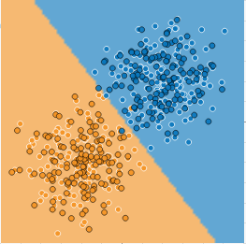

Model – learning/training – inference
http://playground.tensorflow.org/
parameters 𝜃 and hyperparameters

Slide 6
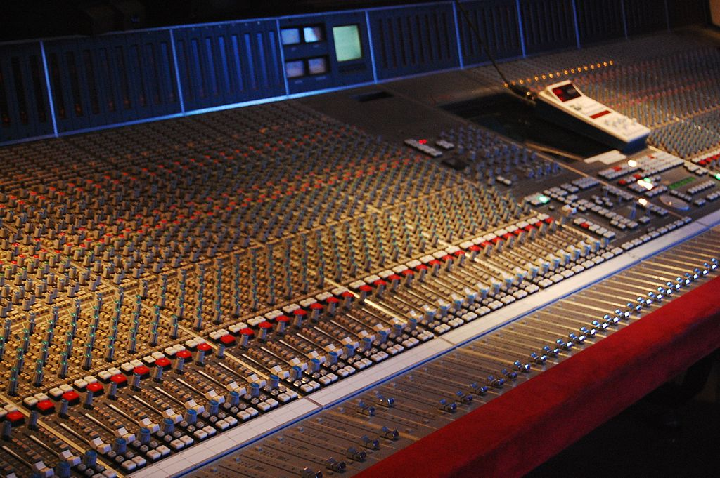

Optimization
Mathematical optimization:
“the selection of a best element (with
regard to some criterion) from some
set of available alternatives” (Wikipedia)
Main types:
finite-step, iterative, heuristic
Learning as an optimization problem
  cost function:
By Rebecca Wilson (originally posted to Flickr as Vicariously) [CC BY 2.0], via Wikimedia Commons
loss
regularization

Slide 7
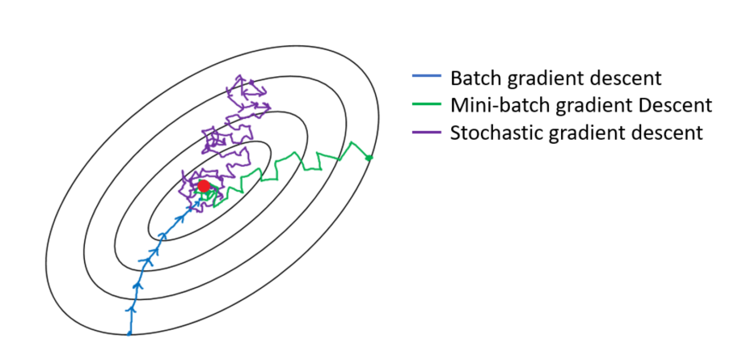

Gradient descent
Derivative and minima/maxima of functions
Gradient: the derivative of a multivariable function
Gradient descent:
(Mini-batch) stochastic gradient
descent (and its variants)
Image from: https://towardsdatascience.com/gradient-descent-algorithm-and-its-variants-10f652806a3

Slide 8
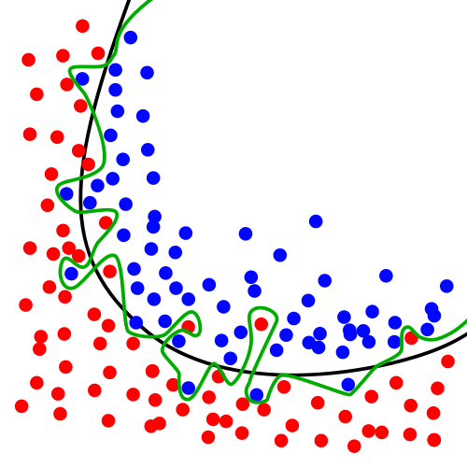
Over- and underfitting, generalization, regularization
Models with lots of parameters can easily overfit to training data
Generalization: the quality of ML model is measured on new, unseen samples
Regularization: any method* to prevent overfitting
  simplicity, sparsity, dropout, early stopping
  *) other than adding more data
By Chabacano [GFDL or CC BY-SA 4.0], from Wikimedia Commons

Slide 9
Deep learning

Slide 10
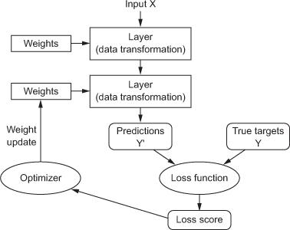
Anatomy of a deep neural network
Layers
Input data and targets
Loss function
Optimizer

Slide 11
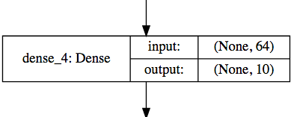
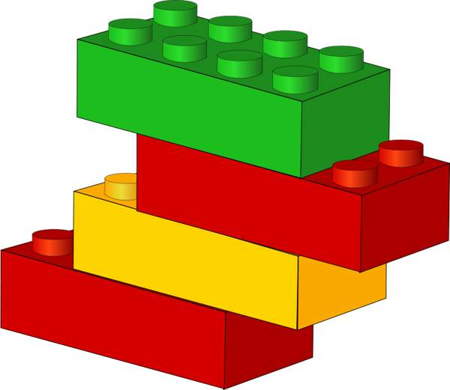
Layers
Data processing modules
Many different kinds exist
  densely connected
  convolutional
  recurrent
  pooling, flattening, merging, normalization, etc.
Input: one or more tensors
output: one or more tensors
Usually have a state, encoded as weights
  learned, initially random
When combined, form a network or
a model

Slide 12
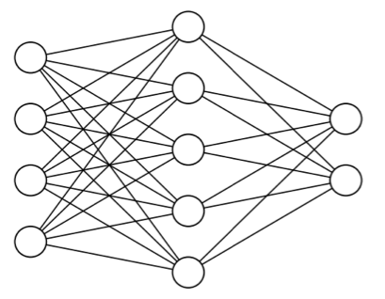

Input data and targets
The network maps the input data X to predictions Y′
During training, the predictions Y′ are compared to true targets Y using the loss function
cat
dog

Slide 13
Loss function
The quantity to be minimized (optimized) during training
  the only thing the network cares about
  there might also be other metrics you care about
Common tasks have “standard” loss functions:
  mean squared error for regression
  binary cross-entropy for two-class classification
  categorical cross-entropy for multi-class classification
  etc.
https://lossfunctions.tumblr.com/

Slide 14
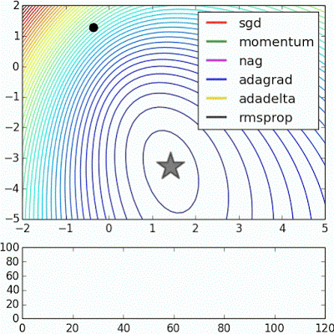
Optimizer
How to update the weights based on the loss function
Learning rate (+scheduling)
Stochastic gradient descent, momentum, and their variants
  RMSProp is usually a good first choice
  more info: http://ruder.io/optimizing-gradient-descent/
Animation from: https://imgur.com/s25RsOr
Notes:
RMSProp mentioned in Hinton’s lecture notes

Slide 15
Anatomy of a deep neural network

Slide 16
Deep learning frameworks

Slide 17












Slide 18

Deep learning frameworks
Actually tools for defining static or dynamic general-purpose computational graphs
Automatic differentiation
Seamless CPU / GPU usage
  multi-GPU, distributed
Python/numpy or R interfaces
  instead of C, C++, CUDA or HIP
Open source
+
+
✕
✕
x
y
5

Slide 19
Deep learning frameworks
Lasagne
Keras
TF Estimator
torch.nn
Gluon
Theano
TensorFlow
CNTK
PyTorch
MXNet
Caffe
Keras is a high-level
neural networks API
  we will use TensorFlow
  as the compute backend
  included in TensorFlow 2 as tf.keras
  https://keras.io/ , https://www.tensorflow.org/guide/keras
PyTorch is:
  a GPU-based tensor library
  an efficient library for dynamic neural networks
  https://pytorch.org/
CUDA, cuDNN
HIP, MIOpen
MKL, MKL-DNN
GPUs
CPUs

Slide 20

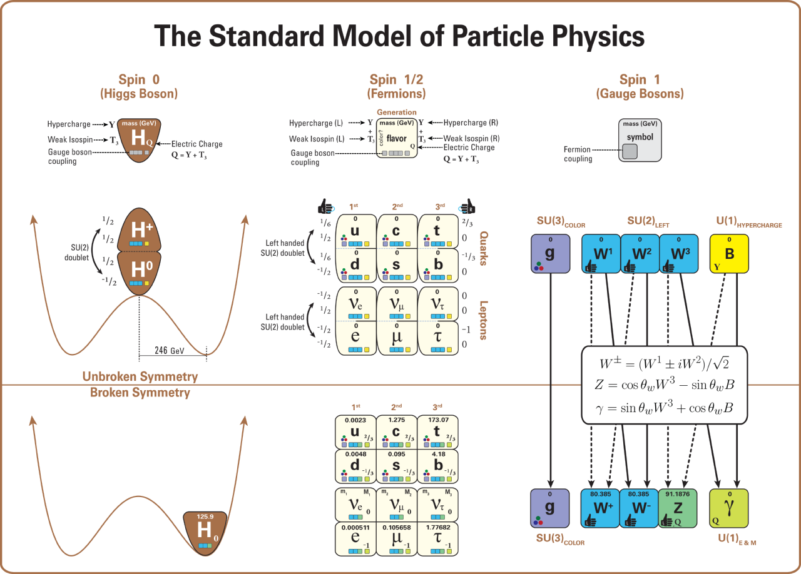
Source: https://en.wikipedia.org/wiki/Mathematical_formulation_of_the_Standard_Model

Slide 21
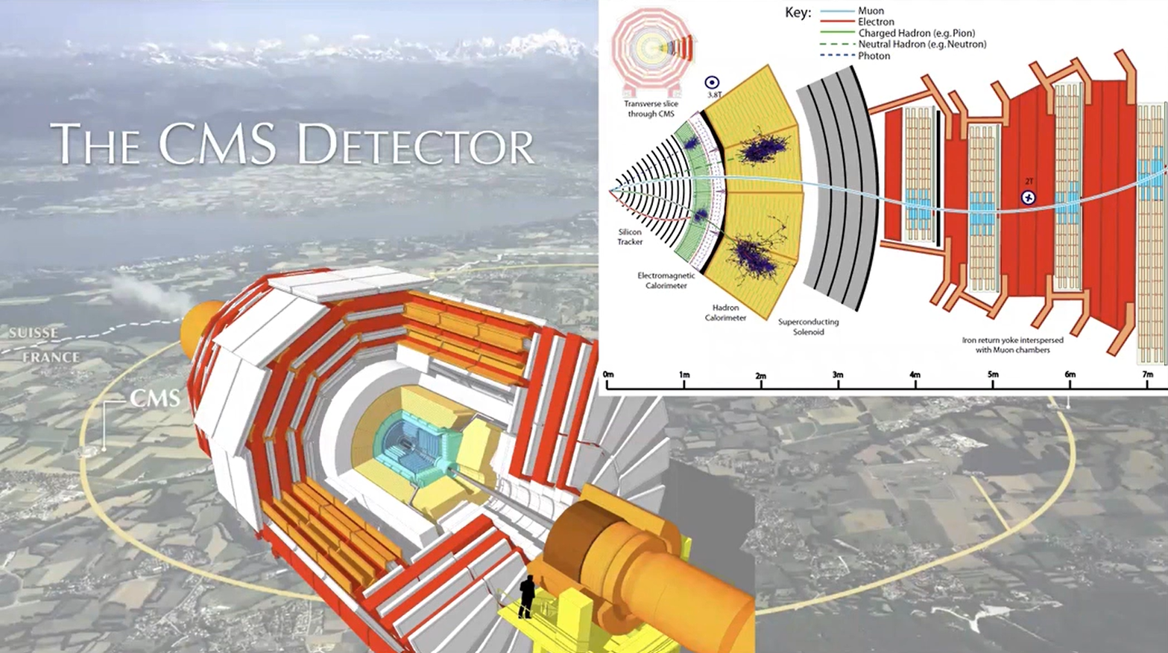

Slide 22
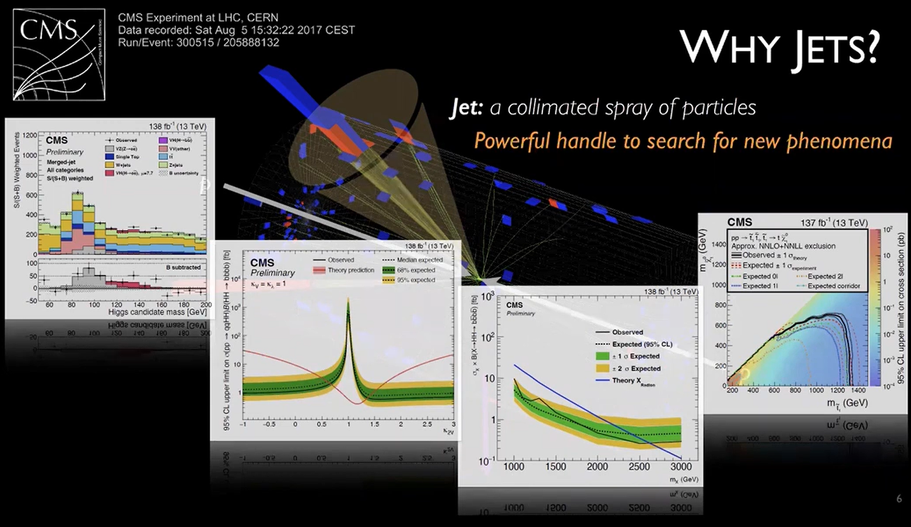

Slide 23
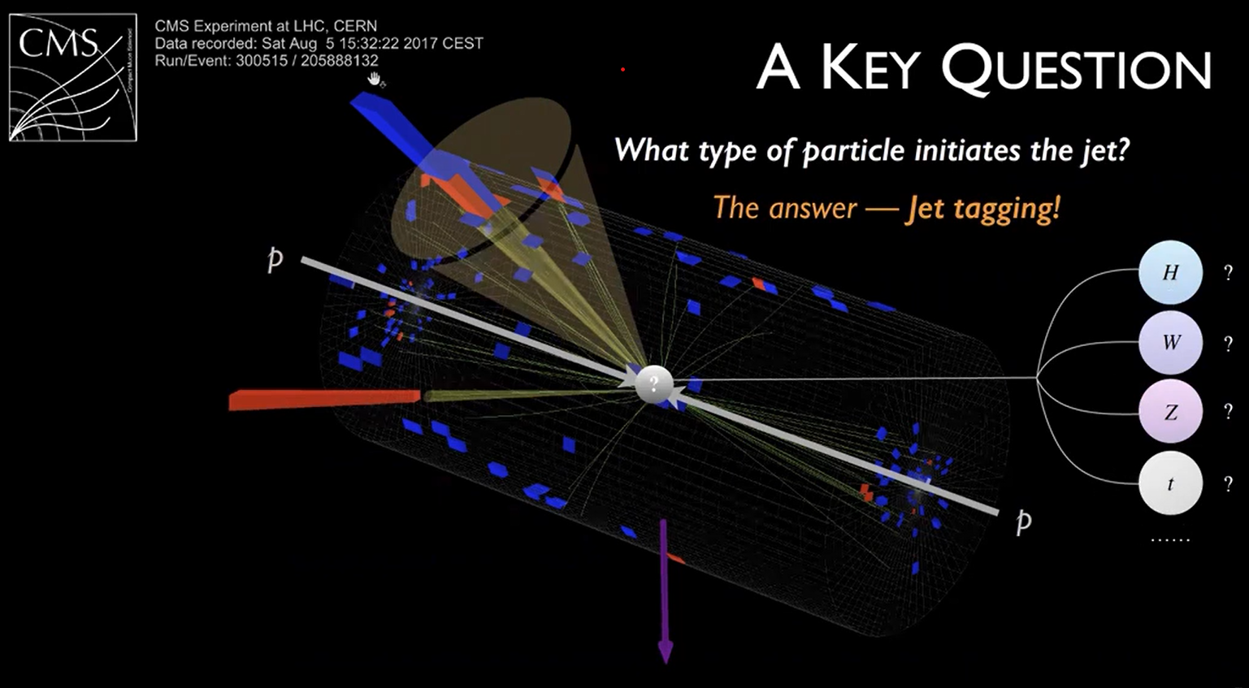

Slide 24
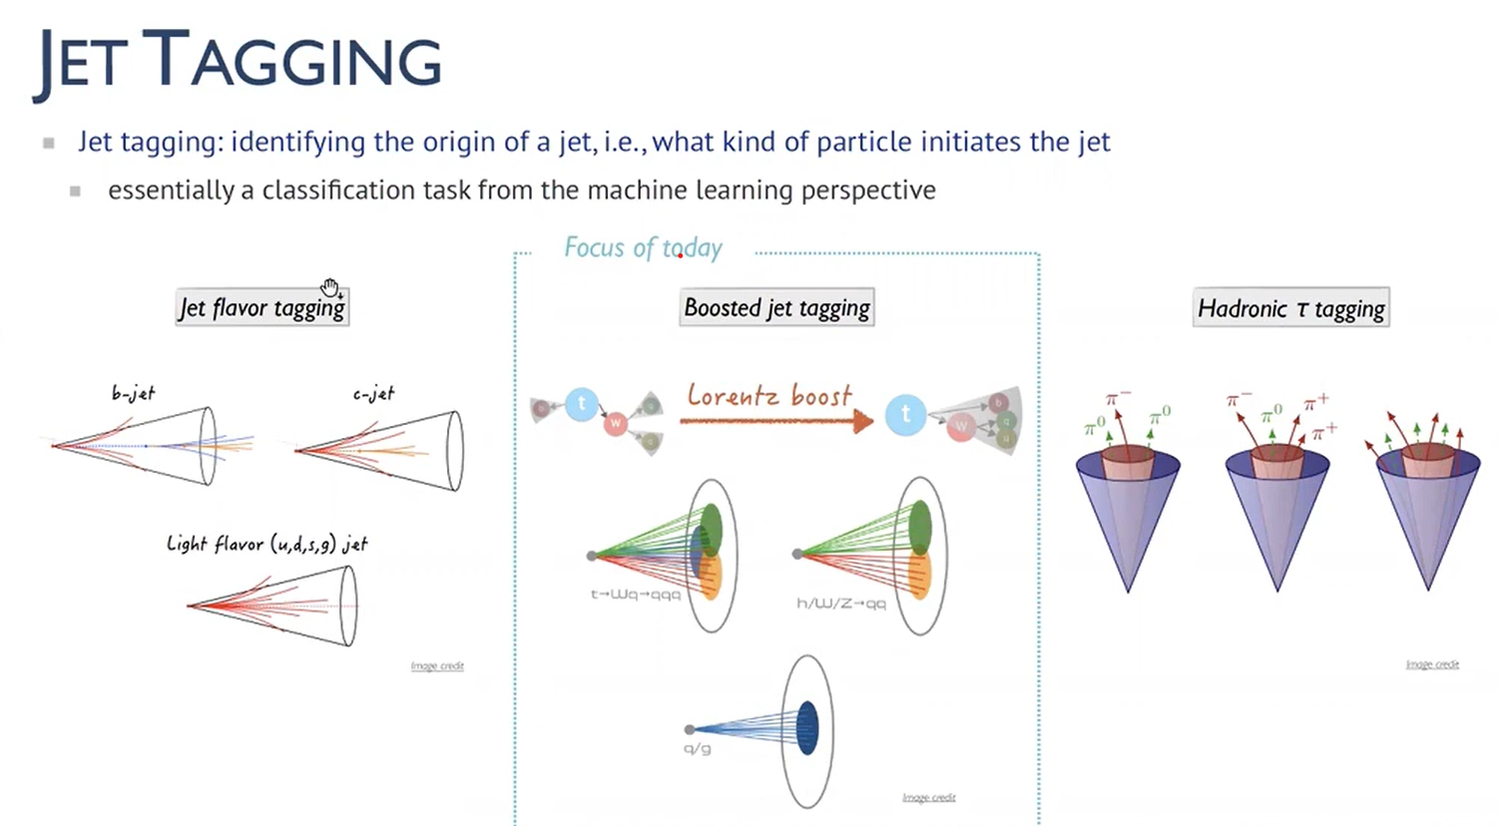

Slide 25
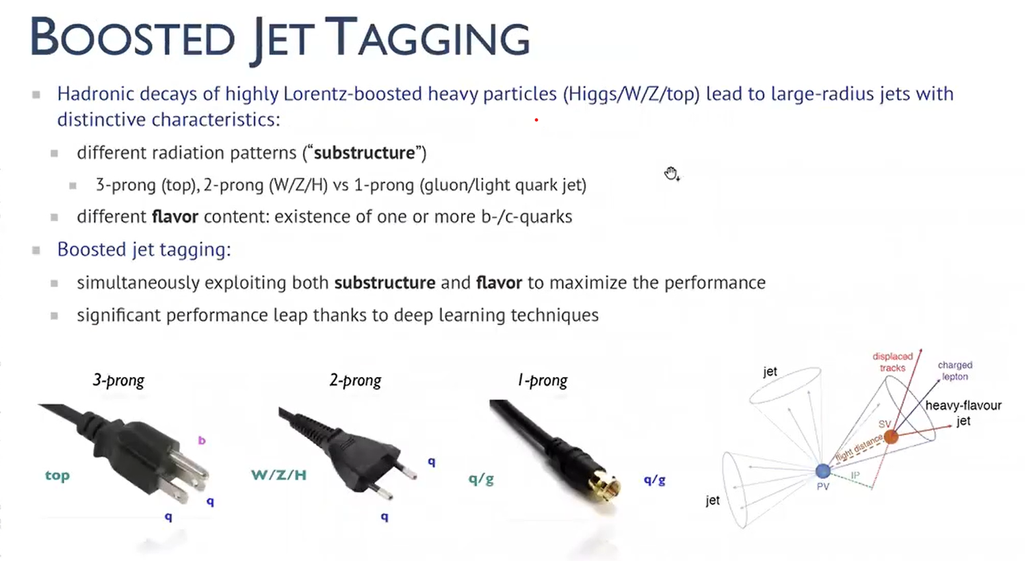

Slide 26
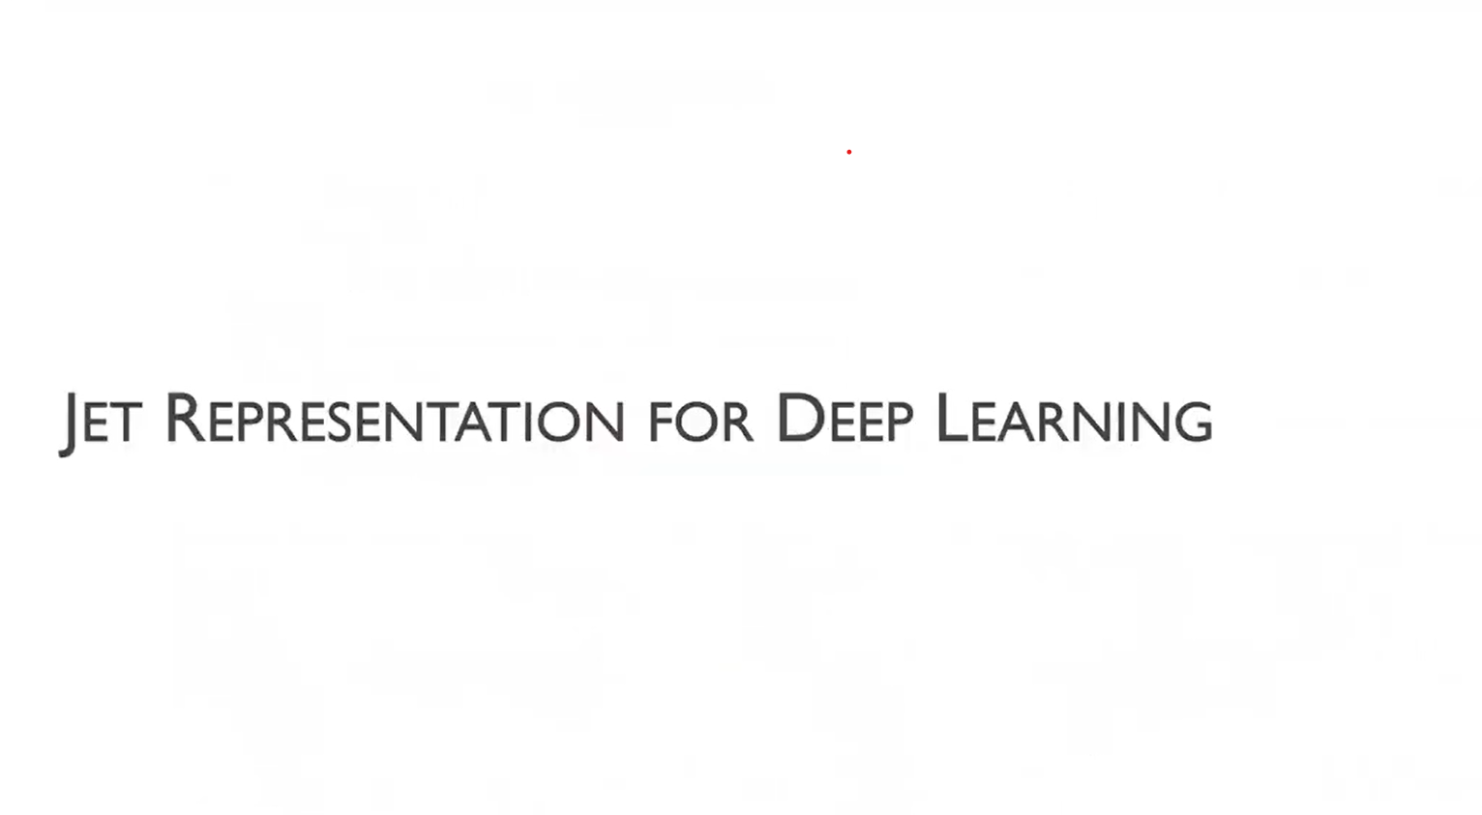

Slide 27
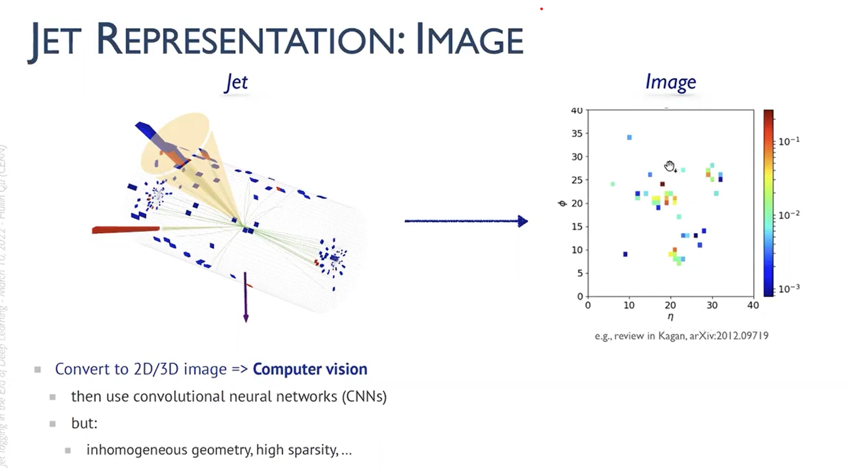

Slide 28
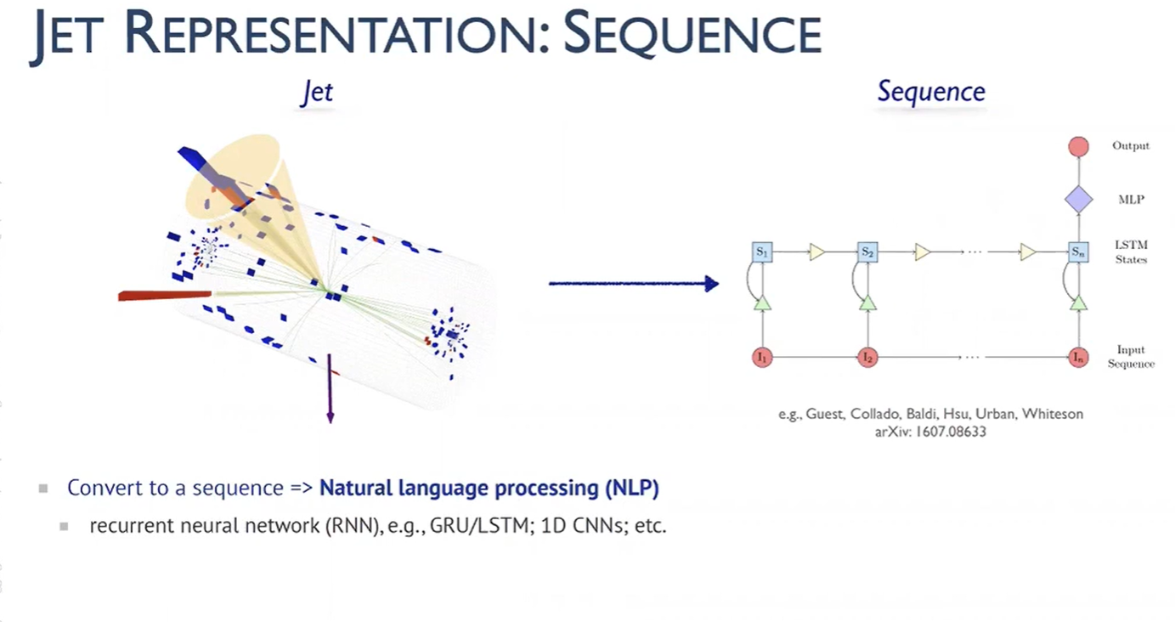

Slide 29
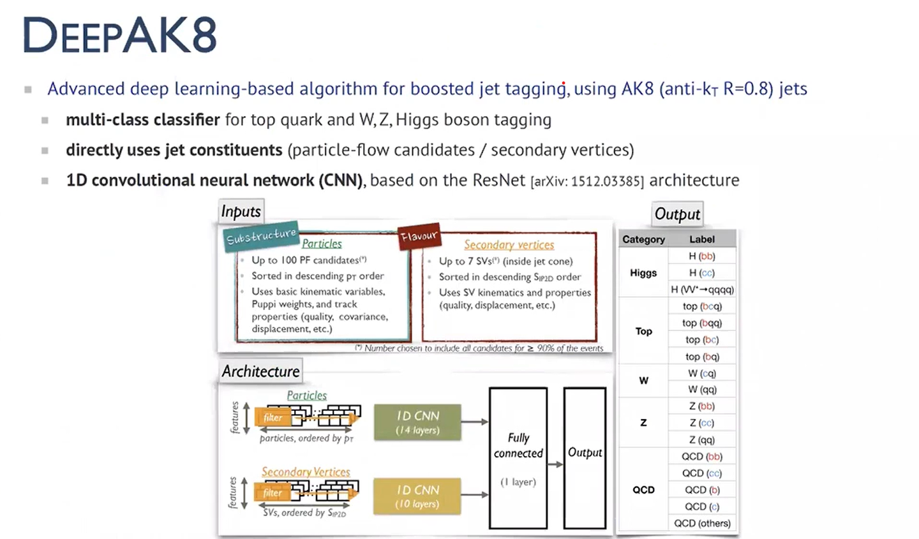

Slide 30



Project Description
Aim of the project is to develop a predictive classifier model, based on deep convolutional neural network trained on publicly available big data, that can discriminate efficiently jets produced by top quark decays (signal) from the background jets (noise).
Work with the Deep Learning Toolbox™ products to develop and train, validate, and test a deep learning classification network using MATLAB® and publicly available data on CERN’s Zenodo database

Slide 31
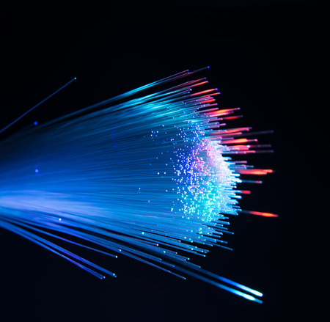
Steps:
Become familiar with the MATLAB based deep learning examples listed in the Background Material section below.
Download Live Script on: Deep Learning for Real-Time Top Quark Jet Tagging
Download particle jets open datasets from: Kasieczka, Gregor, Plehn, Tilman, Thompson, Jennifer, & Russel, Michael. (2019). Top Quark Tagging Reference Dataset (v0 (2018_03_27)) [Data set]. Zenodo. https://doi.org/10.5281/zenodo.2603256
Import datasets as pandas dataframes and save as parquet files. Run Python directly from MATLAB with the following commands:
pyrun("import pandas as pd")
pyrun("df=pd.read_hdf('train.h5','table')") pyrun("df.to_parquet('jets.parquet.gzip', compression='gzip')")
Use parquet datastore and Tall Array, to manage and preprocess the particle jets data and arrange it into 2D grayscale images.
Build a deep convolutional neural network, analogous to the one in: Deep Learning for real-Time Top Quark Jet Tagging using Deep Network designer app and train network using training datasets.
Check accuracy of the network on test datasets. Use imageDatastores, where label sources come from folder names.
Project variations:
Instead of a simple 3-layer CNN, Adopt more complex deep learning networks such as resnet18. Call blank architecture of resnet18 and train its weights. GPU can be handy when training more complicated deep networks, especially when dealing with big data.
Instead of gray-scale images use additional variables of the jets and encode them into the color of the image. In practice researchers use up to 7 or 8 colors.

Slide 32

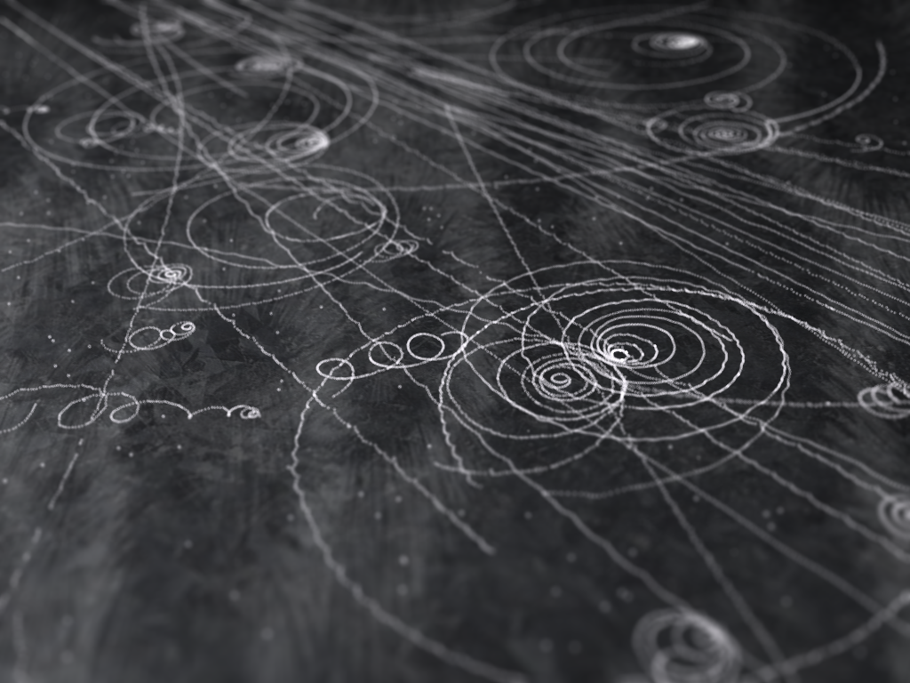

Background Resources
For Deep Learning:
Get started with Deep Learning Toolbox for simple examples of designing and training deep learning networks.
Deep Learning for Top Quark Jet Tagging, without using Big Data
For Big Data:
Datastore for Parquet files
Tall Array for working with Big Data

Slide 33



In conclusion, the fusion of Deep Learning and Big Data Analysis oﬀers a transformative pathway to enhance detection, revolutionizing the landscape of particle physics research. With continued innovation and collaboration, we are poised to unlock new frontiers in our quest to understand the universe.

Slide 34


Do you have any questions? vaidiksharma124@gmail.com
+91 983 481 1839
LinkedIn: https://www.linkedin.com/in/vaidik-sharma-2aba80186/
Instagram: VaidikS_124

