Slide 1

Natural Language Processing (NLP)
- Hotel Rating Classification
Team No: Team 5
1. Aniket N. Kumbhar
2. Ramazan A. Raheem
3. Ankita S. Patil
4. CHETAN S. SADAWARTE
5. Priyanka . J
6. Madhan R
7. Ummaneni Lokesh

Slide 2
Business Objective
T and major objective is what are the attributes that travelers are considering while selecting a hotel. With this manager can understand which elements of their hotel influence more in forming a positive review or improves hotel brand image.

Slide 3
Project Lifecycle
Data Analysis
Feature Engineering
Feature Extraction
Model Building
Model Deployment

Slide 4
Exploratory Data Analysis (EDA) and Feature Engineering
Missing Values
Duplicate Values
Feature Extraction
Feature scaling
Confusion Matrix
Splitting data in dependent and independed features

Slide 5
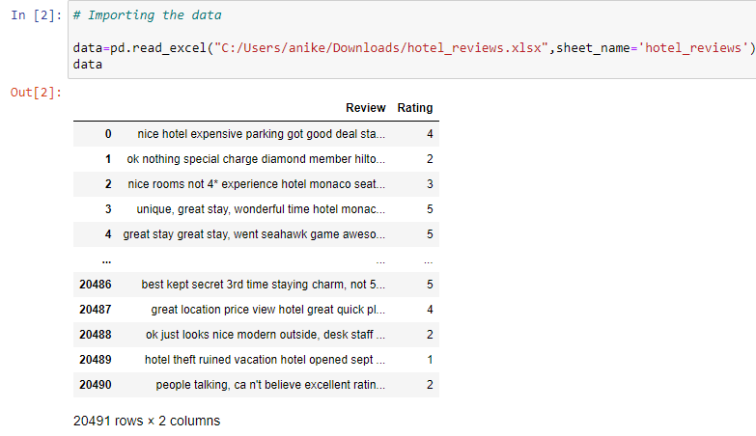
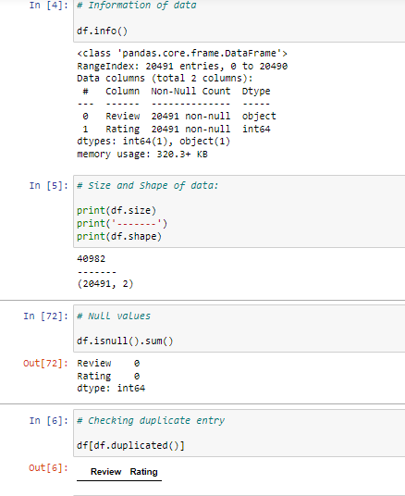

Slide 6
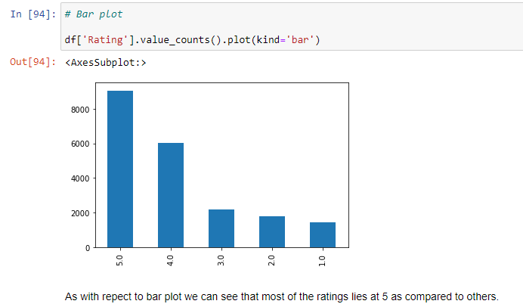
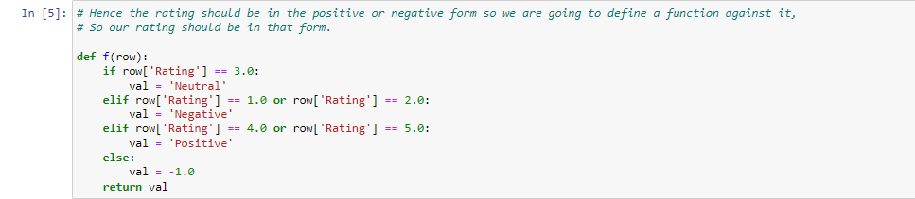
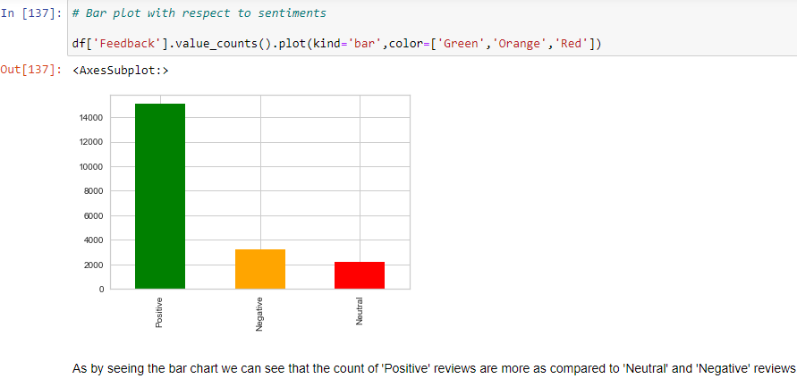

Slide 7
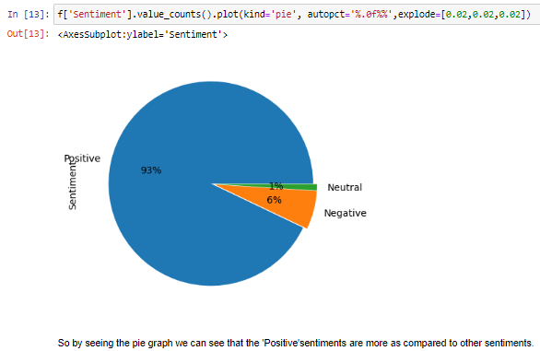
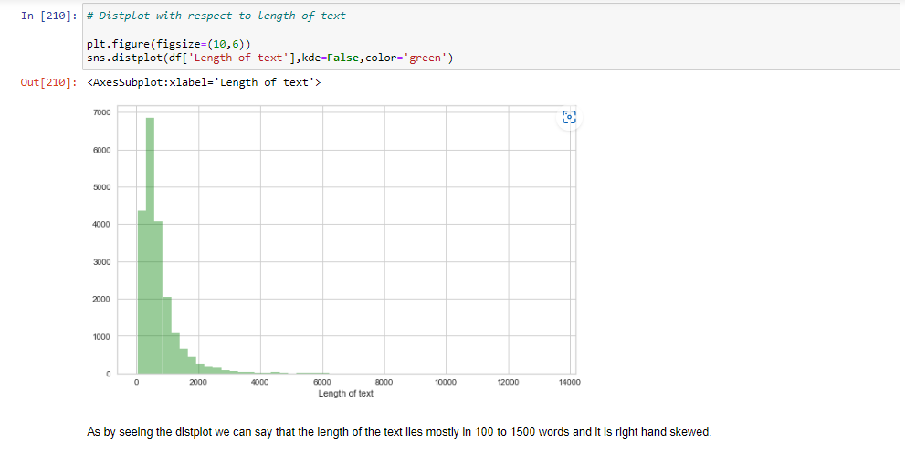

Slide 8
Pre-processing of Data
Pre-processing steps:
1.Contraction Mapping /Expanding contractions
2.Tokenization
3.Noise Cleaning / Punctuations
4.Stop words removing
5.Stemming And Lemmatization

Slide 9
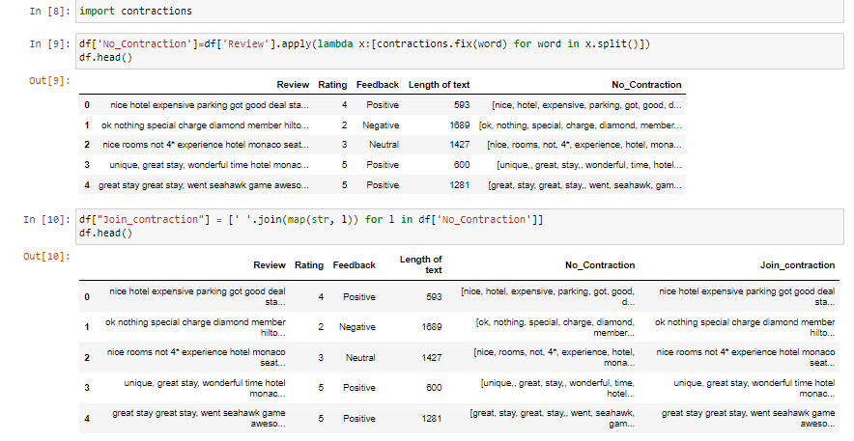
Contraction Mapping /Expanding contractions

Slide 10
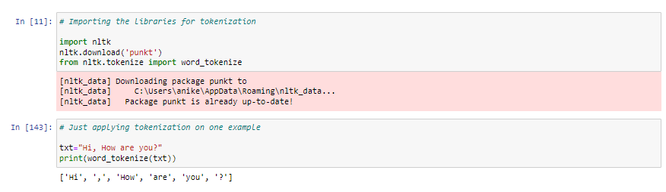
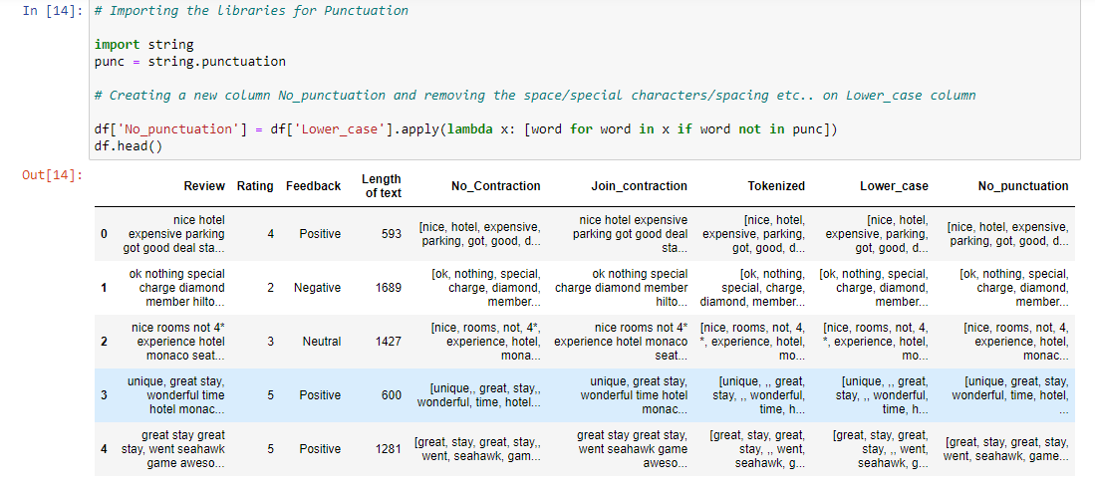
Tokenization and Noise Cleaning / Punctuations Removing

Slide 11
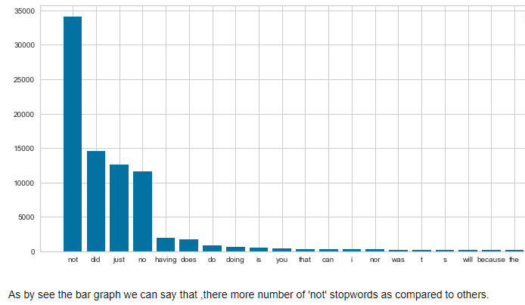
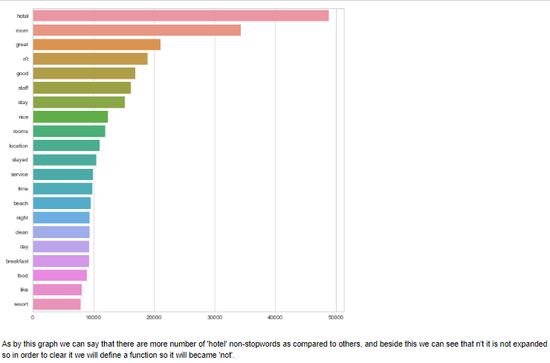
Stop words removing

Slide 12
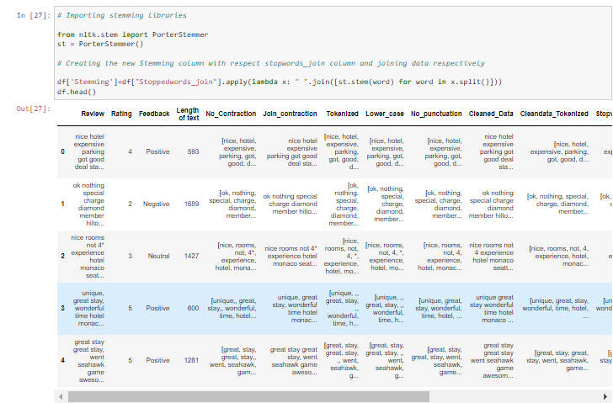
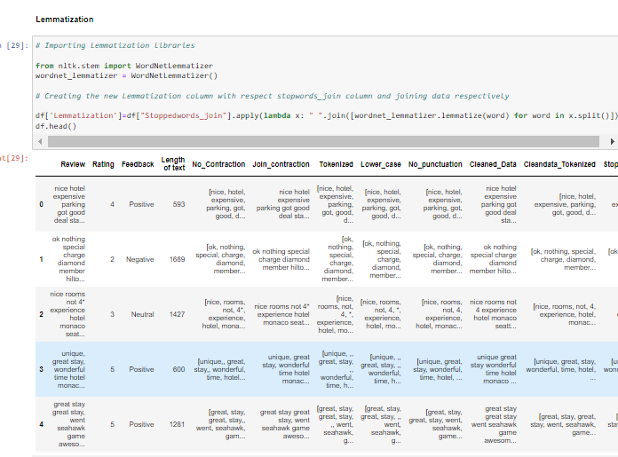
Stemming And Lemmatization

Slide 13
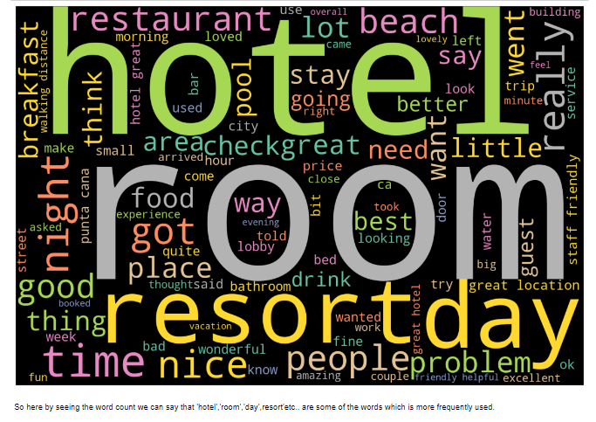
Word Cloud

Slide 14
Feature Extraction
Types :
Binary weights
Bag of words (count vectorizer)
TF-IDF (Term frequency-Inverse document frequency)
N-Grams

Slide 15
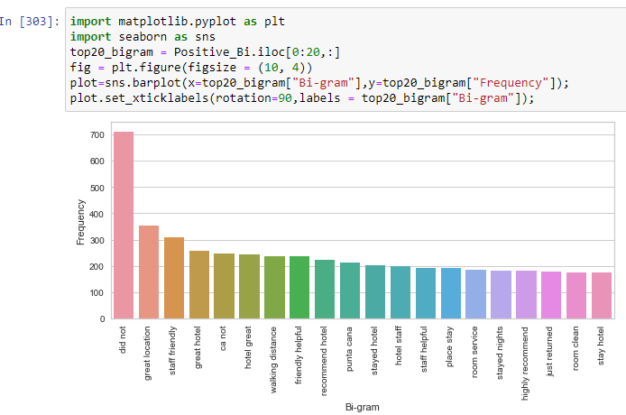
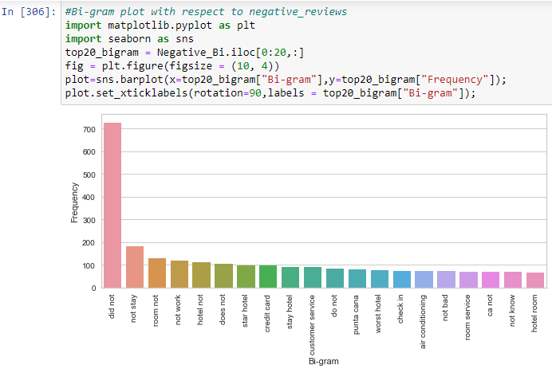
Bi-grams positive & Negative reviews

Slide 16
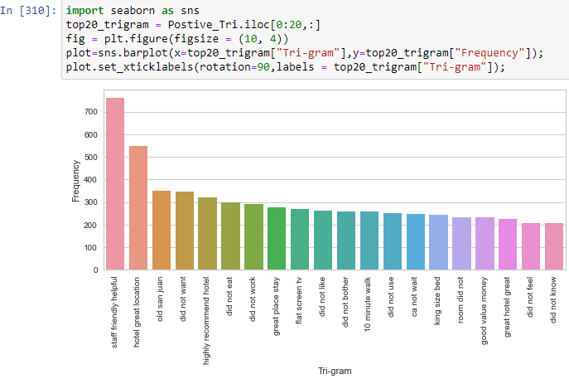
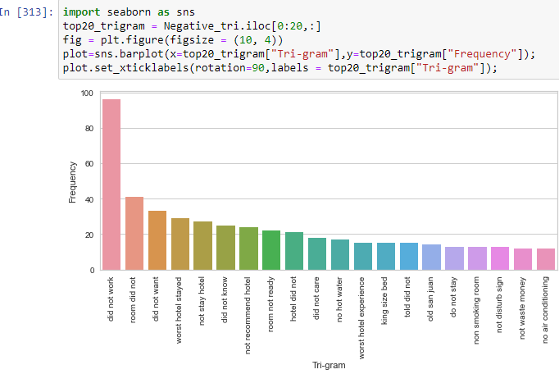
Tri-grams positive & Negative reviews

Slide 17
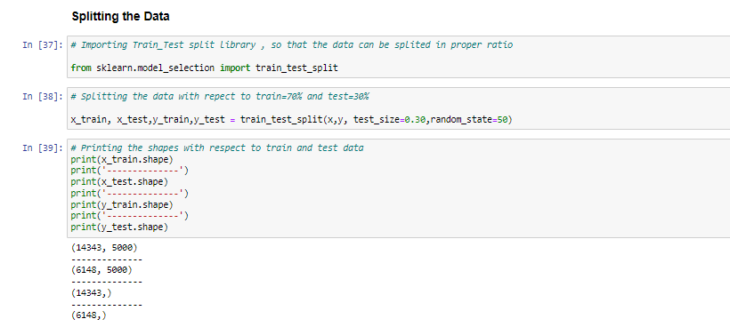
Splitting the Data

Slide 18
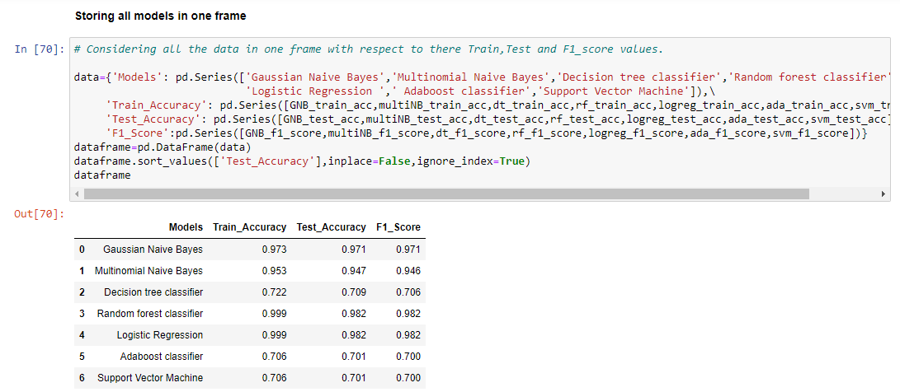
Model Building
Gaussian Naive Bayes
Multinomial Naive Bayes
Decision tree classifier
Random forest classifier
Logistic Regression
Ada-boost classifier
Support Vector Machine

Slide 19
Storing all models in one data-frame

Slide 20
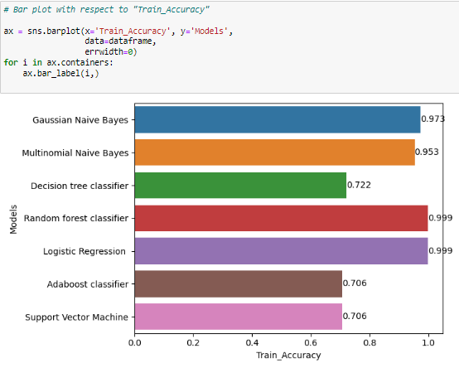
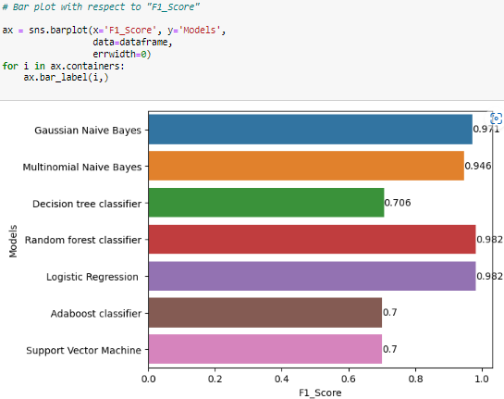
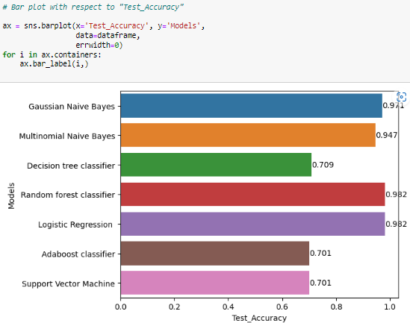
Model Accuracies

Slide 21
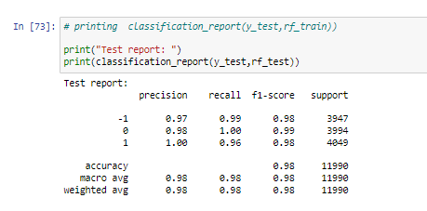
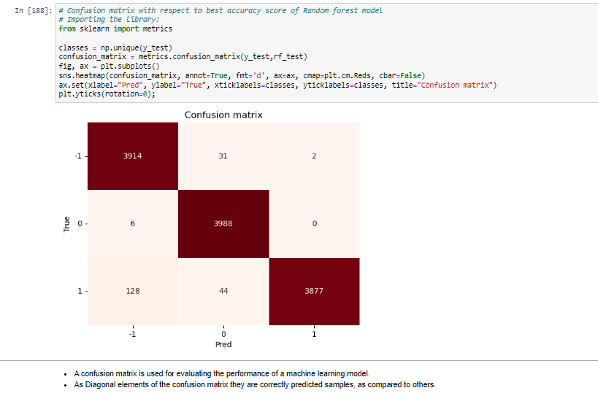
Finalized model : Random forest
Based on accuracy score we have finalized random forest as a best model..

Slide 22
Model Deployment
Stream lit / Flask / Heroku.
Used:
Stream lit

Slide 23
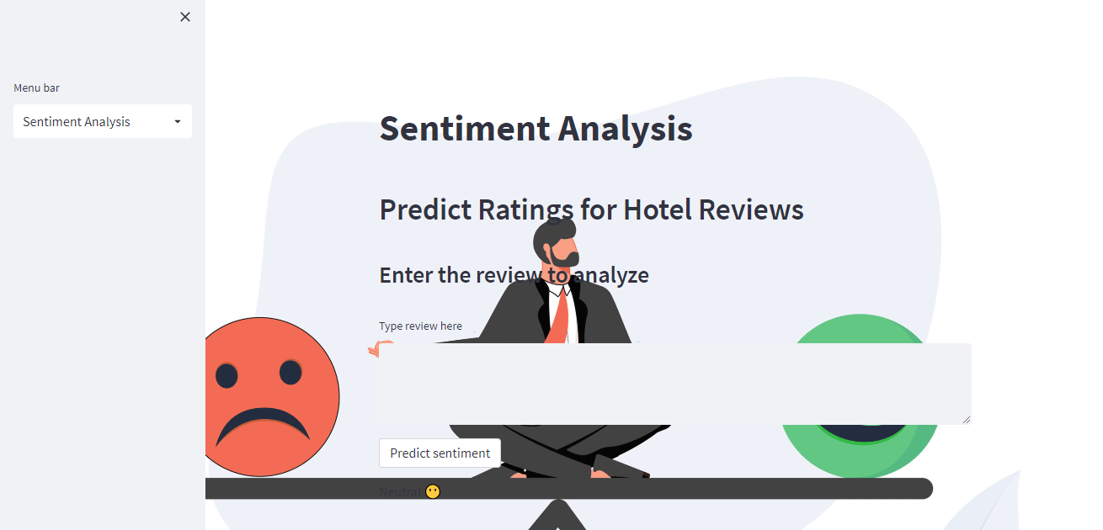
User Interface

Slide 24
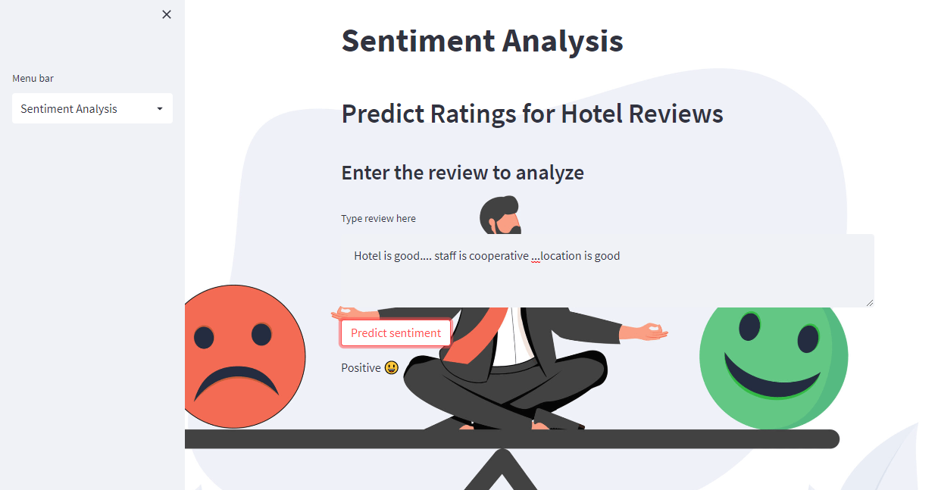
Example of Positive review

Slide 25
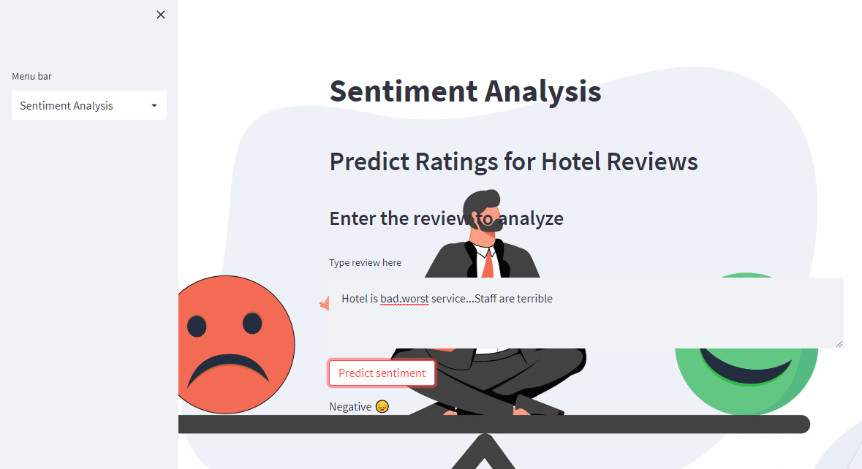
Example of negative review

Slide 26

THANk you…….

