Slide 1
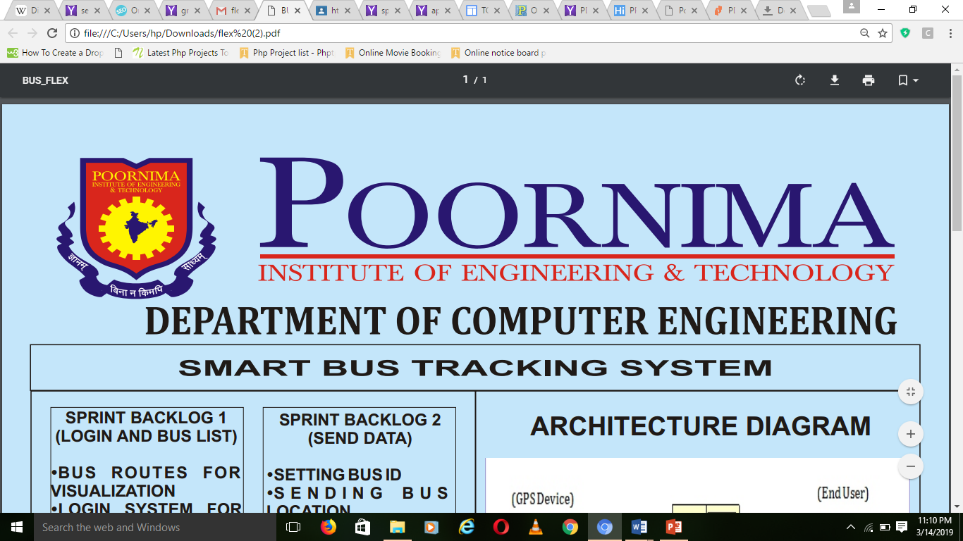
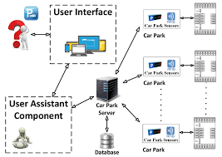
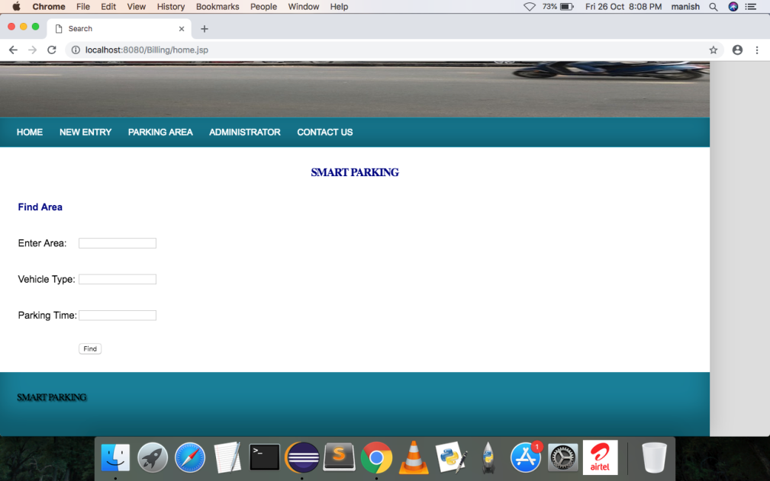
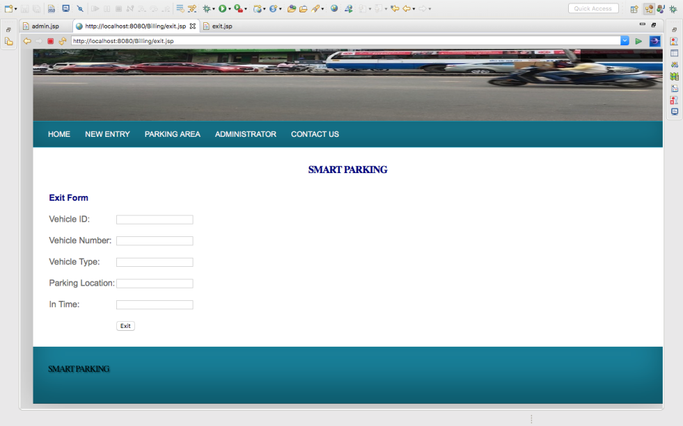
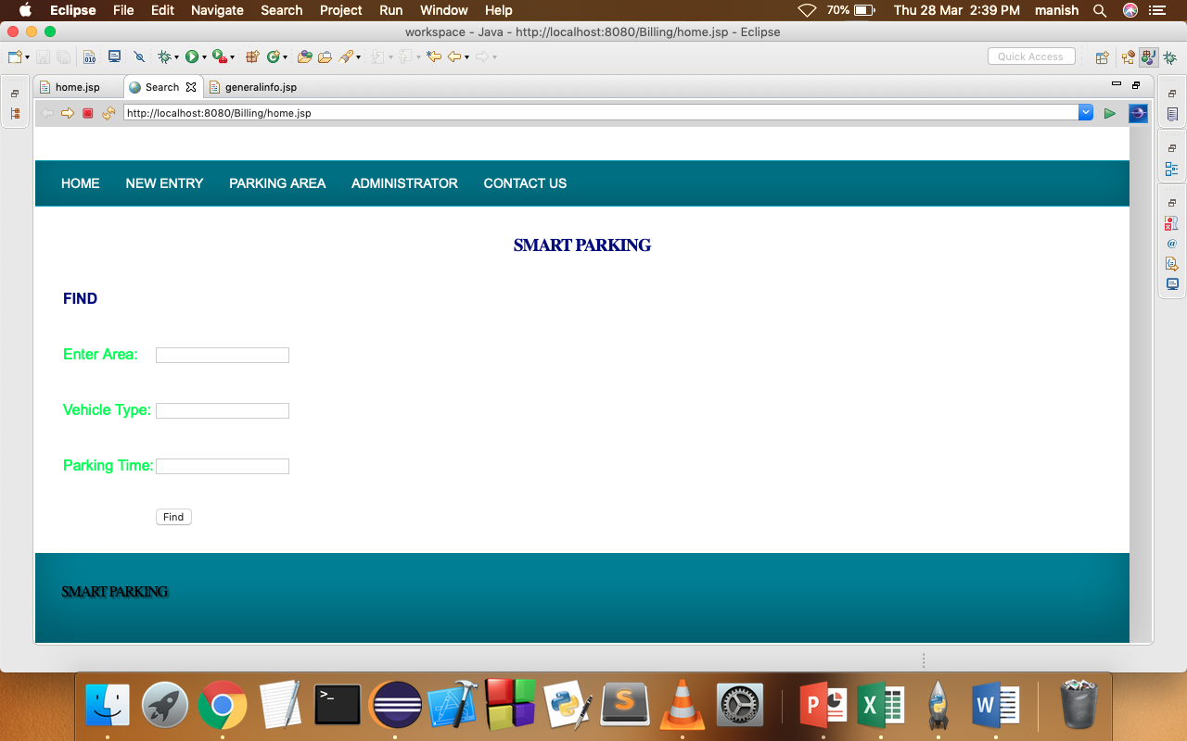
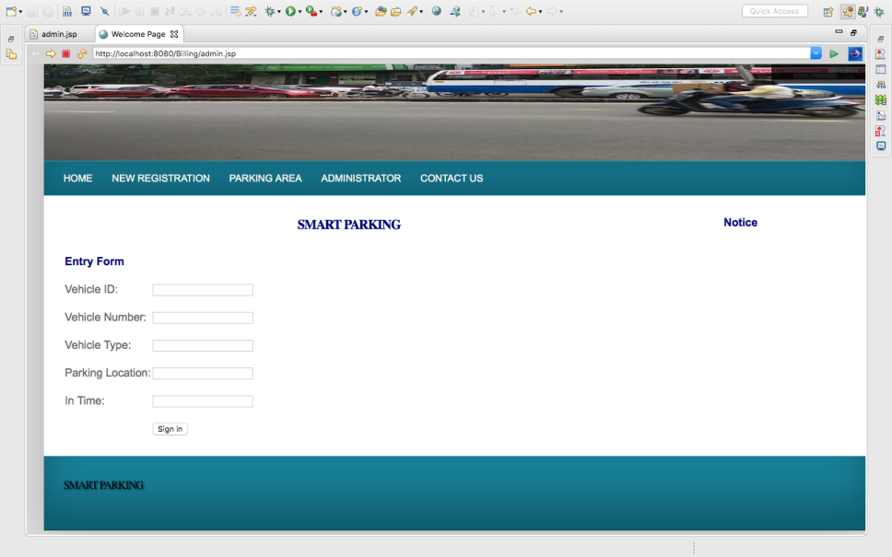
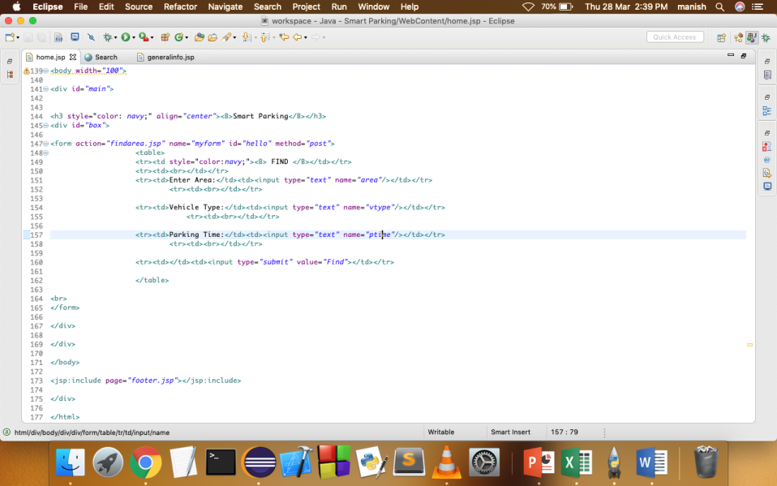
Smart Parking System
SPRINT BACKLOG 1
(Front End)
Applied the steps of
Front end.
1. Create HTML files
2. Create CSS files
3.Parking Owner Login
4.Parking Owner Register
5.Home Page
SPRINT BACKLOG 2
(Implementation on
Front end )
1.Learn JSP
2.Learn use of JavaScript
3.Start using JDBC
4.Implement open
Project
ARCHITECTURE DIAGRAM
SPRINT BACKLOG 3
(Implementation
Of JSP)
1.Testing
2.Destect Error
3.Give Final View
4.Apply to the Project
APPLICATION
SPRINT BACKLOG 4
(Back End Database
)
1.Admin Panel
2.Create Database
3.Connect Database
4.View Project
1. Faster processing time and more accurate data for Parking Lot
2. Ability for travellers to see parking available.
3. Major technological upgrades to the current travel system
PROJECT GUIDE :
Dr.Ajay Maurya
PIET/2018-19
Aniket Mathur (PIET15CE015) , Kartik Tiwari (PIET15CE049) , Mahesh Meena (PIET15CE058)

