Slide 1
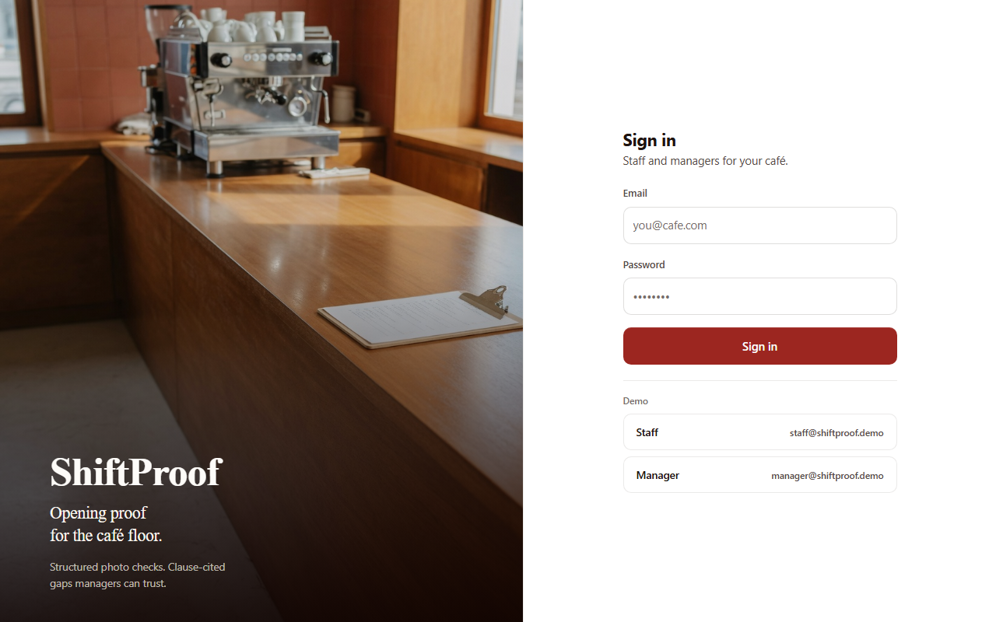
AI FIRST HACKATHON · GRAND FINALE
ShiftProof
WhatsApp shift photos become clause-cited scores a manager can trust.
Photo-proof SOP compliance · one café open
Track: AI for Industry, Business & Productivity
Lunaris · Anikesh Paul & Riya Sinha
ICFAI University Tripura
Notes:
0:00–0:20 Riya. Do not read the slide. One sentence: WhatsApp photos become clause-cited scores a manager can trust. Then next.

Slide 2
THE PROBLEM
SOPs exist. Daily proof is a WhatsApp dump.
Rules live in PDFs. Proof is a messy chat thread. Inspection day is when the gaps appear.
6.7M¹
5.2 lakh²
~1 in 5²
food businesses in India
inspections in FY 2025–26
(+30% vs prior year)
samples failed
safety tests
PDF SOPs
WhatsApp photos
Hope as proof
Inspection panic
Nobody opens them on the floor
Not linked to any clause
Manager has to trust, not see
No day-to-day gap log
1 FSSAI perpetual-licence reform: more than 6.7 million food business operators. Mint, 17 Jun 2026.
2 5,20,566 inspections; 40,023 of 2,23,808 samples non-conforming. Ministry of Health written reply, Lok Sabha, FY 2025–26 (ANI, 24 Jul 2026).
02
Notes:
0:20–0:50 Riya. Cite 6.7M as context, not TAM. If challenged: Mint 17 Jun 2026 on FSSAI; Lok Sabha / MoHFW FY26 via ANI 24 Jul 2026.

Slide 3
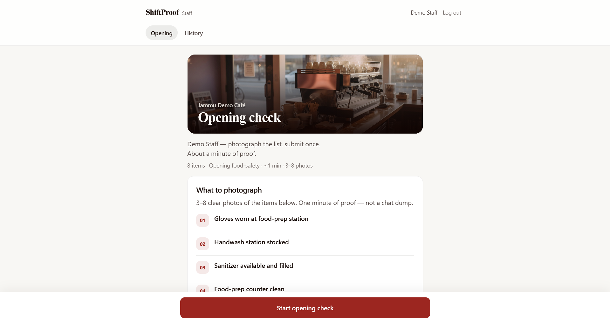
THE PRODUCT
Photos in. Pass, Gap, or Unclear out.
Each finding quotes the SOP. Fix it. Export one page. Not a chat.
1
2
3
4
5
Staff photos
Gemini scores
Scoreboard
Manager acts
One-page pack
3–8 shots of the open
Against the live clause set
Pass / Gap / Unclear
Override, assign, reject
Audit trail, not a certificate
Hard freeze
One café opening checklist.
Scoreboard only — no free chat.
Unclear is a feature.
Human override is required.
ShiftProof · Lunaris · AI First Hackathon
03
Notes:
0:50–1:05. Ten seconds on this slide, then Alt-Tab to the live app. Do not linger.

Slide 4
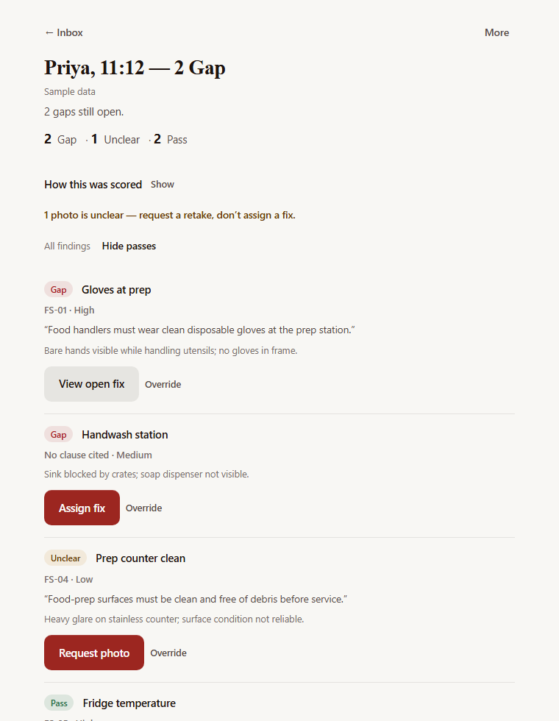
LIVE PROTOTYPE
The next four minutes are the product.
01
Staff
Upload a gap kit. Submit proof.
02
Score
Gemini Flash. Clause, quote, High / Medium / Low.
03
Act
Override with a reason. Assign a fix.
04
Pack
One-page compliance record.
ShiftProof · Lunaris · AI First Hackathon
04
Notes:
Flash this, then Alt-Tab. Anikesh drives. If Gemini hangs past 75s, disclose golden_gap_open.

Slide 5
TECHNICAL ARCHITECTURE
One Function. Three honest calls.
EXTRACT
SCORE
RE-CHECK
SOP upload
Opening check
One photo, one clause
Gemini at high thinking pulls at most eight photo-provable opening rules. That live set is what is in force. A failed extract leaves the previous set.
Medium thinking. Photo pool plus the live set — never the PDF again. JSON findings: Pass / Gap / Unclear, clause, quote, confidence.
Same Function, different body. If the model is down, staff attest — labelled Staff attested, never as AI.
AI Pass requires High
Keys stay on the server
Failures fail clean
Human is in the loop
Low is always Unclear. Gap may stand at Medium.
Gemini + Appwrite server key on the Function only.
No silent stub. Jobs older than 10 min fail on load.
Override needs a reason. Reject if it is not an opening.
ShiftProof · Lunaris · AI First Hackathon
05
Notes:
4:40–5:30 Anikesh. Extract HIGH, score MEDIUM, re-check one photo/one clause. Confidence is evidence sufficiency. No silent stub.

Slide 6
BUSINESS MODEL
The owner-manager pays. WhatsApp is free, and unusable.
BUYER
PRICE
Café owner-manager
₹799 / site / month
5–50 people. Already has an SOP. Already collects phone photos. Staff will not buy this.
Our working number for one café, unlimited opens — not a live price. A 5-site pack for a small chain later.
WHY NOW
NOT SELLING
Inspection pressure is up
Certification
5.2 lakh inspections in FY 2025–26.² Nearly 16,000 licences suspended or cancelled over five years.²
We do not pass you. We leave daily, clause-cited proof so inspection day is not a surprise.
2 5,20,566 inspections in FY 2025–26; 4,461 licences suspended and 11,493 cancelled over five years. Ministry of Health written reply, Lok Sabha (ANI, 24 Jul 2026).
06
Notes:
5:30–6:10 Riya. ₹799 is a working price, not a live plan. Not FSSAI certification. Beachhead is not 6.7M sites. 5.2 lakh and 16,000 licences: same Lok Sabha source as slide 2.

Slide 7
GO-TO-MARKET & SCALE
Same spine. New packs. Not a second industry this week.
1
2
3
Campus cafés
Independent cafés
Small multi-unit
We can walk in. Mess and kiosk opens already take photos.
Through FoSTaC / hygiene trainers who already talk to owners.
5-site pack for QSR that dumps WhatsApp photos to an area manager.
What scales · what does not
Scales: more SOP packs (closing, retail), more sites, stronger packs. The Function, findings schema, and HITL stay.
Does not scale this as: a chatbot, a hospital QMS, or a promise that you will pass inspection.
ShiftProof · Lunaris · AI First Hackathon
07
Notes:
6:10–6:35. Campus first. Then trainers. Then small chains. Scale is SOP packs and sites, not chat.

Slide 8
SHIFTPROOF
Photo in. Scoreboard out.
Human still in the loop.
Pass
Gap
Unclear
Evidence supports the clause
Evidence supports non-compliance
Thin evidence — manager decides
Questions.
Live · shift-proof-phi.vercel.app Code · github.com/Anikesh-Paul/ShiftProof
Lunaris · Anikesh Paul · Riya Sinha
ShiftProof · Lunaris · AI First Hackathon
08
Notes:
6:35–7:00. One recap sentence. Links. Stop talking. Hands off the mouse.

Slide 9
Q&A
Why this is not ChatGPT plus a login.
WhatsApp
Free, already there
No clauses, no audit, no scoreboard
Forms / checklists
Cheap habit
Cannot see a messy photo
ChatGPT on a photo
Can describe a scene
No shift, no source, no pack
Enterprise QMS
Deep compliance
Too heavy for a 15-person café
ShiftProof
Daily opening habit
Vision + live clauses + HITL + pack
ShiftProof · Lunaris · AI First Hackathon · Q&A
09
Notes:
Q&A only. ChatGPT can describe a photo. It cannot run a shift.

Slide 10
Q&A
When the model is wrong, slow, or down.
Wrong Pass
Thin photo
Manager override with a required reason. Audit event keeps AI vs human distinct.
Unclear. We do not invent a Pass. Manager can request a retake or reject the check.
Gemini down
Re-check fails
Job fails clean. Retry. Stale jobs fail after 10 minutes. No silent stub.
Staff attestation, labelled Staff attested — never stamped as AI.
On-stage miss
Known limit
Disclose a golden pre-scored opening on the same gap kit. Continue override → pack.
No EXIF forensics in the MVP. Manager sees the photos and can reject the opening.
ShiftProof · Lunaris · AI First Hackathon · Q&A
10
Notes:
Q&A only. Golden shifts are insurance, disclosed. Attestation is labelled.

Slide 11
Q&A
Where the numbers come from.
1
6.7 million food businesses
FSSAI perpetual-licence reform, covering more than 6.7 million food business operators. Mint, 17 Jun 2026.
2
5.2 lakh inspections · ~1 in 5 samples · ~16,000 licence actions
Ministry of Health written reply, Lok Sabha. FY 2025–26: 5,20,566 inspections (vs 4,01,391 in FY 2024–25); 40,023 of 2,23,808 samples non-conforming. Five years: 4,461 licences suspended, 11,493 cancelled. Reported by ANI, 24 Jul 2026.
—
₹799 / site / month
Our working price for the pitch — not a live plan, not a surveyed WTP figure. Label it as such if asked.
ShiftProof · Lunaris · AI First Hackathon · Q&A
11
Notes:
Q&A only. 6.7M is context, not TAM. Exact inspection count is 5,20,566. Fail rate is 40,023 / 2,23,808.

