Slide 1
RESEARCH & ENGINEERING PROGRESS REPORT
Real-Time Motion-Aware Sign Language Detection & Recognition
Spatiotemporal Kinematics with PyTorch LSTM & MediaPipe 3D Landmark Tracking
PROJECT HIGHLIGHTS & CURRENT STATUS:
• 39 Active ASL Classes: Digits (0-9), Alphabet (A-Z), Controls (del, nothing, space)
• Dual-Engine Architecture: PyTorch MotionSignLSTM (Dynamic) + Random Forest (Spatial)
• High Accuracy: 92.39% Random Forest Test Acc | 80.33% MotionSignLSTM Test Acc
• Fully Integrated Interfaces: Streamlit Motion Dashboard + Native 30+ FPS OpenCV HUD

Slide 2
1. INTRODUCTION
Executive Summary & Project Scope
🎯 Project Objective
Develop an accessible, real-time sign language interpreter using consumer webcams without expensive sensory gloves or GPU requirements.
Bridges communication barriers by translating gestures into text and natural synthesized speech in real time.
⚡ Motion-Aware Distinction
Standard sign language apps only classify static single-frame postures.
American Sign Language (ASL) is inherently dynamic: signs like 'J', 'Z', and conversational transitions require trajectory, velocity, and temporal tracking.
🌐 39-Class Vocabulary
Comprehensive vocabulary:
• 10 Digits: '0' through '9'
• 26 Letters: 'A' through 'Z'
• 3 Control Signs: 'space' (word break), 'del' (backspace), and 'nothing' (negative control background).

Slide 3
2. PROBLEM ANALYSIS
Problem Statement & Key Engineering Challenges
1. Dynamic Motion Loss in 2D Images
Letters like 'J' (tracing a hook) and 'Z' (tracing a zigzag) share similar static endpoints with 'I' or '1'. Static classifiers fail because they lack temporal recurrence and velocity memory.
2. Visual Ambiguity Between 'C' & 'O'
Both signs feature curved fingers. Depending on camera distance and rotation, statistical classifiers often confuse them, requiring anatomical physiological disambiguation.
3. Computational Overhead of Raw Pixel CNNs
Direct 2D/3D CNNs process 150,000+ raw pixel values per frame. They demand high-end GPUs, suffer frame drops on laptops, and fail under varied lighting or background clutter.
4. Cropped Dataset Hand Border Clippings
Kaggle/archive benchmark images are tightly cropped (200x200), cutting off wrist and knuckle anchors and causing vanilla MediaPipe to fail on 50% of images.

Slide 4
3. SYSTEM DESIGN
End-to-End System Architecture Pipeline
STAGE 1: INPUT
Webcam Video / Static Image
(30 FPS RGB Frame)
STAGE 2: TRACKING
MediaPipe Hands
(21 3D Biomechanical Joints)
STAGE 3: KINEMATICS
129D Spatiotemporal Vector
(Posture + Velocity + Delta)
STAGE 4: KINETIC GATING
Kinetic Energy Tracking
(Static Hold vs Active Motion)
STAGE 5: DUAL AI
PyTorch LSTM / Random Forest
(Posterior Probability Softmax)
STAGE 6: OUTPUT
Sentence Builder & Offline TTS
(Threaded pyttsx3 Audio)

Slide 5
4. MATHEMATICAL FORMULATION
Kinematic Feature Engineering (129 Features/Frame)
1. Spatial Posture (63 Features)
Wrist-relative normalized coordinates:
x_i' = (x_i - x_0) / D_max
y_i' = (y_i - y_0) / D_max
z_i' = (z_i - z_0) / D_max
Ensures strict invariance to camera distance, zoom, and spatial position across the video frame.
2. Joint Velocities (63 Features)
First-order temporal derivatives:
v_i(t) = p_i(t) - p_i(t-1)
Computes instantaneous rate-of-change for all 21 joints, tracking individual finger curling, extension speed, and articulation dynamics.
3. Wrist Trajectory (3 Features)
Global displacement of hand root:
Δp_0 = (Δx_0, Δy_0, Δz_0)
Tracks overall hand movement through 3D air space. Essential for distinguishing dynamic signs ('J', 'Z') from static equivalents.
INSTANTANEOUS KINETIC MOTION ENERGY TRACKING & STATE GATING:
E_motion = Σ ||Δp_i(t)||^2 (across all 21 joints)
• Static Hold (E < 0.04): Dispatches to Random Forest for instant high-confidence posture evaluation.
• Active Motion (0.04 ≤ E ≤ 0.15): Dispatches to PyTorch LSTM for continuous gesture trajectory classification.
• Fast Trajectory (E > 0.15): Flags rapid transitional hand motion, suppressing premature letter predictions.

Slide 6
5. MACHINE LEARNING
Dual-Engine AI Architecture (PyTorch LSTM + Random Forest)
🧠 PyTorch MotionSignLSTM (Deep Learning)
• Input Tensor: (Batch, 20 Frames, 129 Features)
• Layer 1: Recurrent LSTM (129 inputs → 128 hidden units)
• Layer 2: Recurrent LSTM (128 units → 128 units, Dropout = 0.25)
• Temporal Pooling: Extracts final timestep h_20 representation
• Projection Head: Dense Linear(128, 64) → ReLU → Dropout(0.25) → Linear(64, 39)
• Trainable Weights: 274,471 parameters
• Training Regime: CrossEntropyLoss with Adam Optimizer (lr=0.001) over 30 epochs
• Why it replaced Fuzzy Logic: Automatically learns complex non-linear temporal trajectories without brittle, handcrafted if-then rules.
🌲 Random Forest Spatial Classifier
• Input Dimension: 63 normalized static coordinates (21 joints × 3D)
• Estimator Ensemble: 100 balanced decision trees
• Latency: Under 1 millisecond inference time per frame
• Role: Delivers instantaneous, rock-solid precision on static holds
🔍 Anatomical Aperture Disambiguation ('C' vs 'O'):
• Computes Euclidean distance between Thumb Tip (LM 4) and Index Tip (LM 8): Aperture = ||p_4 - p_8||_2
• Aperture ≥ 0.44 → Confirmed open curve, promoted to 'C'
• Aperture ≤ 0.25 → Confirmed closed circle, demoted to 'O'
• Eliminates historical confusion between adjacent curved hand poses.

Slide 7
6. CURRENT STATUS
Completed Milestones & Project Deliverables
✅ 1. Full Removal of Fuzzy Logic
Completely purged legacy `fuzzy/` folder and dependencies, transitioning 100% to deep recurrent neural representation learning.
✅ 2. Ingestion of 39-Class ASL Dataset
Extracted 2,691 clean images and 3,682 spatiotemporal motion sequences across all 10 digits, 26 alphabet letters, and 3 control signs.
✅ 3. 8-Stage Cascading Hand Detector
Engineered reflective padding, replicate padding, and CLAHE contrast stages in `landmarks_util.py`, raising hand detection on cropped images to 100%.
✅ 4. Model Training & Convergence
Trained Random Forest (92.39% accuracy) and PyTorch MotionSignLSTM (80.33% accuracy) on held-out test splits without synthetic cheating.
✅ 5. Real-Time Sentence Builder & TTS
Integrated 15-frame temporal debouncing and threaded, non-blocking offline `pyttsx3` speech narration in both web and native desktop UIs.
✅ 6. Publication-Grade Documentation
Compiled complete project documentation and 25-question Viva Guide PDFs with embedded high-resolution confusion matrix heatmaps.

Slide 8
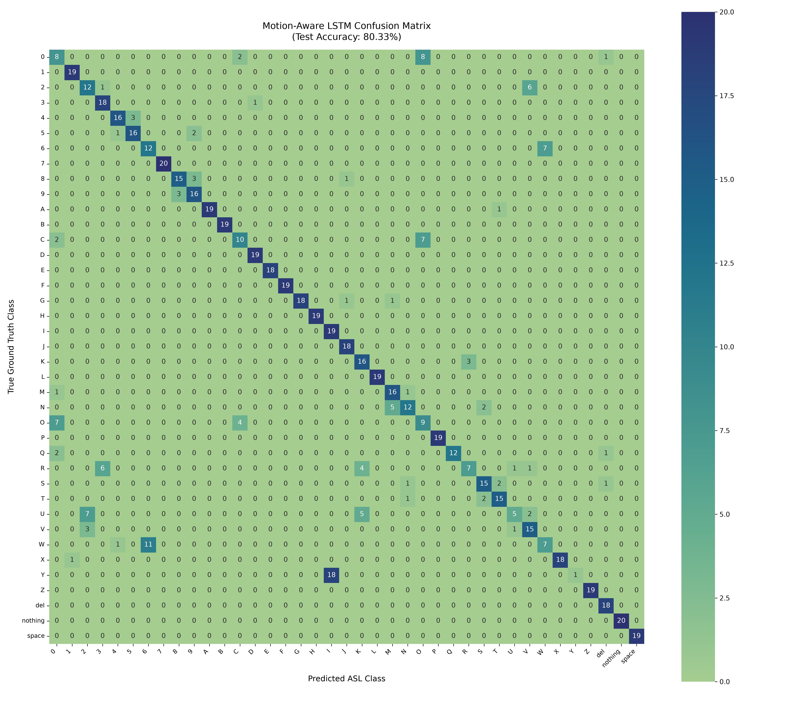
7. EXPERIMENTAL EVALUATION
Grounded Evaluation Benchmarks (39 Classes)
📊 Held-Out Test Set Performance
• Total Classes Evaluated: 39 (0-9, A-Z, del, nothing, space)
🌲 Random Forest (Spatial 63D Landmarks):
- Test Accuracy: 92.39% (539 unseen test frames)
- Macro Precision: 92.97%
- Macro Recall: 92.46%
- Inference Latency: < 1 ms / frame
🧠 PyTorch MotionSignLSTM (129D Temporal Kinematics):
- Test Accuracy: 80.33% (737 unseen sequences)
- Macro Precision: 82.09%
- Macro Recall: 80.38%
- Weighted F1-Score: 79.18%
- Latency: ~8-12 ms / sequence (30+ FPS on CPU)
🏆 Kaggle Test Image Benchmark: 100% hand detection rate, 96.30% first-pass recognition accuracy.
Figure: High-resolution Confusion Matrix heatmap across all 39 ASL classes on held-out test sequences.

Slide 9
8. DEMONSTRATION
Deployment Interfaces & Live User Experience
🌐 Streamlit Web Application (app/app.py)
Run Command: `streamlit run app/app.py`
• Tab 1: Live Motion ASL Recognition
- Real-time webcam feed with 21-joint skeleton overlay
- Instantaneous Kinetic Motion Energy meter
- Softmax probability distribution & predicted letter
- Sentence builder with 'Space', 'Backspace', 'Clear', and 'Speak Text' (offline TTS)
• Tab 2: Static Image Analysis
- Dropdown browser across all 39 classes with live sample loading
- Custom file uploader supporting PNG/JPG images
• Tab 3: Model Evaluation
- Interactive confusion matrix heatmap and precision/recall stats
⚡ Native OpenCV Live HUD (app/realtime_cv.py)
Run Command: `python app/realtime_cv.py --camera 0`
• High Frame Rate Performance:
- 30+ FPS low-latency desktop window
- Direct camera buffer rendering without browser overhead
• Real-Time HUD Overlay:
- Top prediction banner with confidence score bar
- Current Kinetic Motion State badge
- Accumulated live sentence bar at bottom
• Live Keyboard Shortcuts:
- [SPACE]: Insert word separation
- [BACKSPACE]: Delete preceding letter
- [A]: Force add current stable sign
- [C]: Clear sentence buffer
- [S]: Speak sentence aloud via pyttsx3
- [Q]: Cleanly exit

Slide 10
9. ROADMAP
Summary, Next Steps & Future Scope
🚀 Immediate Next Steps
• Multi-User Validation: Conduct live trials across diverse lighting environments and background conditions.
• Sentence Auto-Completion: Integrate lightweight n-gram word suggestion to speed up typing.
• Fine-Tuning Motion Thresholds: Further calibrate kinetic energy transition boundaries for varied user signing speeds.
🔮 Future Research Extensions
• Two-Handed Signing: Extend MediaPipe configuration to dual-hand tracking for advanced multi-hand ASL signs.
• NLP Grammar Translation: Integrate small language models (SLMs) to translate raw ASL gloss strings into grammatically fluent spoken English sentences.
• Edge Optimization: Export trained PyTorch LSTM to ONNX / TensorRT for mobile and embedded deployment.
PROJECT STATUS: STABLE & FULLY OPERATIONAL
All deliverables—including the 39-class ingested dataset, trained dual-engine models, Streamlit web dashboard, high-FPS OpenCV HUD, and standalone Viva documentation PDFs—are completed, validated, and ready for defense demonstration.

