Slide 1


Diffie-Hellman Key Exchange Algorithm
Presented By:
Anikesh Kumar
Sanjeev Ranjan
Shubham Kumar
Under Guidance Of:
Asst. Prof. Prashant Kumar
Department of Computer Science, GEC Jamui
Government Engineering College, Jamui

Slide 2
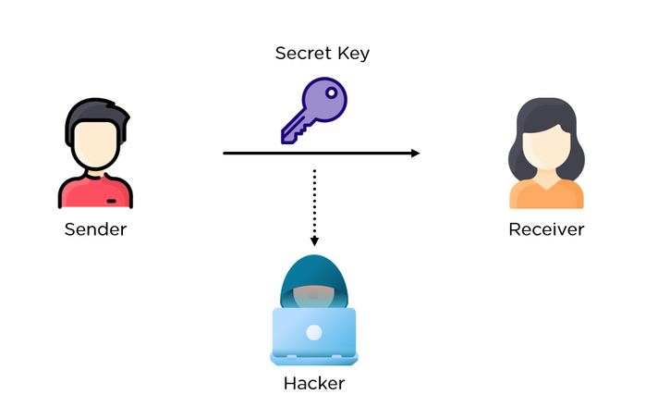
What is Diffie–Hellman Key Exchange?
Diffie–Hellman Key Exchange is a method to securely share a secret key between two people (or computers) over an insecure public network (like the internet), without directly sending the key.
It was invented by Whitfield Diffie and Martin Hellman in 1976

Slide 3
Why It’s Needed
When two people want to communicate secretly, they first need a shared secret key for encryption.
But how do they agree on a secret key if they are talking over the internet, where hackers could listen?
That’s where Diffie–Hellman helps!
It lets them generate the same secret key independently — even if a hacker is watching their entire conversation.

Slide 4
The Core Concept
Public Color:
Alice and Bob publicly agree on a common paint color (e.g., yellow). This is public knowledge; anyone can see it.
Private Colors:
Alice secretly chooses a private color (e.g., red).
Bob secretly chooses a different private color (e.g., blue).
They never share these secret colors.
Mixing and Sharing:
Alice mixes her secret red with the public yellow to get orange. She sends this orange paint to Bob.
Bob mixes his secret blue with the public yellow to get green. He sends this green paint to Alice.

Slide 5
The Core Concept
The Shared Secret:
Alice receives Bob's green paint and mixes it with her own secret red paint.
Bob receives Alice's orange paint and mixes it with his own secret blue paint.
Result: Both now have the exact same final color (a brownish-grey)!

Slide 6
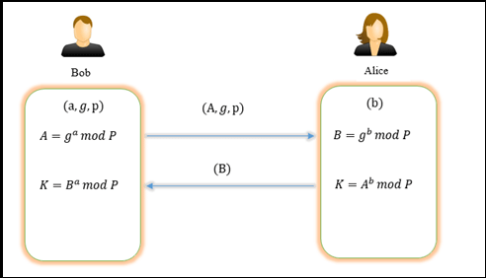
The Mathematics Behind It
Public Numbers (like the yellow paint):
A large prime number, p.
A generator (or primitive root modulo p), g.
Both p and g are public.
Private Keys (secret colors):
Alice chooses a secret integer, a. Only Alice knows a.
Bob chooses a secret integer, b. Only Bob knows b.

Slide 7
The Mathematics Behind It
Public Key Exchange (sending mixed paint):
Alice computes her public key, A, and sends it to Bob:
A = g^a \mod p
Bob computes his public key, B, and sends it to Alice:
B = g^b \mod p
Eve can see A and B, but cannot easily figure out a or b.
Calculating the Shared Secret (the final color):
Alice takes Bob's public key B and computes the secret S:
S = B^a \mod p
Bob takes Alice's public key A and computes the same secret S:
S = A^b \mod p

Slide 8
A Numerical Example
Public Numbers:
Let's agree on p = 23 and g = 5.
Private Keys:
Alice chooses her secret a = 4.
Bob chooses his secret b = 3.

Slide 9
A Numerical Example
Public Key Exchange:
Alice calculates A = 5^4 \mod 23 = 625 \mod 23 = 4.
She sends 4 to Bob.
Bob calculates B = 5^3 \mod 23 = 125 \mod 23 = 10.
He sends 10 to Alice.
Shared Secret Calculation:
Alice computes s = B^a \mod p = 10^4 \mod 23
= 10000 \mod 23 = 18.
Bob computes s = A^b \mod p = 4^3 \mod 23 = 64 \mod 23 = 18.
Result: Their shared secret key is 18.

Slide 10
Security and Vulnerabilities
Strength:
The security relies on the difficulty of the Discrete Logarithm Problem. Given g, p, and A = g^a \mod p, it is computationally infeasible for an attacker to figure out the secret a when the numbers are very large. It's a mathematical "one-way street."

Slide 11
Security and Vulnerabilities
Weakness, Man-in-the-Middle (MITM) Attack:
Standard Diffie-Hellman is vulnerable to a MITM attack because the public keys (A and B) are not authenticated.
How it works:
An attacker, Eve, sits between Alice and Bob.
Alice sends her public key A to Bob, but Eve intercepts it.
Eve generates her own secret key, e, and sends her public key E to Alice and Bob, pretending it's from the other person.

Slide 12
Security and Vulnerabilities
How it works:
Alice and Eve now share a secret key. Bob and Eve also share a different secret key.
Eve can now decrypt messages from Alice, re-encrypt them with Bob's key, and send them along. Both Alice and Bob think they are communicating securely, but Eve is reading everything.
The Fix:
This is solved by using digital signatures (e.g., RSA) to authenticate the public keys. This ensures Alice knows she is talking to Bob, and not Eve.

Slide 13
References
GFG & Wikipedia:
How Diffie-Hellman key exchange algorithms works.
Man in the Middle Attack, step by step explanation about it.
Various Online Sources:
Youtube - Concept of Diffie-Hellman Key Exchange Algorithm.
Cloudflare - Articles on Internet Security.

Slide 14
Thank You
From,
Team - Zero Dobt

