Slide 1

Intelligent Vulnerability Management & Risk Prioritization Platform
From thousands of noisy scanner rows to owned, explainable, business-aware remediation
Barclays Early Careers · final-year software engineering capstone
Synthetic data only · no live bank systems
Notes:
Introduce the platform in one sentence: it consolidates findings from six simulated sources, scores them with business and threat context, assigns owners, tracks SLAs and exceptions, and gives every role its own view. Everything shown uses a deterministic synthetic dataset.

Slide 2
Security teams drown in findings that lack business context
2,500
28.6%
3,454
?
raw rows from five tools in one import cycle
of rows are duplicates of the same issue
open findings — which ones matter first?
who owns the fix, and is the SLA at risk?
Our answer
Consolidate and de-duplicate every source into one record per issue
Score with eight explainable factors: technical, threat and business context
Route each fix to an accountable owner with an SLA, escalation and evidence trail
Show every role — analyst to CISO — exactly the view and data it needs
Notes:
Numbers come from the seeded academic dataset (seed 42). The point: volume and duplication hide the real risk; context and ownership are what turn findings into action.

Slide 3








One platform covers all 14 use cases end to end
Asset inventory
Ingest & correlate
Explainable risk
Attack paths
Register assets, criticality, crown jewels, regulatory tags, owners (UC-1/2)
Scanner, CSPM, pentest, container/K8s, identity, EASM, threat intel (UC-3/4/5)
8-factor configurable score with a what-if preview (UC-6)
Graph routes to crown jewels raise priority (UC-7)
Remediation
Exceptions
Reporting
AI assistant
Auto-ownership, SLA, escalation, tickets, evidence (UC-8/9/10)
Temporary/long-term risk acceptance, review packs (UC-11)
Role dashboards, heatmap, MTTR, forecasts, board report (UC-12)
Plain-English questions, recommendations, remediation plan (UC-13/14)
Notes:
Walk left to right as the data flows: inventory, ingestion, scoring, attack paths, remediation, exceptions, reporting, AI. Each tile names the use cases it satisfies.

Slide 4

Layered, API-first architecture with one scoring path
React + TypeScript UI
Deployment options
permission-driven menus, 14 pages, token refresh
Kubernetes
HPA API replicas, single scheduler, TLS ingress, NetworkPolicies
FastAPI REST API (104 operations)
central default-deny RBAC, row-level scope, OpenAPI
Docker Compose
PostgreSQL, API, nginx, optional TLS proxy
Services
ingestion · scoring · attack paths · ownership · SLA · exceptions · analytics · forecasting · AI · reports
Dev script & CI
SQLAlchemy + Alembic
one-command start; CI lint, tests, scans, E2E, build
PostgreSQL 15 (prod) / SQLite (dev); hash-chained, append-only audit
Notes:
Key design decision: every score — at import, after a weights change, an asset edit or a threat-feed update — goes through one rescoring service, so threat intel and attack-path context are never lost. Scheduling can be split out so the API scales horizontally.

Slide 5
Eight explainable factors combine into one priority
Why it works
Every point has a stated reason on the finding page
Bands: critical ≥ 80, high ≥ 60, medium ≥ 40
Weights are versioned; a what-if preview shows the re-ranking before saving
2,588 of 3,454 open findings land in a different band than scanner severity alone
444 findings would drop a band without KEV/exploitation signals (SC-5)
Notes:
This is the spec formula implemented literally: CVSS + criticality + exposure + exploitability + threat intel + data sensitivity + regulatory + attack path. Show the finding page live to prove explainability.

Slide 6
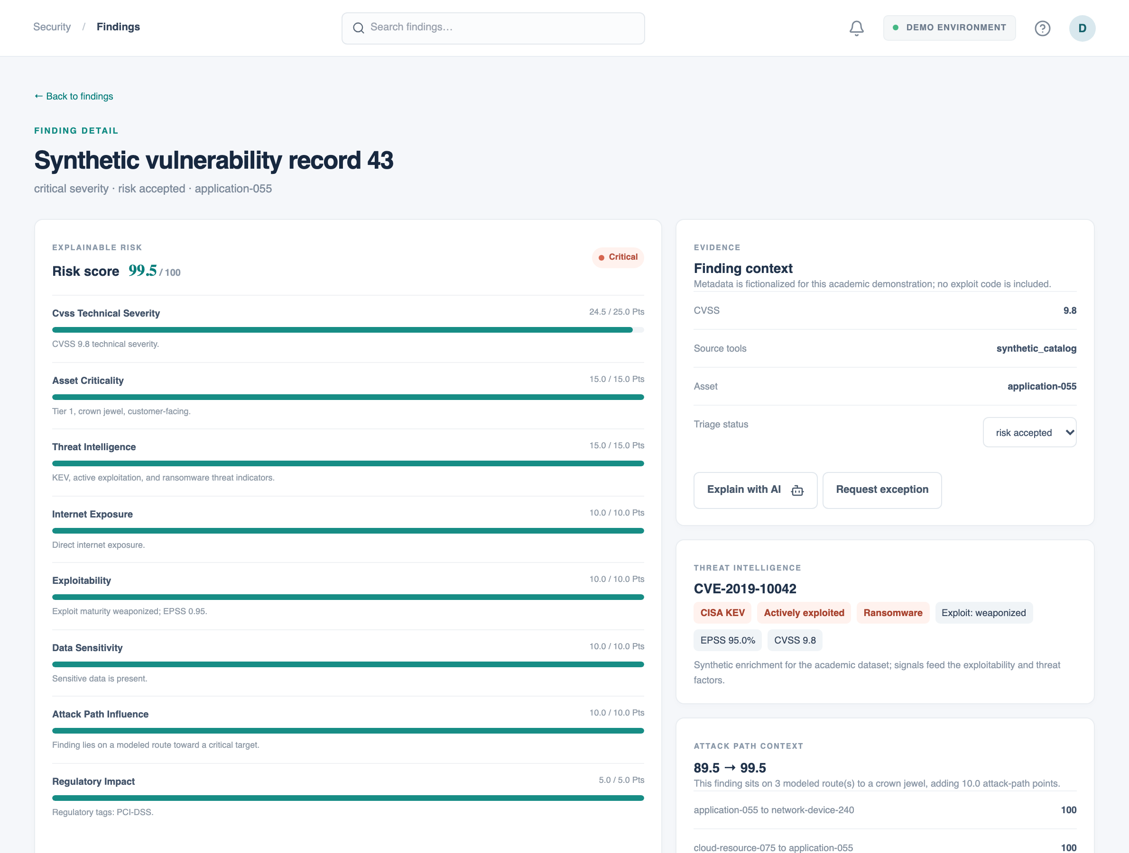
Every score is explained, with threat and path context
Factor-by-factor points and reasons
Threat intel: KEV, active exploitation, ransomware, EPSS
Attack-path context shows base → final score
Source records prove survivorship across tools
"Explain with AI" sends the finding to the assistant
Notes:
Point at one factor bar and read the reason aloud. Then the attack-path card: this finding gained ten points because it sits on a modeled route to a crown jewel.

Slide 7
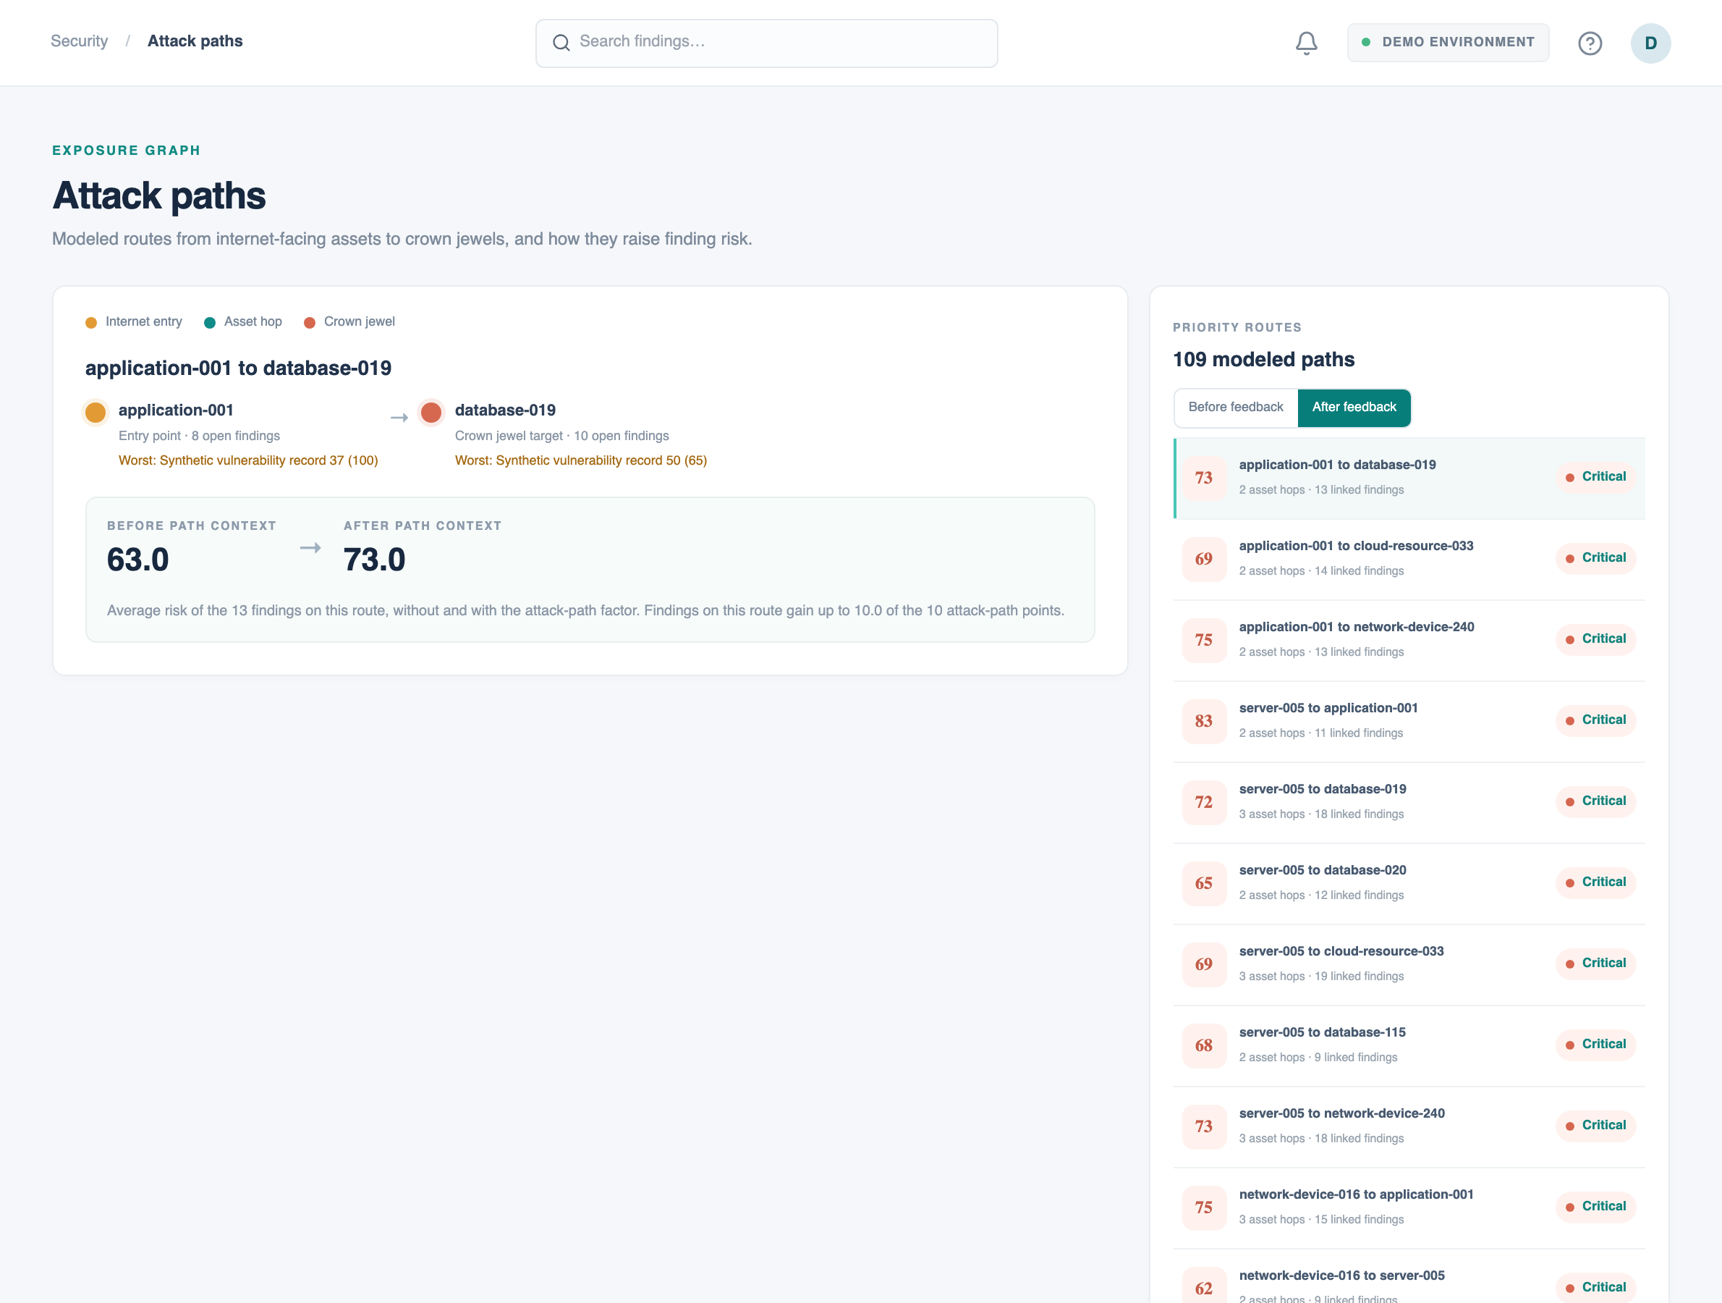
Exposure chains change what gets fixed first
555
findings sit on modeled routes from internet entry points to crown jewels
300
were raised a full risk band by path context (SC-9)
+9.7
points average increase on path findings
Notes:
networkx finds simple paths of up to five hops from internet-exposed assets to crown-jewel or sensitive targets. Path risk feeds back into each finding as the attack-path factor. The graph also exports to Neo4j Cypher and GraphML.

Slide 8
Six sources become one trustworthy record per issue
Upload CSV / JSON
Normalize to common schema
Match asset (host, FQDN, URL, IP)
Correlate & survivorship
Score & assign owner
714
500
0
duplicate rows merged on the seed load (28.6%)
findings corroborated by two or more tools
rows lost: failures are kept with their error and retryable
Survivorship keeps the highest severity and CVSS, the most specific description and the CVE link; findings seen again after closure are reopened with their task. Threat-feed updates rescore affected findings immediately.
Notes:
Demo the EASM import: 70 rows, 13 merge into existing scanner findings, 5 unknown hosts are rejected but kept — register the asset and press retry.

Slide 9
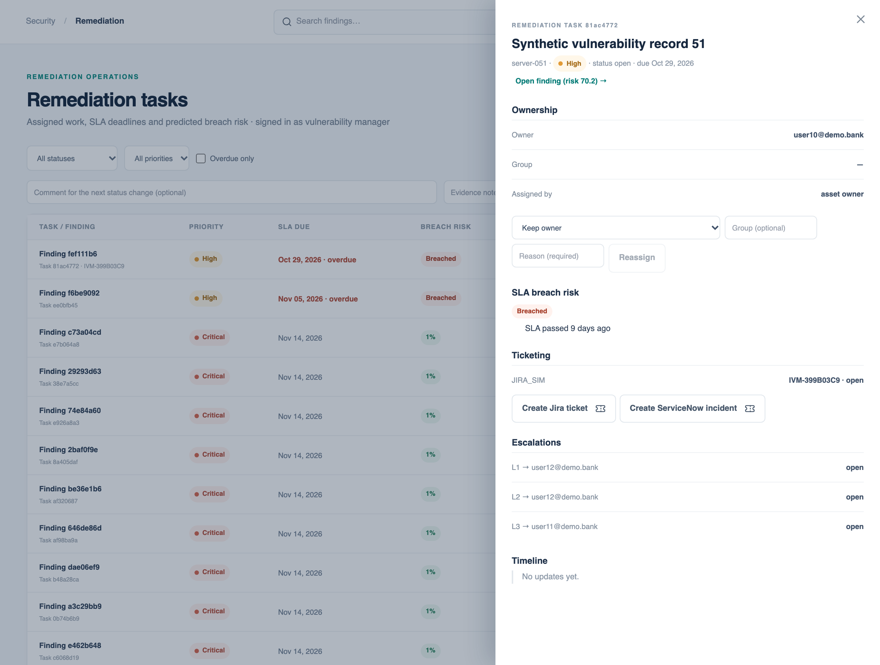
Accountable remediation with SLAs that predict breaches
100%
of tasks routed to the dataset owner (SC-6, target 90%)
4.4 / 8.5 d
MTTR for critical / high
≈ 96%
SLA compliance; breaches escalate in three policy-driven levels
Notes:
Ownership rules match business unit, service, asset type, environment or regulatory tag, then fall back to the asset owner and BU manager. Closing requires evidence and closes the finding. The breach model learns typical time-to-close and each owner's on-time rate from history. Jira and ServiceNow simulators plus a signed webhook cover SC-11.

Slide 10



Risk acceptance with segregation of duties and evidence
1. Request
2. Approve
3. Expire
4. Evidence
Temporary (≤ 90 days) or long-term (≤ 365 days) with justification and compensating controls
Requester can never approve; long-term needs a security architect
Warnings at 14 and 7 days; expiry reopens the finding and its SLA
One-click review pack: risk breakdown, threat intel, paths, checklist and hash-chained audit trail
Every reviewed exception has an audit record (SC-8).
Notes:
Show a pending request approved by a different user, then download the review pack — designed for auditors.

Slide 11
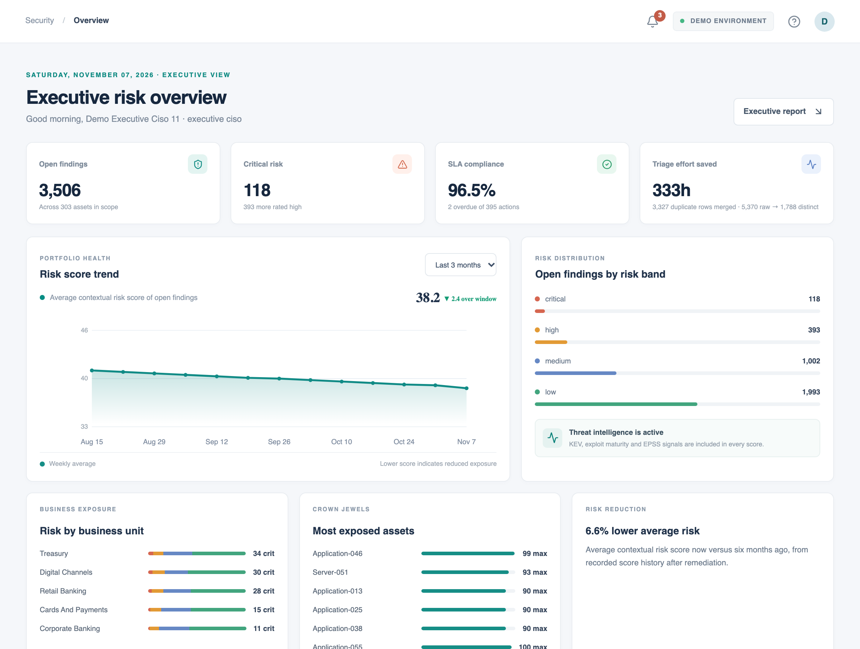
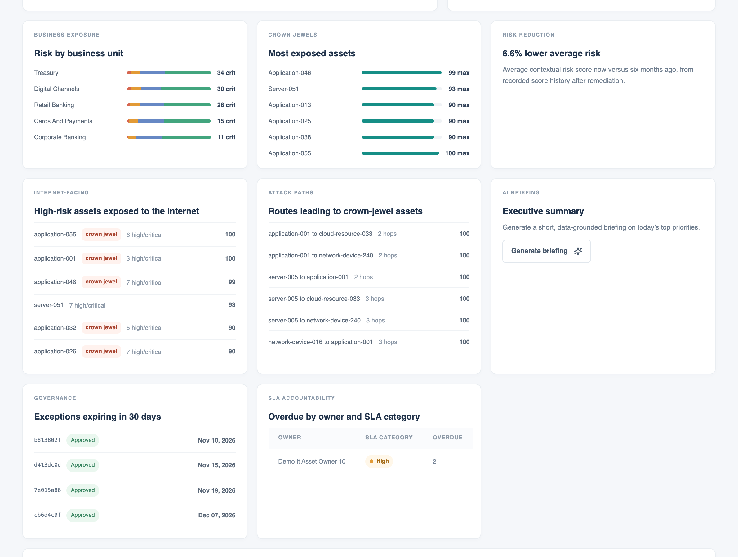
Every role gets its own dashboard; executives get a board report
Covers every section-13 item: top risky assets, critical by business unit, internet-facing high-risk assets, overdue by owner and SLA category, expiring exceptions, paths to crown jewels, trend, risk reduction, MTTR and a service heatmap — plus forecasts and a printable board report.
Notes:
Executive, analyst, manager and auditor views come from distinct endpoints scoped to the user. Under 25 concurrent users the API serves about 65 requests per second with p95 1.5 s against the 3 s target.

Slide 12
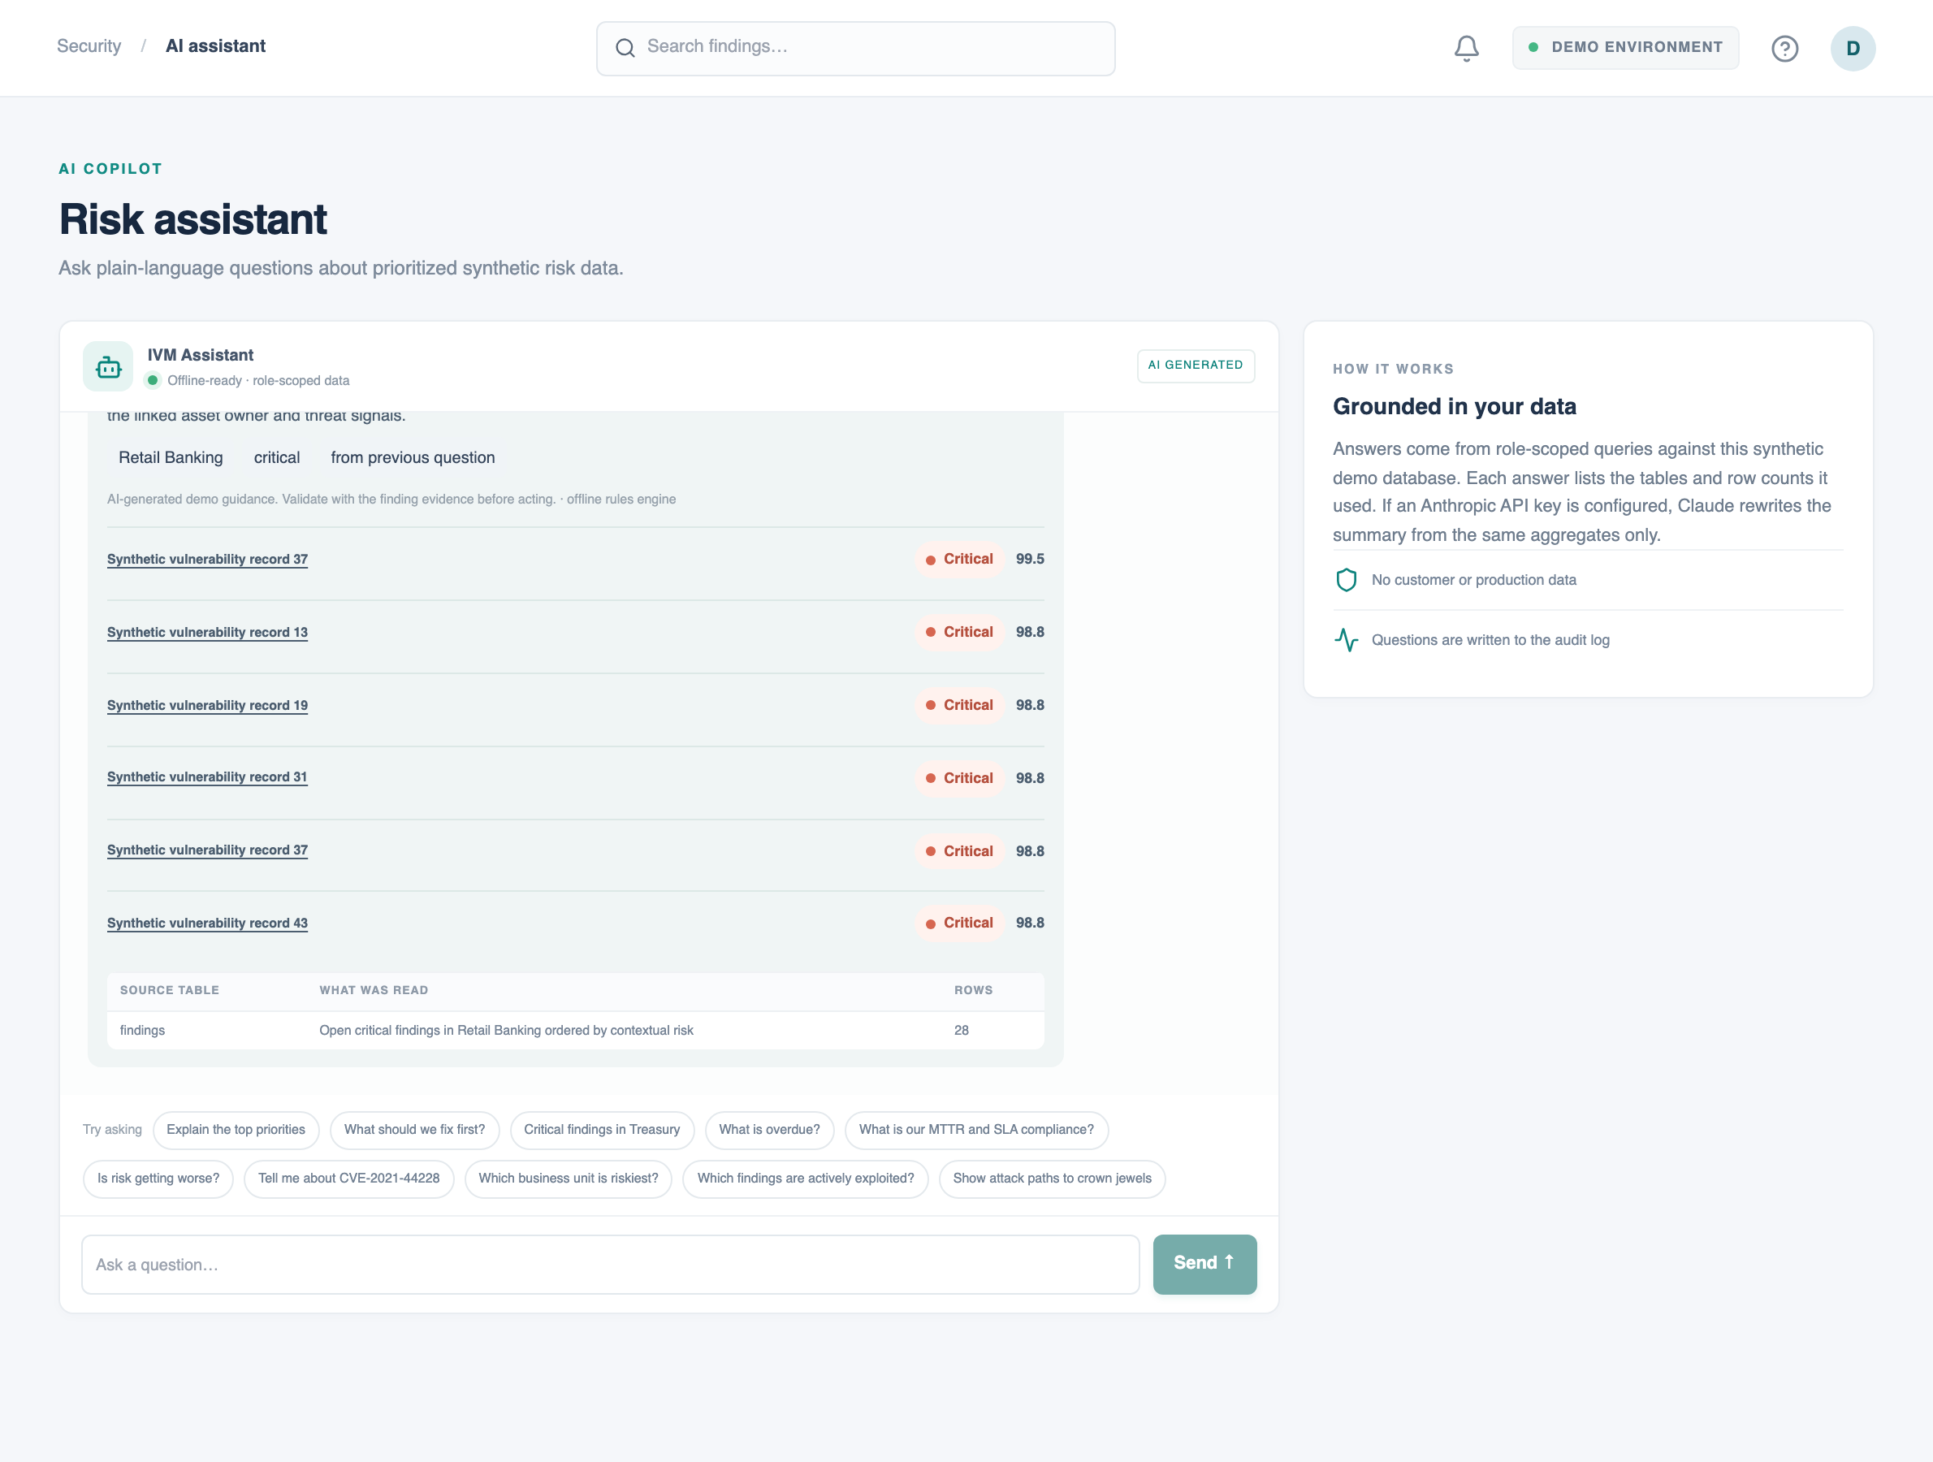
An assistant that answers from the data and shows its sources
Try asking
“Critical findings in Treasury” → “what about Retail Banking?”
“What should we fix first?” — effort-weighted plan
“Tell me about CVE-2021-44228”
“Who owns server-051?”
“Is risk getting worse?” — trend forecast
Role-scoped queries, a sources table on every answer, every question audited. Claude can rephrase answers from aggregates when an API key is configured.
Notes:
The offline engine recognises business units, assets, CVEs and risk bands, carries context into follow-ups, and never sees data outside the user's scope. Answers cite tables and row counts so they can be checked.

Slide 13



Security engineered in, not bolted on
Access control
Identity
Tamper-evident audit
9 roles × 28 permissions, central default-deny, one row-level scope rule set, tested role by endpoint
bcrypt, lockout, rate limits, rotating refresh tokens, TOTP MFA (encrypted secrets), password policy
SHA-256 hash chain, append-only DB triggers, one-click integrity verification
Input & output safety
Secrets & platform
DevSecOps
strict validation, CSV formula-injection guard, signed webhooks, CSP and security headers
env-only secrets, weak-key refusal, non-root containers, TLS, NetworkPolicies
bandit, pip-audit, npm audit, gitleaks and type checks gate every CI run
Notes:
34 defects were found and closed during hardening, including scope leaks through AI endpoints, an MFA bypass for non-privileged roles and a re-score that silently erased attack-path context. All are in the defect summary with their regression tests.

Slide 14
Measured quality: tests, coverage, scans and speed
86%
0 errors
whole-backend line coverage (gate: 70%)
600 requests from 25 concurrent users, p95 1.5 s (target < 3 s)
0
0
bandit issues; 0 serious WCAG violations (axe)
known vulnerable dependencies (pip-audit, npm audit)
Regenerate everything with scripts/collect_evidence.sh --with-e2e → docs/evidence/
Notes:
Evidence files are committed under docs/evidence with exit codes. Not verified locally: Docker/PostgreSQL runtime and gitleaks — both run in CI.

Slide 15
All twelve success criteria met — measured, not asserted
SC-1 | All 300 dataset assets tracked | ✔ | SC-7 | Every overdue task escalated | ✔
SC-2 | 5 import sources (+ EASM, threat intel) | ✔ | SC-8 | Exceptions end-to-end with audit records | ✔
SC-3 | 714 duplicates merged automatically | ✔ | SC-9 | 300 findings raised a band by paths | ✔
SC-4 | Business context re-bands 2,588 findings | ✔ | SC-10 | Four role dashboards + board report | ✔
SC-5 | Threat intel moves 444 findings a band | ✔ | SC-11 | Jira/ServiceNow + signed webhook | ✔
SC-6 | 100% ownership accuracy (target 90%) | ✔ | SC-12 | ≈ 99 analyst hours saved (stated assumptions) | ✔
Live scorecard: Reports & insights → Success criteria (computed from the database on every visit).
Notes:
Open the Reports page live — each row carries the evidence string computed from the current data, so assessors can see exactly how each criterion is met.

Slide 16
Limits we are honest about — and what comes next
Access tokens live 15 min after logout → add token versioning
Audit immutability at DB level → add external WORM storage
Docker/PostgreSQL and Kubernetes verified in CI design only → run in a real cluster
Business-unit scoping policy → stakeholder sign-off before real data
Thank you — questions welcome
Notes:
Close on limits stated plainly, then invite questions. Demo video: docs/demo/ivm-demo.webm.

