Slide 1

PIMPRI CHINCHWAD EDUCATION TRUST’S PIMPRI CHINCHWAD COLLEGE OF ENGINEERING SECTOR NO. 26, PRADHIKARAN, NIGDI, PUNE- 411044.
Project Topic: Image Processing Based Semi-Automated Target Detector and Shooter
Project ID:- A-16 Project Group Members:
Sr. No | Name | Roll No.
1. | Aniket Sudhakar Chopade | BEETA121
2. | Swapnil Nileshrao Dasarwar | BEETA123
3. | Raviraj Mahadeo Khopade | BEETA146
Mr. M. M. Narkhede | Prof. A. B. Patil | Dr. M. T. Kolte
Project Guide | Project Coordinator | HoD (EnTC)
DEPARTMENT OF ELECTRONICS & TELECOMMUNICATION B.E. (E&TC) 2020-2021

Slide 2
CONTENTS
Introduction
Problem Statement
Necessity
Objectives
Work done till date
Components
Software specification
Block Diagram
Flow Chart
Conclusion
Object Detector Model Training Results

Slide 3
INTRODUCTION
Threats to India from neighbouring countries.
Human casualties & defence improvisation.
Robots and why we need them?
Basic idea of semi-automatic defence system.

Slide 4
PROBLEM STATEMENT
To design an integrated Computer Vision based semi-automated system which captures real time video input and processes it to detect specific object and shoot it.

Slide 5
NECESSITY
Self defence in 21st century.
Reduce human casualties on borders.
Need to improve defence by introducing robotic systems.
Systems which can be operating automatically or operated by humans remotely.

Slide 6
OBJECTIVES
Proposed system should be able to detect particular specified object/target by the help of video processing algorithm.
After detection of object/target system controller should be able to shoot at that particular object.
The shooting mechanism is pneumatic based subsystem which helps the controller gain maximum accuracy for hitting the target.
Proposed system consists of wireless communication which provide a long-range contactless operability to user.
System can replace Humans on the battlefield and therefore helps in reducing the human casualties on borders.

Slide 7
WORK DONE TILL DATE
1) Selection of Problem Statement.
2) Selection of approach to be taken for providing efficient solution.
3) Synopsis of the project.
4) Selection of softwares to be used.
5) Learning required concepts i.e. Image Processing, Pneumatics etc.
6) Collection of dataset and annotation for target detection system.

Slide 8
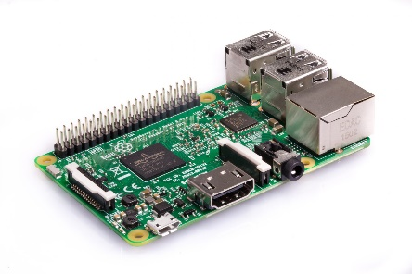
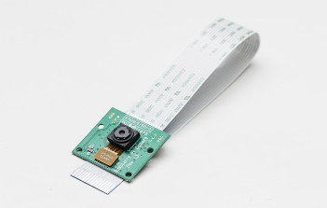
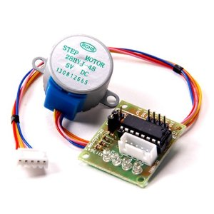
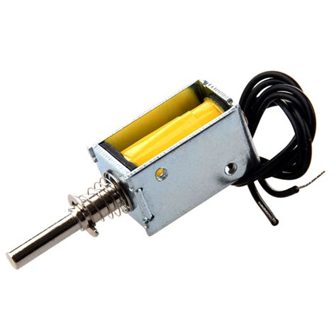
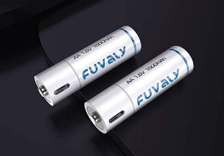
COMPONENTS
Raspberry pi 3 B
Pi cam
Stepper motor & DC motors
Driver IC’s (ULN2003, L293D)
Push-Pull Solenoid
Lithium ion batteries

Slide 9
SOFTWARE SPECIFICATION
Python 3
Visual Studio Code
Anaconda Libraries
Numpy
Labelimg
Google Colab

Slide 10
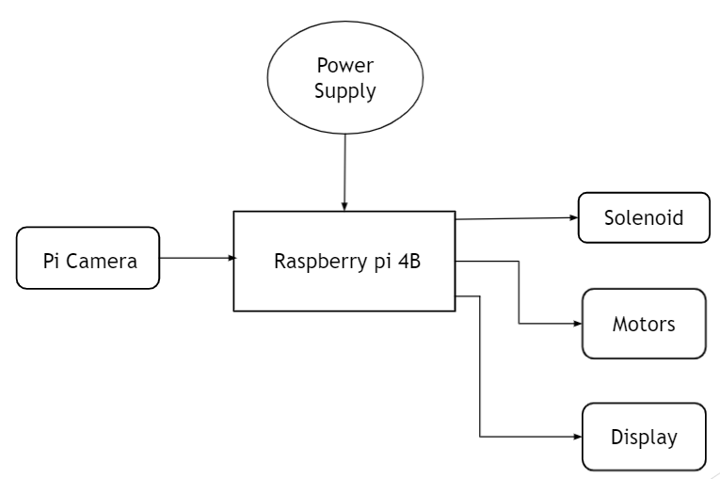
BLOCK DIAGRAM

Slide 11
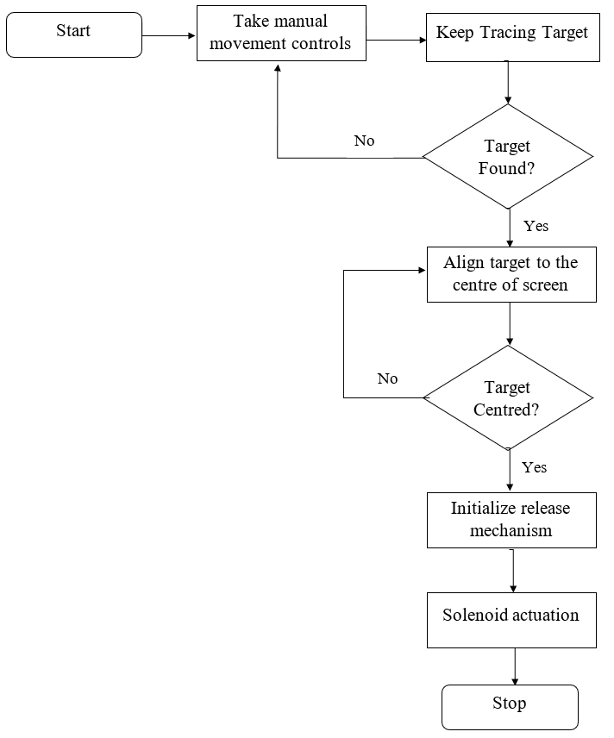
FLOW CHART

Slide 12
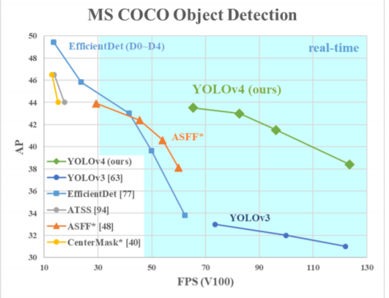
Object Detection Model Comparison
Image Source: Google Images

Slide 13
Why YOLOv4?
One stage Detection Model
Consists of 53 layered CNN architecture
Neck (SSP) removes the fixed size constraint
10% more meanAP YOLOv3
12% more FPS Support than YOLOv3

Slide 14
EXPECTED CONCLUSION
The project plans to propose a system which would detect specific target objects with the help of video processing algorithm. Once the target object is detected, system controller shoots aiming at the same targeted object. Maximum accuracy is achieved by using pneumatic based subsystem. This proposed system consisting of wireless communication provides long range contactless operability to the users. Hence ,this system in future can replace human- beings and therefore help in reducing human casualties on the border.

Slide 15
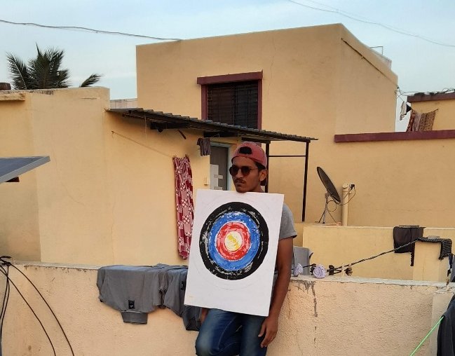
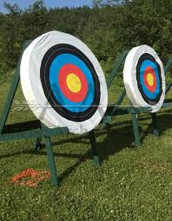
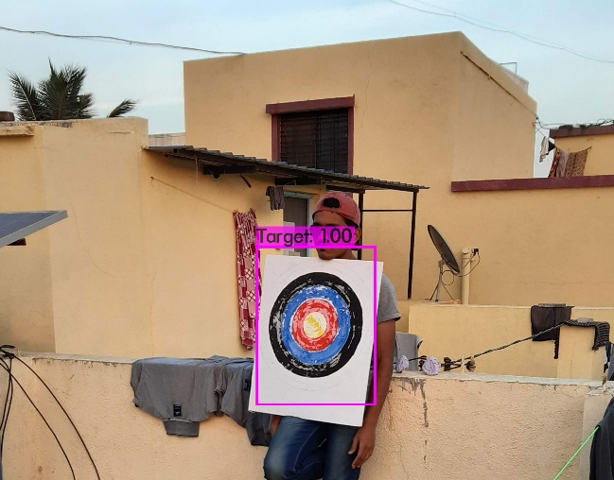
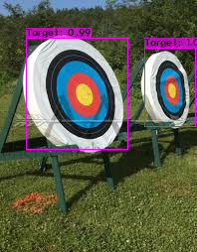
Object Detector Model Training Results
Image 1
Image 2

Slide 16
THANK YOU

