Slide 1
AI101 / MINI PROJECT / GROUP 50
THE TEAM
Four roles. One shared project.
EMPLOYEE
ATTRITION
01
Member 1 — Aniket
Data Exploration and documentation lead
PREDICTION USING LOGISTIC REGRESSION
Member 2 — Jaswanth Adapa
02
Preprocessing & PPT lead
Using workforce data to understand patterns linked with employee exits and build a binary classification model.
03
Member 3 — Kaushal Kejariwal
Model Training and Execution lead
HR ANALYTICS
BINARY CLASSIFICATION
04
Member 4 — Sarthak Nitin Naik
Model Analysis and Video lead
PROJECT REPOSITORY
Replace placeholders with your actual names.
github.com/Aniket-09042008/AI101-Mini-Project-Group-50
PEOPLE ANALYTICS · MACHINE LEARNING · CLASSIFICATION

Slide 2
01 / PROBLEM FRAMING AND DATASET
02
Can HR data help flag employees who may leave?
THE QUESTION
DATASET SNAPSHOT
Why look at attrition?
1,470
35
2
16.12%
• Employee exits affect workforce continuity and planning.
• HR records contain signals such as role, overtime, income and satisfaction.
• Our goal: predict whether an employee stays or leaves.
employee records
original columns
target classes
employees left
TARGET: ATTRITION
0 / STAYED
1 / LEFT
Binary outcome
CLASS DISTRIBUTION
16.12% left · 237 employees
83.88% stayed
1,233 employees stayed
Source: IBM HR Analytics Employee Attrition & Performance · Kaggle
1470 rows × 35 cols
AI101 · EMPLOYEE ATTRITION PREDICTION
GROUP 50

Slide 3
02 / METHOD
03
A simple pipeline from employee records to prediction
01
02
03
04
05
INPUT DATA
EXPLORE
PREPARE
TRAIN
PREDICT
›
›
›
›
CSV dataset
1,470 rows
35 columns
Check data types
Missing values
Duplicates + EDA
Encode categories
Remove redundant fields
80/20 split + scaling
Logistic Regression
max_iter = 1,000
Fit on training set
Test-set classes
Stay (0) / Leave (1)
Probability scores
PREPROCESSING
Removed 4 non-informative columns · One-hot encoded categorical data · Omitted YearsInCurrentRole · Stratified 80% / 20% split
Train: 1,176 rows
Test: 294 rows
43 model input features after preparation
TOOLS USED
pd
Pandas
np
NumPy
plt
Matplotlib
sns
Seaborn
sk
Scikit-learn
data tables
numerical work
plots
statistical visuals
model + metrics
AI101 · EMPLOYEE ATTRITION PREDICTION
GROUP 50

Slide 4
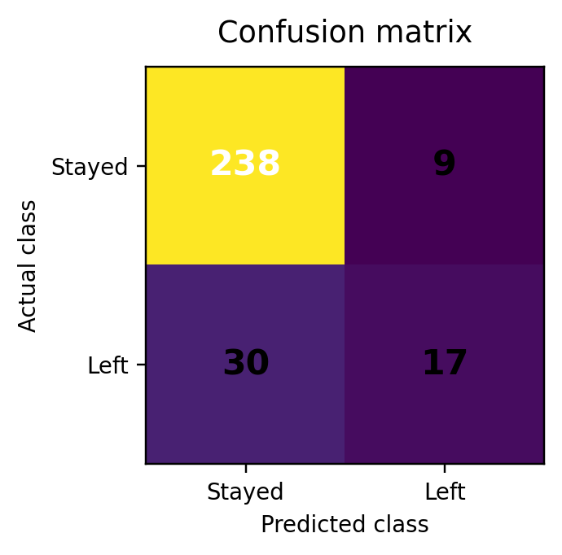
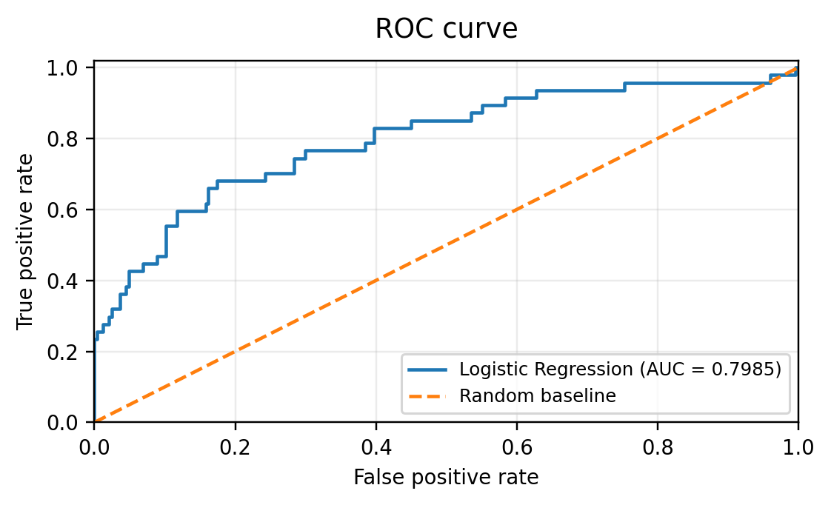
03 / MODEL EVALUATION
04
Performance on the held-out test set
86.73%
65.38%
36.17%
46.58%
0.7985
ACCURACY
PRECISION · LEFT
RECALL · LEFT
F1 · LEFT
ROC-AUC
CONFUSION MATRIX
ROC CURVE
NOTEBOOK RUN OUTPUT
$ python / notebook cell
Model trained successfully
Accuracy: 0.8673
ROC-AUC: 0.7985
Precision-recall average precision: 0.5735
30 actual leavers were missed (false negatives).
AUC = 0.7985 · Above random baseline
Interpretation: accuracy is strong, but recall for the minority “Left” class is lower — class imbalance remains important.
AI101 · EMPLOYEE ATTRITION PREDICTION
GROUP 50

Slide 5
04 / TAKEAWAYS
05
What worked, what needs attention, and who contributed
WHAT WORKED
WHAT NEEDS ATTENTION
• A clear preprocessing workflow made the dataset ready for modelling.
• ROC and precision-recall metrics added context beyond accuracy.
• Only 36.17% of employees who left were detected at the default threshold.
• Future work: test class weights and decision thresholds to improve recall.
TEAM CONTRIBUTIONS
01
MEMBER 1
02
MEMBER 2
03
MEMBER 3
04
MEMBER 4
Data Exploration and documentation lead
Preprocessing & PPT lead
Model Training and Execution lead
Model Analysis and Video lead
Name : Aniket
Name: Jaswanth Adapa
Name: Kaushal Kejariwal
Name: Sarthak Nitin Naik
AI-USE DISCLOSURE
ChatGPT and Claude were used to support coding, clarify machine learning concepts debug errors, and organize the project documentation and presentation
AI101 · EMPLOYEE ATTRITION PREDICTION
GROUP 50

