Slide 1

Design and Development of WalkSense: A Vision-Language Assistant For Real-Time Scene Understanding For Visually Impaired Individuals
A Mid-Semester Progress Report for AIMLCZG628T: DISSERTATION
Student:
ANIKET AYODHYA CHAUHAN (2023AD05122)
Supervisor:
Manish Kumar (Ignisnova Robotics Private Limited, Navi Mumbai)

Slide 2
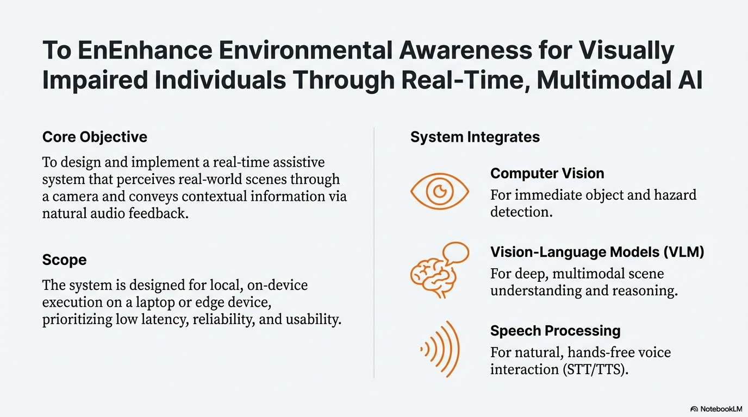

Slide 3






A Safety-Isolated Architecture to Balance Real-Time Perception and Semantic Reasoning
Input Layer Camera Video Source
Microphone
Perception Layer
Handles primary visual processing using Y0L0
for high-speed, deterministic object detection.
Reasoning Layer
Employs a VLM (Qwen3-VLM) for ‘best-effort’ conteKtual understanding from sampled frames.
Perception
Layer
toro Object Detection Module
Safety Criti¢al, Determinisîic
Frame Sampler
Rate Control Composent
Reasoning Layer
\/iSiOfl LaflgU4ge ki0del
Qwen3.¥tN.8e$-EFod,Non.C inc
Scene Understanding
Module
Safety Layer(Isolated)
, Satcty Laycr
Priorité Alert
Generator
A critical component. Rule-based logic acts on
Y0L0’s output to generate priority alerts, completely independent of the slower, non-deterministic VLM.
Orchestration & Interaction Layers
Puse inputs, manage context, and handle user
IJ0, always prioritizing safety alerts.
Orchestration Layer
Fusion Engjne | C0ntert Manager | “ | Decision Router
Interaction
Layer
5peech-toText Module |  | Test.bS ch Module |  | U er Feedbac£ Interface
Design Rationale: This layered, isolated approach ensures that critical safety functions are never blocked or delayed by computationally intensive AI reasoning tasks.
G NotebookLtVi

Slide 4
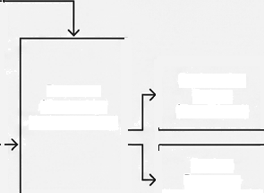
Three Parallel Processing Flows Ensure Deterministic
Safety and Rich Context
PRIMARY SAFETY FLOW (Continuous, Critical)
Ftowt: Primary Safety Flow (Cominuous,
Critical)
Path: Frame Capture —+ Object Detection
(Y0l.0) —› Safery Rules —i Immediate Alert Output.
Characteristics: Always on, deterministic, low-latency. Operates at full frame rate.
— Key Principle: Strict isolation boundary ensures no dependency on AI reasoning for safety.
Camera / Video Source
Object Detection
(YOLO)
(Continuous,
Deterministic)
Safety Rules (Deterministic Logic)
System Alerts (e.g., Emergency Stop)
Frame Capture
(Always on)
Alert Output
(Immediate)
— — — — — — - — — ISOLATION BOUNDARY: No Direct Dependency from Safety to Ai/ Reasoning
— — — — — — — - —
VISION REASONING FLOW (Best Effort) Frame Sampling Vision—Language Scene (Best effort, Model Summary - Slower) (Inferencing) (JSON)
 | Reasoner (Contextual Understanding)
AUDIO QUERY FLOW (On-Demand, Optional) ^{Speech} User Query Reason-filment 6 Recognition _{(0n-demand)} (text/JSOH) (text/JSON)
Flow 2: Vision Reasoning Flow (Best Efiort)
- Path: Frame Sampling —› VLM Scene Summary —› Contextual Reasoned —› Explanation Output.
Gharacteristics: Slower, operates on sampled frames to manage computational load.
Provides deep semantic understanding.
Explanation Output (Text/Visua1)
Spoken Response
(Audio Synthesis)
User Audo (Microphone)
Flow 3: Audio Query Flow (On-Demand, Optional)
Path: Inset Audio —› Speech Recognition -+
User Query —+Reasoner -+ Spoken Response.
- Characteristics: User-initiated for interactive
—
W NotebaokLM

Slide 5



The Technology Stack is Selected for Real-Time Performance
on Consumer-Grade Hardware
Core Models
Object Detection
YOLOv8n (3.2M parameters)
Rationale: Chosen for its high speed (z 30 FPS target) and small footprint, making it ideal for the
safety-critical loop.
Vision- Language Model
Qwen3 Vision-Language Model (Qwen3-VL)
Rationale: Selected for its strong scene understanding and reasoning capabilities, running asynchrOnously in the “best-effort” flow.
System & Hardware
OS: Windows 10/1l
CPU: Quad-core (Intel i5 / Ryzen 5) GPU: NVIDIA (* 6GB VRAM rec.) RAM: * 16 GB
Audio Pipeline
STT: SpeechRecognition library TTS: pyttsx3 (offline synthesis) Latency Target: Sub-second response for alerts
Deployment
Execution: Fully local, on-device Optimization: ONNX export, quantization planned

Slide 6

Project Status: Core System Architecture and All Key Modules are Implemented
Phase 1: Research &
Finalization (Completed)
Phase 2: Core Implementation (In Progress)
Phase 3: Optimization & Validation (Planned)
Literature Review
System Architecture & Tech Stack Finalization
Dataset Preparation
Integration of vision (YOLO), VLM (Qwen), OCR, and speech models.
Establishment of the main processing engine and interaction controller.
Real-Time Execution & Optimization (ONNX/TFLite conversion)
Testing & User Feedback Loop
Final Refinements & Documentation
G
NotebookLM

Slide 7
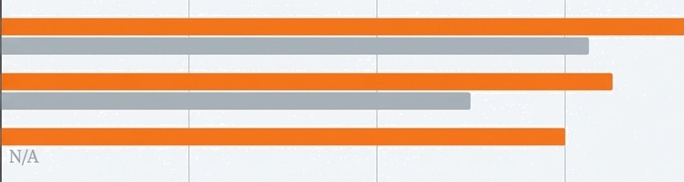
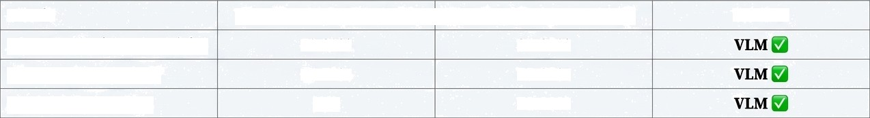
Key Finding #1: VLM Demonstrates Superior Spatial Accuracy Over Heuristic Methods
Context: We empirically tested the accuracy of spatial reasoning using two methods: a heuristic based on YOLO's bounding box position ("YOLO Method") and direct querying of the VLM ('VLM Method").
Direction (Left/Center/Right) Distance (Categorical) Spatial Relationships
0
25
50
Accuracy (%)
75
100
Metric | YOLO Method (Heuristic) | VLM Method (Reasoning)
Direction (Lefi/Center/Right) | 70-80% | 85-95°A
Distance (Categorical) | 60-70% | 75—8S°A
Spatial Relationships | N/A | 70-80%
Winner
Implication: This validates our hybrid approach. We use YOLO for its speed in the safety loop, but rely on the slower, more accurate VLM for answering detailed spatial user queries.
G
NotebookLtVi

Slide 8
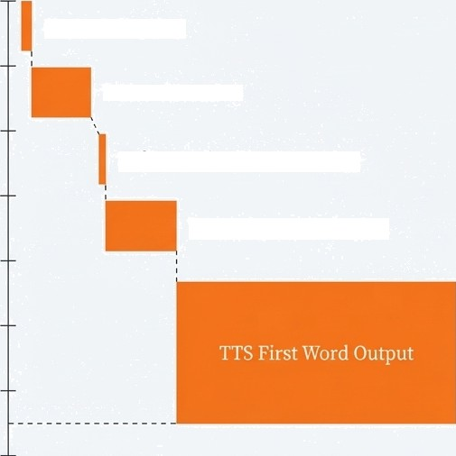
Key Finding #2: The Critical Safety Path Delivers Alerts from Detection-to-Speech in Under 65Oms
Oms
””End-to-End Latency Breakdown (Critical Path)
Camera Capture
100ms
YOLO Detection
200ms
Safety Evaluation & Routing
300ms
TTS Subprocess Spawn
400ms
500ms
Stage | Latency | Cumulative
Camera Capture | 1-5ms | l-5ms
YOLO Detection | 30-50ms | 31-5Sms
Safety Evaluation & Routing | <2ms | 32-57ms
TTS Subprocess Spawn | 50-100ms | 82-157ms
TTS First Word Output | 200-500ms | 282-657ttis
Conclusion: Total latency is 280-6s0ms. The system successfully meets the real-time requirement for its most critical function, proving the effectiveness of the safety-isolated architecture.
600ms
700ms
G
NotebookLM

Slide 9
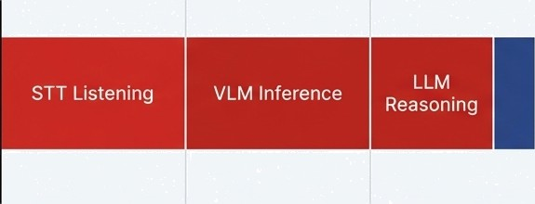
Identified Challenge: The Full VLM+LLM Pipeline Introduces Significant User Query Latency
Context: While the safety path is fast, queries requiring fresh visual analysis and language model reasoning are currently very slow, impacting the user experience.
Technical Editorial
Latency Breakdown (Slowest Path)):
STT Listening: 2.0 - 5.0 seconds
VLM Inference: 2.0 - 5.0 seconds
LLM Reasoning: 1.0 - 3.0 seconds
Other Overhead (TTS, etc.): 0.5 -
1.2 seconds
Other Overhead
0s
5s
1Os
15s
2os
TOtat latency: 5.5to 19.2 seconds.
Implication: This performance is unacceptable for a fluid interactive experience. This bottleneck is a primary focus for our future optimization work.
G
NotebookLtVi

Slide 10






Rigorous Self-Critique Has Identified Key Architectural Collisions for Refinement
Introduction: Beyond performance metrics, we've identified several logic and state management
conflicts that need to be addressed to improve system robustness.
1 Query State Synchronization
Issue
The user query state is tracked in two separate locations, creating a race condition that can lead to duplicate processing or missed queries.
2. Dual Redundancy Checking
to independent redundancy filters (one for
TTS output, one for VLM history) exist with
different thresholds, causing inconsistent message suppression.
3. STT Blocking
Despite threading, the current Speech to-Text implementation blocks the main loop for 2 5 seconds during listening, freezing real-time detection.
4 Spatial TTS Interrupts
Automatic announcements for nearby objects (a WARNING) can internipt a user-requested scene description or query answer (a RESPONSE), violating conversational priority.
G
NotebookLM

Slide 11
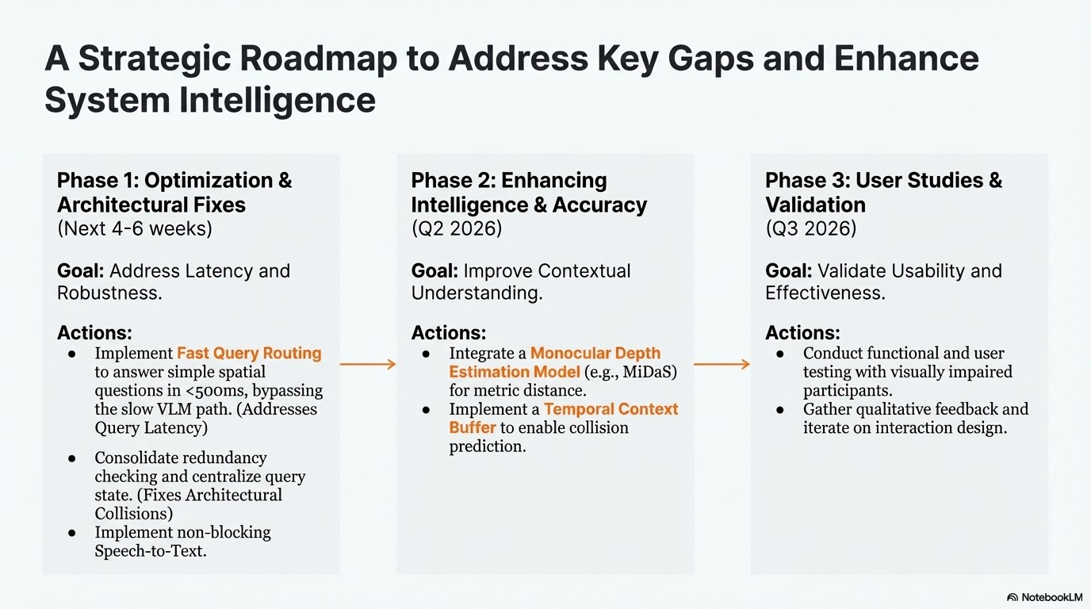

Slide 12
WalkSense Delivers a Novel and Reusable Architectural Pattern for Assistive Systems
Summary of Key Contributions
1. A Validated Hybrid Architecture
Successfully demonstrates how a real-time safety loop (30 50ms) can coexist
with a deep semantic reasoning loop (2-Ss) without compromising critical alert speed.
2. An Adaptive Multi- Tier Query Design
A novel routing pattern that can answer -70⁰zf of user queries in under
<500ms by using the fastest available data source, reserving the slow
VLM/LLM path for only the most complex questions.
3. Empirical Finding on VLM Spatial Accuracy Provides clear evidence
that modern VLMs are superior to heuristic-based methods for spatial reasoning tasks, justifying their inclusion despite higher latency.
Broader Impact: This work provides a robust, safety-first blueprint
for the next generation of AI-powered assistive technologies.

