Slide 1
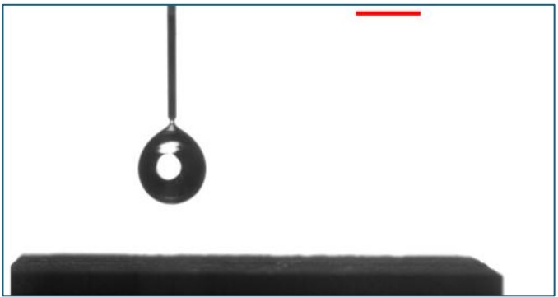
ME3101 • PROJECT 1
Image Processing of
Droplet Dynamics on a
Superhydrophobic Surface
Image-based measurement of droplet deformation,
motion and rebound behaviour
Aniket Kumar
Roll No.: 2401ME12
IMAGE-BASED ANALYSIS
Deformation • Motion • Rebound
Figure 1: Reference frame with 2 mm scale bar
ME3101 • Project 1 • Image Processing
01

Slide 2
1
My Approach
OVERALL IMPLEMENTATION PIPELINE
Video Input
Grayscale
Calibration
Segmentation
Boundary +
Bounding Box
Frame Tracking
Geometry
Motion
Bounce Detection
HOW THE ANALYSIS WAS BUILT
KEY IMPLEMENTATION VALUES
● The supplied high-speed video is processed frame by frame rather than analysing only a single image.
● Each frame is converted to grayscale so the intensity contrast between the droplet and background can be used for segmentation.
● The 2 mm scale bar from the reference image is used to establish the pixel-to-millimetre relationship.
● Because the reference image and video have different dimensions, the scale is adjusted to the actual video resolution.
● A binary mask is generated using intensity thresholding, followed by removal of the known nozzle/support and substrate regions.
● Internal gaps are filled and the largest remaining connected dark region is retained as the droplet.
● The detected region is then used consistently to obtain dimensions, area, centroid and top/bottom boundary positions.
● Finally, the centroid trajectory is analysed to identify repeated impact-rebound events.
512 × 800
Frame resolution (H × W)
0.01765229
Calibration (mm/pixel)
The important design choice is to keep the same detected droplet region as the common input for both geometry and motion measurements.
ME3101 • Project 1 • Image Processing
02

Slide 3
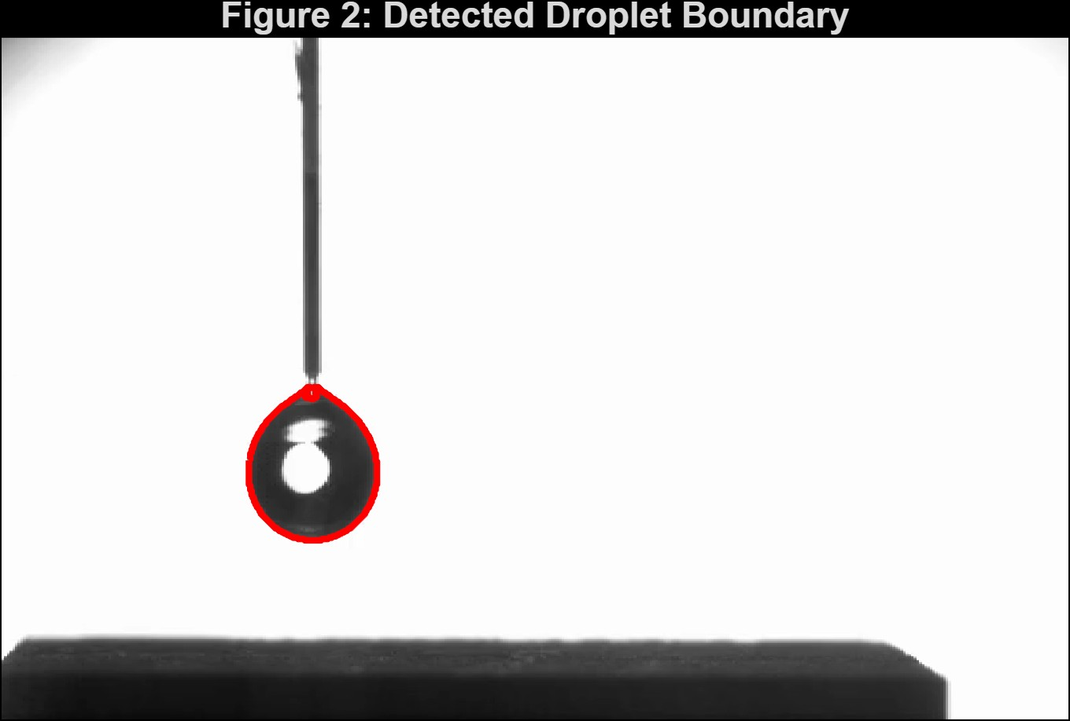
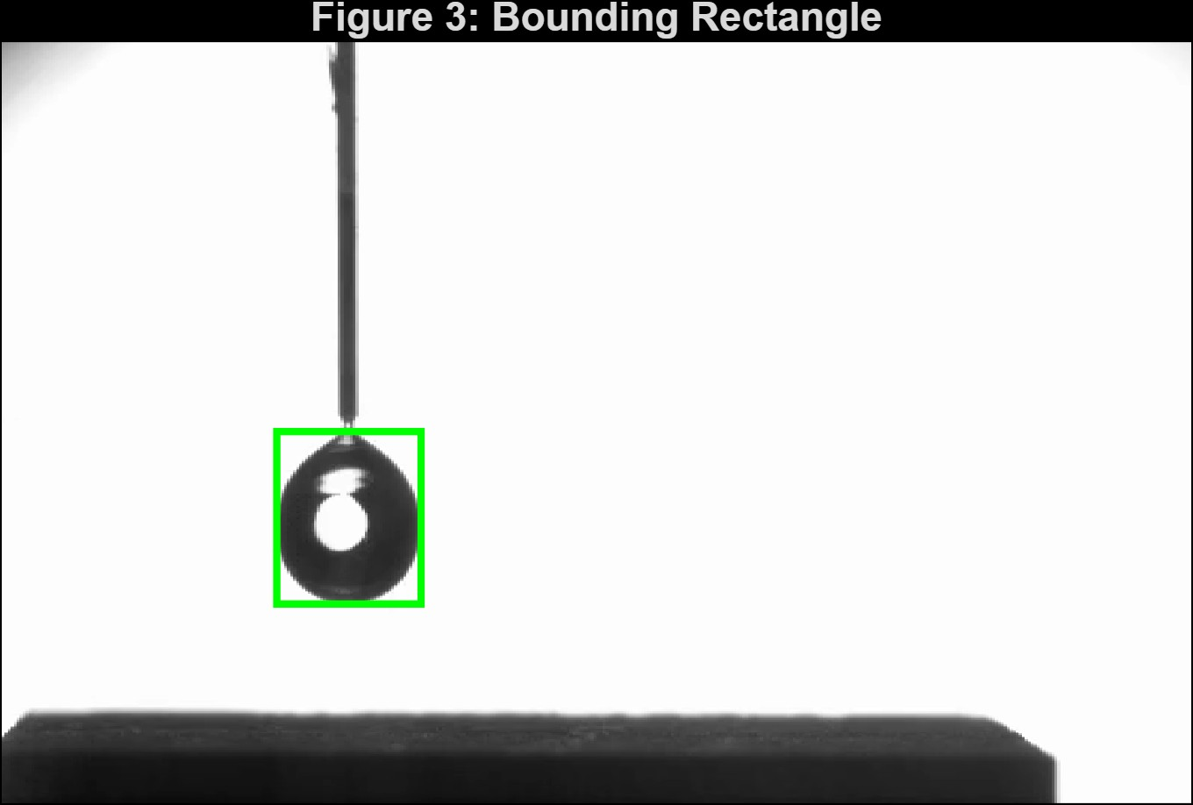
2
Droplet Detection
DETECTED IMAGE RESULTS
PROCESSING SEQUENCE
01
Grayscale frame
WHY THIS APPROACH?
02
Intensity thresholding
The droplet is visible as a comparatively dark connected region. A simple threshold alone could also select parts of the nozzle or substrate. Restricting the region of interest removes these known unwanted regions before connected-component selection.
03
Remove nozzle / support
Figure 2: Detected Droplet Boundary
04
Remove substrate
05
Fill enclosed regions
KEY PROCESSING CHOICE
06
Connected-component analysis
Thresholding + spatial restriction + largest connected component gives a more reliable droplet mask than thresholding alone.
07
Select largest dark region
Figure 3: Bounding Rectangle
8,356 px
2.6038 mm²
Projected droplet area
Calibrated area
Detection output = droplet mask → boundary → bounding rectangle
ME3101 • Project 1 • Image Processing
03

Slide 4
3
Tracking & Measurements
MEASUREMENTS EXTRACTED FROM EACH FRAME
MEASUREMENT LOGIC
01 HORIZONTAL / VERTICAL SIZE
Width and height of the detected bounding rectangle provide the horizontal and vertical droplet dimensions.
02 CENTROID POSITION
The centroid coordinates are calculated for every frame. The vertical centroid position relative to the substrate provides the motion trajectory.
03 VOLUME ESTIMATION
The droplet is treated as an axisymmetric ellipsoid. The measured dimensions are converted to millimetres before estimating the volume.
Annotated droplet: bounding box
04 BOUNDARY MOTION
The uppermost and lowermost points of the detected region are tracked to observe vertical deformation and rebound.
WIDTH
HEIGHT
CENTROID
TOP
BOTTOM
All measurements originate from the same segmented droplet region.
CALIBRATION: 2 mm reference scale → 0.01765229 mm/pixel
ME3101 • Project 1 • Image Processing
04

Slide 5
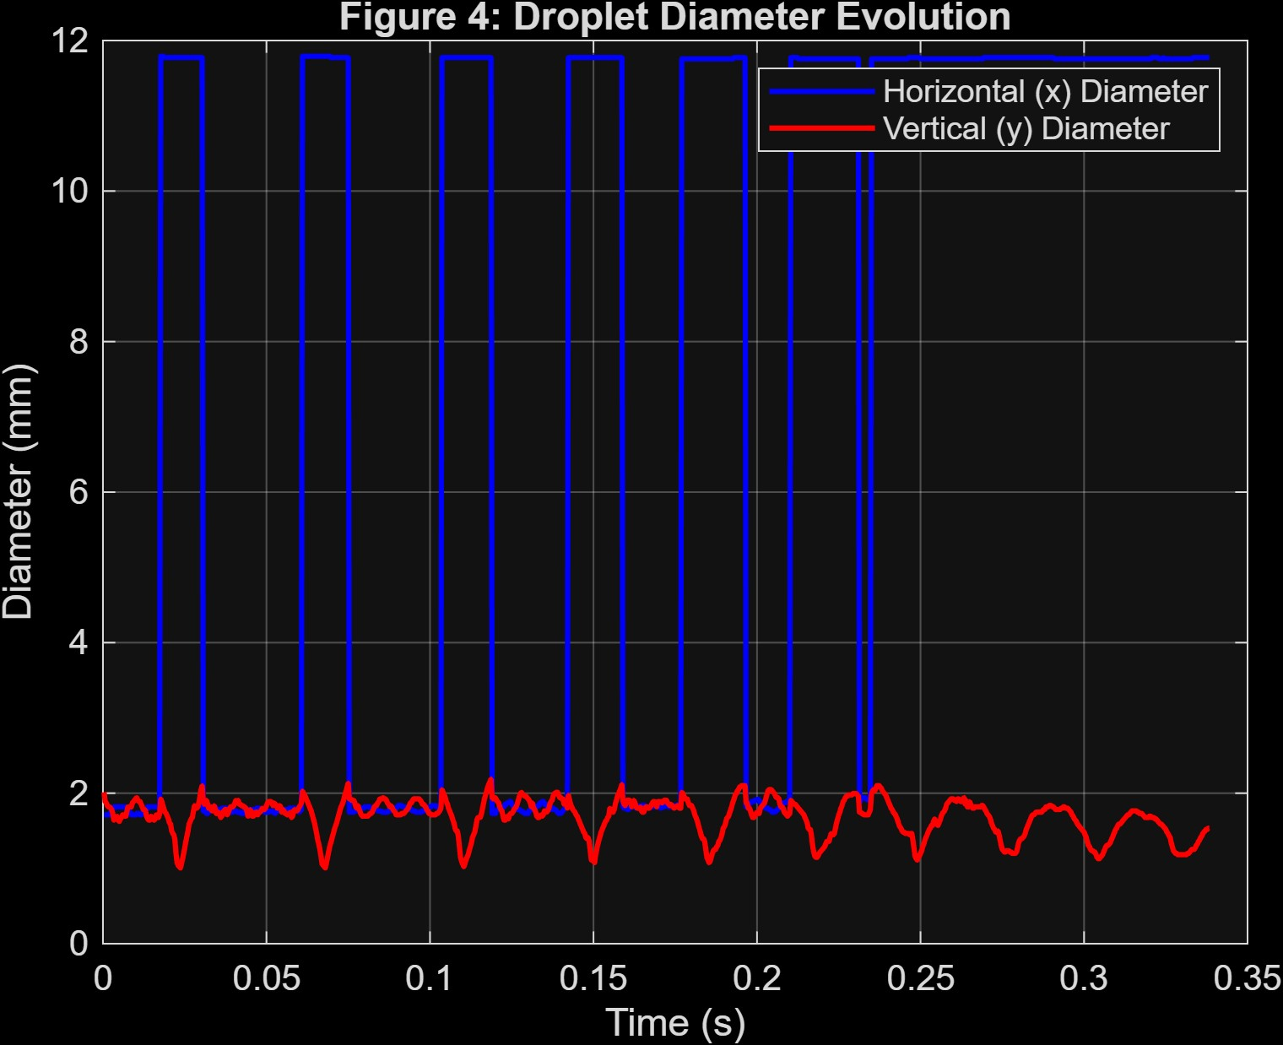
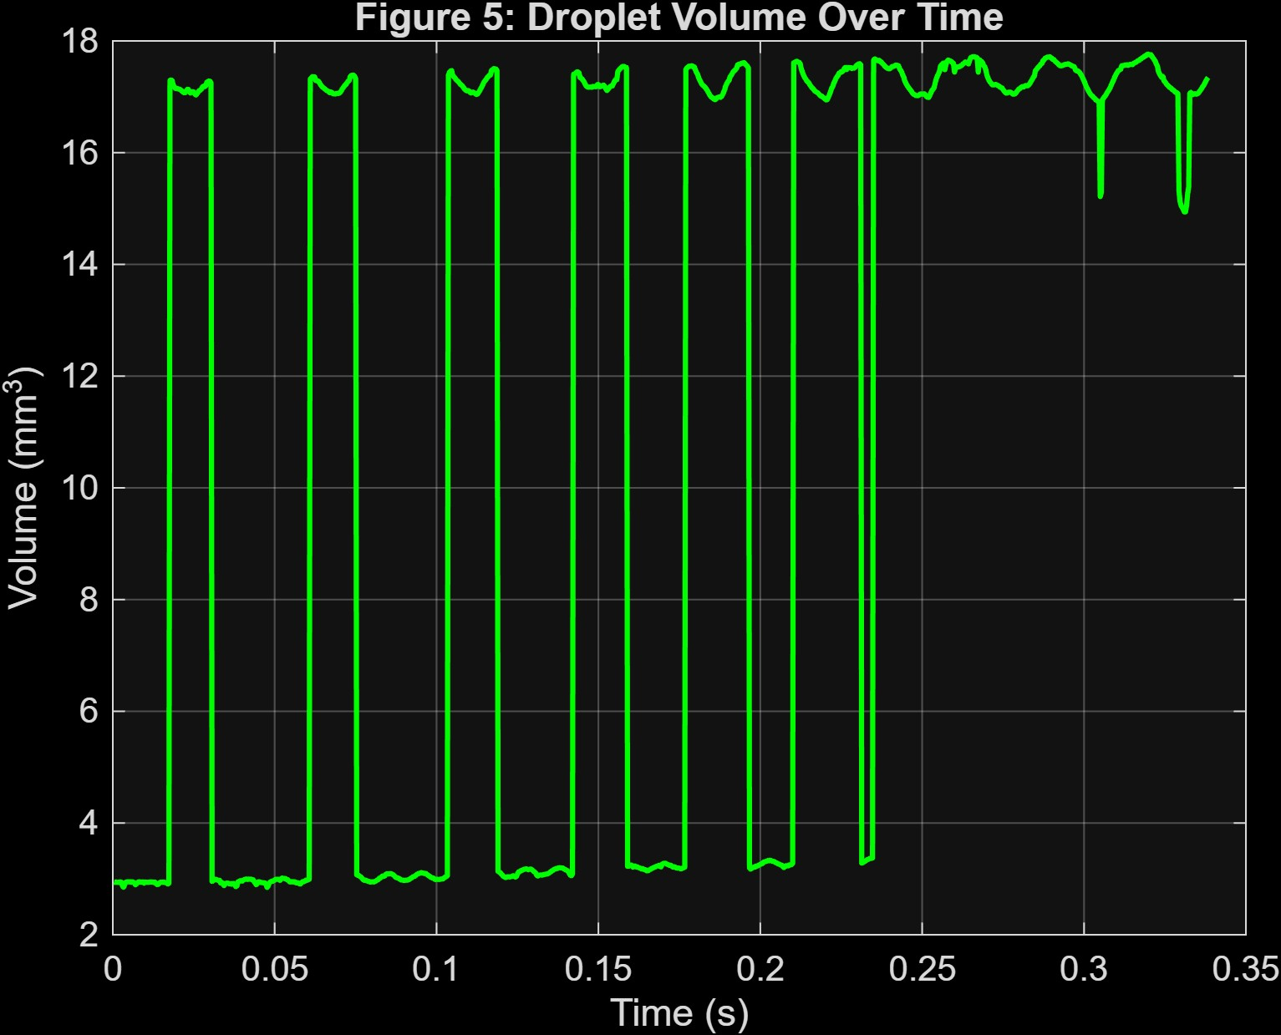
4
Key Results: Droplet Geometry
GEOMETRY EVOLUTION
WHAT THE GEOMETRY SHOWS
Diameter evolution
● Horizontal and vertical dimensions do not change identically during impact.
● The droplet spreads laterally while becoming vertically compressed.
● The separation between the two dimensions is therefore an indicator of deformation.
● During later rebounds, the deformation becomes progressively smaller.
Figure 4: Droplet Diameter Evolution
Volume estimate
● Volume is calculated from the detected geometry using the ellipsoidal approximation.
● The estimate changes as the measured droplet dimensions change.
● It should be interpreted as an image-based estimate rather than a direct 3D measurement.
Figure 5: Droplet Volume Over Time
INITIAL PROJECTED AREA = 2.6038 mm²
The diameter plot is primarily a deformation measurement; the volume plot is a consistency check on extracted geometry.
ME3101 • Project 1 • Image Processing
05

Slide 6
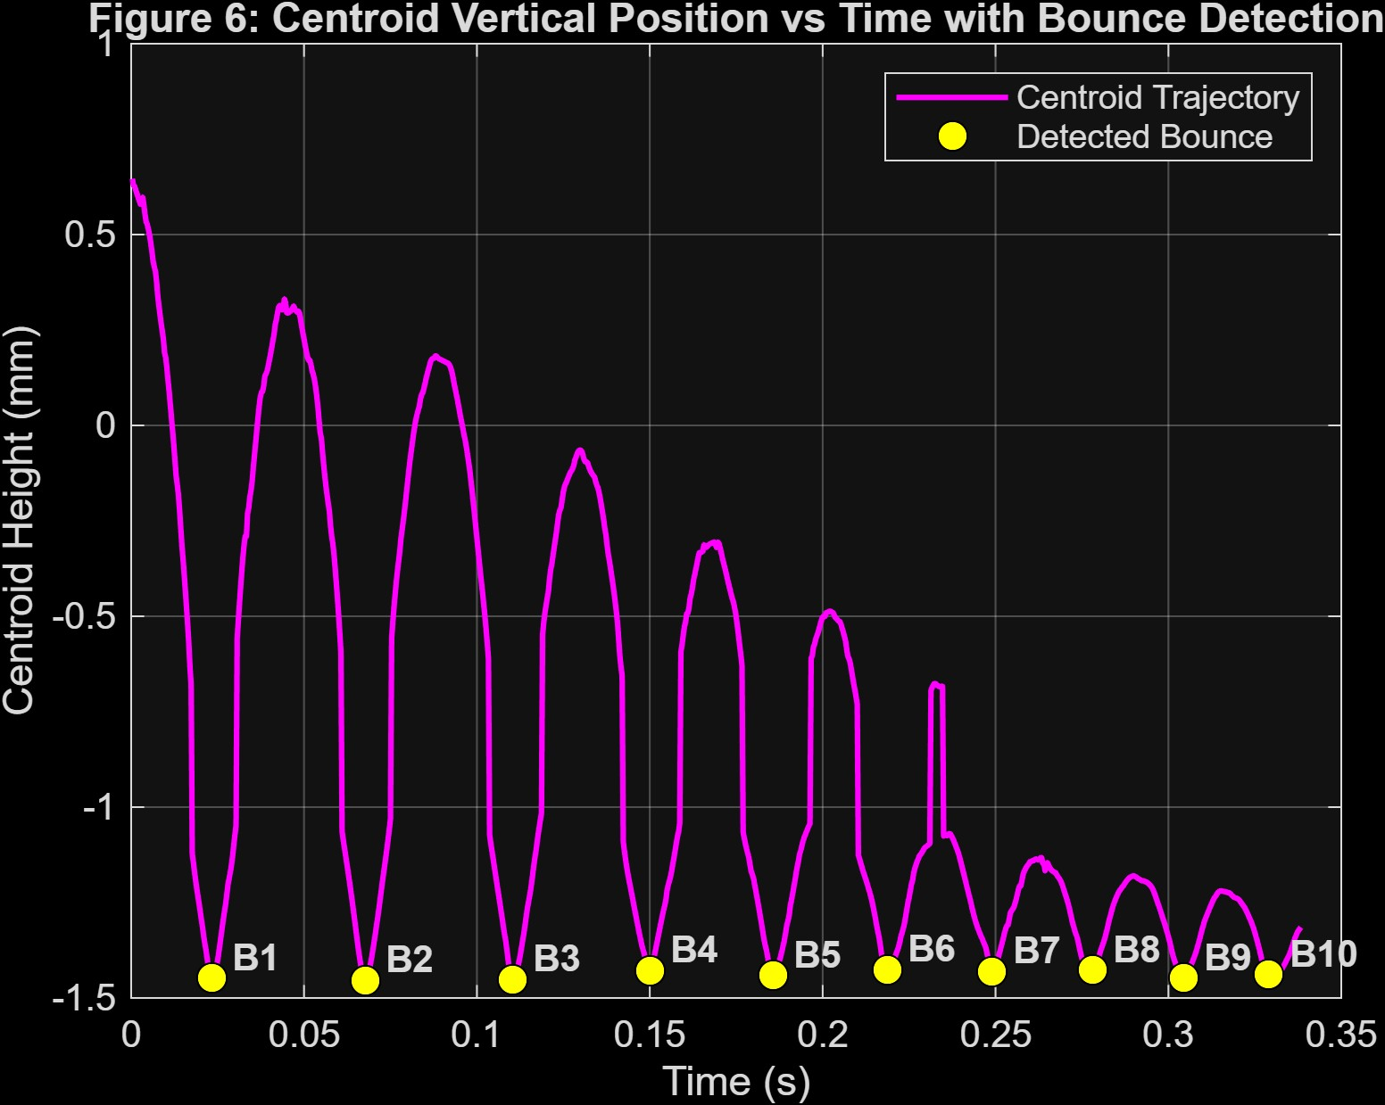
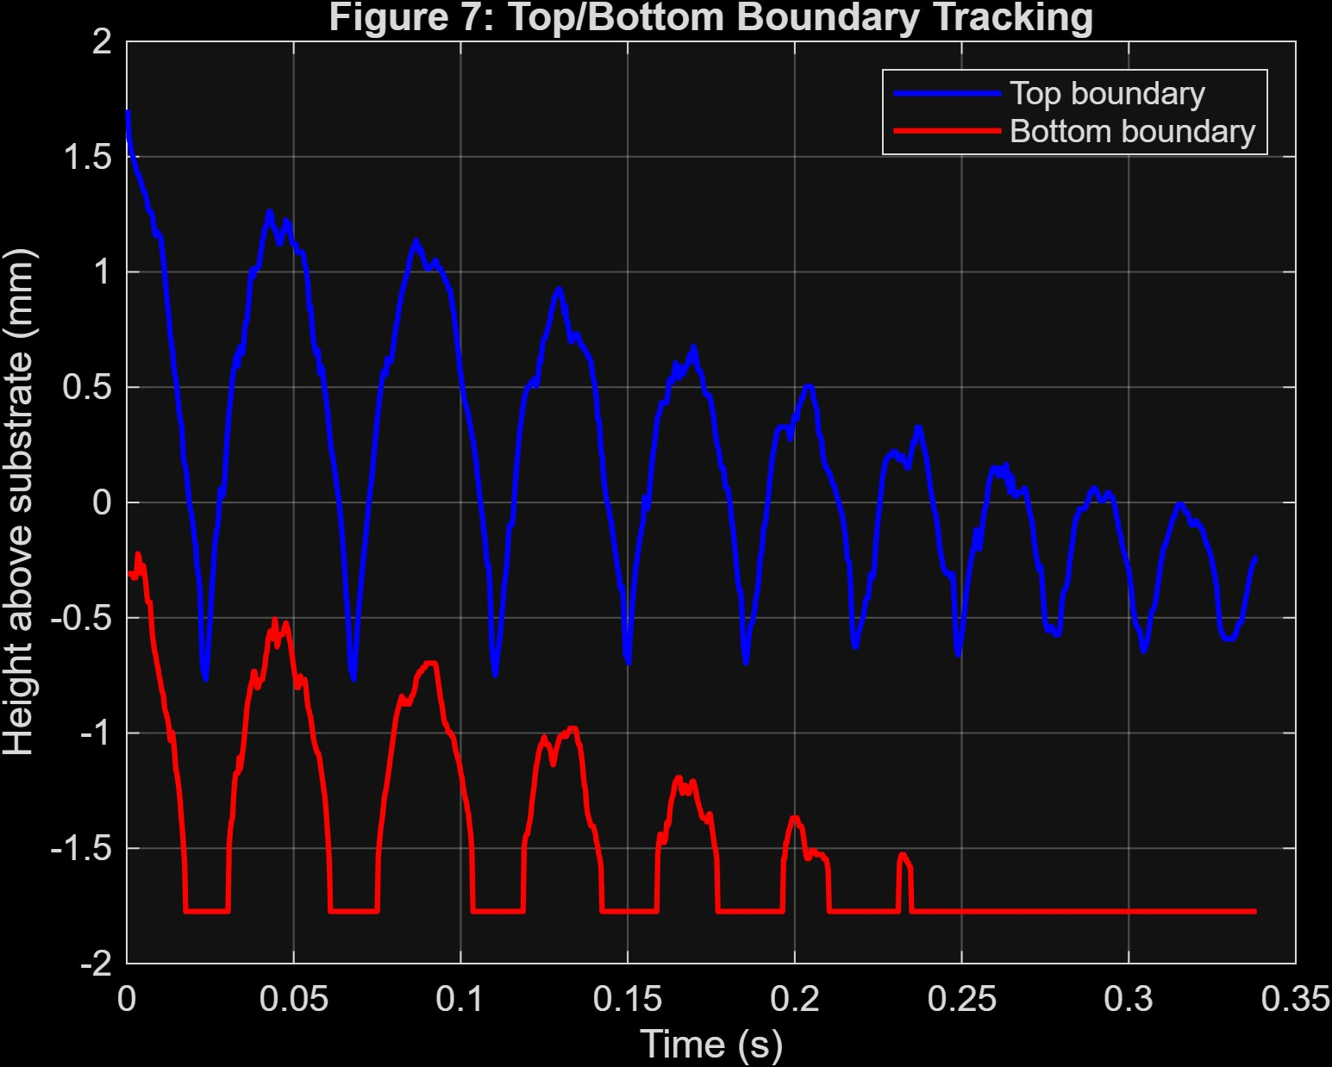
5
Key Results: Motion & Bounce
CENTROID VERTICAL POSITION
TOP / BOTTOM BOUNDARY TRACKING
Figure 7: Top and Bottom Boundary Tracking
BOUNCE DETECTION LOGIC
Centroid trajectory
↓
Smooth trajectory
↓
Locate downward minima
↓
Minimum separation + height criterion
Figure 6: Centroid Vertical Position vs Time — B1 to B10
10 BOUNCES
Frames :- 71 | 204 | 332 | 451 | 558 | 657 | 748 | 835 | 914 | 988
Free fall → first impact → rebound → repeated impacts → decreasing oscillation amplitude
Why centroid?
Each impact-rebound cycle creates a distinct downward minimum. Smoothing reduces small frame-to-frame fluctuations before minima detection.
ME3101 • Project 1 • Image Processing
06

Slide 7
6
Analysis & Interpretation
The plots describe what happened; this slide explains the physical meaning.
DROPLET DEFORMATION
IMPACT & REBOUND
ENERGY CONVERSION
During impact, the droplet spreads laterally and becomes vertically compressed. The increasing difference between horizontal and vertical dimensions indicates non-spherical deformation.
The downward motion of the centroid stops when the droplet reaches the surface. Upward motion after this point represents rebound.
Kinetic energy associated with downward motion is temporarily stored in deformation and surface-related effects. The rebound does not recover all of the initial motion.
SUCCESSIVE BOUNCES
SURFACE BEHAVIOUR
WHAT THE IMAGE ANALYSIS ADDS
Each later rebound reaches a smaller excursion from the surface. The decreasing oscillation amplitude indicates progressive energy dissipation.
Repeated separation after impact indicates that the droplet continues to rebound instead of immediately remaining attached to the surface.
The method converts visual motion into measurable quantities: size, centroid position, boundary position and bounce timing.
KEY TAKEAWAY • Decreasing centroid oscillation amplitude provides the clearest evidence of progressive energy loss.
ME3101 • Project 1 • Image Processing
07

Slide 8
7
Method Evaluation & Conclusions
METHOD EVALUATION
CONCLUSIONS
What worked
01
512 × 800 px
● Threshold-based segmentation isolated the droplet from the high-contrast background.
● Restricting the upper and lower regions reduced interference from the nozzle and substrate.
● The same detected region supplied geometry, centroid and boundary measurements.
● Centroid-based analysis identified 10 bounce events.
Frame resolution
02
0.01765229
mm/pixel calibration
03
2.6038 mm²
Limitations
Initial projected area
● Detection depends on sufficient contrast between the droplet and background.
● Fixed upper/lower removal regions are specific to the present video geometry.
● Small segmentation changes can affect measured dimensions and calculated volume.
● The volume is an approximate geometric estimate rather than a direct 3D measurement.
● Calibration depends on scaling the reference image to the actual video dimensions.
10
04
Bounce events detected
05
↓ amplitude
Progressive energy loss
Possible improvements
Adaptive thresholding • Automatic nozzle/substrate localization • Robust contour tracking • Profile-based volume estimation
Image processing converts droplet motion into measurable evidence.
ME3101 • Project 1 • Image Processing
08

