Slide 1

PYTHON PROJECT
FRAUD DETECTION MODEL

Slide 2


Project Overview
2
The dataset contains 1.3M credit card transactions with 24 features ( time, merchant, location, and cardholder info). Each transaction is labeled as fraud or not ( binary target variable : is_fraud )
Goal: Maximize fraud detection (recall) while minimizing false positives to maintain security and
trust.

Slide 3
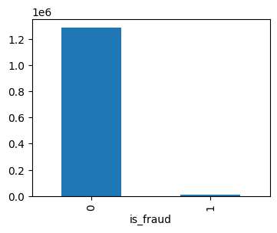
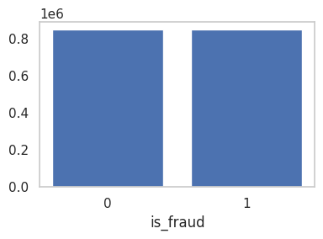
Target Variable
3
Target Variable: is_fraud (Binary)
0: Legitimate
1: Fraudulent
The data was highly imbalanced, with very few fraud cases.
To address this, I applied SMOTE after splitting the data to:
Generate synthetic fraud samples
Improve recall
Help the model learn fraud patterns without hurting precision
BEFORE SMOTE
AFTER SMOTE

Slide 4
Data Preprocessing
4
Before building the model, the dataset required careful cleaning and transformation to ensure the features were usable and meaningful for training. Here's what was done:
📅 1. Datetime Features
Converted trans_date_trans_time to datetime
Extracted hour & dayname to spot time-based fraud
👤 2. Age Calculation
Used dob to get customer age at transaction time
Age reveals fraud trends by demographics
📍 3. Distance Calculation
Used lat/long of customer & merchant
Applied geodesic distance (km)
🧹 4. Cleanup
Dropped redundant & ID columns

Slide 5
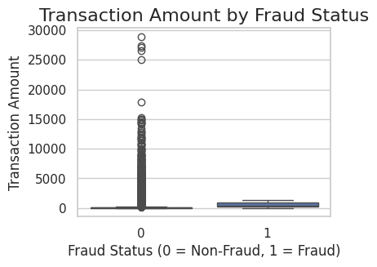
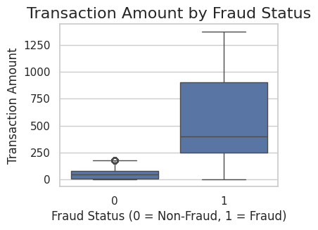
Outlier Treatment
5
🔹 After Treatment
More balanced distribution
Better fraud vs non-fraud separation
Removed extreme amt values using custom rules to boost model accuracy
🔹Before Treatment
Many outliers in non-fraud transactions
Skewed distribution
Fraud vs non-fraud hard to separate
🔹 Methodology
Removed transactions > $17,000
Dropped non-fraud cases > $175

Slide 6
Statistical Feature Selection
6
CATEGORICAL (CHI-SQUARE)
To identify categorical features that are statistically associated with the target variable is_fraud
If the p-value is less than 0.05, it means the result is statistically significant
Feature | p-Value | Significance
category | 1.000 | ❌ Not Significant
gender | 1.000 | ❌ Not Significant
state | 1.000 | ❌ Not Significant
hour | 1.000 | ❌ Not Significant
None of the tested categorical features had a p-value < 0.05, so they are not statistically significant

Slide 7
Statistical Feature Selection
7
CONTINUOUS (ANOVA)
To identify continuous features that are statistically associated with the target variable is_fraud
If the p-value is less than 0.05, it means the result is statistically significant
Feature | p-Value | Significance
amt | 0.0000 | ✅ Significant
zip | 0.0285 | ✅ Significant
city_pop | 0.0011 | ✅ Significant
age | 8.88-40 | ✅ Highly Significant
distance_from_home | 0.6249 | ❌ Not Significant
Since amt, zip, city_pop, age has p-value < 0.05 this means they are statistically significant

Slide 8
Feature Scaling
8
🔍 Objective
Ensure all numerical features are on the same scale to improve model performance.
Prevent features with larger ranges from dominating others during training
⚙️ Method: Min-Max Scaling
Scales each feature to a range between 0 and 1.
✅ Benefits
Helps algorithms like Logistic Regression to perform better.
Speeds up convergence in gradient-based models.
Ensures fair feature contribution in distance-based calculations.

Slide 9
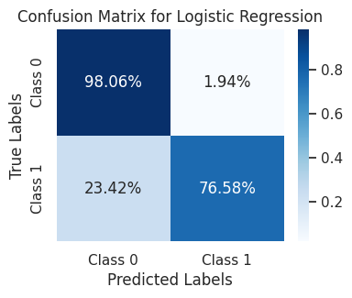
Model Building– Logistic Regression
9
🧠 Model Used:
Logistic Regression with L2 regularization
Parameters:penalty='l2', solver='liblinear'
📈 Performance on Test Data:
Metric | Class 0 (Not Fraud) | Class 1 (Fraud)
Precision | 1.00 | 0.20
Recall | 0.98 | 0.77
F1-Score | 0.99 | 0.31
Highest Precision and F1-score across all the models
Low Recall means it does not capture fraud Transaction Effectively.

Slide 10
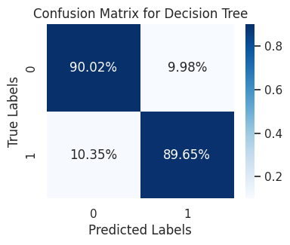
Model Building– Decision Tree
10
🧠 Model Used:
Decision Tree Classifier
Criterion: Entropy (Information Gain),Max Depth: 4
📊 Model Evaluation on Test Data
Metric | Class 0 | Class 1
Precision | 1.00 | 0.05
Recall | 0.90 | 0.90
F1-Score | 0.95 | 0.10
Support (Samples) | 363,742 | 2,242
High Recall but precision as well as F1-score is extremely poor
Lots of false alarms.

Slide 11
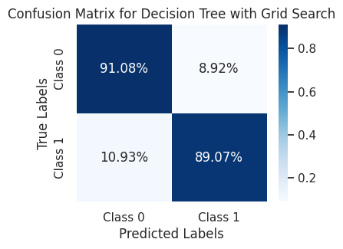
11
Model Building– Decision Tree
With GridSearch CV
🧠 Model Used: DecisionTreeClassifier(random_state=42)
Grid Search Parameters: criterion: ['gini', 'entropy'] ,splitter: ['best'],max_depth: [3, 5, 10],min_samples_split: [5, 6],min_samples_leaf: [1, 2] ,max_features: ['sqrt', 'log2']
Cross-Validation: 5-fold
Scoring Metric: f1_weighted
📊 Model Evaluation on Test Data
Class | Precision | Recall | F1-Score | Support
0 | 1.00 | 0.91 | 0.95 | 363,742
1 | 0.06 | 0.89 | 0.11 | 2,242
Accuracy |  |  | 0.91 | 365,984
Slightly Better than plain DT but still bad precision

Slide 12
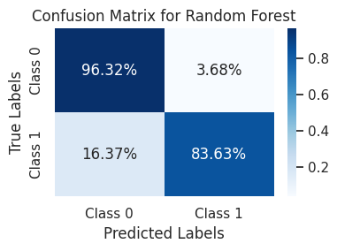
12
Model Building– Random Forest
🧠 Model Used:
Algorithm: Random Forest Classifier
Parameters:
max_depth=6
n_estimators=500
criterion='gini'
📈 Model Performance on Test Set
Class | Precision | Recall | F1-Score | Support
0 | 1.00 | 0.96 | 0.98 | 363,742
1 | 0.12 | 0.84 | 0.21 | 2,242
Most Balanced Model

Slide 13
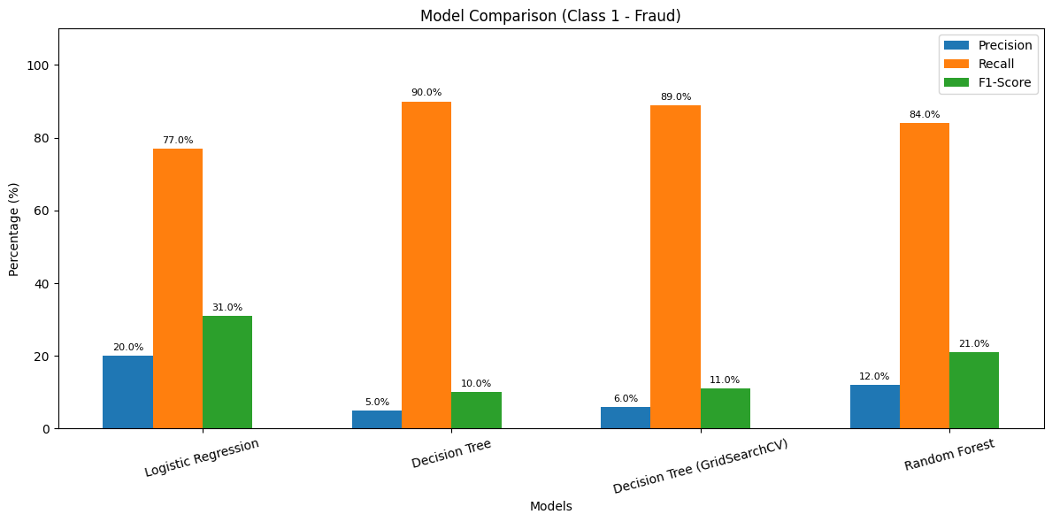
Model Comparison Graph
13
Model Performance Summary:-
Logistic Regression showed strong performance across all metrics: Precision, Recall, and F1-Score.
Plain Decision Tree had higher Recall but performed poorly overall due to class imbalance.
Decision Tree with GridSearchCV improved over the plain version.
Random Forest delivered the most balanced performance across all metrics.

Slide 14
Model Selection Justification
14
RANDOM FOREST
Why Random Forest?
High Recall for Fraud (Class 1):
Achieved 84% recall, capturing most fraud cases — crucial for fraud detection.
Balanced Performance:
Precision for fraud was 12%, but F1-score outperformed most models.
Maintains a good balance between false positives and false negatives — minimizing customer disruption.
Cross-Validation:
Average CV accuracy of 98%, indicating strong generalization.
🔍 Summary:
Random Forest was chosen due to its high recall, balanced F1-score,Precision and strong cross-validation performance — making it a reliable and effective choice for a high-stakes fraud detection system.

Slide 15

THANK
YOU

