Slide 1
SNV Detection Tool
Implementation of python 2 Tkinter module for making GUI

Slide 2
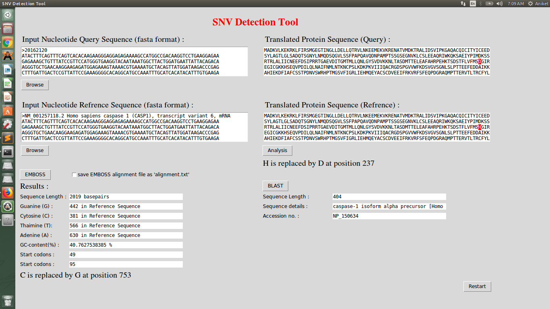

Slide 3
Objectives
Global alignment of two provided nucleotide sequences (query & reference) using EMBOSS.
Give ‘SNP call’ from given nucleotide sequences and identify its position in the sequence
Give Translated protein query and reference sequences
Corrosponding change in amino acid in protein sequence due to SNP if any (Highlighted in red)
BLAST the transleted refrence protein sequence to get some information

Slide 4
Modules used
Python2 modules:
  Tkinter
  tkFileDialog
  ttk
  sys
  os
  Biopython module
User defined modules:
  nucleotide (to perform nucleotide sequence operations)
  protein (to perform protein sequence operations)

Slide 5
Features included in tool by using Tkinter
Text and Text formatiing
Entry Box : to enter a text data manually or by copy paste it from somewhere
Browse button : to browse a file and copy data from file into coresponding entry box
Checkbox : to check and uncheck for given process to happen or not
Highlighted Text : highlight part of text in entry box
Multiple small entery boxes to give statastical outputs from the given prosses
Restart Button : to reset all program / rerun program

Slide 6
User Defined Modules
nucleotide
  DoEmboss()
  SeqStats()
protein
  GetProtein()
  CompareProtein()
  blast()

