Slide 1
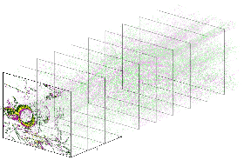
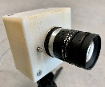
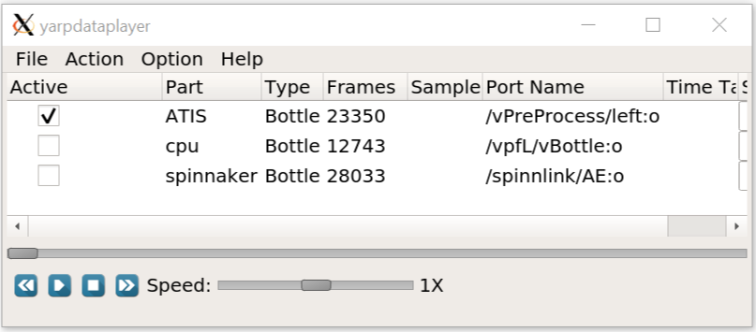
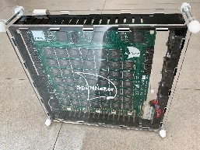
Laptop/CPU
yarpview
event-camera/yarpdataplayer
vPreProcess
vFramer
vParticleFilterTracker
yarpview
SpiNNaker

