Slide 1
PRACTICAL CASE STUDY 11
E-Commerce Sales Analytics
using DuckDB
A practical data platform that cleans historical sales, answers business questions and processes new orders through RabbitMQ
TEAM MEMBERS
Member 1 Harsh Birje
Member 2 Aayush Chavanke
Member 3 Aniket Nikam
Member 4 Lokesh Ture
Python · DuckDB · SQL · Parquet · FastAPI · RabbitMQ · Streamlit
github.com/Aniket-Nikam/E-Commerce-Sales-Analytics-Data-Engineering-
Presenter: Harsh Birje
Notes:
Harsh Birje speaking guide
Introduce the selected practical topic: E-Commerce Sales Analytics using DuckDB, SQL and Python.
State the extension clearly: the project covers both batch analytics and strict event-driven ingestion through RabbitMQ.
Mention that the repository, report, evidence and runnable code are part of the submission.
Handoff: Harsh Birje continues with the problem and scope.

Slide 2
02
Why this data engineering project is needed
The business problem
What we built and why
Raw sales files contain duplicates, missing IDs, invalid numbers and inconsistent labels. Direct analysis would produce incorrect revenue and unreliable decisions.
01
Clean historical data
Prevents bad rows from changing KPIs
02
Model a warehouse
Why engineering is required
Makes repeated analysis fast and consistent
The pipeline creates one trusted definition of every metric before anyone sees a chart.
Questions the platform answers
03
Explain business results
Turns SQL output into decisions
How much realized revenue did the business generate?
Which categories and regions drive performance?
How quickly can storage formats answer the same query?
Can a validated order survive a broker and reach the dashboard once?
04
Process new orders
Keeps ingestion working during traffic bursts
Inputs: reproducible CSV, public API snapshot and continuously generated demo events
Presenter: Harsh Birje
E-Commerce Sales Analytics · DuckDB + RabbitMQ
Notes:
Harsh Birje speaking guide
Explain that the historical dataset is synthetic and deterministic. It contains deliberate defects so cleaning can be demonstrated safely and repeatedly.
The public DummyJSON snapshot adds a current external API source. The streaming simulator adds new events continuously, but it does not represent a real company's orders.
Define success: valid data, reusable SQL, measurable query performance, visible business insights and idempotent live ingestion.
Rubric coverage: environment setup, dataset load, transformations, optimization, captured output and performance analysis.

Slide 3
03
Batch and streaming serve different timing needs
BATCH LANE
CSV + API
Python + SQL
DuckDB
Parquet
SQL views
Streamlit
raw inputs
clean and type
star schema
year/month
OLAP metrics
decisions
STREAMING LANE
Simulator
FastAPI
RabbitMQ
Consumer
DuckDB
Streamlit
1 event/sec
validate + 202
durable queue
manual ACK
idempotent stage
5 sec refresh
Why two lanes
Batch processing rebuilds accurate history in bulk. Streaming processes one new event at a time within seconds. Separate DuckDB files avoid write contention, while the dashboard presents both views together.
Presenter: Harsh Birje
E-Commerce Sales Analytics · DuckDB + RabbitMQ
Notes:
Harsh Birje speaking guide
Walk through the upper lane first. CSV and API data enter a repeatable ETL job, then DuckDB stores the warehouse and Parquet holds a compressed analytical copy.
Walk through the lower lane second. FastAPI accepts an order only after RabbitMQ confirms publication. The consumer acknowledges it only after a successful DuckDB insert.
Explain why there are two DuckDB files: one read-mostly historical warehouse and one single-process real-time staging database.
Handoff to Aayush Chavanke: the next slides explain how the data becomes trustworthy and queryable.

Slide 4
04
Cleaning turns raw rows into trusted facts
Row movement
Control and reason
250,250
Standardize labels so South and south form one group
TRY_CAST isolates bad values instead of stopping the full load
ROW_NUMBER removes duplicate line IDs and prevents double counting
Range checks keep impossible quantity, price and discount values out of KPIs
rejected_orders keeps the failed row and reason for audit and correction
raw CSV rows
250,000
typed after deduplication
248,555
accepted fact rows
1,445
rejected with reasons
TRY_CAST(order_date AS TIMESTAMP)
QUALIFY ROW_NUMBER() OVER (PARTITION BY line_id) = 1
WHERE quantity BETWEEN 1 AND 20
AND unit_price > 0
AND discount_pct BETWEEN 0 AND 80
0.58% of typed rows were rejected
Build evidence
7.061 s build · 22.012 MB DuckDB · 6.666 MB Parquet
Presenter: Aayush Chavanke
E-Commerce Sales Analytics · DuckDB + RabbitMQ
Notes:
Aayush Chavanke speaking guide
Start with profiling: 250,250 raw rows include 250 deliberate duplicate rows. Typing leaves 250,000 rows, and the business rules reject 1,445 rows.
Explain TRY_CAST: it prevents one malformed value from stopping the load. Instead, the row can be inspected and routed to rejected_orders.
The rejected table supports auditability because it stores the original fields and a concatenated rejection reason.
Source: evidence/data_quality.json and sql/schema.sql in the repository.

Slide 5
05
The star schema keeps metrics consistent
Analytical star schema
1 : many joins · PK = primary key · FK = foreign key · DD = degenerate dimension
DIM_DATE
DIM_PRODUCT
PK date_key
full_date
year · quarter · month
week_of_year · day_of_week
1
∞
∞
1
PK product_key
product_id
product_name
category
date_key
FACT_SALES
product_key
GRAIN one accepted order line
PK line_id
DD order_id · order_date
FK date_key
FK customer_key
FK product_key
MEASURES
quantity · unit_price
gross_amount · net_revenue
ATTRIBUTES
channel · payment · status
DIM_CUSTOMER
REJECTED_ORDERS
PK customer_key
customer_id
customer_segment
region
1
∞
line_id · original values
rejection_reason
QUALITY SIDE OUTPUT
Excluded from analytical KPIs
customer_key
248,555 trusted rows
ETL FLOW
raw_orders
stg_orders
dimensions
fact_sales
Parquet
CSV landing
typed + deduped
surrogate keys
clean metrics
year / month
Why: stable grain prevents double counting, dimensions reuse descriptions and rejects protect KPIs.
Presenter: Aayush Chavanke
E-Commerce Sales Analytics · DuckDB + RabbitMQ
Notes:
Aayush Chavanke speaking guide
Define the grain before the tables: one fact row represents one accepted order line.
DuckDB generates surrogate product and customer keys with ROW_NUMBER. The date key uses YYYYMMDD so filtering and joins remain simple.
This design is intentionally dimensional for analytics. The rejected table remains separate so bad rows never contaminate the facts.
The pipeline exports the enriched dataset as ZSTD Parquet partitioned by year and month for column pruning and compression.

Slide 6
06
Views and OLAP reuse one business definition
Why SQL views are used
LAG(revenue) OVER (ORDER BY sales_month)
GROUP BY CUBE (region, sales_channel)
GROUP BY GROUPING SETS (
(region, category), (region), (category), ()
)
vw_daily_revenue
date · revenue · orders · customers
vw_monthly_growth
LAG revenue · month-over-month growth
vw_repeat_customer_pct
customers with more than one realized order
Why analytical patterns matter
$28.777M
77.51%
42
LAG compares one month with the previous month. ROLLUP builds hierarchical totals. CUBE explores every selected dimension combination. GROUPING SETS returns only the totals the business needs.
realized revenue
repeat customers
grouping rows
Presenter: Aayush Chavanke
E-Commerce Sales Analytics · DuckDB + RabbitMQ
Notes:
Aayush Chavanke speaking guide
Explain why views matter: the realized-revenue rule includes Delivered and Shipped orders and should not be retyped in every dashboard query.
LAG compares each month with the previous month. ROLLUP and CUBE produce subtotal combinations without manual UNION statements.
The grouping-sets output contains 30 region-category detail rows, 5 regional totals, 6 category totals and one grand total.
Handoff to Aniket Nikam: the next section evaluates speed and shows the BI output.

Slide 7
07
Columnar storage and threads reduce query time
Same aggregation, median of five runs
Why performance improves
Parquet reads only required columns and skips irrelevant partitions
DuckDB tables avoid parsing CSV text for every query
Four threads scan and aggregate independent data blocks in parallel
Indexes help key lookups used by joins and filters
EXPLAIN ANALYZE shows where the query spends time
Measured plan
0.0249 s total. HASH_JOIN combines dimensions and HASH_GROUP_BY calculates category totals.
DuckDB, 4 threads: 29.319 ms median
Presenter: Aniket Nikam
E-Commerce Sales Analytics · DuckDB + RabbitMQ
Notes:
Aniket Nikam speaking guide
All bars use the same analytical query and five runs. The slide shows median milliseconds, so smaller bars mean faster execution.
At four threads, DuckDB took 29.319 ms, Parquet took 57.009 ms and CSV took 330.050 ms.
Do not call this a distributed cluster benchmark. It is a local scale-up comparison across storage formats and thread counts.
Source: evidence/tables/benchmark_results.csv and evidence/plans/category_revenue_explain_analyze.txt.

Slide 8
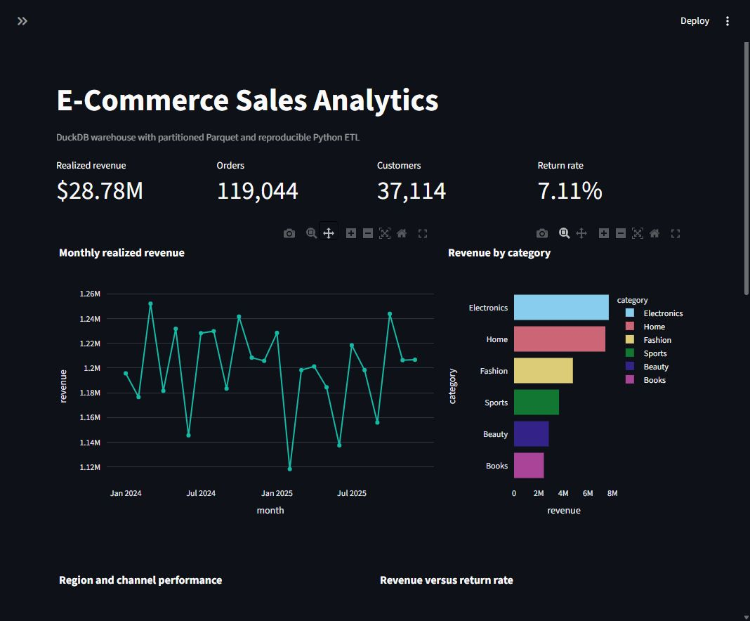
08
The dashboard turns warehouse data into decisions
Measured KPIs
$28.777M
realized revenue
119,044
distinct orders
37,114
customers
7.11%
return rate
Why this view matters
Filters update every KPI and chart together
Electronics and South lead realized revenue
The 77.51% repeat rate supports retention planning
Presenter: Aniket Nikam
E-Commerce Sales Analytics · DuckDB + RabbitMQ
Notes:
Aniket Nikam speaking guide
Demonstrate the filters for date, region and category. The KPI queries run against the enriched warehouse view, not raw CSV.
Explain the distinction between gross and realized revenue. Realized revenue includes only Delivered and Shipped status values.
Use the plots to answer business questions: trend over time, strongest categories, region and channel performance, return-rate risk and top products.
Source: evidence/dashboard_full.png and evidence/tables/kpis.json.

Slide 9
09
RabbitMQ protects live orders between services
One event moves through five controlled stages
1
2
3
4
5
POST /orders
RabbitMQ
Consumer
DuckDB
Dashboard
Pydantic validation
durable queue
manual ACK
ON CONFLICT
refresh 5 sec
Reliability rule and purpose
channel.queue_declare(
queue=queue_name, durable=True
)
channel.confirm_delivery()
properties = BasicProperties(
delivery_mode=Persistent,
message_id=str(event.event_id)
)
# consumer
ch.basic_ack(delivery_tag=tag)
Queue survives broker restart because durable=True
Message survives because delivery_mode is Persistent
Publisher confirms before FastAPI returns HTTP 202
Consumer ACKs only after a successful insert
event_id primary key makes redelivery idempotent
Invalid queued JSON is logged and rejected without requeue
Presenter: Aniket Nikam
E-Commerce Sales Analytics · DuckDB + RabbitMQ
Notes:
Aniket Nikam speaking guide
RabbitMQ sits between the API and database so short consumer interruptions do not lose accepted orders.
Durable queue and persistent messages address broker restarts. Publisher confirms address uncertainty during publication.
Manual acknowledgement changes the failure point: a message leaves the queue only after the database insert succeeds.
event_id is the idempotency key. A redelivered message reaches ON CONFLICT DO NOTHING and does not double revenue.
Handoff to Lokesh Ture: the remaining slides cover the API contract, deployment and live demonstration.

Slide 10
10
FastAPI validates every live order before queueing
Validated JSON contract
Endpoints and purpose
{
"order_id": "LIVE-...",
"customer_id": "C004281",
"product_id": "P017",
"category": "Electronics",
"quantity": 2,
"unit_price": 499.90,
"discount_pct": 0.10,
"region": "West"
}
POST /orders
Validate, publish and return 202 after broker confirmation
GET /health
Confirm that the API and consumer path are available
GET /metrics
Return live event count, customers and revenue
GET /orders/recent
Return the latest accepted events for the dashboard
What is live in this project
Why validate first
The simulator creates an order about every second. FastAPI, RabbitMQ, the consumer and DuckDB process each event. Streamlit refreshes every five seconds. The source is simulated, so this is a near real time demonstration.
Validation blocks bad types and impossible values before the broker, then calculates revenue from the accepted contract.
Presenter: Lokesh Ture
E-Commerce Sales Analytics · DuckDB + RabbitMQ
Notes:
Lokesh Ture speaking guide
Explain that Pydantic checks required IDs, quantity from 1 to 100, positive price and a fractional discount from 0 to 0.80.
The API returns 202 only after RabbitMQ confirms publication. The consumer may write the event a moment later.
Use http://127.0.0.1:8001/docs for the host demo. The container still listens on port 8000 internally.
Be precise about the word live: the transport and processing are real, while the order source is a continuous simulator.

Slide 11
11
Conclusion
A complete data engineering lifecycle
The project turns imperfect e-commerce records into governed metrics and supports continuous order capture through a reliable message path.
Raw data
Quality
Warehouse
Live path
Decisions
CSV + public API
clean + quarantine
star schema + views
FastAPI + RabbitMQ
Streamlit metrics
Measured outcome
248,555
1,445
$28.777M
29.319 ms
clean fact rows
rejected rows retained
realized revenue
DuckDB median, 4 threads
Final result: reproducible batch analytics plus near real time order processing with validated, idempotent writes.
Presenter: Lokesh Ture
E-Commerce Sales Analytics · DuckDB + RabbitMQ
Notes:
Lokesh Ture speaking guide
Close by following the data from source to decision. Raw CSV and the public API snapshot enter the quality layer, accepted rows enter the warehouse and live orders enter through RabbitMQ.
The warehouse provides one definition for revenue, growth and repeat customers. This prevents each dashboard chart from applying different business rules.
The measured results prove that the pipeline completed at the intended scale and that columnar execution reduced the benchmark time.
The live source is simulated, while FastAPI validation, RabbitMQ transport, consumer processing, idempotent DuckDB storage and dashboard refresh form the actual near real time path.
End with the limitation: this is an educational local platform, not a hard real time production service.

