Slide 1
PRACTICAL CASE STUDY
E-Commerce Sales
Analytics using DuckDB
250,000
generated source rows
23.0x
A reproducible analytics platform built with Python, SQL, Parquet and Streamlit
CSV 1-thread to DuckDB 4-thread speedup
Bonus: API ingestion | Kubernetes | execution-mode benchmark
Notes:
Introduce the practical topic and explain that every displayed number comes from the reproducible 250,000-row evidence run.

Slide 2
FOUNDATION
02
Problem statement and project scope
Raw transaction files slow repeated analysis and hide quality failures
01
Clean
Type safely, standardize values, remove duplicates and quarantine invalid rows.
The implementation converts an imperfect CSV into governed analytical tables, reusable metrics and a live dashboard. Every stage leaves evidence that can be inspected during evaluation.
02
Model and analyze
Build a star schema, views, window functions and OLAP grouping patterns.
03
Communicate
Measure performance and present decision-focused KPIs in Streamlit.
119,044 orders
37,114 customers
48 products
2-year coverage
E-Commerce Sales Analytics using DuckDB
Python | SQL | DuckDB | Streamlit
Notes:
Use this slide to explain the business need and the practical coverage. The project focuses on implementation, not a theory-only discussion.

Slide 3
IMPLEMENTATION
03
Pipeline architecture
Sources
Extract
Transform
Warehouse
Serve
Generated CSV
DummyJSON API
read_csv
raw JSON snapshot
TRY_CAST
deduplicate
validate
fact_sales
3 dimensions
KPI views
Parquet
Streamlit
Kubernetes
Persistent evidence
data_quality.json
EXPLAIN ANALYZE plans
benchmark results
dashboard capture
API metadata
E-Commerce Sales Analytics using DuckDB
Python | SQL | DuckDB | Streamlit
Notes:
Walk left to right. Point out that the architecture is local and reproducible, while the container and Kubernetes files make the presentation layer deployable.

Slide 4
MODELING
04
Data quality and star schema
250,250
1,445
248,555
0.578%
raw rows
rejected with reasons
clean fact rows
rejection rate
dim_customer
fact_sales
dim_product
segment
region
order and line IDs
date, customer, product keys
quantity, price, discount
gross amount, net revenue
status, channel, shipping
product name
category
dim_date
year, quarter
month, week
Cleaning rules: TRY_CAST | canonical text | range checks | duplicate removal | rejected-row audit
E-Commerce Sales Analytics using DuckDB
Python | SQL | DuckDB | Streamlit
Notes:
Explain the fact grain first. Then explain why customer, product and date attributes sit in dimensions. Rejected rows remain available for audit.

Slide 5
ANALYSIS
05
SQL analytics and OLAP patterns
Reusable views
Window functions
Multidimensional SQL
Daily revenue
Monthly growth with LAG
Repeat-customer percentage
Enriched fact-to-dimension join
DENSE_RANK for customer leaders
LAG for prior-period revenue
LEAD for next-day comparison
ROLLUP for subtotals
CUBE for all dimension combinations
GROUPING SETS for selected levels
One query can return detail, regional totals, category totals and a grand total
SELECT region, category, SUM(net_revenue)
FROM warehouse.vw_sales_enriched
GROUP BY GROUPING SETS ((region, category), (region), (category), ());
E-Commerce Sales Analytics using DuckDB
Python | SQL | DuckDB | Streamlit
Notes:
Connect the SQL features to the syllabus. Emphasize that KPI views avoid rewriting business logic for every dashboard query.

Slide 6
INSIGHTS
06
Business KPI findings
$28.78M
realized revenue
77.51%
repeat customers
7.11%
return rate
South
top region
Electronics leads revenue; Sports has the highest category return rate at 7.38%
E-Commerce Sales Analytics using DuckDB
Python | SQL | DuckDB | Streamlit
Notes:
Explain that realized revenue includes Delivered and Shipped orders. The generated dataset is illustrative, so the decisions demonstrate the analytical method rather than a real company result.

Slide 7
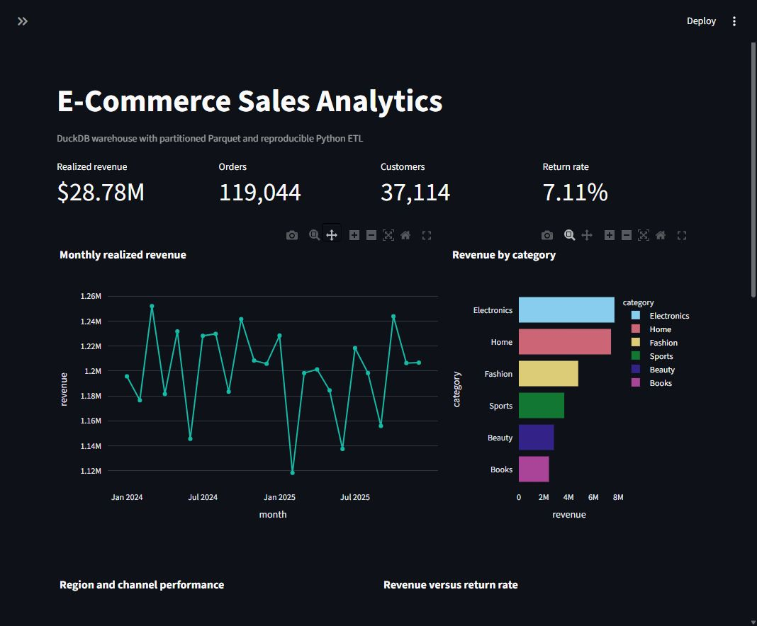
LIVE ANALYTICS
Streamlit dashboard
Date, region and category filters update four KPIs, four charts and a top-products table
Notes:
Demo the live application if time allows. The screenshot documents the verified local run.

Slide 8
OPTIMIZATION
08
Performance across storage and thread modes
Storage | Threads | Median ms
CSV | 1 | 674.031
CSV | 4 | 330.050
Parquet | 1 | 104.650
Parquet | 4 | 57.009
DuckDB | 1 | 44.775
DuckDB | 4 | 29.319
23.0x
faster: CSV 1-thread to DuckDB 4-thread
Five timed repetitions after a warm-up; lower is better
E-Commerce Sales Analytics using DuckDB
Python | SQL | DuckDB | Streamlit
Notes:
State clearly that these are DuckDB execution modes on one machine, not a distributed cluster. The benchmark is reproducible and machine-specific.
Source: https://duckdb.org/docs/current/guides/performance/how_to_tune_workloads
Source: https://duckdb.org/docs/current/guides/meta/explain_analyze

Slide 9
EXTENSIONS
09
Bonus-mark implementation
01
Public API ingestion
Raw JSON, CSV snapshot and DuckDB table
194 products, 208 carts and 800 flattened cart lines
02
Kubernetes deployment
One Kustomize command applies all resources
Deployment, Service, PVC, health probes and HPA
03
Execution-mode benchmark
Six measured modes with plans and timing files
CSV, Parquet and DuckDB under 1 and 4 threads
Kubernetes caution
The HPA scales dashboard pods. A writable DuckDB file still needs single-writer discipline.
E-Commerce Sales Analytics using DuckDB
Python | SQL | DuckDB | Streamlit
Notes:
This slide maps every bonus criterion to implemented evidence. The API is a public test service and the Kubernetes files are deployment assets for Minikube, kind or another cluster.
Source: https://dummyjson.com/docs/products
Source: https://dummyjson.com/docs/carts
Source: https://kubernetes.io/docs/concepts/workloads/autoscaling/horizontal-pod-autoscale/

Slide 10
CONCLUSION
The practical covers the full analytical path
Imperfect CSV
Clean warehouse
Reusable OLAP
Decision dashboard
248,555 clean rows
4 KPI views
42 grouping-set rows
4 interactive charts
Demo sequence
1. Run the CLI pipeline
2. Open the generated quality and benchmark evidence
3. Start Streamlit and filter the KPIs
4. Show the API snapshot and Kubernetes manifests
Ready for GitHub submission
Code | Report | PPT | Results
Notes:
Close by restating the practical flow. Keep the demo sequence ready for questions from the evaluator.

