Slide 1
PRACTICAL CASE STUDY 11
E-Commerce Sales Analytics
using DuckDB
A reproducible batch warehouse with RabbitMQ event streaming, SQL OLAP and a Streamlit decision dashboard
DuckDB
Python
RabbitMQ
FastAPI
Streamlit
Team: Member 1 · Member 2 · Member 3 · Member 4
github.com/Aniket-Nikam/E-Commerce-Sales-Analytics-Data-Engineering-
Presenter: Member 1
Notes:
Member 1 speaking guide
Introduce the selected practical topic: E-Commerce Sales Analytics using DuckDB, SQL and Python.
State the extension clearly: the project covers both batch analytics and strict event-driven ingestion through RabbitMQ.
Mention that the repository, report, evidence and runnable code are part of the submission.
Handoff: Member 1 continues with the problem and scope.

Slide 2
02
Problem, scope and success criteria
Business problem
What the implementation delivers
Sales data arrives with duplicate rows, invalid values and inconsistent labels. Analysts need trusted KPIs, fast OLAP queries and a path for new orders to appear within seconds.
01
Historical pipeline
CSV cleaning, rejects and typed staging
02
Analytical warehouse
Star schema, SQL views and OLAP
Questions answered
How much realized revenue did the business generate?
Which categories and regions drive performance?
How quickly can storage formats answer the same query?
Can a validated order survive a broker and reach the dashboard once?
03
Decision dashboard
Business KPIs and drill-down filters
04
Live order stream
FastAPI, RabbitMQ, consumer and metrics
Source types: deterministic CSV · public API snapshot · continuous synthetic events
Presenter: Member 1
E-Commerce Sales Analytics · DuckDB + RabbitMQ
Notes:
Member 1 speaking guide
Explain that the historical dataset is synthetic and deterministic. It contains deliberate defects so cleaning can be demonstrated safely and repeatedly.
The public DummyJSON snapshot adds a current external API source. The streaming simulator adds new events continuously, but it does not represent a real company's orders.
Define success: valid data, reusable SQL, measurable query performance, visible business insights and idempotent live ingestion.
Rubric coverage: environment setup, dataset load, transformations, optimization, captured output and performance analysis.

Slide 3
03
Batch and streaming architecture
BATCH LANE
CSV + API
Python + SQL
DuckDB
Parquet
SQL views
Streamlit
raw inputs
clean and type
star schema
year/month
OLAP metrics
decisions
STREAMING LANE
Simulator
FastAPI
RabbitMQ
Consumer
DuckDB
Streamlit
1 event/sec
validate + 202
durable queue
manual ACK
idempotent stage
5 sec refresh
Shared outcome
Historical context and new order activity meet in one dashboard. Separate DuckDB files avoid concurrent write contention between the batch warehouse and the streaming stage.
Presenter: Member 1
E-Commerce Sales Analytics · DuckDB + RabbitMQ
Notes:
Member 1 speaking guide
Walk through the upper lane first. CSV and API data enter a repeatable ETL job, then DuckDB stores the warehouse and Parquet holds a compressed analytical copy.
Walk through the lower lane second. FastAPI accepts an order only after RabbitMQ confirms publication. The consumer acknowledges it only after a successful DuckDB insert.
Explain why there are two DuckDB files: one read-mostly historical warehouse and one single-process real-time staging database.
Handoff to Member 2: the next slides explain how the data becomes trustworthy and queryable.

Slide 4
04
Exploration, cleaning and quality controls
Row movement
Rules applied
250,250
Trim text and standardize region, channel, category and status labels
Use TRY_CAST so invalid dates and numbers become detectable nulls
Remove duplicate line IDs with ROW_NUMBER
Reject missing keys, quantities outside 1–20, nonpositive prices and discounts outside 0–80%
Preserve every failed row with a readable rejection reason
raw CSV rows
250,000
typed after deduplication
248,555
accepted fact rows
1,445
rejected with reasons
TRY_CAST(order_date AS TIMESTAMP)
QUALIFY ROW_NUMBER() OVER (PARTITION BY line_id) = 1
WHERE quantity BETWEEN 1 AND 20
AND unit_price > 0
AND discount_pct BETWEEN 0 AND 80
0.58% of typed rows were rejected
Build evidence
7.061 s build · 22.012 MB DuckDB · 6.666 MB Parquet
Presenter: Member 2
E-Commerce Sales Analytics · DuckDB + RabbitMQ
Notes:
Member 2 speaking guide
Start with profiling: 250,250 raw rows include 250 deliberate duplicate rows. Typing leaves 250,000 rows, and the business rules reject 1,445 rows.
Explain TRY_CAST: it prevents one malformed value from stopping the load. Instead, the row can be inspected and routed to rejected_orders.
The rejected table supports auditability because it stores the original fields and a concatenated rejection reason.
Source: evidence/data_quality.json and sql/schema.sql in the repository.

Slide 5
05
Warehouse model and ETL grain
Analytical star schema
dim_date
dim_product
date_key · year · quarter
month · week · weekday
product_key · product_id
product_name · category
fact_sales
one row per order line
248,555 clean rows
FKs + measures + status
side output from stg_orders
dim_customer
rejected_orders
customer_key · customer_id
segment · region
failed rule · original values
rejection_reason
Surrogate integer keys stabilize joins; the fact table keeps order_id and line_id for traceability.
ETL path: raw_orders → stg_orders → dimensions → fact_sales → ZSTD Parquet partitioned by year/month
Presenter: Member 2
E-Commerce Sales Analytics · DuckDB + RabbitMQ
Notes:
Member 2 speaking guide
Define the grain before the tables: one fact row represents one accepted order line.
DuckDB generates surrogate product and customer keys with ROW_NUMBER. The date key uses YYYYMMDD so filtering and joins remain simple.
This design is intentionally dimensional for analytics. The rejected table remains separate so bad rows never contaminate the facts.
The pipeline exports the enriched dataset as ZSTD Parquet partitioned by year and month for column pruning and compression.

Slide 6
06
Reusable metrics and OLAP SQL
Views hide repeated business logic
LAG(revenue) OVER (ORDER BY sales_month)
GROUP BY CUBE (region, sales_channel)
GROUP BY GROUPING SETS (
(region, category), (region), (category), ()
)
vw_daily_revenue
date · revenue · orders · customers
vw_monthly_growth
LAG revenue · month-over-month growth
vw_repeat_customer_pct
customers with more than one realized order
Analytical patterns
$28.777M
77.51%
42
ROLLUP adds hierarchical subtotals. CUBE returns every dimension combination. GROUPING SETS calculates selected detail and total levels in one query.
realized revenue
repeat customers
grouping rows
Presenter: Member 2
E-Commerce Sales Analytics · DuckDB + RabbitMQ
Notes:
Member 2 speaking guide
Explain why views matter: the realized-revenue rule includes Delivered and Shipped orders and should not be retyped in every dashboard query.
LAG compares each month with the previous month. ROLLUP and CUBE produce subtotal combinations without manual UNION statements.
The grouping-sets output contains 30 region-category detail rows, 5 regional totals, 6 category totals and one grand total.
Handoff to Member 3: the next section evaluates speed and shows the BI output.

Slide 7
07
Performance engineering and measured results
Same aggregation, lower is better
What changed
ZSTD Parquet partitions by year and month
DuckDB tables avoid repeated CSV parsing
Four execution threads reduce scan and aggregation time
Indexes support date, customer and product key lookups
EXPLAIN ANALYZE records the physical operators
Query plan
0.0249 s total · HASH_GROUP_BY · HASH_JOIN · filtered fact scan
DuckDB, 4 threads: 29.319 ms median
Presenter: Member 3
E-Commerce Sales Analytics · DuckDB + RabbitMQ
Notes:
Member 3 speaking guide
All bars use the same analytical query and five runs. The slide shows median milliseconds, so smaller bars mean faster execution.
At four threads, DuckDB took 29.319 ms, Parquet took 57.009 ms and CSV took 330.050 ms.
Do not call this a distributed cluster benchmark. It is a local scale-up comparison across storage formats and thread counts.
Source: evidence/tables/benchmark_results.csv and evidence/plans/category_revenue_explain_analyze.txt.

Slide 8
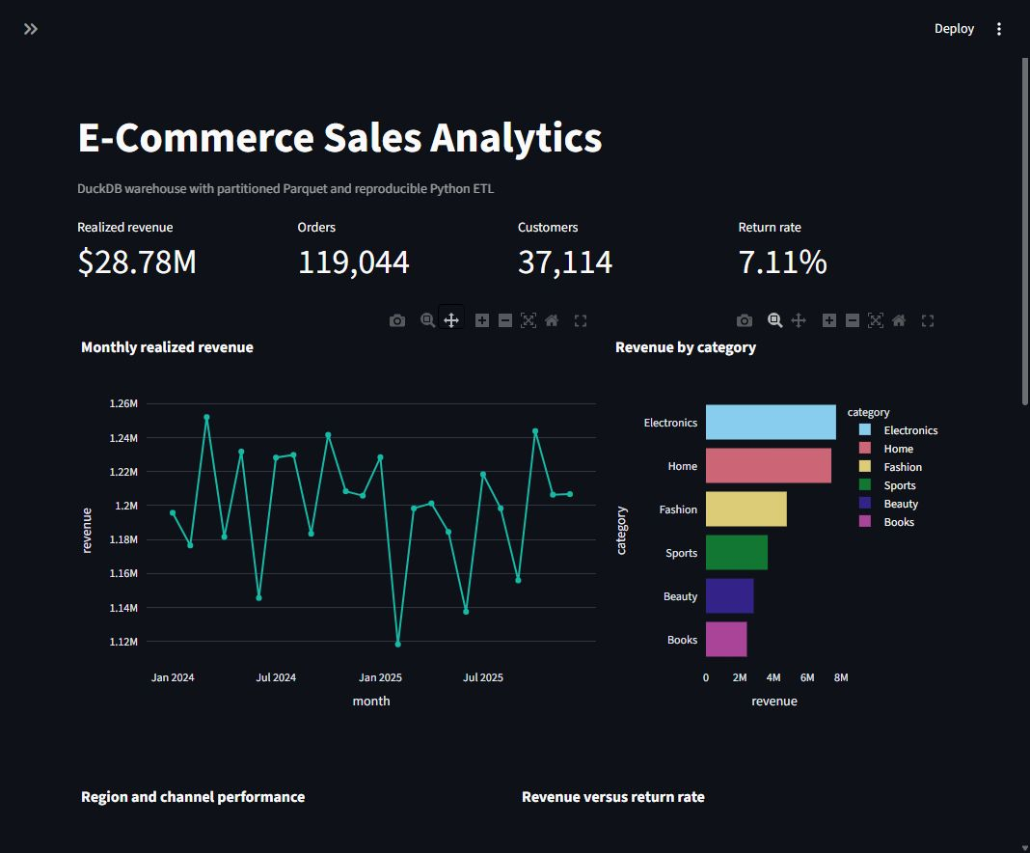
08
Dashboard evidence and business findings
Measured KPIs
$28.777M
realized revenue
119,044
distinct orders
37,114
customers
7.11%
return rate
Decision findings
Electronics leads category revenue
South leads regional revenue
Repeat customers account for 77.51%
Presenter: Member 3
E-Commerce Sales Analytics · DuckDB + RabbitMQ
Notes:
Member 3 speaking guide
Demonstrate the filters for date, region and category. The KPI queries run against the enriched warehouse view, not raw CSV.
Explain the distinction between gross and realized revenue. Realized revenue includes only Delivered and Shipped status values.
Use the plots to answer business questions: trend over time, strongest categories, region and channel performance, return-rate risk and top products.
Source: evidence/dashboard_full.png and evidence/tables/kpis.json.

Slide 9
09
RabbitMQ event delivery and reliability
One order event
1
2
3
4
5
POST /orders
RabbitMQ
Consumer
DuckDB
Dashboard
Pydantic validation
durable queue
manual ACK
ON CONFLICT
refresh 5 sec
Delivery contract
channel.queue_declare(
queue=queue_name, durable=True
)
channel.confirm_delivery()
properties = BasicProperties(
delivery_mode=Persistent,
message_id=str(event.event_id)
)
# consumer
ch.basic_ack(delivery_tag=tag)
Queue survives broker restart because durable=True
Message survives because delivery_mode is Persistent
Publisher confirms before FastAPI returns HTTP 202
Consumer ACKs only after a successful insert
event_id primary key makes redelivery idempotent
Invalid queued JSON is logged and rejected without requeue
Presenter: Member 3
E-Commerce Sales Analytics · DuckDB + RabbitMQ
Notes:
Member 3 speaking guide
RabbitMQ sits between the API and database so short consumer interruptions do not lose accepted orders.
Durable queue and persistent messages address broker restarts. Publisher confirms address uncertainty during publication.
Manual acknowledgement changes the failure point: a message leaves the queue only after the database insert succeeds.
event_id is the idempotency key. A redelivered message reaches ON CONFLICT DO NOTHING and does not double revenue.
Handoff to Member 4: the remaining slides cover the API contract, deployment and live demonstration.

Slide 10
10
API contract and live dashboard loop
Validated order payload
Endpoints
POST /orders
202 after broker confirmation
{
"order_id": "LIVE-...",
"customer_id": "C004281",
"product_id": "P017",
"category": "Electronics",
"quantity": 2,
"unit_price": 499.90,
"discount_pct": 0.10,
"region": "West",
"sales_channel": "Web"
}
GET /health
queue and consumer mode
GET /metrics
events, customers and revenue
GET /orders/recent
latest 1–100 accepted events
Live loop
Simulator sends one event per second. The dashboard requests metrics and recent orders, then reloads after five seconds only when the API responds successfully.
net_revenue = price × quantity × (1 − discount)
Presenter: Member 4
E-Commerce Sales Analytics · DuckDB + RabbitMQ
Notes:
Member 4 speaking guide
Pydantic enforces nonblank IDs, quantity from 1 to 100, positive price and discount from 0 to 0.80 for live events.
The API computes net_revenue in the model, so the consumer receives a consistent business value.
Show FastAPI documentation at http://127.0.0.1:8000/docs during the demo. Submit one POST and then open /metrics and /orders/recent.
The dashboard shows the historical warehouse even when the live API is offline. Its live section becomes active when the API is healthy.

Slide 11
11
Deployment model and bonus evidence
Docker Compose demo
Bonus-mark coverage
rabbitmq
API + consumer
dashboard
simulator
✓
Real-time dataset / API
5672 / 15672
realtime-api · 8000
Streamlit · 8501
continuous · 1 event/sec
Continuous order events + current DummyJSON snapshot
Kubernetes option
✓
Kubernetes deployment
Deployments and Services for dashboard, API, RabbitMQ and simulator
PersistentVolumeClaim for both DuckDB files
Startup, readiness and liveness probes
Secret-backed RabbitMQ connection and CPU-based HPA
Kustomize, probes, PVC, Secret and HPA
✓
Execution-mode comparison
CSV vs Parquet vs DuckDB at 1 and 4 threads
Public API snapshot
194 products · 208 carts · 800 cart items loaded
Presenter: Member 4
E-Commerce Sales Analytics · DuckDB + RabbitMQ
Notes:
Member 4 speaking guide
Compose provides the fastest classroom demonstration because all services share a network and the API waits for RabbitMQ health.
Kubernetes adds deployment objects, services, health probes, persistent storage, a Secret and an HPA. The HPA requires a Metrics Server.
The public API snapshot observed 194 products and 208 carts, flattened 800 cart items and loaded all 800 into DuckDB.
Explain the performance comparison honestly: it compares local storage and thread modes, not multiple-node clusters.

Slide 12
12
Presentation roles, demo runbook and validation
Presenter | Slides | Technical ownership | Main explanation
Member 1 | 1–3 | Scope and architecture | Why batch and streaming share one platform
Member 2 | 4–6 | Cleaning, model and SQL | How quality rules create trusted metrics
Member 3 | 7–9 | Performance, BI and RabbitMQ | Why the faster query and delivery guarantees matter
Member 4 | 10–12 | API, deployment and demo | How to run, verify and explain limitations
Live demonstration
Validation boundary
4 automated tests passed
Docker Compose configuration valid
Kubernetes Kustomize output valid
Current host: Docker Linux engine requires repair before a broker screenshot can be claimed
docker compose --profile demo up -d --build
Dashboard : http://127.0.0.1:8501
API docs : http://127.0.0.1:8000/docs
RabbitMQ UI: http://127.0.0.1:15672
Conclusion: a reproducible analytical warehouse with a technically complete RabbitMQ streaming path and clear runtime evidence boundaries.
Presenter: Member 4
E-Commerce Sales Analytics · DuckDB + RabbitMQ
Notes:
Member 4 speaking guide
Replace Member 1–4 with the four names before submission. Each presenter owns exactly three slides.
Demo order: start Compose, open RabbitMQ management, open FastAPI docs, submit an order, verify queue activity, open /metrics, then show Streamlit.
Validation evidence reports four passing tests and valid Compose and Kustomize configurations.
Important accuracy boundary: Docker Desktop on the current host stopped before the Linux engine started because its internal socket was inaccessible. The project does not claim a successful RabbitMQ container run on this host until /health responds.
Close with the repository link and invite questions about idempotency, partitions, OLAP or deployment.

