Slide 1


Software group project and java mini project
Sem 3
Bookmymovie app
Group members
Aniket Khalasi 19DCE057
Janak Kavad 19DCE055
Gautam Kaku 19DCE051

Slide 2
outline of project
Our main goal for this project is to book movie tickets online through online payment without going to box office.
Second most important thing in our project is that users should experience a good UI and UX designs.
Even security matters. So keeping in the mind that security is our first criteria there will be no transaction frauds.
Application security features include authentication, authorization, encryption, logging, and application security testing.

Slide 3
Problem Statement
There are some difficulty occurs during booking of tickets of any movie in offline mode.
For book the tickets , we have to go to the theatre and then we can book the tickets.
For rural people ,they faces such kind of problems at there.
Some times in big malls there are different positions of ticket counter and screen of movies. So it can be time consuming to find out.
Therefore online mode is required. So that we can book tickets from home.

Slide 4
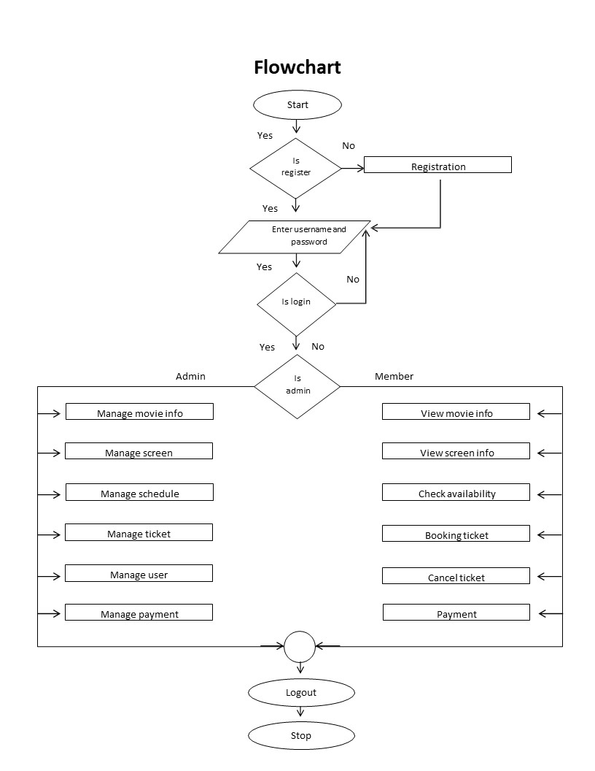
Problem Statement

Slide 5
Hardware and Software requirement
Minimum 8 GB Ram Pc
Android Studio
SDK File For Virtual Emulator
Any Other Android Phone Or Tablet In Place Of Virtual Emulator

Slide 6
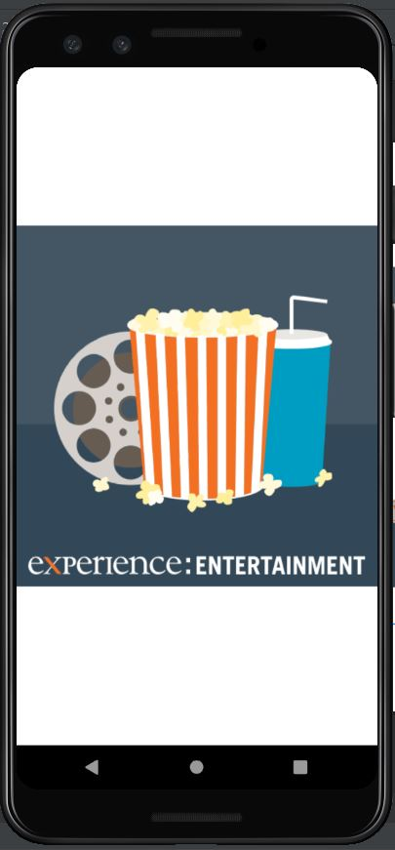
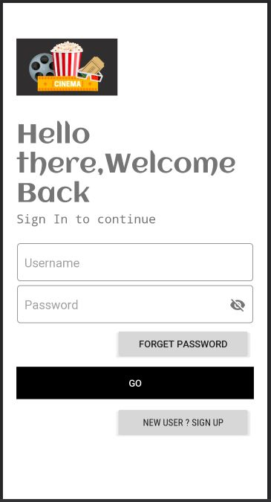
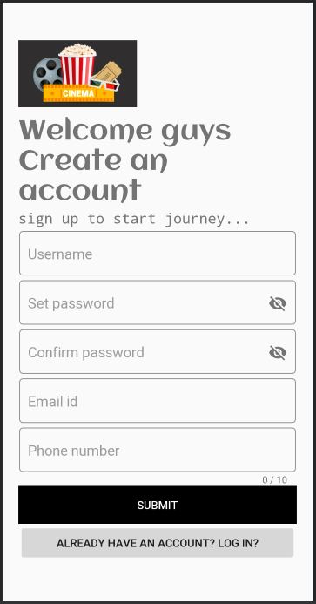
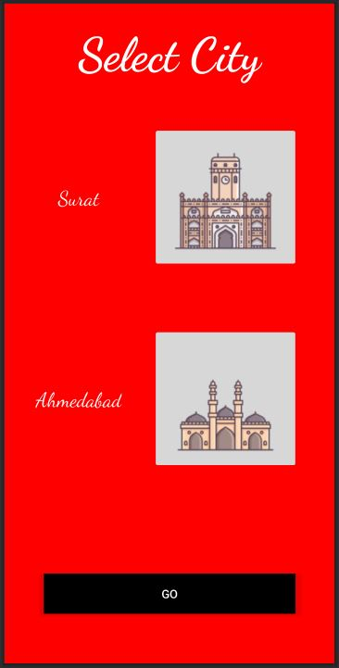
Splash screen
Log in page
New account
Select City

Slide 7
Roles & Responsibility of each members
At initial time period we are working on Android Studio.
We are making different portion of Android app.
Designing work and some layout by Aniket.
Layouts, functions and method developing by Janak and Gautam.

Slide 8
Expected outcomes
We can see what’s going on theatre.
Which movies are trending.
Easily book tickets from home.
Grab best discounts and vouchers.
We can also have reviews of movies.

Slide 9
references
https://youtu.be/inigfusipl8
http://www.studentshow.com/gallery/40665623/Social-Media-Graphics-and-GIFs
https://youtu.be/HHaghq5wXic

Slide 10
Thank you

