Slide 1
Prudential Group Insurance Product and system overview
July, 2013

Slide 2
Short Term Disability
What is Short Term Disability (STD)?
STD is a disability product that pays the employee a benefit, usually a percentage of there earnings, if they become injured or sick and are out long enough.
STD only has 1 benefit amount either a percentage of the employee’s earnings or a flat dollar amount.
STD can be setup as contributory or non contributory or anything in between. Partially contributory plans are more common in the disability products
Most of the variables we will see affect Standard Register and do not impact the Web.
STD rates are usually single flat rates but can be age banded. I have not seen smoker non smoker rates

Slide 3
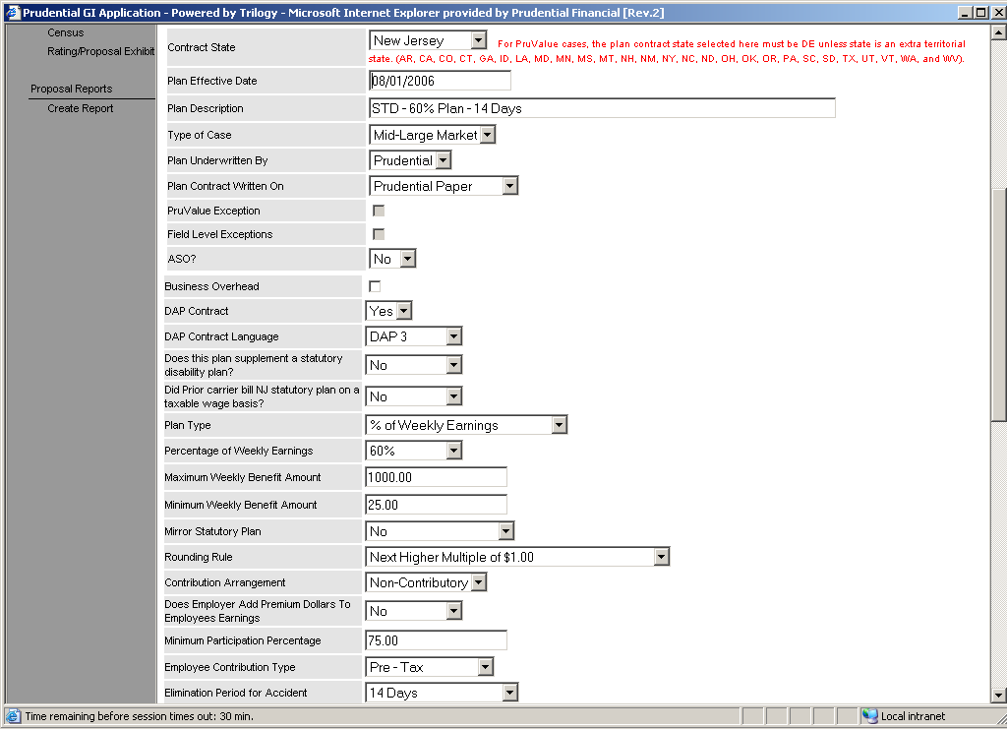
STD Plan Design 1
Plan Description Used to identify the plan
Plan Type: This field indicates how the STD benefit will be calculated either a Percentage of earnings or a flat amount
Minimum Weekly Benefit: After the weekly salary is multiplied by the benefit % we compare the benefit to the minimum and take the greater of the 2 numbers
Percentage of Weekly Earnings: this field is the number that will be multiplied by the weekly salary and then paid out as a benefit
Contribution Arrangement: This field indicates if the employer or the employee will pay for the coverage. Contributory Means the Employee Pays. Non Contributory means the employer pays
Maximum Dollar amount: After the weekly salary is multiplied by the benefit % we compare the benefit to the maximum and take the lesser of the 2 numbers
Elimination Period Accident: this is the amount of time an employee must be out of work due to an accident before they start receiving STD payments

Slide 4
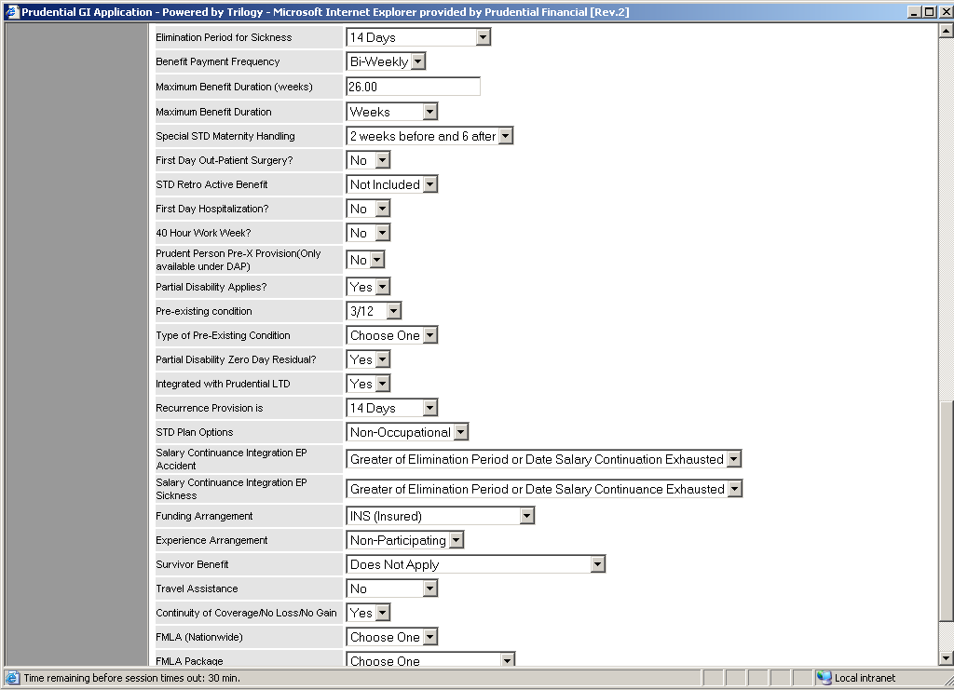
STD Plan Design 2
Elimination Period Accident: this is the amount of time an employee must be out of work due to an accident before they start receiving STD payments
Maximum Benefit Duration: This is the maximum amount of time Prudential will pay STD benefits. This passes to Standard Register
Prudent Person pre ex: Indicates that we will not cover a sickness if you fail to seek treatment for an illness or injury that a normal person would seek treatment for. Standard Register
Partial Disability: This field indicates if we will pay partial benefits if you are less than completely disabled. There is also a 2nd field partial disability 0 day residual. Which indicates that if you attempt to return to work but cannot we will not force you to repeat the elimination period (Both Go to Standard Register)
Survivor Benefit and Accelerated Survivor benefit: Pays a benefit to your family if you die while on STD disability. Standard Register
Pre Existing condition: Indicates if Prudential will exclude disability payment for pre existing conditions. Passes to Standard Register as Yes (Any Value other than None) and No (Value = None)

Slide 5
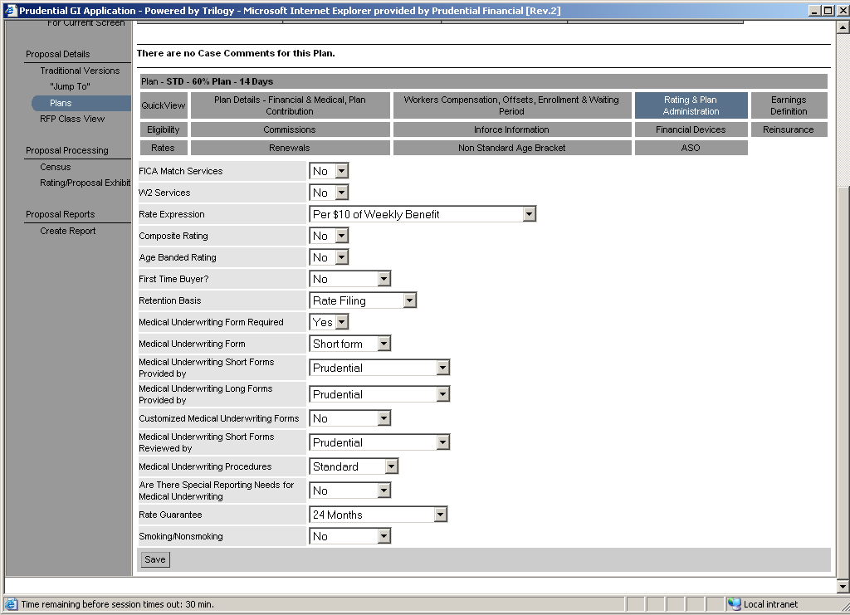
STD Rating & Plan Admin
Rate Expression: This field indicates what the rate will be multiplied by to determine the employee’s deduction. There are 2 basic kinds of rate expressions. Volume based and life based. Volume based rate take the amount of the employee benefit divides by the amount and multiplies by the rate. Life based rates charge a flat fee if the ee enrolls.
Age Banded Rating: The field indicates if rates vary based on age.

Slide 6
Long Term Disability
What is Long Term Disability (LTD)?
LTD is a disability product that pays the employee a benefit, usually a percentage of there earnings, if they become injured or sick and are out long enough.
LTD only has 1 benefit amount either a percentage of the employee’s earnings or a flat dollar amount.
LTD can be setup as contributory or non contributory or anything in between. Partially contributory plans are more common in the disability products
Most of the variables we will see affect Standard Register and do not impact the Web.
LTD rates are usually single flat rates but can be age banded. I have not seen smoker non smoker rates
The Main difference between STD and LTD is the length of time the disability is covered for. This leads to several additional benefits

Slide 7
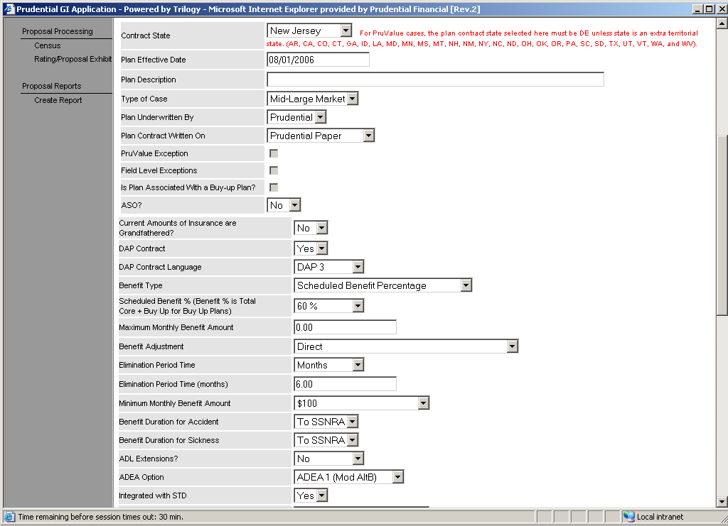
LTD Contract Type
Plan Type: This field indicates how the LTD benefit will be calculated either a Percentage of earnings or a flat amount. The flat amount is very rare for LTD
Maximum Dollar amount: After the weekly salary is multiplied by the benefit % we compare the benefit to the maximum and take the lesser of the 2 numbers
Scheduled Benefit %: this field is the number that will be multiplied by the Monthly salary and then paid out as a benefit
Elimination Period: this is the amount of time an employee must be out of work due to an accident before they start receiving LTD payments it is broken into 2 pieces 1 for accident and one for sickness. Passes to Standard register
Maximum Benefit Duration: This is the maximum amount of time Prudential will pay LTD benefits. This passes to Standard Register

Slide 8
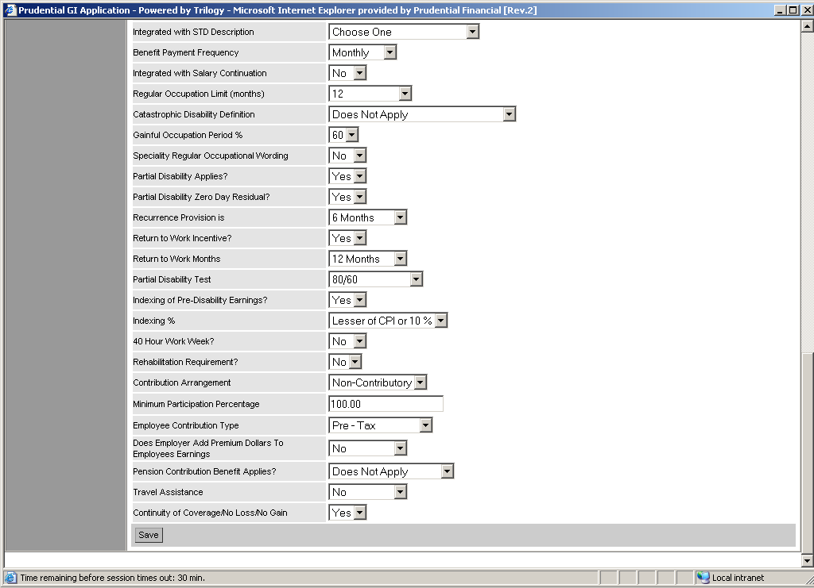
LTD Contract Type 2
Regular Occupation: This is the amount of time that Prudential will pay a benefit while an employee cannot work at there current job. After this time they have to be disabled enough to not work at a job appropriate for there education Standard Register)
Partial Disability: This field indicates if we will pay partial benefits if you are less than completely disabled. There is also a 2nd field partial disability 0 day residual. Which indicates that if you attempt to return to work but cannot we will not force you to repeat the elimination period (Both Go to Standard Register)
Return to Work Incentive: This is a benefit that pays money if the employee attempts to return to there job even on a part time basis
Contribution Arrangement: This field indicates if the employer or the employee will pay for the coverage. Contributory Means the Employee Pays. Non Contributory means the employer pays

Slide 9
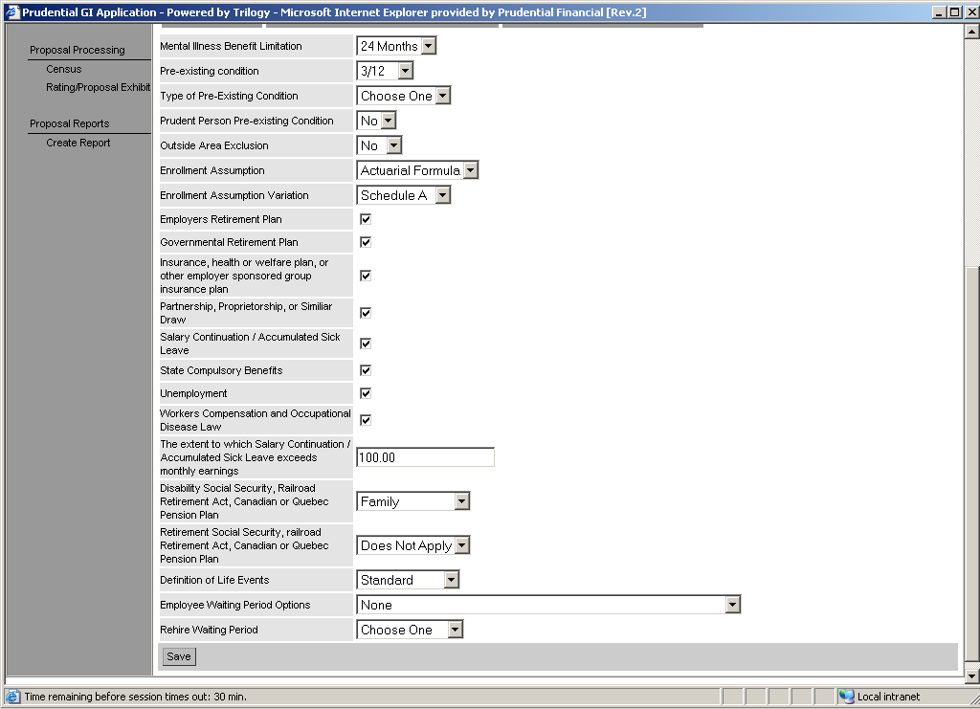
LTD Exclusions
Mental Illness Benefit Limitation: Indicates the maximum amount of time Prudential will pay for a disability due to mental illness includes alcohol/drugs. Standard Register
Pre Existing condition: Indicates if Prudential will exclude disability payment for pre existing conditions. Passes to Standard Register as Yes (Any Value other than None) and No (Value = None)
Prudent Person pre ex: Indicates that we will not cover a sickness if you fail to seek treatment for an illness or injury that a normal person would seek treatment for. Standard Register
Partial Disability: This field indicates if we will pay partial benefits if you are less than completely disabled. There is also a 2nd field partial disability 0 day residual. Which indicates that if you attempt to return to work but cannot we will not force you to repeat the elimination period (Both Go to Standard Register)

Slide 10
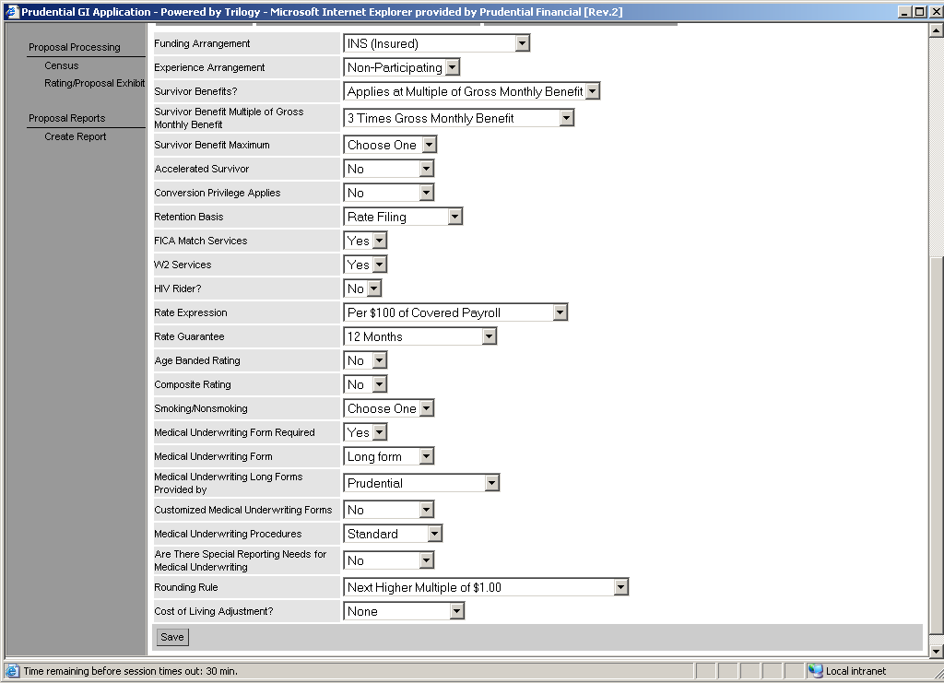
LTD Financial Arrangements
Survivor Benefit and Accelerated Survivor benefit: Pays a benefit to your family if you die while on STD disability. Standard Register
Rate Expression:LTD’s rate expression selection is fundamentally different than any other products. LTD is priced on a covered payroll basis. To calculate covered payroll take monthly salary multiply by the benefit % cap at the maximum dollar amount then divide by the benefit %. The shorthand way is to just us e the monthly salary
Age Banded Rating: The field indicates if rates vary based on age.

Slide 11
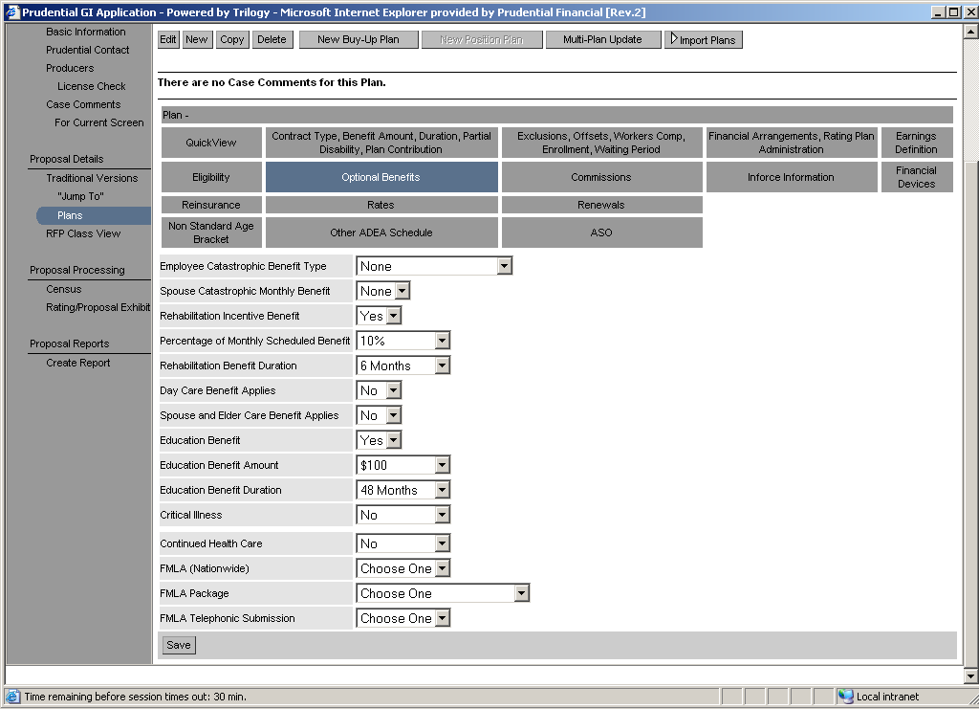
LTD Additional Benefits
Employee Catastophic benefit: Pays the employee and additional benefit if they cannot perform 2 activities of daily life. (ex. Bathing, feeding yourself) Standard Register
Spouse Catastophic benefit: Pays the employee if there spouse if they cannot perform 2 activities of daily life. (ex. Bathing, feeding yourself) Standard Register
Rehab incentive benefit: Pays an additional benefit if the employee attends rehab for there injuries/sickness. Standard Register
Education Benefit: Pays a benefit to help with your dependent’s college expenses while you are on disability Standard Register
Critical Illness: Provides an additional benefit when the employee is disabled with certain illnesses. Ex Heart Attack, Cancer, Transplant, Stroke, Renal Failure, Standard Register
Continued Healthcare. Pays healthcare premiums while you are on disability Standard Register

Slide 12
GUL/GVUL
What is GUL/GVUL?
GUL and GVUL are very similar to Optional life.
They are both Contributory coverages that have plan designs that allow multiple options
From a business perspective the difference between GUL/GVUL and Optional Life is that GUL and GVUL have an investment portion that can gain value. GUL Pays a certain percentage like a money market. GVUL has mutual funds attached to it
GUL and GVUL are typically sold to very large companies (10,000+ lives)
While the basic plans are similar to Optional life GUL and GVUL offer some different challenges since they are not core SPARC products

Slide 13
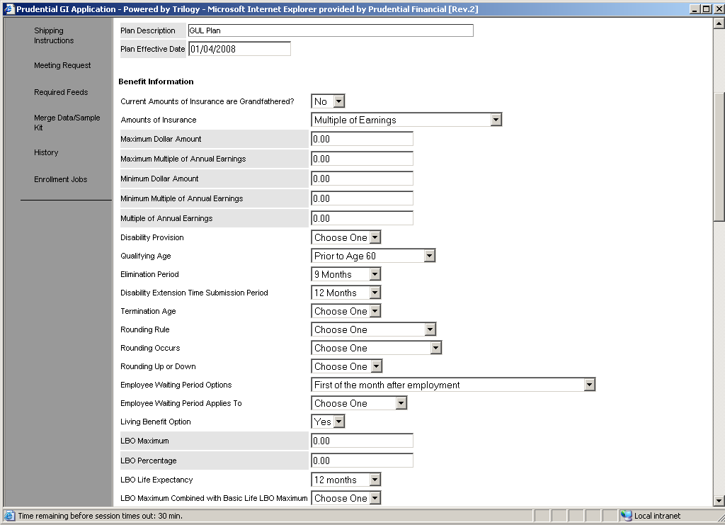
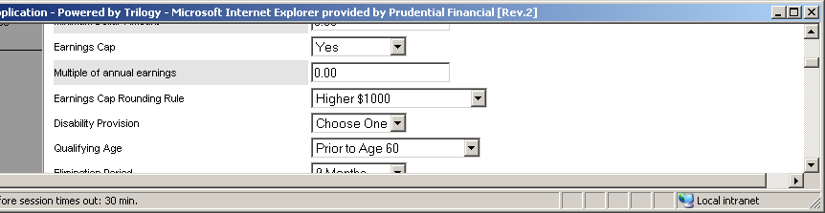
GUL/GVUL Plan Design 1
The Amounts of insurance field controls how the employee’s insurance will be calculated. There are 2 basic types Multiple of Earnings where the salary is multiplied by the annual Salary, and flat amounts where employees are insured for a specific dollar amount. In optional Products the amounts of insurance allows the employee to choose there amount.
Earnings Cap Rounding Rule: This field works much like the rounding rule but, it rounds after the salary has been multiplied by the earnings cap multiple
Earnings Cap: This field restricts the Maximum benefit for the employee on Incremental flat plans. In addition to the incremental max the salary is also multiplied by the multiple. The final max is the lesser of the multiple and the incremental max

Slide 14
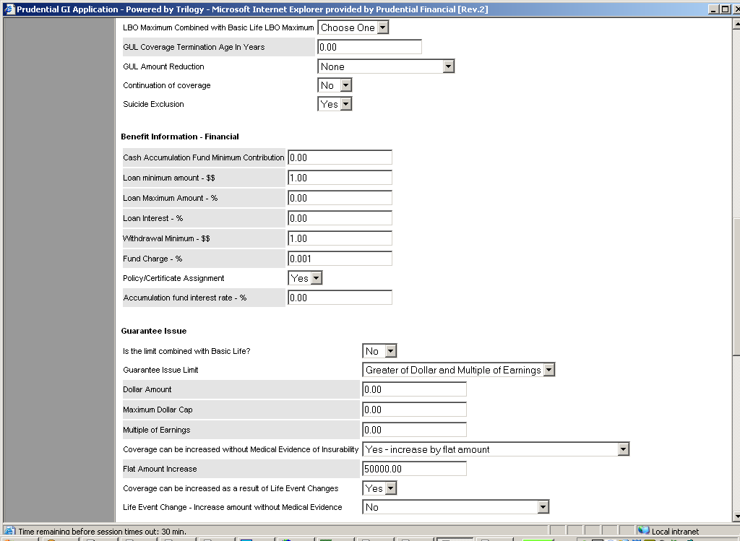
GUL/GVUL Plan Design 2
GUL Termination Age in Years: This field indicates the maximum age that someone can be and still purchase GUL coverage.
Is there an Annual Enrollment without medical evidence: This field controls a portion of the Guarantee issue limit called the Bump. The Bump allows employees with current coverage to increase there Coverage. Bumps allow you to go up by coverage amounts not dollars, the best way to imagine how the bump allow an employee to increase coverage is to write all of the amounts the employee can get down then write there current coverage down and count up by the number of increments specified
Is the Limit Combined with Basic Life: This field indicates that the Guarantee issue limit includes the basic life amount. So whatever basic life coverage the employee has is subtracted from the GUL GI
Guarantee Issue Limit: The Guarantee issue limit defines the maximum amount of insurance an employee can purchase without proving they are in good health. The Guarantee issue limit can be defined as a dollar amount, a multiple of earnings or both
Bump Maximum Field: This field defines the maximum amount the bump can increase the employee’s coverage. There are 2 choices lesser of bump and GI which will allow the user to increase to the lesser of the bump amount and the guarantee issue. Lesser of Bump and Flat Dollar which will allow the user to increase to the bump or a flat dollar amount even if it exceeds the Guarantee issue

Slide 15
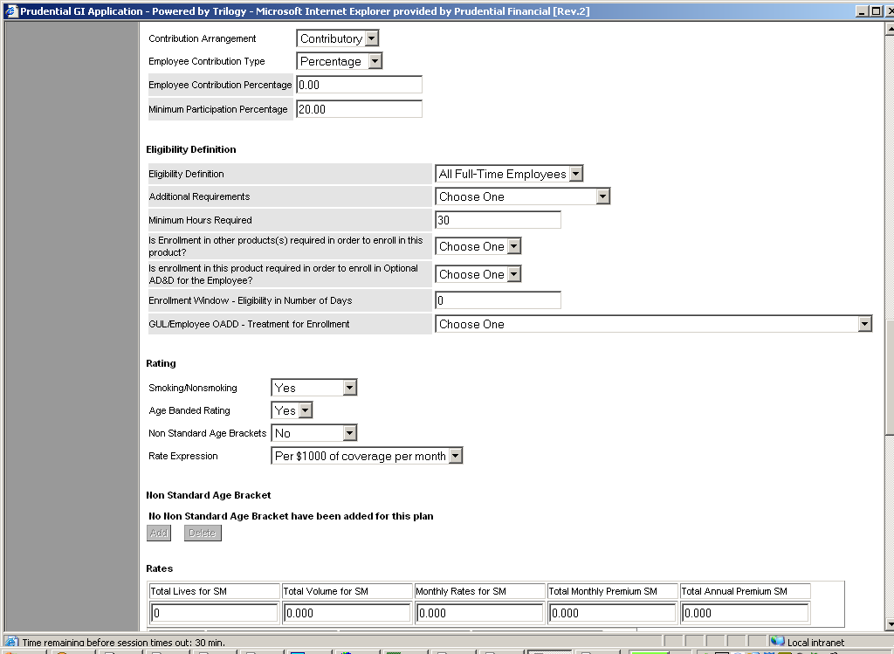
GUL/GVUL Plan Design 3
Smoking/Non Smoking: Indicates if rates vary based on whether they smoke or not. This only applies to mid/large market cases.
Contribution Arrangement: This field indicates if the employer or the employee will pay for the coverage. Contributory Means the Employee Pays. Non Contributory means the employer pays
Is Enrollment in this product required in order to in Optional ADD for the Employee and Is enrollment in other products required to enroll in this product: Both of these fields will be replaced by the new dependency functionality
Rate Expression: This field indicates what the rate will be multiplied by to determine the employee’s deduction. There are 2 basic kinds of rate expressions. Volume based and life based. Volume based rate take the amount of the employee benefit divides by the amount and multiplies by the rate. Life based rates charge a flat fee if the ee enrolls.
Age Banded Rating: The field indicates if rates vary based on age.
Non Standard Age banding: This indicates that age bands are customized. It only appears when age banding = Yes. Will also not appear if the case is small market Setting this field to Yes will enable the Non Standard age bracket tab where users can define any age bands they want ex. 0-20, 20-25. This will determine the age bands the rates are captured in

Slide 16
Critical Illness
What is Critical Illness?
Provides money when the employee has a serious covered illness
Critical illness can be setup as a basic or optional product

Slide 17
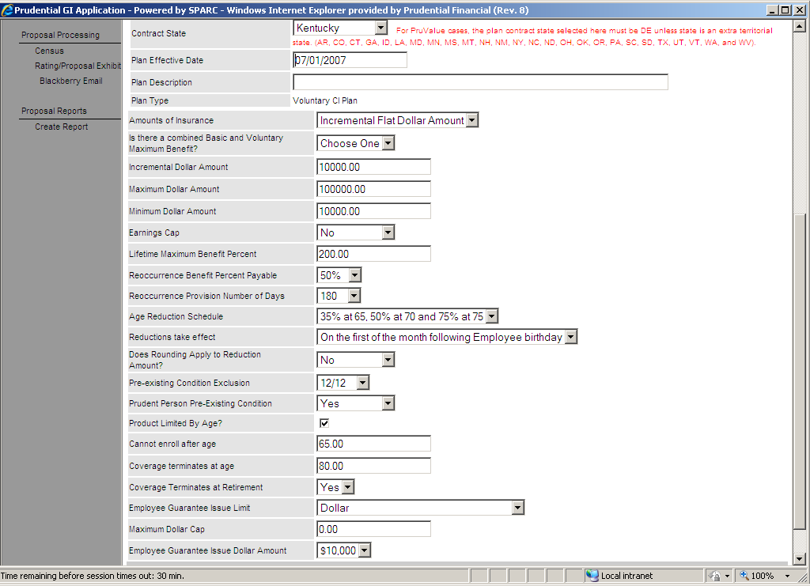
Critical Illness Plan Design 1

Slide 18
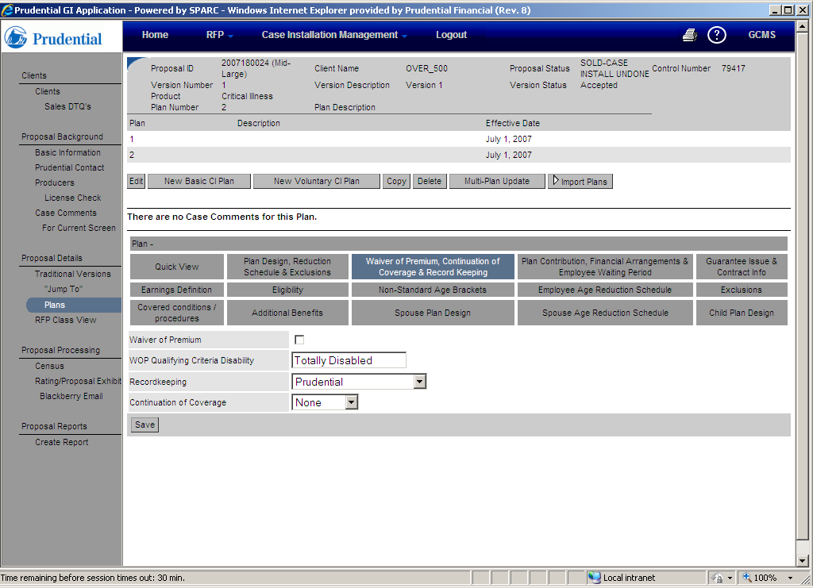
Critical Illness Plan Design 2

Slide 19
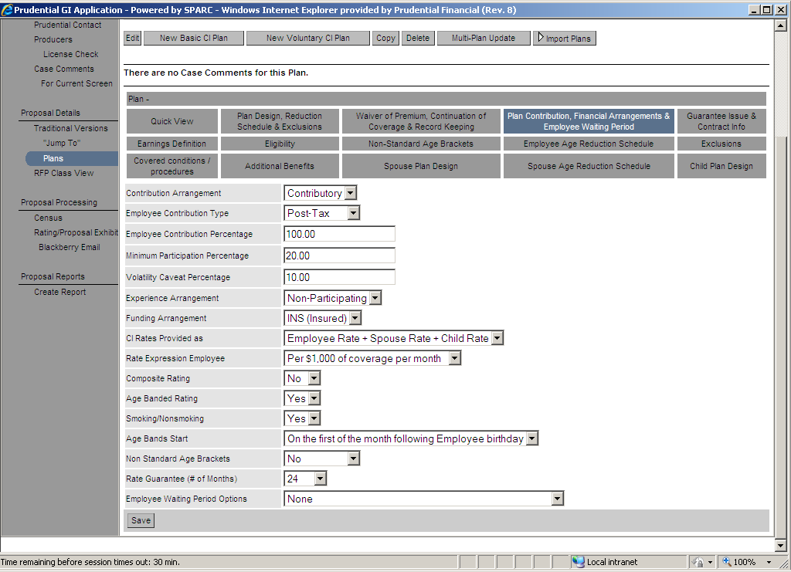
Critical Illness Plan Design 3

Slide 20
Critical Illness Plan Design 3

Slide 21
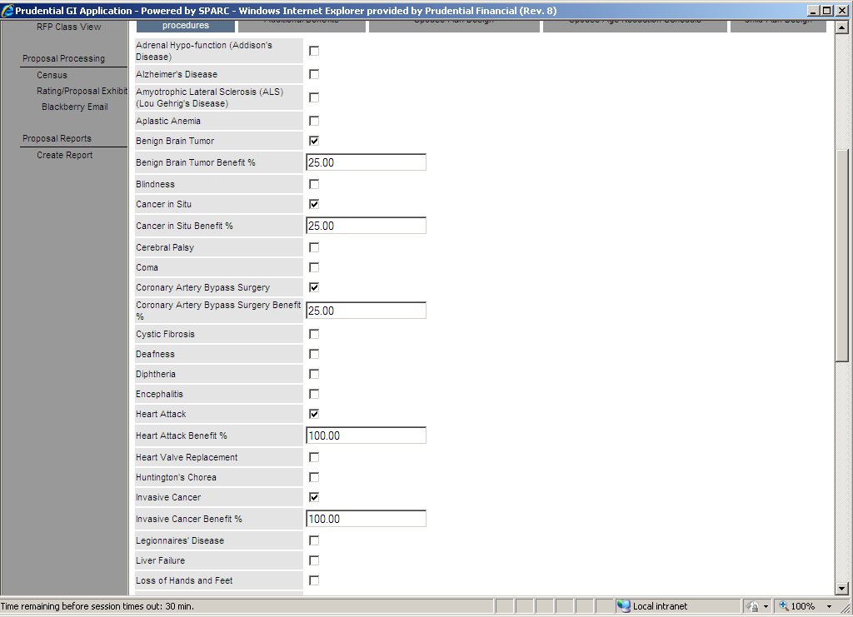
Critical Illness Plan Design 4

Slide 22
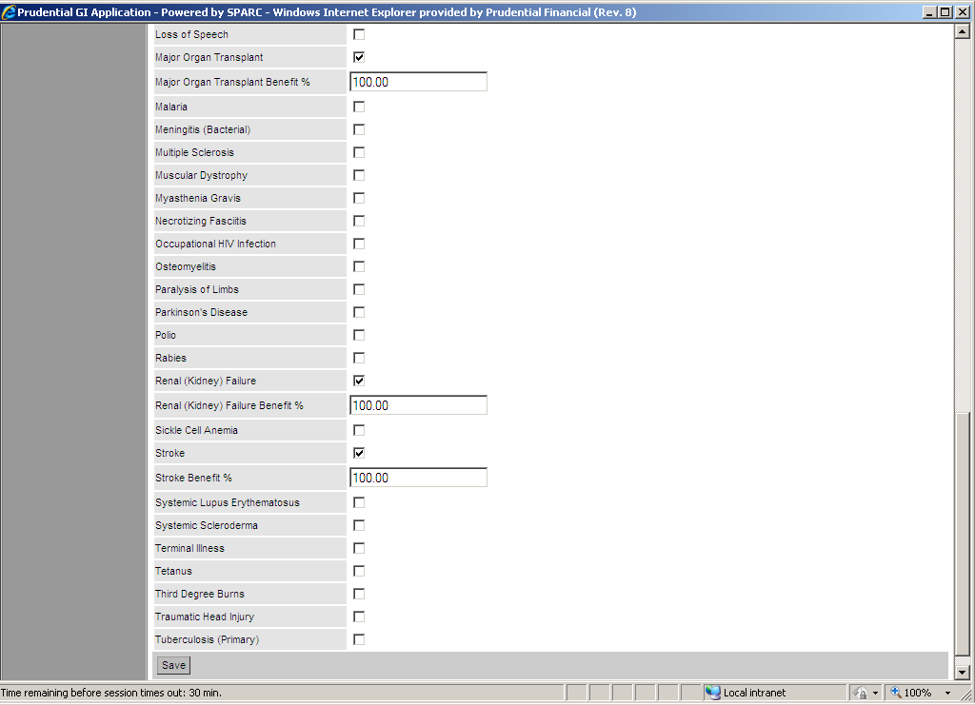
Critical Illness Plan Design 5

Slide 23
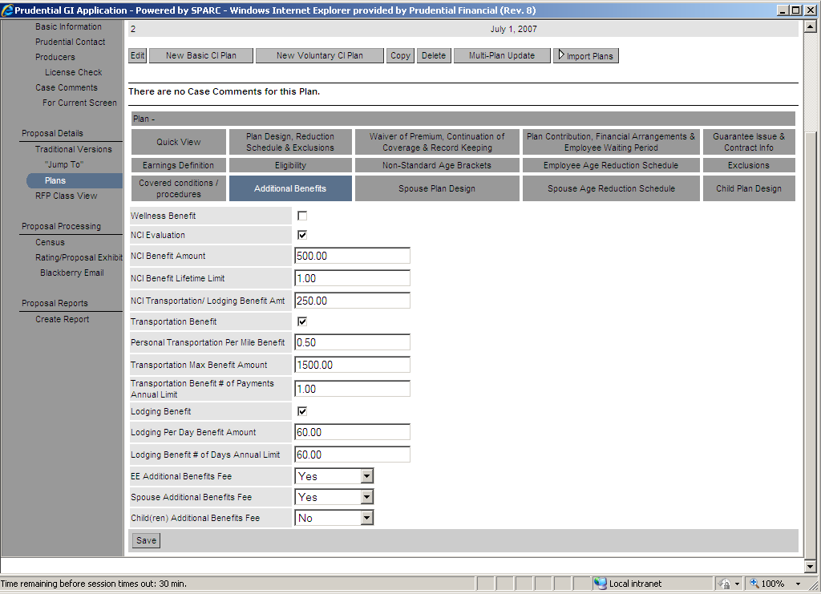
Critical Illness Plan Design 6

Slide 24
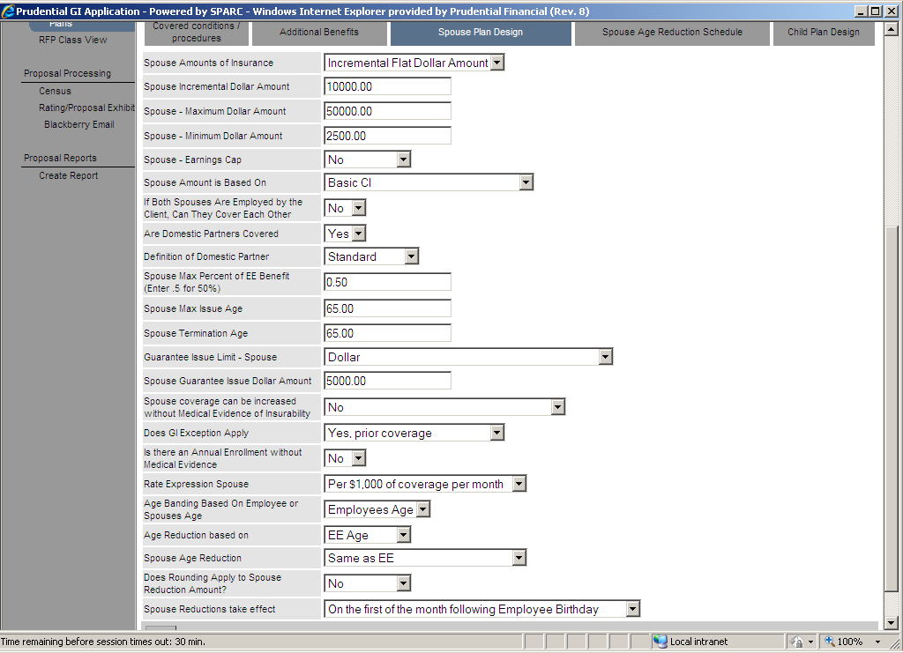
Critical Illness Plan Design 6

Slide 25
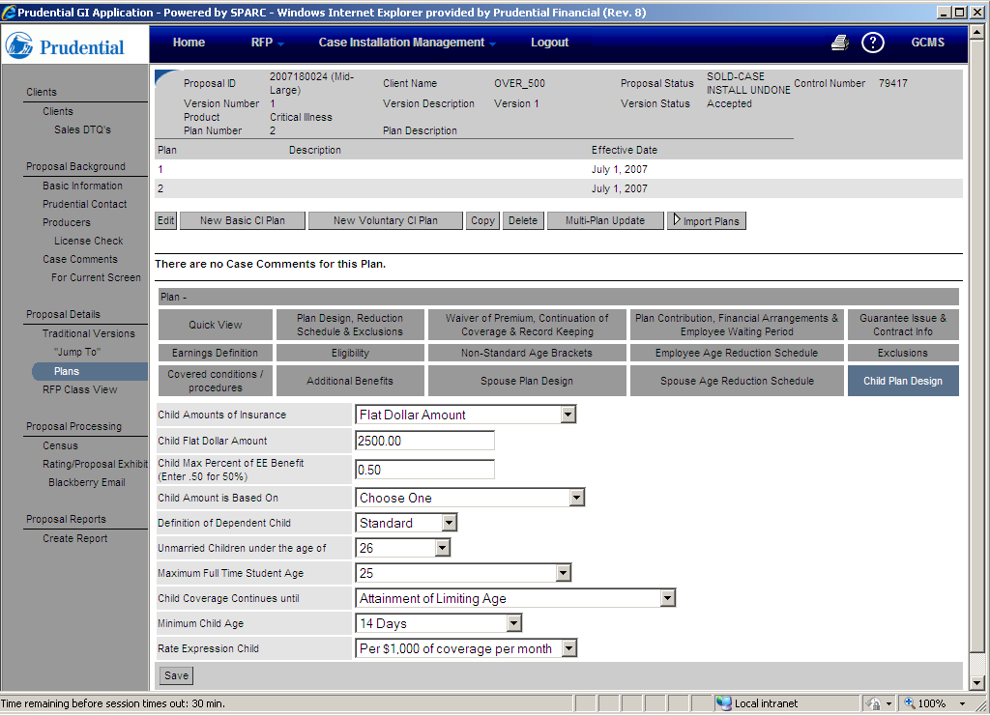
Critical Illness Plan Design 6

Slide 26
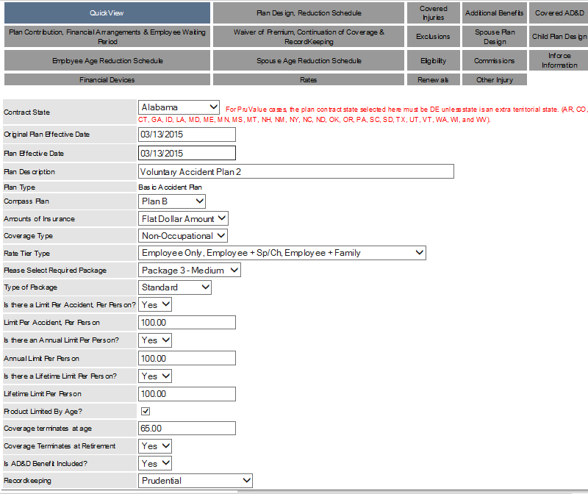
Accident Quickquote

Slide 27
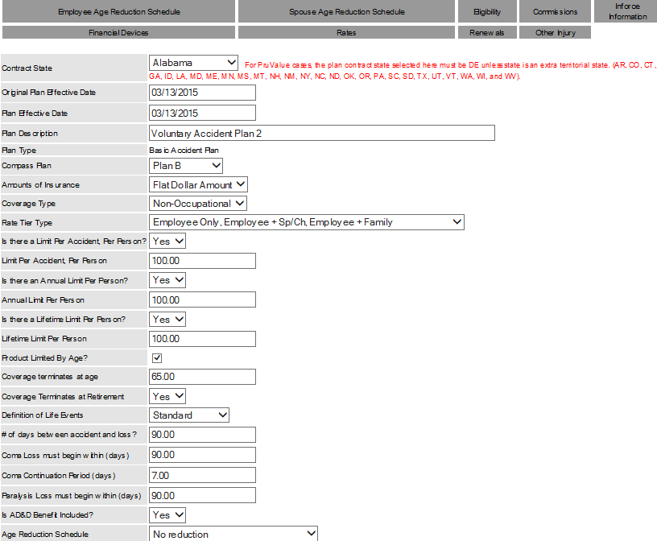
Accident Plan Design Tab

Slide 28
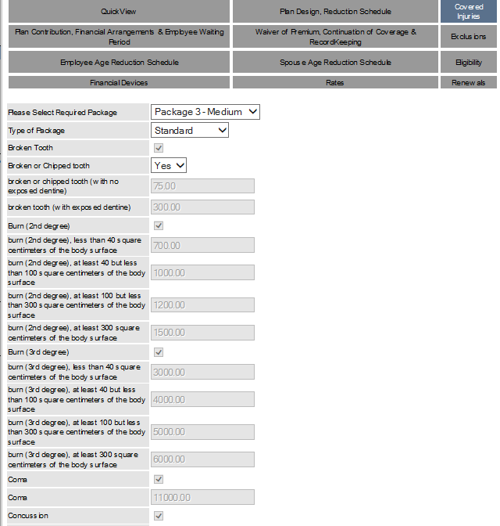
Accident Covered Injuries Tab

Slide 29
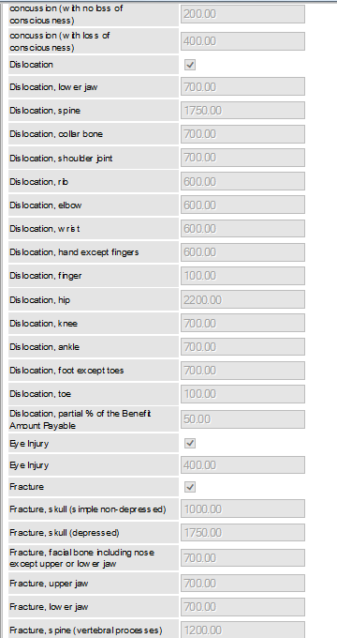
Accident Covered Injuries

Slide 30
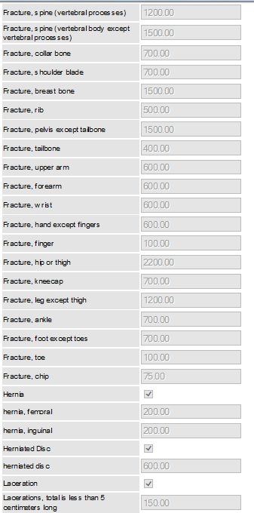
Accident Covered Injuries Tab

Slide 31
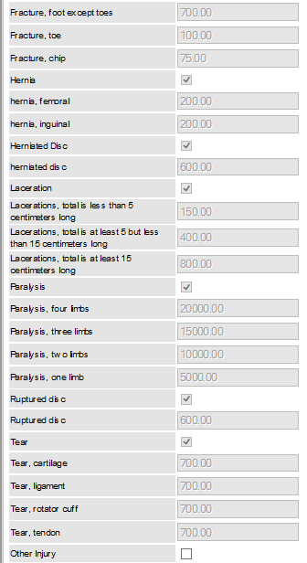
Accident Covered Injuries

Slide 32
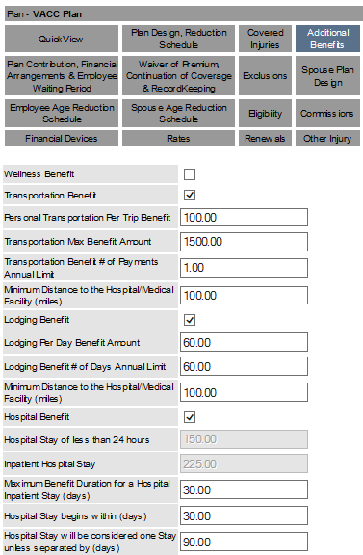
Accident Additional Benefits

Slide 33
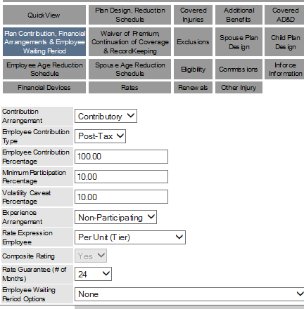
Accident Plan Contribution Tab

Slide 34
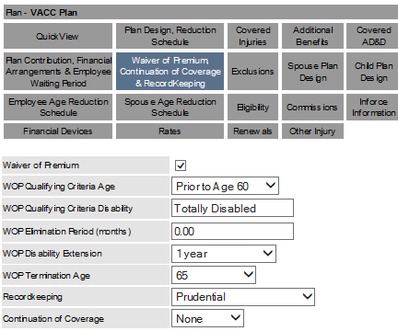
Accident Waiver of Premium

Slide 35
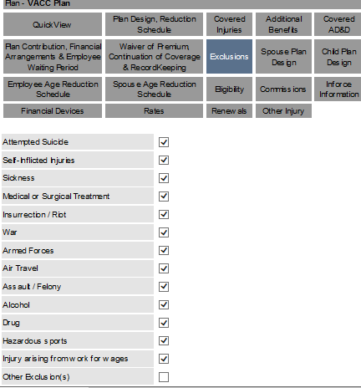
Accident Exclusions

Slide 36
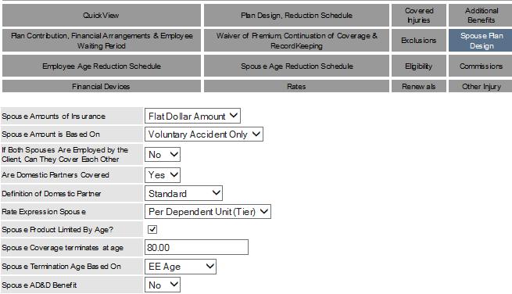
Accident Spouse Plan Design

Slide 37
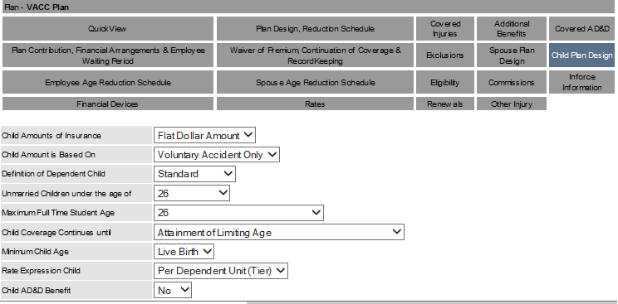
Accident Child Plan Design

Slide 38
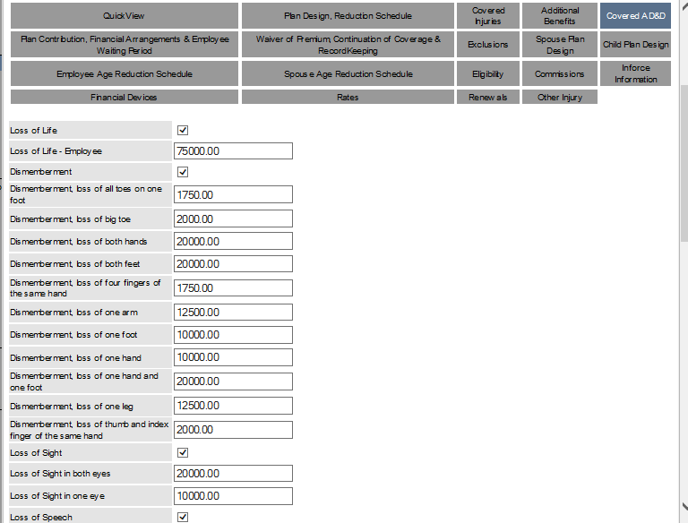
Accident Covered ADD

Slide 39
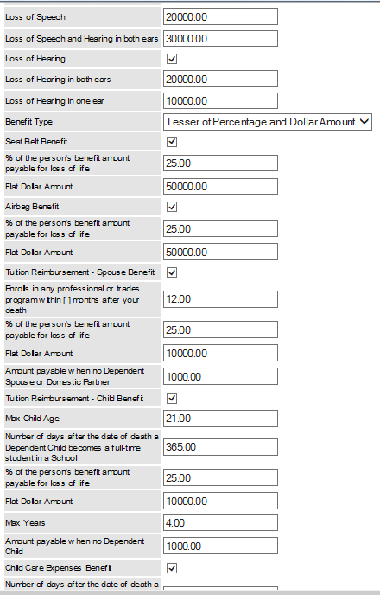
Accident Covered ADD

Slide 40
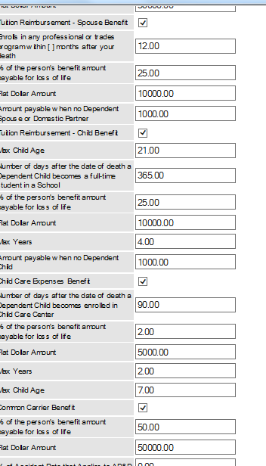
Accident Covered ADD

Slide 41
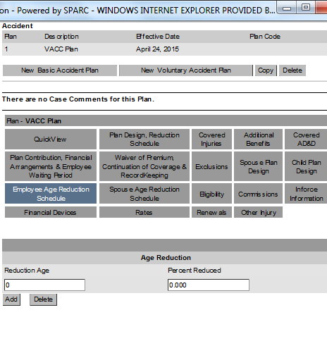
Accident Employee Custom Age Reduction

Slide 42
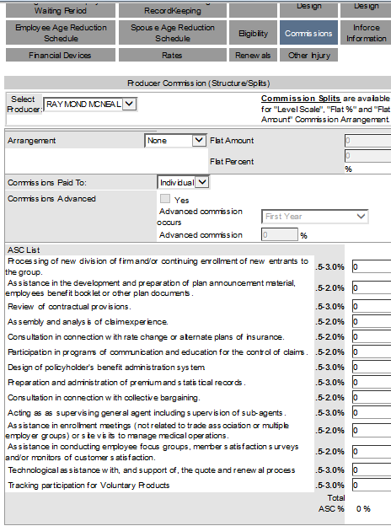
Accident Commissions

Slide 43
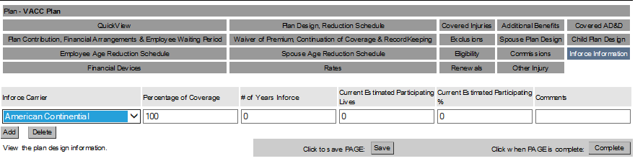
Accident Inforce Information

Slide 44
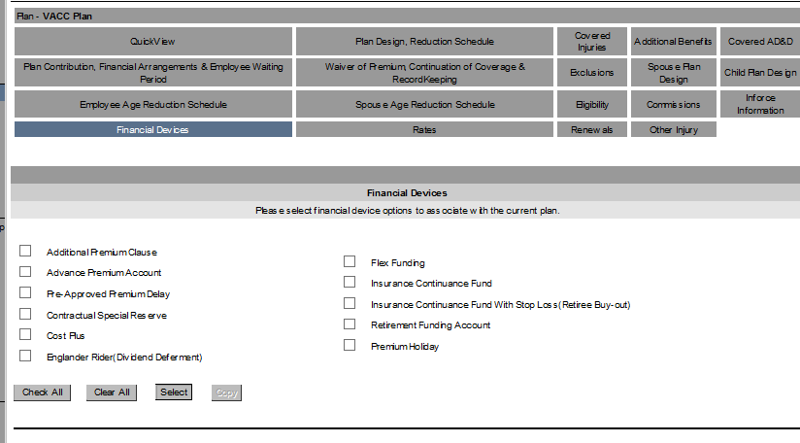
Accident Financial Devices

Slide 45
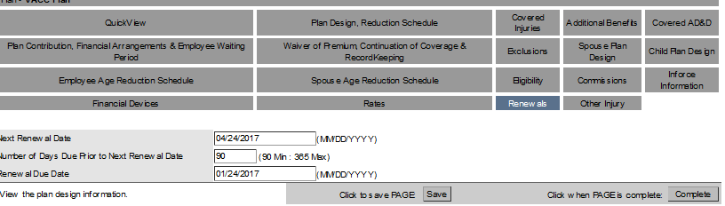
Accident Renewals

Slide 46
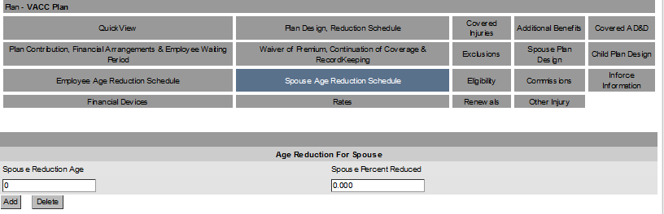
Accident Spouse Age Reduction

Slide 47
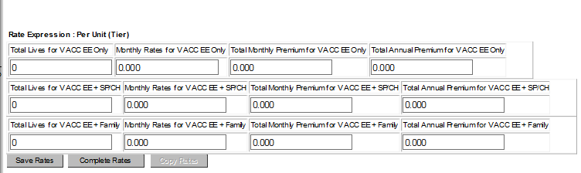
Accident Rates

Slide 48
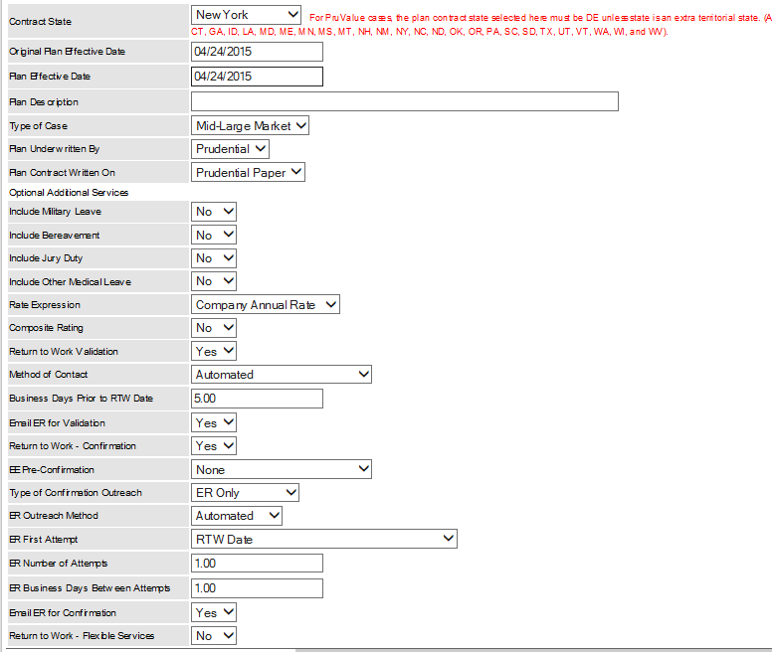
Absence Plan Design

Slide 49
Absence Commissions

Slide 50
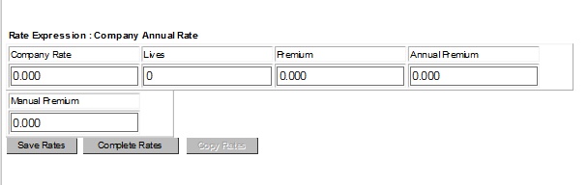
Absence Rates

