Slide 1
SPARC PoC – Functional and Technical Demo
Capgemini, 7th Sept 2016

Slide 2
Plan Configuration – Existing Capabilities
Sr No | Capabilities | Achieved in Versata Config model | Achieved in pruValue.xml | Achieved in Basic_Life.xml
1 | Ability to configure display order of fields on UI | No | No | Yes. Using: "positionNumber" attribute
2 | Ability to show hide tabs/sections | No | No | Yes. Using: <page> tag
3 | Define contents common for all products | Yes | No | No
4 | Define contents common for product family | Yes | No | No
5 | Define contents specific for product | Yes | No | No
6 | Reflexivity - Show hide fields based on conditions | Yes. Using: - Rule type include - Rule type exclude - Rule type choice | No | No
7 | Add/Remove values to be shown in dropdown | Yes. Using - Rule type include - Rule type exclude | Yes. Using: - MISC | No
8 | Setting default values of fields | Yes. Using - Rule type setValue | Yes. Using: - ATTRIBUTES | No
9 | Setting default values of dropdown: | Yes. Using - Rule type choice (min - max = 1 - 1) - Rule type choice (min - max = 0 - 1) | Yes. Using: - REQUIRED - OPTIONAL | No
10 | Showing error message | No | Yes. Using: - MESSAGES | No

Slide 3
Plan Configuration – Future State Solution Mapping
# | Capability | Achieved by
1 | Ability to configure display order of fields on UI | Decision Table (FieldMetaData)
2 | Ability to show hide tabs/sections | Decision Table (FieldMetaData)
3 | Define contents common for all products | Decision Table (FieldMetaData)
4 | Define contents common for product family | Decision Table (FieldMetaData)
5 | Define contents specific for product | Decision Table (FieldMetaData)
6 | Reflexivity - Show hide fields based on conditions | Decision Table (Rule based)
7 | Add/Remove values to be shown in dropdown | Decision Table (Rule based)
8 | Setting default values of fields | Decision Table (Rule based)
9 | Setting default values of dropdown | Decision Table (Rule based)
10 | Showing error messages | Angular JS
11 | *Dynamic UI rendering | Angular JS
Notes:
Sync the wordings

Slide 4
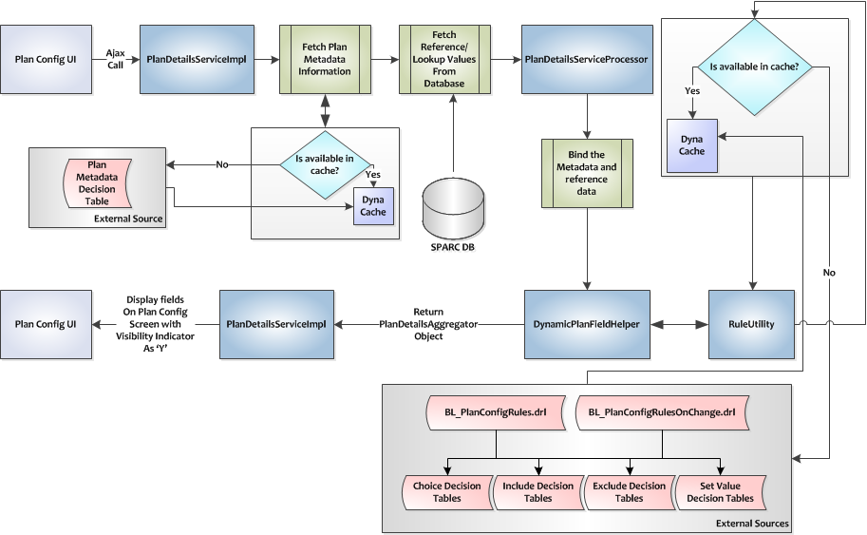
Plan Config Design

Slide 5
Plan Configuration – Development Cookbook
Type | Minoccurs | Maxoccurs | Field Type | Guideline
Choice | ANY | >1 | ANY | Configure in FieldMetaData
Choice | <=1 | <=1 | TEXTBOX | Configure in FieldMetaData
Choice | 0 | 1 | DROPDOWN | Write Include DT to add ‘Choose One’ value
Choice | 1 | 1 | DROPDOWN | Write SetValue DT to have first val in dropdown as default value
Optional | ANY | ANY | ANY | Configure in FieldMetaData
Type | Minoccurs | Maxoccurs | Field Type | Inference
Choice | ANY | >1 | ANY | Ignore
Choice | <=1 | <=1 | TEXTBOX | Ignore
Choice | 0 | 1 | DROPDOWN | Add Choose One
Choice | 1 | 1 | DROPDOWN | Set selected value as first val in dropdown
Optional | ANY | ANY | ANY | Ignore

Slide 6
Plan Configuration – Development Cookbook (contd)
Type | Minoccurs | Maxoccurs | Field Type | Inference
Choice | ANY | >1 | ANY | Ignore
Choice | <=1 | <=1 | TEXTBOX | Ignore
Choice | 0 | 1 | DROPDOWN | Add Choose One
Choice | 1 | 1 | DROPDOWN | Set selected value as first val in dropdown
Optional | ANY | ANY | ANY | Ignore
Type | LHS | RHS | Parsed Constraint | Inference
Include | BLANK | Contains id which is part of Optional rule |  | Ignore
Include | BLANK | NOT BLANK and not part of Optional rule |  | Fire always
Include | NOT BLANK | NOT BLANK | Contains all fields in LHS | Evaluate all Parsed constraints with AND condition
Include | NOT BLANK | NOT BLANK | DOES NOT Contain all fields in LHS | Evaluate condition as: (ALL Parsed constraints with AND condition) OR (The all LHS field not used in constraint with OR condition)
Include | NOT BLANK | NOT BLANK | BLANK | Evaluate all LHS with OR condition
Exclude | BLANK | NOT BLANK |  | Fire always
Exclude | NOT BLANK | NOT BLANK | Contains all fields in LHS | Evaluate all Parsed constraints with AND condition
Exclude | NOT BLANK | NOT BLANK | DOES NOT Contain all fields in LHS | Evaluate condition as: (ALL Parsed constraints with AND condition) OR (The all LHS field not used in constraint with OR condition)
Exclude | NOT BLANK | NOT BLANK | BLANK | Evaluate all LHS with OR condition
setValue | BLANK | NOT BLANK | NOT BLANK | Evaluate all Parsed constraints with AND condition
setValue | NOT BLANK | NOT BLANK | NOT BLANK | Evaluate all Parsed constraints with AND condition

Slide 7
High Level Technical Walkthrough

Slide 8
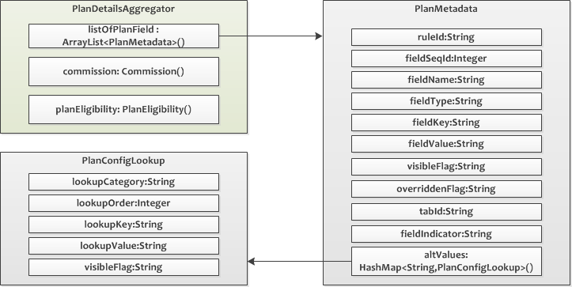
Plan Config – Model object

Slide 9
Plan Config – Design Decisions
Current
Resources are kept outside of EAR for configuration which avoids deployment on changes in DTs or DRLs
Dyna Cache Implementation for faster execution of DRLs and DTs
Usage of Metadata DT for configurability
Math utilities for comparisons which are reused across all rules.
Lookup values are maintained in DB for ease of maintenance.
Future:
Persisting plan data as Key value pair in DB
Caching of Reference data that is currently fetched from DB

Slide 10
RE– Future State Solution Mapping
# | Capability | Achieved by
1 | Lookup table | Decision Table (Rule based)
2 | Looping | DRLs (Rule based)
3 | Initialization/Assignment | Decision Table (Rule based)
4 | Conditional Initialization | Decision Table (Rule based)
5 | Conditional Initialization with Lookup | Decision Table (Rule based)
6 | Calculation | Decision Table (Rule based)
7 | Aggregation operations within loop | Combination of DRL and Java Utilities
8 | Condition on factor table lookup | Decision Table (Rule based)
Notes:
Sync the wordings

Slide 11
Rating Engine – Existing Capabilities
Sr No | Capabilities | Currently Achieved Using Rating Model
1 | Standalone : Initialization/Assignment | Yes: Using Basic step Adjustment with no conditions <BASIC_STEP> <ADJUSTMENT>
2 | Standalone : Conditional Initialization/Assignment | Yes: Using Basic step Adjustment with conditions <CONDITION></CONDITION> <IF_BRANCH></IF_BRANCH>
3 | Standalone : Conditional Initialization/Assignment with Lookup | Yes: Using Basic step Adjustment with conditions and Factor table look up with in adjustment <TABLE_LOOKUP></TABLE_LOOKUP>
4 | Standalone : Calculation based assignment | Yes: Using Basic step Adjustment with no conditions and calculation attributes <PLUS> </PLUS>, <DIVIDE></DIVIDE>
5 | Start Loop | Yes : Using <LOOP_STEP>
6 | Close Loop | Yes : Using </LOOP_STEP>
7 | Within loop : Conditional Initialization/Assignment | Yes. Using - Basic step Adjustment within Loop Steps and conditional steps
8 | Within loop : Conditional Initialization/Assignment with Lookup | Yes. Using - Basic step Adjustment having <TABLE_LOOKUP> within Loop Steps and conditional steps

Slide 12
RE– Existing Capabilities
Sr No | Capabilities | Currently Achieved Using Rating Model
9 | Within loop : Calculation based assignment | Yes. Using - Basic step Adjustment having calculation attributes(<PLUS> ,<DIVIDE>) within Loop Steps and conditional steps
10 | Within loop : Initialization/Assignment | Yes. Using - Basic step Adjustment within Loop Steps with no conditions
11 | Within loop : Calculation based assignment with Lookup | Yes. Using - Basic step Adjustment having calculation attributes(<PLUS> ,<DIVIDE>) and <TABLE_LOOKUP> within Loop Steps and conditional steps
12 | Standalone : Calculation based assignment with Lookup | Yes. Using - Basic step Adjustment having calculation attributes(<PLUS> ,<DIVIDE>) and <TABLE_LOOKUP> outside of Loop Steps and with no conditions
13 | Aggregation Step | Yes. Using <AGGREGATION_STEP ></AGGREGATION_STEP >
14 | Factor Table/LookUp Tables | Yes. Using -<FACTOR_TABLE></FACTOR_TABLE>
15 | Rounding Methodology | Yes : Using -Basic step Adjustments with in <METHODOLOGY name = "Rounding_SubMethodology“></METHODOLOGY >

Slide 13
RE – Our solution to the existing capabilities
Sr No | Capabilities | Our Solution
1 | Standalone : Initialization/Assignment | Implemented using DTs (Java Drools API)
2 | Standalone : Conditional Initialization/Assignment | Implemented using DTs (Java Drools API)
3 | Standalone : Conditional Initialization/Assignment with Lookup | Implemented using DTs (Java Drools API)
4 | Standalone : Calculation based assignment | Implemented using DTs (Java Drools API)
5 | Start Loop | Implemented using DRLs (Java Drools API)
6 | Close Loop | Implemented using DRLs (Java Drools API)
7 | Within loop : Conditional Initialization/Assignment | Implemented using a combination of DTs and DRL”s
8 | Within loop : Conditional Initialization/Assignment with Lookup | Implemented using a combination of DTs and DRL”s
9 | Within loop : Calculation based assignment | Implemented using DTs (Java Drools API)
10 | Within loop : Initialization/Assignment | Implemented using DTs (Java Drools API)

Slide 14
RE – Our solution to the existing capabilities
Sr No | Capabilities | Our Solution
11 | Within loop : Calculation based assignment with Lookup | Implemented using DTs (Java Drools API)
12 | Standalone : Calculation based assignment with Lookup | Implemented using DTs (Java Drools API)
13 | Aggregation Step | Implemented using a combination of DRL and Java utilities
14 | Factor Table/LookUp Tables | Implemented using DTs (Java Drools API)
15 | Rounding Methodology | Implemented using Java utilities

Slide 15
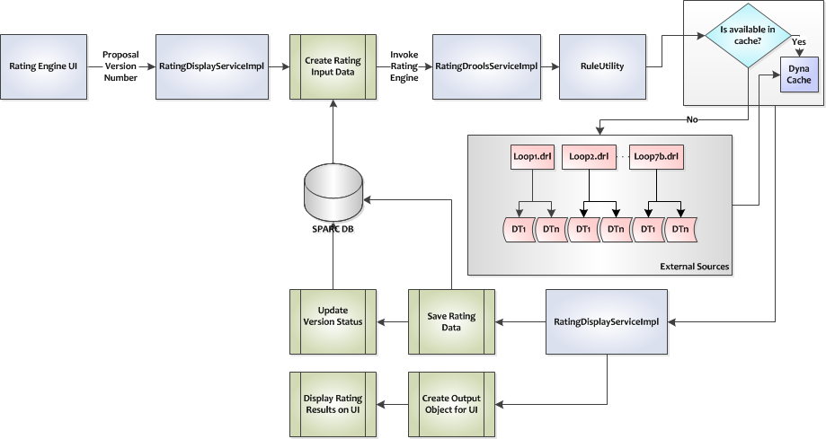
Rating Engine Design

Slide 16
Rating Engine – Development Cookbook
Activation Group | Use Activation Group with ‘Sequential = True’ across all factor tables and DTs having multiple rules for sequential execution of rules and improved performance
Agenda Group | Use Agenda Groups in DRLs to execute loops sequentially.
DT Functions | Use Function keyword in DTs to create common functions which can access Factor tables from within other DTs
SBigDecimal | Use SBigDecimal in place of BigDecimal to manage precisions.
MathUtility | MathUtility should be leveraged for all mathematical calculations (Addition,Subtraction,Multiplication,Division)
AggregationUtility | Aggregation utilities should be used to process Aggregation Steps from the Model file (Min,Max,Sum,Avg)

Slide 17
High Level Technical Walkthrough

Slide 18
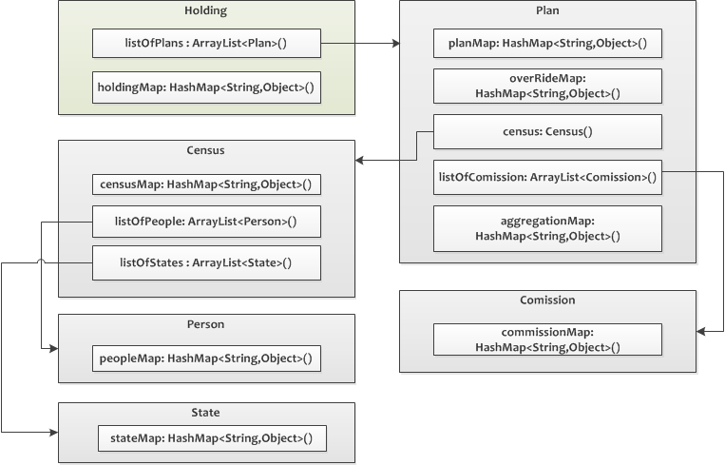
RE – Model object

Slide 19
Rating Engine – Design Decisions
Current:
Resources are kept outside of EAR for configuration.
Dyna Cache Implementation for faster execution of DRLs and DTs
Splitting of huge factor tables into Master Child structure for faster execution and easy maintenance.
Usage of Activation Group for sequential execution of Rules within DTs.
Future
Factor table DTs to RDBMS tables

Slide 20
Appendix

Slide 21
Plan Config – Existing Capabilities
Sr No | Capabilities | Can be achieved in Config model? | Can be achieved in pruValue.xml? | Can be achieved in Basic_Life.xml?
1 | Ordering of fields on UI | No | No | Yes. Using: "positionNumber" attribute
2 | Show hide tabs/sections | No | No | Yes. Using: <page> tag
3 | Define contents common for all products | Yes | No | No
4 | Define contents common for product family | Yes | No | No
5 | Define contents specific for product | Yes | No | No
6 | Reflexivity - Show hide fields based on product/value selection/etc | Yes. Using: - Rule type include - Rule type exclude - Rule type choice | No | No
7 | Add/Remove values to be shown in dropdown: | Yes. Using - Rule type include - Rule type exclude | Yes. Using: - MISC | No
8 | Setting default values of fields | Yes. Using - Rule type setValue | Yes. Using: - ATTRIBUTES | No
9 | Validations on values??? | Validations on values??? | Validations on values??? | No
10 | Setting default values of dropdown: | Yes. Using - Rule type choice (min - max = 1 - 1) - Rule type choice (min - max = 0 - 1) | Yes. Using: - REQUIRED - OPTIONAL | No
11 | Showing error message | No | Yes. Using: - MESSAGES | No

Slide 22
Plan Config – Future state solution
Sr No | Capabilities | Achieved using
1 | Ordering of fields on UI | Using Sequence Id in FieldMetaData DT
2 | Show hide tabs/sections | Angular JS show/hide tabs
3 | Define contents common for all products | FieldMetaData DT
4 | Define contents common for product family | FieldMetaData DT
5 | Define contents specific for product | FieldMetaData DT
6 | Reflexivity - Show hide fields based on product/value selection/etc | Using rules in Include DT, Exclude DT, Choice DT
7 | Add/Remove values to be shown in dropdown: | Using rules in Include DT, Exclude DT
8 | Setting default values of fields | Using rules in SetValue DT
9 | Validations on values???
10 | Setting default values of dropdown: | Using rules in SetValue DT
11 | Showing error message

Slide 23
Plan Configuration – Existing Capabilities
Ability to configure display order of fields on UI
Ability to show hide tabs/sections
Define contents common for all products
Define contents common for product family
Define contents specific for product
Show hide fields based on conditions
Add/Remove values to be shown in dropdown
Setting default values of fields
Setting default values of dropdown

Slide 24
RE – Optimizations
Current:
Resources are kept outside of EAR for configuration.
Dyna Cache Implementation for faster execution of DRLs and DTs
Splitting of huge factor tables into Master Child structure for faster execution and easy maintenance.
Aggregation utilities which are reused across all loops
Rounding Methodology utilities which are reused across all loops
Math utilities for complex calculations which are reused across all loops
Customized BigDecimal utility for maintaining precision across calculations
Usage of HashMap instead of standard POJO
Usage of Activation Group for sequential execution of Rules within DTs.
Future

