Slide 1

Greyatom Capstone
Mahindra First Choice
Outstanding Outliers
Arun Singh
Rounak Sharma
Aniket Naik

Slide 2
Flow of Project
Dataset Details
Customer Segmentation
Feature Engineering
Model and Approaches
Overview
Problem Statement
Exploratory Data Analysis
Pipeline
Feature Importance
Value to the Business (Recommendations)

Slide 3
Business Overview
Mahindra First Choice Services (MFC Services) is a part of the USD 20.7 billion Mahindra group and is India's largest chain of multi-brand car and two-wheeler service workshops with a network of 500 franchise partners present in over 350 towns across 26 states.
Each four-wheeler service workshop is spread over an area of 7000 sq. ft- 15000 sq. ft and two-wheeler workshop area ranges from 600 sq. ft- 1200 sqft. MFC Services poised to deliver world-class automobile maintenance and service solutions.
At MFC Services, customers can save up to 20 percent servicing costs as compared to authorized service centers. With the motto to provide right inspection, right parts and right billing, Car and Bike owners can now 'Make the Right Choice' by choosing MFC Services to solve their woes.

Slide 4
Problem Definition
Customer Segmentation
The idea is to segment customers based on when their last purchase was(Recency), how often they’ve purchased in the past(Frequency) and how much they spent(Monetary).
Service time and cost Prediction
Building a machine learning model for Multi-Output Regression to predict the total cost of the service and time required to complete that service.

Slide 5
Key Stakeholders
We have identified the following as out key stakeholders in our problem
Chief Financial Officer (CFO)
Head of Customer Care Department
Manager of Plants
Regional Sales Head

Slide 6
Data Science Metric
Multi-Output Regression Model
Mean Absolute Error (MAE)
Root Mean Square Error (RMSE)
R-Squared Score(R2)

Slide 7
Dataset
Input Features
Final Invoice
KMs Reading
Labour Total
Order Type
Parts Total
Car Model
Cust Count
Plant Count
JTD
Order Item
Item Category
Target Quantity UoM
Order Quantity
Plant master
City
State
Sales Organization
Output Features
Final Invoice
Total Value
Service Time

Slide 8
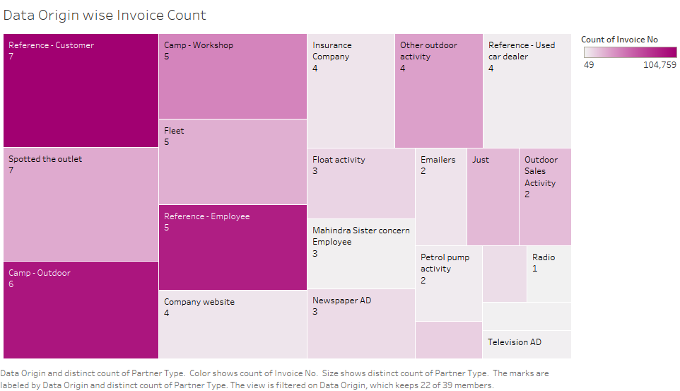
Exploratory Data Analysis (Tableau)
Reference customer has maximum number of invoice counts and has data coming from 7 diff partners
Camp Outdoor has 2 most no. of invoices which brought large number of revenue.Hence we recommend the marketing team to increase the no. of outdoor service camps to maximize reach and profits.

Slide 9
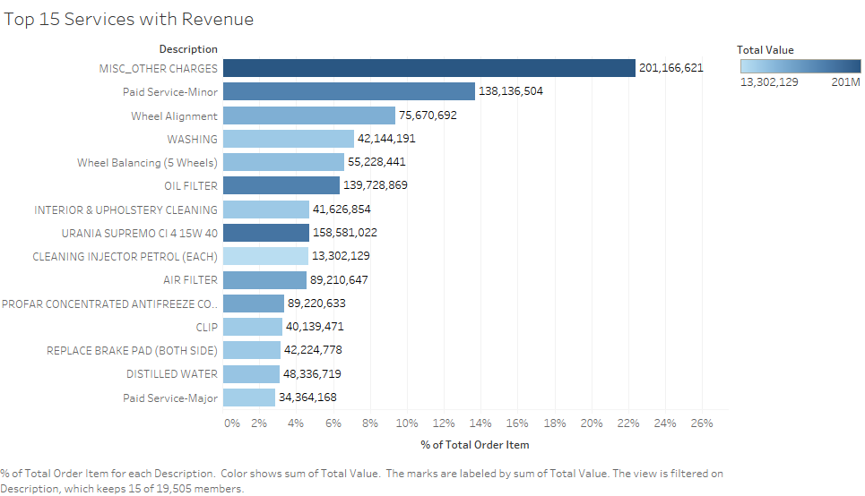
More than 22% of the order items come under the MISC_other Charges type of service that brought maximum revenue.
URANIA SUPREMO being around 5% brings in decent amount of revenue of (16 Cr) being second highest.

Slide 10
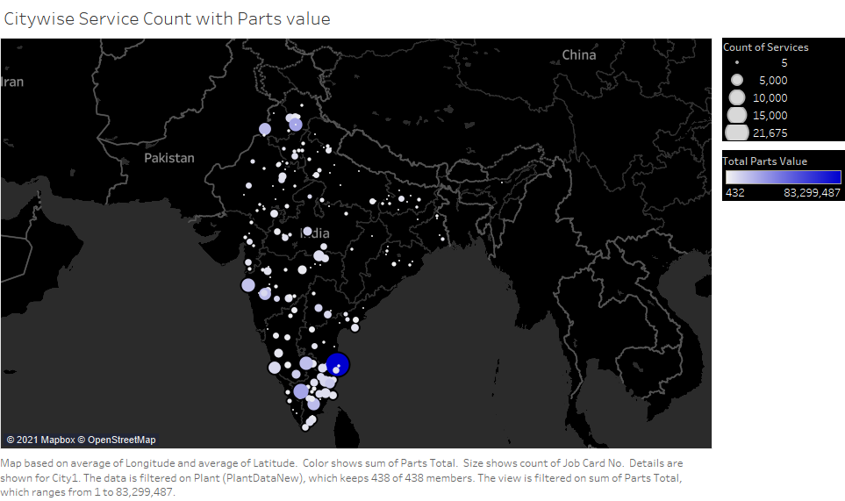
The South zone has highest parts value and service counts too.Thus we suggest the inventory departement that inventory for Southern States be increased.

Slide 11
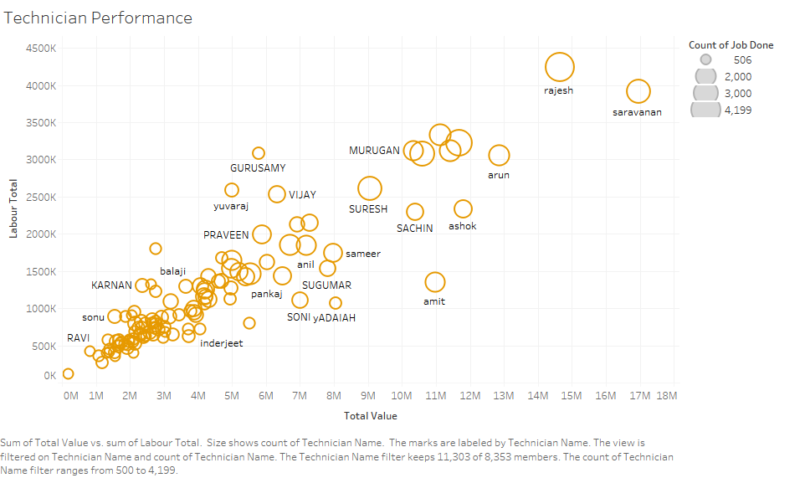
Saravanan has brought highest total value hence we can suggest the human resource department to compensate him with rewards/bonus .
Gurusamy shows around 3 lakh labour charge but he contributes less total value as compared to others.

Slide 12
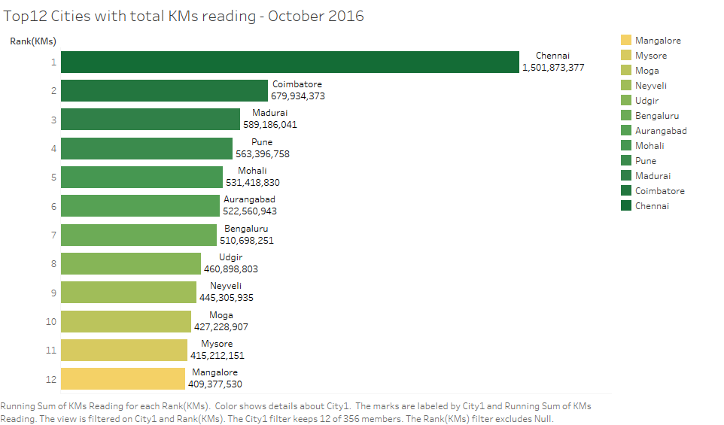
New upcoming plants can be planned accordingly keeping in mind the cities on the basis of KM readings.

Slide 13
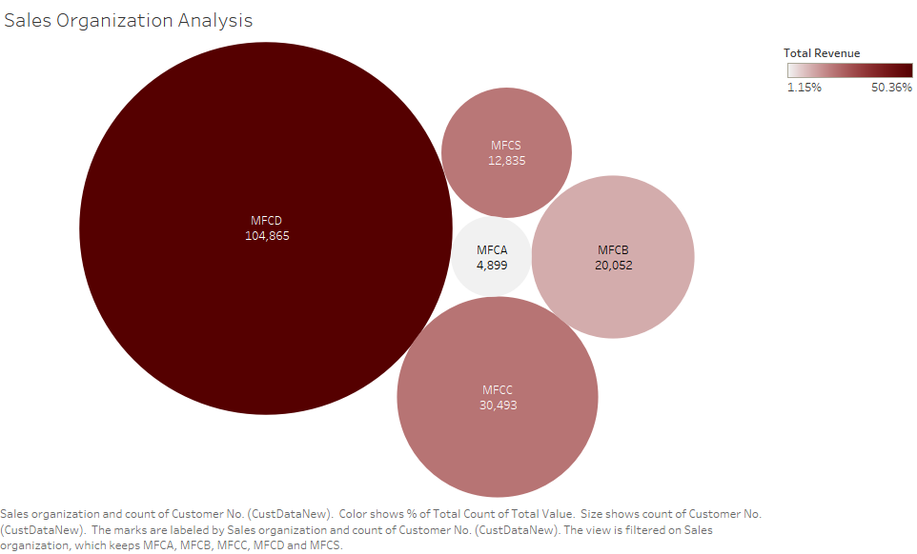

Slide 14
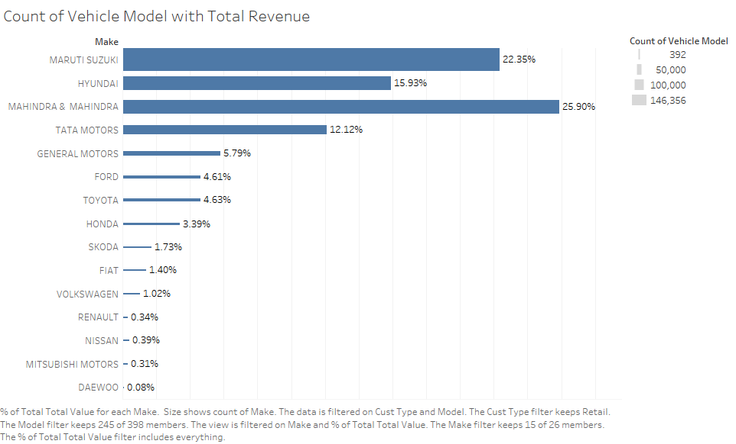

Slide 15
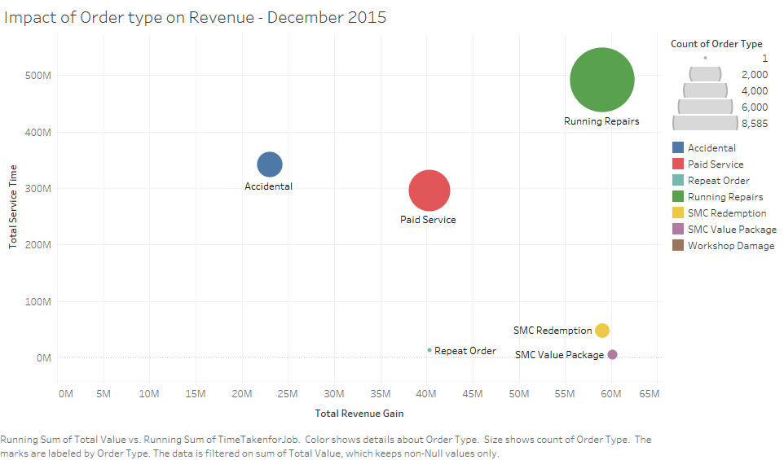

Slide 16
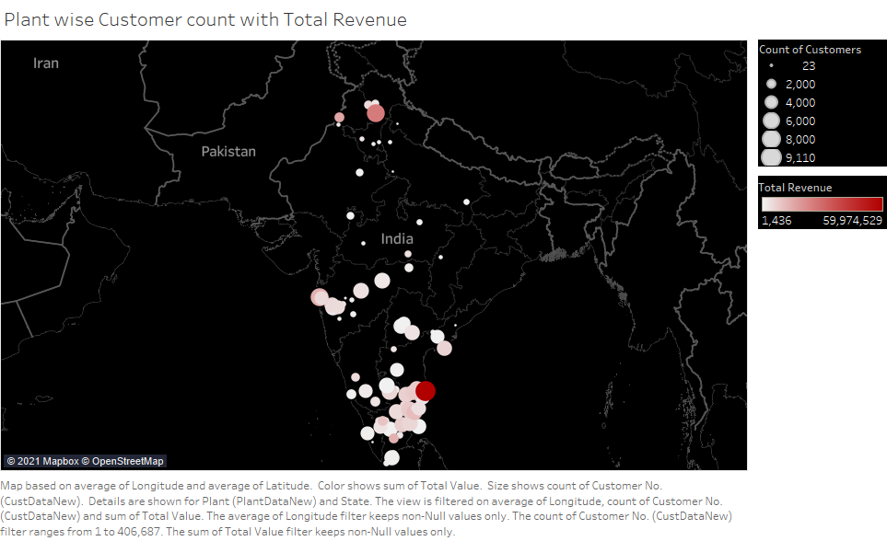

Slide 17
Customer Segmentation using RFM
What is RFM Analysis?
RFM analysis enables personalized marketing, increases engagement, and allows you to create specific, relevant offers to the right groups of customers.RFM analysis is a data-driven customer behavior segmentation technique where RFM stands for recency, frequency, and monetary value.
The idea is to segment customers based on when their last purchase was(Recency), how often they’ve purchased in the past(Frequency), and how much they spent(Monetary). All three of these measures have proven to be effective predictors of a customer’s willingness to engage in marketing messages and offers.
In our case , behavioral segmentation by 3 important features:
Recency — number of days since the last service
Frequency — number of services made over a given period
Monetary — Amount spent over a given period of time
Each of the behavior is quantiled in 3 groups for all of the customers and assigned category from 3 to 1.
3 being the most recent/frequent/revenue and 1 being the least recent/frequent/revenue 333 RFM score is the best.

Slide 18
Customer Segments
1. Core - Your Best Customers
RFM Score: 333
Who They Are: Highly engaged customers who have bought the most recent, the most often, and generated the
most revenue.
2. Loyal - Your Most Loyal Customers
RFM Score: X3X
Who They Are: Customers who buy the most often from your store.
3. Whales - Your Highest Paying Customers
RFM Score: XX3
Who They Are: Customers who have generated the most revenue for your store.
4. Rookies - Your Newest Customers
RFM Score: 31X
Who They Are: Recent buyers on your site.
5. Slipping - Once Loyal, Now Gone
RFM Score: 11X
Who They Are: Great past customers who haven't bought in awhile.
6. Regular - The customers having common behaviour across these metrics.
RFM Score: Remaining Scores
Who They Are: Customer who have average metrics across each RFM scores.

Slide 19
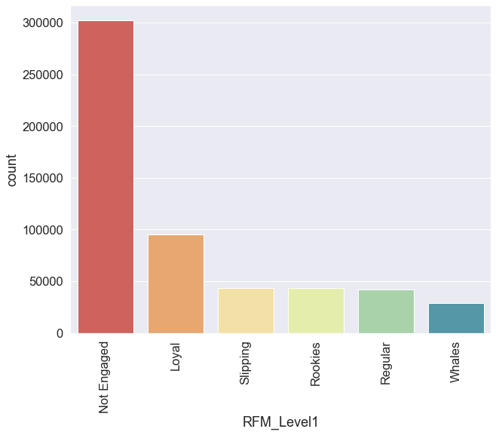
RFM Analysis

Slide 20
1. Not Engaged
A huge potential here. Run marketing campaigns to on-board them with good offers to add to the net new customer base.
2. Loyal - Your Most Loyal Customers
RFM Score: X3X
Give loyalty points which can be encashed against service charges.
Run referral program.
3. Whales - Your Highest Paying Customers
RFM Score: XX3
Make it more easier for them by providing free pick-up/drop. Provide additional feel good services. Run programs for new cars.
4. Rookies - Your Newest Customers
RFM Score: 31X
For stickiness, offer AMC packages.
5. Slipping - Once Loyal, Now Gone
RFM Score: 11X
Run program to reach out to them to understand what is stopping them from returning. If feedbacks available, analyze to understand the pain points.

Slide 21
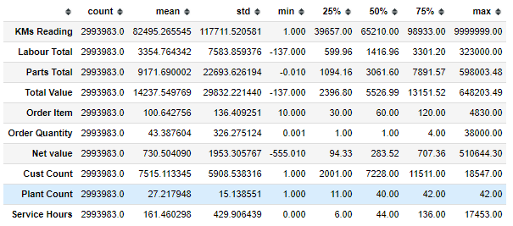
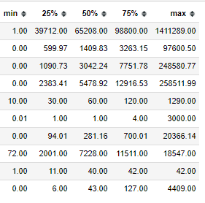
Pipeline(Handling Outliers)
For handling of outliers in the data we used IQR method.
We took the data within the range of 0.001 to 0.999

Slide 22
Feature Engineering
Methods Used for Feature Engineering
One Hot Encoding
Order Type
Sales organization
Item Category
Target quantity UoM
Frequency Encoding
Car Model

Slide 23
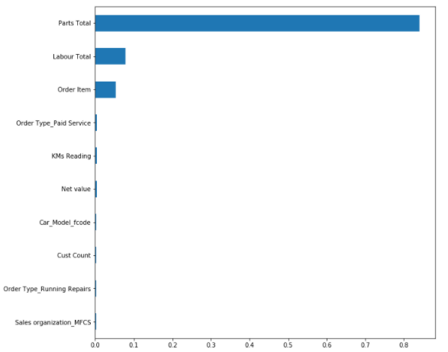
Feature Importance
Methods Used
Correlation Matrix(Numerical
Features)
Extra Trees Regressor
Decision Tree Regressor
Random Forest Regressor

Slide 24
Model and Approaches
Model | RMSE Score | MAE Score | R2 Score
Linear Regression | 2330.87 | 973.73 | 0.64
KNeighbors Regressor | 2421.53 | 964.74 | 0.62
Decision Tree Regression | 2559.34 | 830.10 | 0.42
Random Forest Regression | 1904.27 | 702.39 | 0.71
Direct Multioutput Regression with Linear SVR | 3956.2 | 1459.46 | 0.94
Chained Multioutput Regression with Linear SVR | 3644.4 | 2603.06 | 0.85

Slide 25
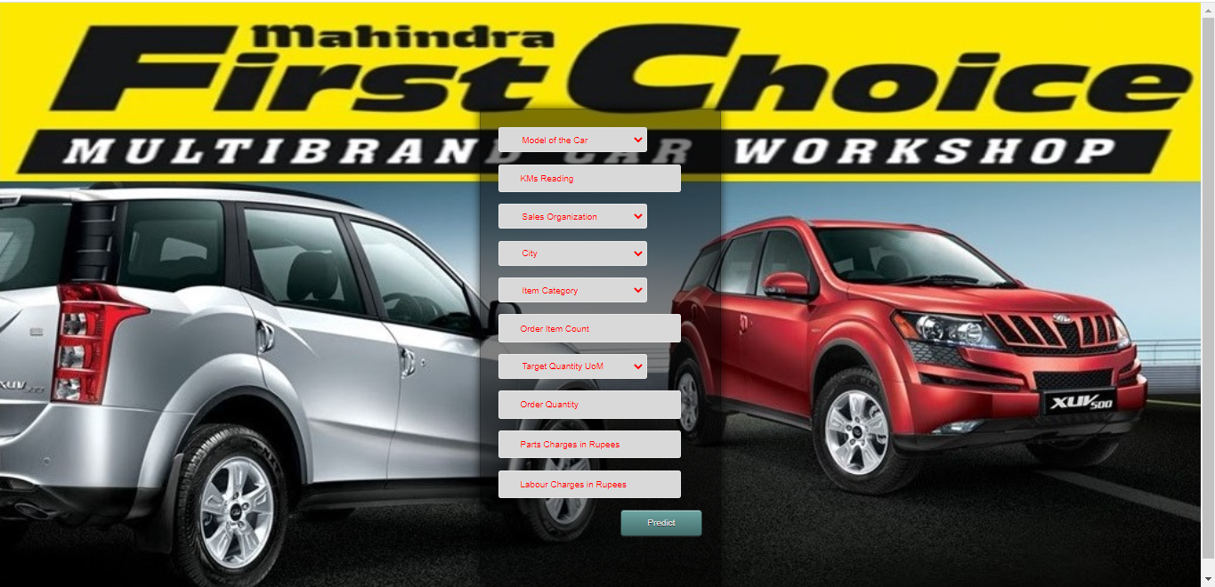
Deployment

Slide 26
Key Recommendation
Camp Outdoor has 2 most no. of invoices which brought large number of revenue.Hence we recommend the marketing team to increase the no. of outdoor service camps to maximize reach and profits.
The South zone has highest parts value and service counts too.Thus we suggest the inventory department that inventory for Southern States be increased.
Saravanan has brought highest total value hence we can suggest the human resource department to compensate him with rewards/bonus .
New upcoming plants can be planned accordingly keeping in mind the cities on the basis of KM readings.
A huge potential for Not engaged clients. Run marketing campaigns to on-board them with good offers to add to the net new customer base.

Slide 27
Future Scope
Inventory Management for optimal parts distribution across all plants.
More granular customer segmentation .
Recommender system for new plants.

Slide 28
Useful Links
Multi Output Regression Model by Jason Brownlee : https://machinelearningmastery.com/multi-output-regression-models-with-python/
Multi Output Regression Model explanation by Krish Naik : https://www.youtube.com/watch?v=26J3bcqhfLE
Mahindra First Choice Prediction Project : https://mahindrafirstchoice.herokuapp.com/
Github Link for Capstone Project : https://github.com/RounakPython/Capstone_Project_Mahindra_First_Choice_Services
Tableau Public Dashboard for Capstone EDA : https://public.tableau.com/profile/rounak.sharma#!/vizhome/Capstone_Project_Mahindra_First_Choice_Services/Capstone_EDA

Slide 29
Thank You For Your Patience!

