Slide 1

Application of machine learning for Cyber Security use cases
Vinayakumar R
PhD Student,
Centre for Computational Engineering and Networking, Amrita Vishwa Vidyapeetham,
Coimbatore
https://vinayakumarr.github.io/

Slide 2
Deep Learning
Deep learning is kind of hard. Why bother with it?
Amazing results… in speech, NLP, vision/multimodal work
Does its own feature selection!
The big players (Google, Facebook, Baidu, Microsoft, IBM…) are doing a lot of this
The hot new thing?
Actually, many of the architectures that we’ll talk about were invented in the 1980s and 1990s
What’s new is hardware that can use these architectures at scale.

Slide 3
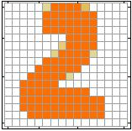
Example Application
Neural Network
Handwriting Digit Recognition
Machine
“2”

Slide 4
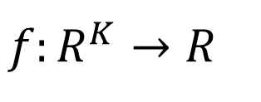
Element of Neural Network
Neural Network
Neuron
$$f:R^{K}→R$$
…
Activation function
weights
bias

Slide 5
Neural Network
neuron
Input
Layer 1
Layer 2
Layer L
Output
……
y₁
……
y₂
……
……
……
……
……
……
y_{M}
Input Layer
Output Layer
Hidden Layers
Deep means many hidden layers

Slide 6
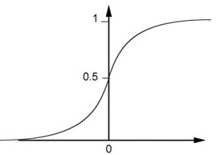
Neural Network
1
4
0.98
1
-2
1
-1
-2
0.12
-1
1
0
Sigmoid Function

Slide 7



Neural Network
……
y₁
W¹
W²
W^{L}
……
y₂
b¹
b²
b^{L}
……
……
……
……
……
x
a¹
a²
y
……
y_{M}
W¹
x
b¹
+
$$σ\left( \right)$$
a¹
b²
W²
+
$$σ\left( \right)$$
W^{L}
b^{L}
a^{L-1}
+
$$σ\left( \right)$$

Slide 8
Neural Network
Training DNN
New Activation Function

Slide 9





ReLU
Neural Network
Rectified Linear Unit (ReLU)
Reason:
$$a$$
$$σ\left(z\right)$$
1. Fast to compute
$$a=z$$
2. Vanishing gradient problem
$$a=0$$
$$z$$

Slide 10
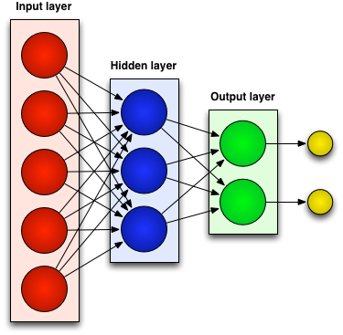
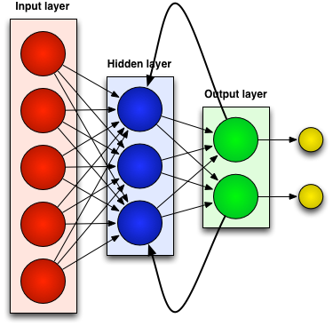
Neural Networks
Generally there are two kinds of neural networks:
Feedforward Neural Networks:
connections between the units do not form a cycle
Recurrent Neural Network:
connections between units form cyclic paths

Slide 11
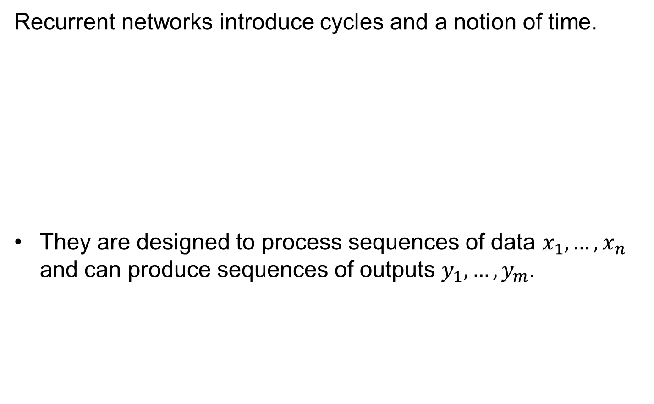




Recurrent Neural Networks
Recurrent networks introduce cycles and a notion of time.
They are designed to process sequences of data $x_{1},…,x_{n}$ and can produce sequences of outputs $y_{1},…,y_{m}$.
$$x_{t}$$
$$y_{t}$$
$$h_{t−1}$$
$$h_{t}$$
One-step delay

Slide 12













Unrolling RNNs
RNNs can be unrolled across multiple time steps.
This produces a DAG which supports backpropagation.
But its size depends on the input sequence length.
$$x_{t}$$
$$y_{t}$$
$$y_{0}$$
$$x_{0}$$
$$h_{t−1}$$
$$h_{t}$$
$$h_{0}$$
$$y_{1}$$
One-step delay
$$x_{1}$$
$$h_{1}$$
$$y_{2}$$
$$x_{2}$$
$$h_{2}$$

Slide 13















Unrolling RNNs
Usually drawn as:
$$y_{0}$$
$$x_{0}$$
$$h_{0}$$
$$y_{0}$$
$$y_{1}$$
$$y_{2}$$
$$y_{1}$$
$$x_{1}$$
$$h_{0}$$
$$h_{1}$$
$$h_{2}$$
$$h_{1}$$
$$y_{2}$$
$$x_{0}$$
$$x_{1}$$
$$x_{2}$$
$$x_{2}$$
$$h_{2}$$

Slide 14


















RNN structure
Often layers are stacked vertically (deep RNNs):
$$y_{10}$$
$$y_{11}$$
$$y_{12}$$
$$h_{10}$$
$$h_{11}$$
$$h_{12}$$
Same parameters at this level
$$x_{00}$$
$$x_{01}$$
$$x_{02}$$
≠
Abstraction
Higher level features
$$y_{00}$$
$$y_{01}$$
$$y_{02}$$
$$h_{00}$$
$$h_{01}$$
$$h_{02}$$
Same parameters at this level
$$x_{0}$$
$$x_{1}$$
$$x_{2}$$
Time

Slide 15
RNN structure
Backprop still works:
$$y_{10}$$
$$y_{11}$$
$$y_{12}$$
$$h_{10}$$
$$h_{11}$$
$$h_{12}$$
$$x_{00}$$
$$x_{01}$$
$$x_{02}$$
Activations
Abstraction
Higher level features
$$y_{00}$$
$$y_{01}$$
$$y_{02}$$
$$h_{00}$$
$$h_{01}$$
$$h_{02}$$
$$x_{0}$$
$$x_{1}$$
$$x_{2}$$
Time

Slide 16
RNN structure
Backprop still works:
$$y_{10}$$
$$y_{11}$$
$$y_{12}$$
$$h_{10}$$
$$h_{11}$$
$$h_{12}$$
$$x_{00}$$
$$x_{01}$$
$$x_{02}$$
Activations
Abstraction
Higher level features
$$y_{00}$$
$$y_{01}$$
$$y_{02}$$
$$h_{00}$$
$$h_{01}$$
$$h_{02}$$
$$x_{0}$$
$$x_{1}$$
$$x_{2}$$
Time

Slide 17
RNN structure
Backprop still works:
$$y_{10}$$
$$y_{11}$$
$$y_{12}$$
$$h_{10}$$
$$h_{11}$$
$$h_{12}$$
$$x_{00}$$
$$x_{01}$$
$$x_{02}$$
Activations
Abstraction
Higher level features
$$y_{00}$$
$$y_{01}$$
$$y_{02}$$
$$h_{00}$$
$$h_{01}$$
$$h_{02}$$
$$x_{0}$$
$$x_{1}$$
$$x_{2}$$
Time

Slide 18
RNN structure
Backprop still works:
$$y_{10}$$
$$y_{11}$$
$$y_{12}$$
$$h_{10}$$
$$h_{11}$$
$$h_{12}$$
$$x_{00}$$
$$x_{01}$$
$$x_{02}$$
Activations
Abstraction
Higher level features
$$y_{00}$$
$$y_{01}$$
$$y_{02}$$
$$h_{00}$$
$$h_{01}$$
$$h_{02}$$
$$x_{0}$$
$$x_{1}$$
$$x_{2}$$
Time

Slide 19
RNN structure
Backprop still works:
$$y_{10}$$
$$y_{11}$$
$$y_{12}$$
$$h_{10}$$
$$h_{11}$$
$$h_{12}$$
$$x_{00}$$
$$x_{01}$$
$$x_{02}$$
Activations
Abstraction
Higher level features
$$y_{00}$$
$$y_{01}$$
$$y_{02}$$
$$h_{00}$$
$$h_{01}$$
$$h_{02}$$
$$x_{0}$$
$$x_{1}$$
$$x_{2}$$
Time

Slide 20
RNN structure
Backprop still works:
$$y_{10}$$
$$y_{11}$$
$$y_{12}$$
$$h_{10}$$
$$h_{11}$$
$$h_{12}$$
$$x_{00}$$
$$x_{01}$$
$$x_{02}$$
Activations
Abstraction
Higher level features
$$y_{00}$$
$$y_{01}$$
$$y_{02}$$
$$h_{00}$$
$$h_{01}$$
$$h_{02}$$
$$x_{0}$$
$$x_{1}$$
$$x_{2}$$
Time

Slide 21
RNN structure
Backprop still works:
$$y_{10}$$
$$y_{11}$$
$$y_{12}$$
$$h_{10}$$
$$h_{11}$$
$$h_{12}$$
$$x_{00}$$
$$x_{01}$$
$$x_{02}$$
Activations
Abstraction
Higher level features
$$y_{00}$$
$$y_{01}$$
$$y_{02}$$
$$h_{00}$$
$$h_{01}$$
$$h_{02}$$
$$x_{0}$$
$$x_{1}$$
$$x_{2}$$
Time

Slide 22
RNN structure
Backprop still works:
$$y_{10}$$
$$y_{11}$$
$$y_{12}$$
$$h_{10}$$
$$h_{11}$$
$$h_{12}$$
$$x_{00}$$
$$x_{01}$$
$$x_{02}$$
Gradients
Abstraction
Higher level features
$$y_{00}$$
$$y_{01}$$
$$y_{02}$$
$$h_{00}$$
$$h_{01}$$
$$h_{02}$$
$$x_{0}$$
$$x_{1}$$
$$x_{2}$$
Time

Slide 23
RNN structure
Backprop still works:
$$y_{10}$$
$$y_{11}$$
$$y_{12}$$
$$h_{10}$$
$$h_{11}$$
$$h_{12}$$
$$x_{00}$$
$$x_{01}$$
$$x_{02}$$
Gradients
Abstraction
Higher level features
$$y_{00}$$
$$y_{01}$$
$$y_{02}$$
$$h_{00}$$
$$h_{01}$$
$$h_{02}$$
$$x_{0}$$
$$x_{1}$$
$$x_{2}$$
Time

Slide 24
RNN structure
Backprop still works:
$$y_{10}$$
$$y_{11}$$
$$y_{12}$$
$$h_{10}$$
$$h_{11}$$
$$h_{12}$$
$$x_{00}$$
$$x_{01}$$
$$x_{02}$$
Gradients
Abstraction
Higher level features
$$y_{00}$$
$$y_{01}$$
$$y_{02}$$
$$h_{00}$$
$$h_{01}$$
$$h_{02}$$
$$x_{0}$$
$$x_{1}$$
$$x_{2}$$
Time

Slide 25
RNN structure
Backprop still works:
$$y_{10}$$
$$y_{11}$$
$$y_{12}$$
$$h_{10}$$
$$h_{11}$$
$$h_{12}$$
$$x_{00}$$
$$x_{01}$$
$$x_{02}$$
Gradients
Abstraction
Higher level features
$$y_{00}$$
$$y_{01}$$
$$y_{02}$$
$$h_{00}$$
$$h_{01}$$
$$h_{02}$$
$$x_{0}$$
$$x_{1}$$
$$x_{2}$$
Time

Slide 26
RNN structure
Backprop still works:
$$y_{10}$$
$$y_{11}$$
$$y_{12}$$
$$h_{10}$$
$$h_{11}$$
$$h_{12}$$
$$x_{00}$$
$$x_{01}$$
$$x_{02}$$
Gradients
Abstraction
Higher level features
$$y_{00}$$
$$y_{01}$$
$$y_{02}$$
$$h_{00}$$
$$h_{01}$$
$$h_{02}$$
$$x_{0}$$
$$x_{1}$$
$$x_{2}$$
Time

Slide 27
RNN structure
Backprop still works:
$$y_{10}$$
$$y_{11}$$
$$y_{12}$$
$$h_{10}$$
$$h_{11}$$
$$h_{12}$$
$$x_{00}$$
$$x_{01}$$
$$x_{02}$$
Gradients
Abstraction
Higher level features
$$y_{00}$$
$$y_{01}$$
$$y_{02}$$
$$h_{00}$$
$$h_{01}$$
$$h_{02}$$
$$x_{0}$$
$$x_{1}$$
$$x_{2}$$
Time

Slide 28
RNN structure
Backprop still works:
$$y_{10}$$
$$y_{11}$$
$$y_{12}$$
$$h_{10}$$
$$h_{11}$$
$$h_{12}$$
$$x_{00}$$
$$x_{01}$$
$$x_{02}$$
Gradients
Abstraction
Higher level features
$$y_{00}$$
$$y_{01}$$
$$y_{02}$$
$$h_{00}$$
$$h_{01}$$
$$h_{02}$$
$$x_{0}$$
$$x_{1}$$
$$x_{2}$$
Time

Slide 29

Recurrent Neural Network
We can process a sequence of vectors x by applying a recurrence formula at every time step:
y
RNN
new state
old state
input vector at some time step
some function
with parameters W
x

Slide 30

Recurrent Neural Network
The state consists of a single “hidden” vector h:
y
RNN
x

Slide 31
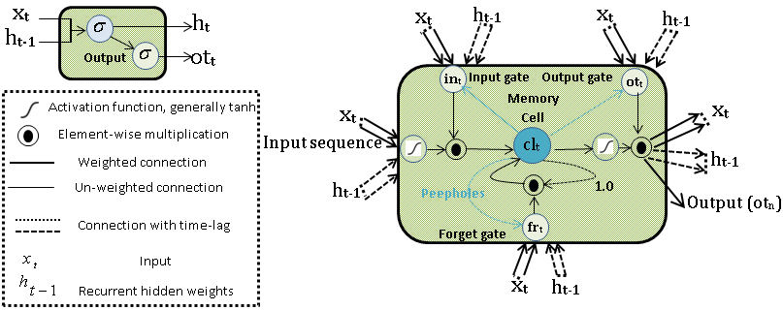
Long short-term memory

Slide 32
Long short-term memory

Slide 33
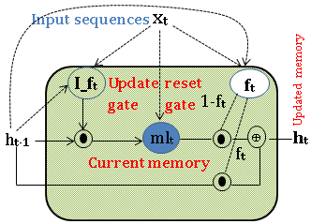
Gated Recurrent Unit
Gated recurrent unit (GRU) is an alternative to LSTM networks.
Formulae shows, unlike LSTM memory cell with a list of gates (input, output and forget), GRU only consist of gates (update and forget) that are collectively involve in balancing the interior flow of information of the unit.

Slide 34
Gated Recurrent Unit
(Update gate)
(Forget or reset gate)
(Current memory)
(Updated memory)

Slide 35
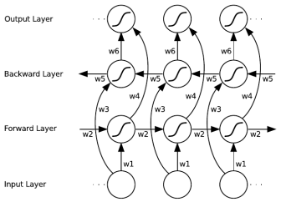
Extensions to LSTM architecture: Bidirectional RNN, LSTM, GRU
Only the past information is taken into account in the training of a unidirectional RNN/LSTM
Bidirectional architecture enables the use of future information
Implementation with separate Forward-pass and Backward-pass specific layer weights
Final output computed as the sum of forward and backward layer outputs

Slide 36
Convolutional Neural Network
Neural Network with a convolution operation instead of matrix multiplication in at least one of the layers
Input an Image
Convolution operation
Detector
Non-linearity
Pooling
Fully connected layer
Normalization
(Optional)

Slide 37
Convolutional Neural Network
Input, e.g. an image
1 | 3 | 5 | 2 | 4
6 | 0 | 2 | 1 | 3
6 | 3 | 1 | 3 | 6
7 | 3 | 2 | 1 | 3
5 | 3 | 0 | 0 | 2
Filter (Kernel)
0.2 | 0.7
-0.5 | 0.7

Slide 38
Convolutional Neural Network
Input, e.g. an image
1 | 3 | 5 | 2 | 4
6 | 0 | 2 | 1 | 3
6 | 3 | 1 | 3 | 6
7 | 3 | 2 | 1 | 3
5 | 3 | 0 | 0 | 2
$$c_{1} =f (0.2∗1+0.7∗3 −0.5 ∗6+0.7∗0) = f(−0.7)$$
$$c_{2} =f(0.2∗3+0.7∗5 −0.5 ∗0+0.7∗2) = f(5.5)$$
Note: Bias terms omitted!
Filter (Kernel)
Feature map
f represents some non-linear activation function
f(-0.7) | f(5.5) | …
0.2 | 0.7
-0.5 | 0.7

Slide 39
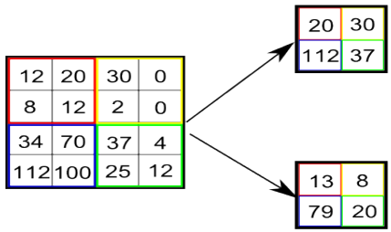
Convolutional Neural Network
Max-pooling
Average pooling

Slide 40
Cyber Security use cases
Intrusion Detection
Domain Generation Algorithms
Malicious URL Analysis
Spam Email Detection
Image Spam Detection
Malware Analysis

Slide 41
Software Installation
sudo apt-get install libatlas-base-dev gfortran python-dev
sudo apt-get install python-pip
sudo pip install --upgrade pip
sudo pip install numpy
sudo pip install scipy
sudo pip install matplotlib
Sudo pip install seaborn
sudo pip install scikit-learn
sudo pip install tensorflow
sudo pip install theano
sudo pip install keras
sudo pip install pandas
sudo pip install h5py
sudo pip install jupyter
sudo pip install ipython

Slide 42
Artificial Intelligence (AI) toolkits
Scikit-learn - Python library that implements a comprehensive range of machine learning algorithms.
easy-to-use, general-purpose toolbox for machine learning in Python.
supervised and unsupervised machine learning techniques.
Utilities for common tasks such as model selection, feature extraction, and feature selection.
Built on NumPy, SciPy, and matplotlib.
Open source, commercially usable - BSD license.

Slide 43
Artificial Intelligence (AI) toolkits
TensorFlow - library for numerical computation using data flow graphs / deep learning.
Open source
By Google
used for both research and production
Used widely for deep learning/neural nets
But not restricted to just deep models
Multiple GPU Support

Slide 44
Artificial Intelligence (AI) toolkits
Keras – It is a high-level neural networks API, written in Python and capable of running on top of TensorFlow, CNTK, or Theano. It was developed with a focus on enabling fast experimentation.
Allows for easy and fast prototyping (through user friendliness, modularity, and extensibility).
Runs seamlessly on CPU and GPU.

Slide 45
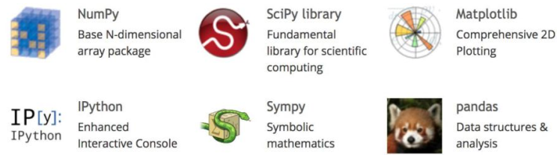
Supporting Libraries

Slide 46
Intrusion Detection
Intrusion : Attempting to break into or misuse your system.
Intruders may be from outside the network or legitimate users of the network.
Intrusion can be a physical, system or remote intrusion.
Intrusion Detection Systems look for attack signatures, which are specific patterns that usually indicate malicious or suspicious intent.
anomaly detection, signature based, host based and network based are different IDS.
There are various approaches to attack malicious activities, namely (1) static approaches: firewalls, encryption and decryption techniques of cryptography, software updates and many others and (2) dynamic approaches: anomaly and intrusion detection (ID).

Slide 47
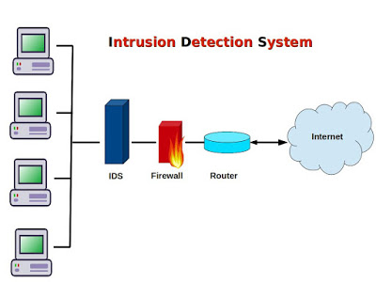
Intrusion Detection

Slide 48
Intrusion Detection
Intrusion detection is categorized in to 2 types based on the network behavior and network type.
Network-based IDS (N-IDS): Most commonly used in both academia and industries, it analyzes all the network traffic by looking in packet level information to find the suspicious activity.
Host-based IDS (H-IDS): focuses on the information of each particular system or host, heavily depends for data on the sources of log files such as sensors, system logs, software logs, file systems, disk resources and many more. Mostly, organizations used combination of both of them to get benefited largely in real-time IDS deployment.
Lincoln Labs - raw TCP dump data collected from a local-area network (LAN).

Slide 49
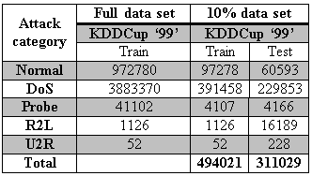
Intrusion Detection
DOS - Intruder aims at making network resources down and consequently, resources are inaccessible to authorized users, e.g. syn flood.
Probe - acquiring statistics about the computer System or network e.g., port scanning.
R2L - Illegitimate access from remote computer , e.g. guessing password.
U2R - acquiring the root or super-user access on a specific computer, e.g., various `buffer overflow' attacks.

Slide 50
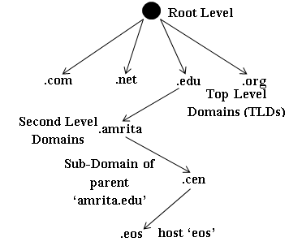
Domain Name System
Domain name system (DNS) is an application protocol.
Maps domain name to IP address and vice-versa.
Hierarchical Domain Name System

Slide 51
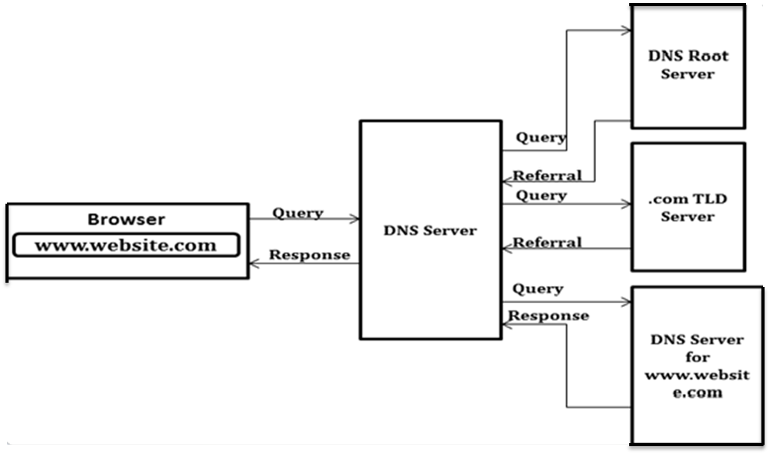
Domain Name System
Recursive and Non-recursive are 2 types of DNS server.
Recursive DNS query

Slide 52
Domain Name System
Adversaries frequently use domain names to connect malware to command and control servers (C2C). These domain names are hardcoded.
Hardcoded domain names are easy to blacklist or sinkhole.
To evade blacklisting, adversaries use the concept of fluxing.
Domain flux and IP-flux are two types of fluxing approaches.
Domain flux uses DGAs.
DGAs generate pseudo random domain names periodically and connects them to a C2C server. The pseudo random domain names are generated based on a seed. A seed is a combination of numeric, alphabet, date/time and other information.
Machine learning methods with feature engineering used to detect the DGA based malware.
Deep learning is a new field of machine learning that has the capability to obtain optimal feature representation by taking raw domain names as input.

Slide 53
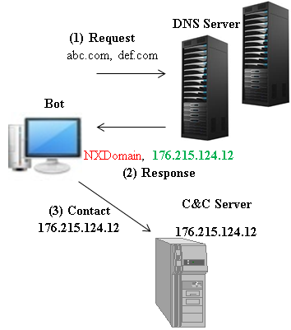
Domain Name System
Diagram of Domain-flux attacks

Slide 54
Thank you
Questions ?
vinayakumarr77@gmail.com
https://vinayakumarr.github.io/

