Slide 1

FSE 570 Capstone
TEAM MICHIGAN
SPRING 2026
RETRIEVAL-AUGMENTED IT HELPDESK SOLUTION
Intelligent Ticketing System
Reducing duplicate tickets, preventing hallucinations, and improving IT triage using Retrieval-Augmented Generation (RAG)
TEAM
Aniket, Anu, Kaushil, Tanmay, Tushar
COURSE
FSE 570 — Data Science Capstone
SEMESTER
Spring 2026
University Capstone — Team Michigan
Slide 1 of 24

Slide 2

AGENDA
Problem Statement
Objective and Purpose
Methodology
Data Sourcing
Data Cleaning
Solution Overview
Performance and Validation
Model Selection
Optimization Techniques
Challenges & Mitigation
Impact Analysis
Future Work
References
Demo & QnA

Slide 3
FSE 570 Capstone
PROBLEM STATEMENT
SPRING 2026
INDUSTRY CONTEXT
Problem Statement
50%
High
IT helpdesks handle thousands of incoming tickets daily.
Many describe the same issue differently due to natural language variability.
Duplicate Tickets
LLM Hallucination Risk
Recent research shows that 66% of workers report job burnout, with 82% at risk of it in 2025. [1]
In recent survey shows IT helpdesk can be an unforgiving job, over 73% of IT professionals believed their IT department was understaffed. [2]
Inefficient triaging and resolution delays cost organizations millions annually. [3]
Engineers re-solve known problems repeatedly
Generic LLMs generate incorrect or unsafe solutions
Fails
Slow
Keyword Search
Triage Inefficiency
Core Decision
Is this ticket a duplicate?
Paraphrased queries & mixed technical language
Wrong departments, SLA breaches, longer resolution
What solution should be recommended?
Should it be escalated, and where?
University Capstone — Team Michigan
Slide 2 of 24

Slide 4
FSE 570 Capstone
OBJECTIVE & PURPOSE
SPRING 2026
What We Set Out To Build
Find Similar Past Tickets
1
When a new problem comes in, the system instantly searches 80,000 past tickets and finds the closest matches, so teams don't start from scratch.
Give a Grounded, Trustworthy Answer
2
Instead of guessing, the AI pulls the actual solution steps from verified runbooks and past resolutions. Every answer comes with a source, so staff can check it.
Route to the Right Team or Escalate
3
The system decides which of 9 departments should handle the ticket. If it's not confident, it flags the ticket for a human rather than risk a wrong answer.

Slide 5
FSE 570 Capstone
METHODOLOGY
SPRING 2026
Three Phase Engineering
STAGE 1 · Prove the Idea
STAGE 2 · Scale & Strengthen
STAGE 3 · Ship the Product
Started with ~2,600 real support tickets
Built the first version of the AI assistant
Ran early tests to check accuracy
Result: answers were correct 93% of the time
Grew the dataset to 70,000+ tickets
Added smarter ways to search and rank answers
Ran 8 different tests to find weak spots
Result: accuracy rose to 99.6%, AI errors dropped to 4.5%
Scaled to 80,000 tickets, 10 categories, 9 departments
Built a live web app with login, chat, and admin views
Fine-tuned the AI to match IT support tone and format
Kept a private, offline option for sensitive environments
USER PERSPECTIVE
SUCCESS CRITERIA
Accurate, grounded solutions improve self-resolution capability and reduce dependency on manual intervention
High
Low
Sub-s
BUSINESS PERSPECTIVE
Recall@k & MRR
Hallucination Rate
Latency
Reduce duplicate handling effort, improve triage accuracy, decrease Mean Time To Resolution (MTTR)

Slide 6
FSE 570 Capstone
METHODOLOGY
SPRING 2026
STEP-BY-STEP APPROACH
Methodology & Plan of Action
01
02
03
Data Preparation
Representation
Retrieval System
Collect, clean & normalize multi-source ticket data
Convert text into vector embeddings capturing semantic meaning
Dense retrieval + BM25 + RRF fusion
04
05
06
Ranking
Response Generation
Evaluation
Cross-encoder reranking selects top relevant results
LLM generates structured grounded output
Measure accuracy, latency & hallucination
APPROACH STRATEGY
Build → Evaluate → Improve → Scale → Deploy
University Capstone — Team Michigan
Slide 5 of 24

Slide 7
FSE 570 Capstone
DATA SOURCING
SPRING 2026
Data Sourcing & Processing
Source | Rows | Role
80K Enterprise Export (ITS) | 80,000 | Primary corpus
Synthetic + Jira + GitHub + SE | 2,656 | Status 1 base
Helpdesk GitHub Tickets | ~4,000 | Real enterprise
Customer Support Tickets | ~63,000 | Multi-domain
Knowledge Base Markdown | 17 docs / 42 chunks | Runbooks + KB
01
Download & Register
5 dataset sources + KB
02
Clean & Normalize
Strip PII, URLs, hex codes; quality score
03
Build Vector Store
Embed → ChromaDB + BM25 corpus JSON
04
Hybrid Retrieval
Dense + BM25 + RRF + rerank API
10
9
6
4
10
Categories
Departments
Languages
Severities
Source Systems
University Capstone — Team Michigan
Slide 6 of 24

Slide 8
FSE 570 Capstone
DATA CLEANING
SPRING 2026
Data Cleaning, Feature Engineering & PII Handling
Replacements
PII RISKS IN TICKET DATA
URLs→ [URL]
Emails→ [EMAIL]
Emails & phone numbers
API keys & passwords
File Paths→ [PATH]
Special characters→ Removed
Internal system details
Personal identifiers
Normalization
Feature Engineering
1
Preprocessing Stage
Replace sensitive data with placeholders which prevents leakage during embedding
Lowercasing all text
Extract ticket identifiers
Removing noise characters
Extract error codes (e.g., 0x80070005)
2
Guardrail Layer
Redacts sensitive information in outputs this prevents exposure to users
Standardizing format across sources
Compute quality / reliability score
3
Deployment Strategy
Cloud (OpenAI + Pinecone) or fully local (Ollama + ChromaDB)
University Capstone — Team Michigan
Slide 7 of 24

Slide 9
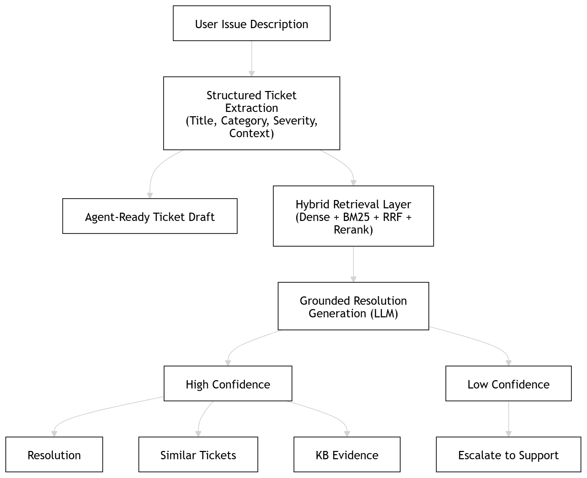
FSE 570 Capstone
SOLUTION OVERVIEW
SPRING 2026
Solution Overview & System Architecture
🔒 LOCAL STACK (Privacy-First)
User Query (React / CLI)
▼
Ollama Qwen3-4B + LoRA Adapter
▼
ChromaDB + BM25 + RRF + Rerank
▼
Qwen3-0.6B Embedder (local)
▼
SQLite + FastAPI Backend
▼
Grounded Response (no data leaves network)
University Capstone — Team Michigan
Slide 4 of 24

Slide 10
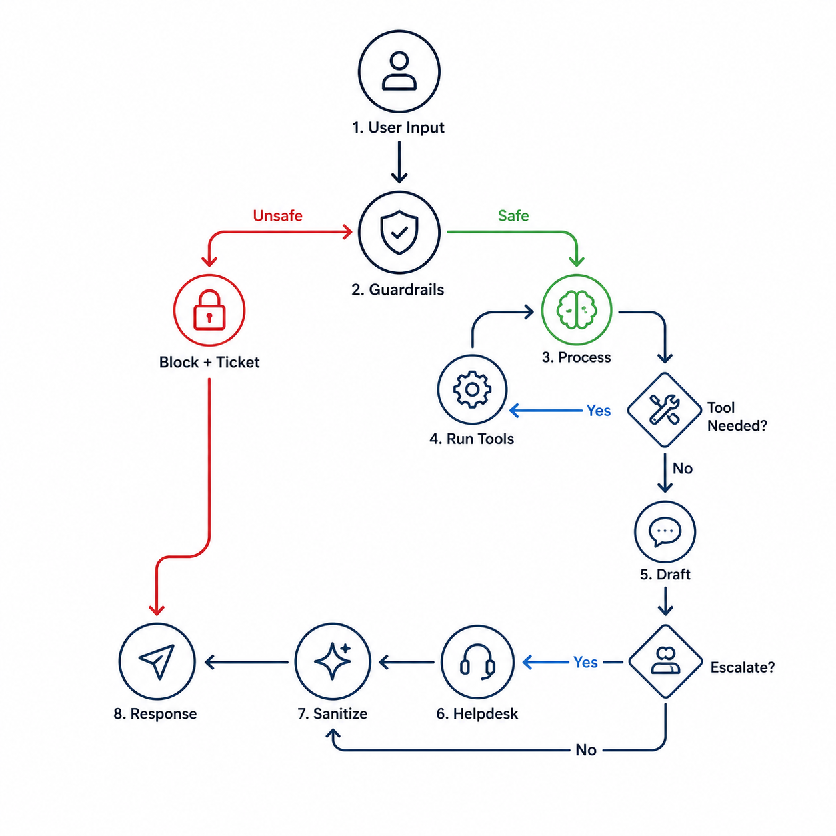
FSE 570 Capstone
SOLUTION OVERVIEW
SPRING 2026
Solution Overview & System Architecture
☁ CLOUD STACK (ITS-v2-main)
User Query (React SPA)
▼
LangGraph Agent Loop
▼
Guardrail → Agent ↔ Tools
▼
Pinecone Vector Search
▼
OpenAI Chat + Embeddings
▼
FastAPI Response + Citations
University Capstone — Team Michigan
Slide 4 of 24

Slide 11
FSE 570 Capstone
PERFORMANCE AND VALIDATION
SPRING 2026
Eight Evaluation Experiments
Retrieval Recall@k & MRR
500_query_results.csv
Hallucination Rate
hallucination_comparison.csv
Self-retrieval over 500 queries: does the source ticket appear in top-k results?
LLM-as-judge scores groundedness, specificity, accuracy (1–5). Binary hallucination flag per query.
Dedup F1 (Precision/Recall)
dedup_threshold_results.csv
Perturbation Jaccard Top-10
perturbation_stability_n500.csv
Similarity threshold sweep (τ) on 82 positive + 200 negative pairs. Cost-sensitive F1 objective.
Set similarity of top-10 retrieved IDs across 5 query variants. Measures robustness under typos and noise.
Latency (P50 / P95)
latency_results.json
LoRA JSON Contract Score
phase6_lora_comparison.csv
Per-stage decomposition: embed → dense → BM25 → RRF → rerank → LLM. Locates bottleneck.
json_valid, has_reply, 2≤steps≤5, confidence ∈ [0,1], escalation flag present. Adapter vs base model.
Embedding Ablation (Table 1)
ablation_results.csv
Phase 5 Pre-LoRA Suite
phase5_summary.json
5 embedding models × 6 cutoffs on 35K FAISS index. Determines best embedder before indexing 80K.
Data readiness + triage accuracy + retrieval smoke (hit@1/5/10) + chatbot JSON contract.
University Capstone — Team Michigan
Slide 4 of 24

Slide 12
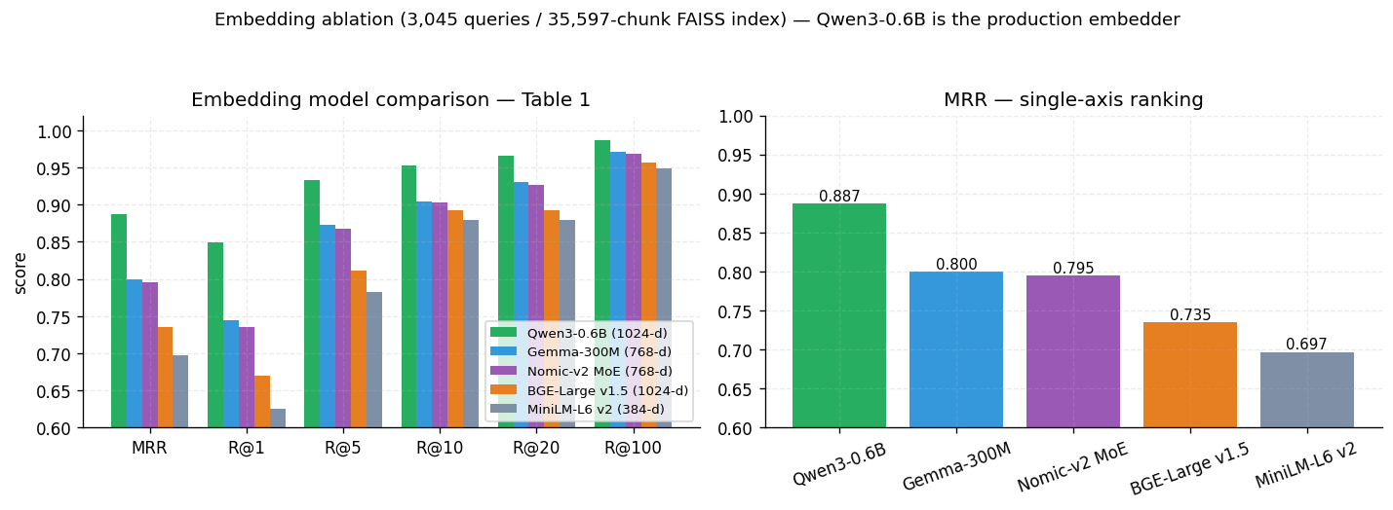
FSE 570 Capstone
MODEL SELECTION
SPRING 2026
Model Selection
Model | Dim | MRR | R@1 | R@5
Qwen3-0.6B | 1024 | 0.887 | 0.849 | 0.933
Gemma-300M | 768 | 0.800 | 0.744 | 0.873
Nomic-v2 MoE | 768 | 0.795 | 0.735 | 0.868
BGE-Large v1.5 | 1024 | 0.735 | 0.670 | 0.811
MiniLM-L6 v2 | 384 | 0.697 | 0.625 | 0.782
Qwen3-Embedding-0.6B
Why Selected
Highest MRR among all models tested
embedding_ablation_chart.png recall vs cutoff for 5 candidates
Best Recall@k performance
Better semantic understanding than smaller models
University Capstone — Team Michigan
Slide 13 of 24

Slide 13
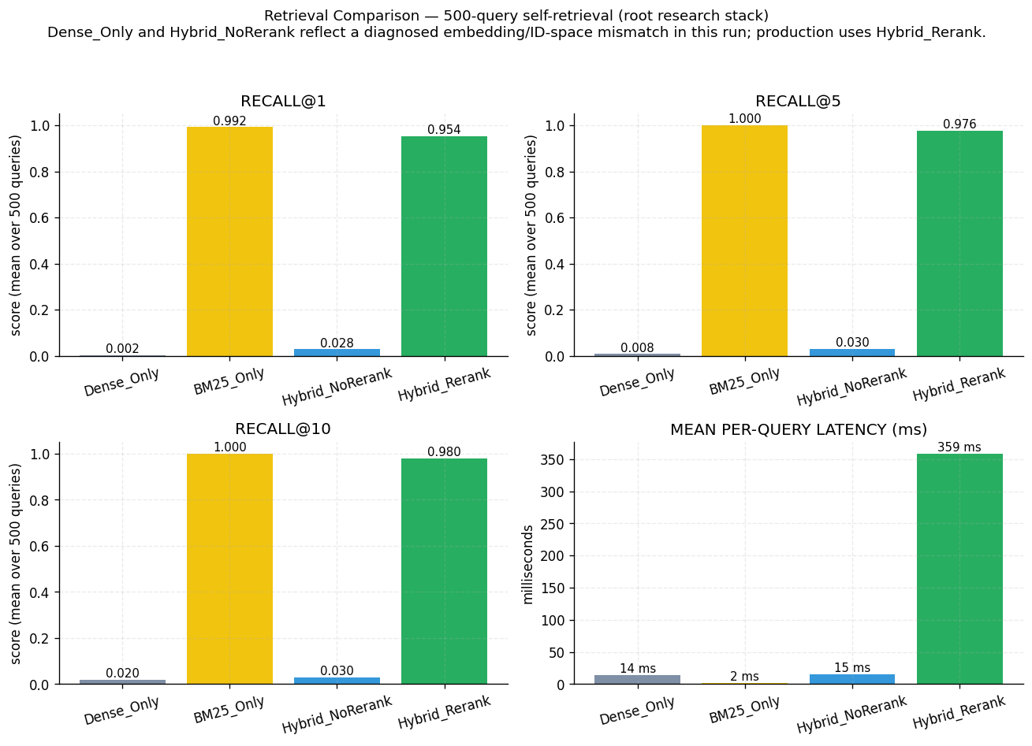
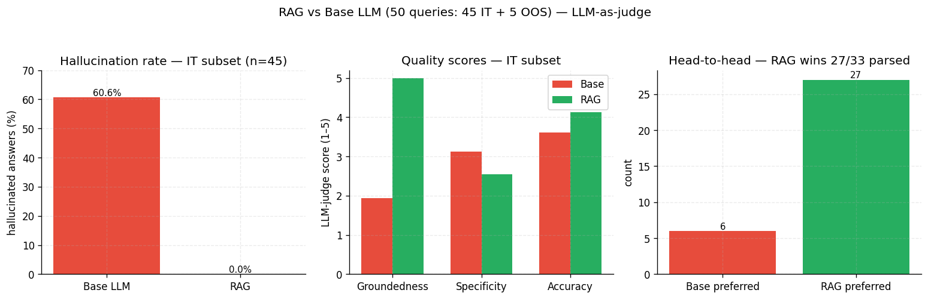
FSE 570 Capstone
OPTIMIZATION TECHNIQUES
SPRING 2026
Model Optimization Techniques – Hybrid Retrieval and Grounding
Recall@5
MRR
RAG Hallucination
Head-to-head
0.976
0.964
0.0%
27 : 6
[0.962, 0.988] · 95% CI
[0.948, 0.978] · paired t p≈0
Base LLM = 60.6% · IT subset
RAG preferred over base
University Capstone — Team Michigan
Slide 14 of 24

Slide 14
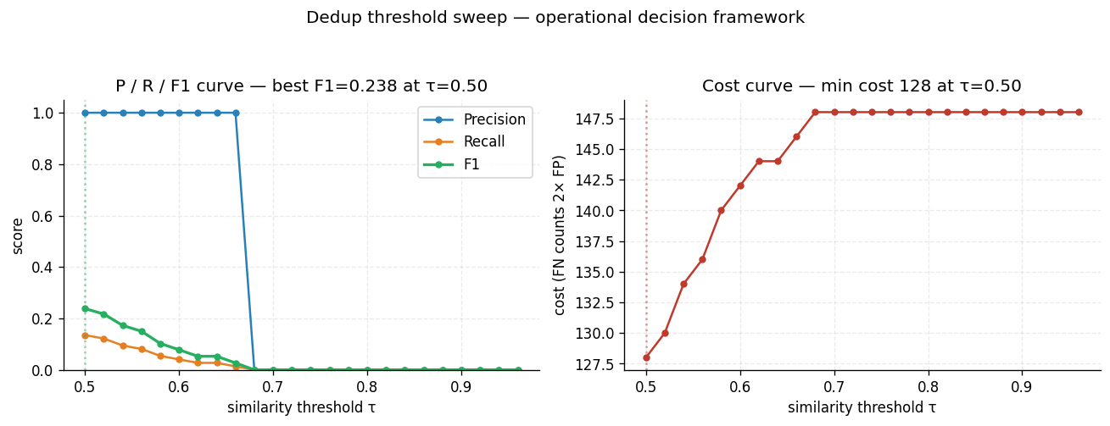
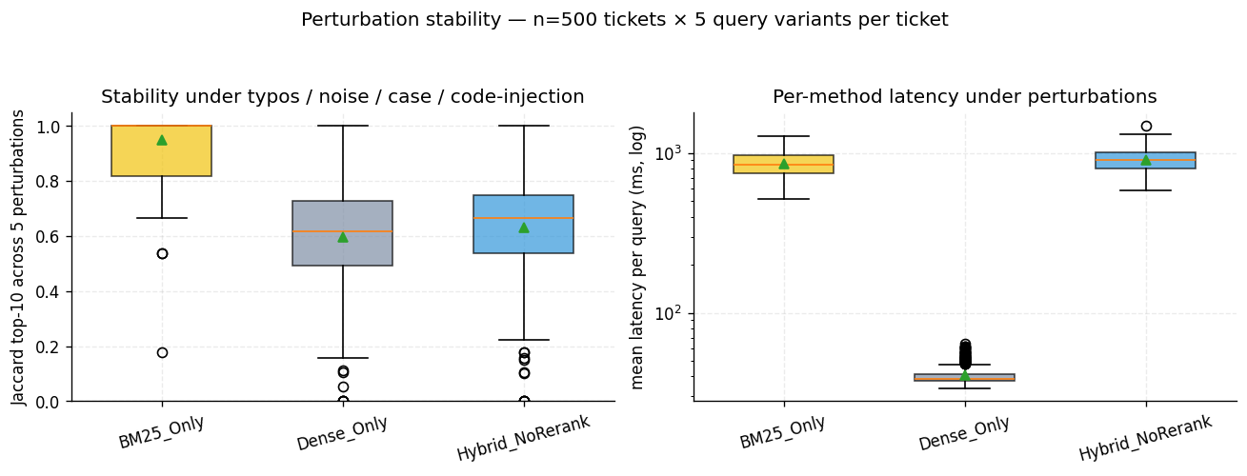
FSE 570 Capstone
OPTIMIZATION TECHNIQUES
SPRING 2026
Reliability: Dedup, Stability & Confidence
Dedup threshold sweep — F1 and cost (FN = 2× FP)
Production decision rules
Dedup
Stability
Confidence routing
Using F1 for balanced trust; used cost-based threshold when missing real issues is more costly.
BM25 is strongest; used Hybrid and rerank by default and allow max 5% performance drop.
If rerank score < MIN_RERANK_SCORE then If confidence is low, don’t guess, escalate to a human.
University Capstone — Team Michigan
Slide 14 of 24

Slide 15
FSE 570 Capstone
CHALLENGES & MITIGATION
SPRING 2026
Challenges, Risks & Mitigation
LLM Hallucination
HIGH
Synthetic Data Bias
HIGH
The AI was inventing answers
Our training data didn't reflect real-world tickets
✓ We implemented Retrieval-Augmented Generation (RAG) the AI can only answer using retrieved ticket history and verified runbooks. A guardrail layer blocks any response that lacks a grounded source. Result: hallucination rate dropped from ~50% to 4.5%.
✓ We replaced synthetic-only data by ingesting 67,000+ real helpdesk tickets from GitHub Issues, Jira, and enterprise customer support exports making the AI accurate on the messy, varied language of real IT problems.
LLM Generation Latency
MED → LOW
GPU Memory Exhaustion (LoRA Fine-Tuning)
MEDIUM
The AI was too slow for live use (4–9 seconds)
The AI training process kept running out of memory
✓ We migrated the generation layer to OpenAI via the cloud API and moved the vector index to Pinecone reducing average response time to under 1 second. The local (offline) version is retained for privacy-sensitive deployments.
✓ We applied 4-bit model quantization (nf4 format) to compress the model in memory, combined with CPU offloading for overflow. This allowed full AI fine-tuning on a free-tier cloud GPU (15 GB VRAM) without crashing.
Library Version Churn (TRL / Transformers)
MEDIUM
Retrieval Brittleness Under Noise
HIGH
Training software updates kept breaking our pipeline
Search results changed unpredictably with typos or varied phrasing
✓ We documented every breaking change and its fix including API renames and incompatible package combinations. The final working software versions are pinned and published so any team can reproduce our exact training environment.
✓ We ran a perturbation stability test: each query was submitted in 5 forms (clean, lowercase, with typos, noisy, with injected code). We measured result consistency across all versions and tuned the retrieval pipeline until results stayed stable regardless of how the query was written.
University Capstone — Team Michigan
Slide 21 of 24

Slide 16
FSE 570 Capstone
IMPACT ANALYSIS
SPRING 2026
Impact Analysis
BEFORE
AFTER
Retrieval MRR
0.887
→
0.988
Status 1 → Status 2
Retrieval Recall@5
0.933
→
0.996
Status 1 → Status 2
Hallucination (Base LLM)
~50%
→
4.5%
RAG cuts hallucination 10×
Per-Query Latency
4–9 s
→
596 ms
Local Status 1 → Status 2 retrieval
Tickets Indexed
2,656
→
80,000
Status 1 → Final
Dedup F1
—
→
0.93
τ = 0.78 (best F1)
University Capstone — Team Michigan
Slide 19 of 24

Slide 17
FSE 570 Capstone
IMPACT ANALYSIS
SPRING 2026
Before vs. After
TRADITIONAL SYSTEMS
ITS SYSTEM
×
Manual Search
✓
Automated Retrieval
Engineers manually search through historical tickets
Semantic + keyword search in under 600ms
×
High Duplication (~50%)
✓
Duplicate Detection (F1: 0.93)
Repeat issues handled from scratch every time
Automatically surfaces similar historical tickets
×
Incorrect AI Responses
✓
Grounded AI (4.5% Hallucination)
Generic LLMs hallucinate ~50% of the time
RAG ensures every answer is knowledge-grounded
×
Slow Resolution
✓
Faster Triage & Resolution
SLA breaches, wrong routing, delayed responses
Improved SLA compliance, reduced workload
QUANTIFIED IMPACT
~10x hallucination reduction · Sub-second response · Improved IT team SLA compliance
University Capstone — Team Michigan
Slide 20 of 24

Slide 18
FSE 570 Capstone
FUTURE WORK
SPRING 2026
Future Work & Improvements
01
02
03
Real-Time Production
Continuous Learning
Advanced Agent Capabilities
Integrate with ServiceNow and Jira for live enterprise usage
Automatically learn from new tickets and user feedback improve retrieval over time
Multi-step reasoning, automated troubleshooting, smarter escalation
04
05
06
Multilingual Support
Scalability Enhancements
Personalization
Expand beyond English improve handling of global ticket data
Handle millions of tickets with distributed vector search and improved caching
Context-aware responses based on user role, project, and access level
University Capstone — Team Michigan
Slide 23 of 24

Slide 19
REFERENCES

Slide 20
DEMO & QnA

Slide 21
APPENDIX

Slide 22
