Slide 1
FSE 570 — DATA SCIENCE CAPSTONE
Intelligent Ticketing System
From a Research RAG Prototype to a Production AI Helpdesk
Team Michigan
PROJECT AT A GLANCE
Aniket · Anu · Kaushil · Tanmay · Tushar
› 80,000 tickets across 10 source systems · 6 languages
› Hybrid retrieval: Qwen3 embed · BM25 · RRF · rerank
› RAG hallucination 0.0% vs base LLM 60.6%
› Two stacks: local ChromaDB / Ollama · cloud Pinecone / OpenAI
› Live LangChain + LangGraph helpdesk agent (React + FastAPI)
Arizona State University · Spring 2026

Slide 2
TODAY'S 10-MINUTE WALKTHROUGH
Agenda
01
Problem & motivation
Why IT helpdesks need grounded retrieval, not free-form LLMs
02
Data sources & preprocessing
80K enterprise tickets · 70K multi-domain · KB runbooks · dedup pairs
03
Research methodology & evaluation
Embedding ablation · hybrid retrieval · hallucination · stability · LoRA
04
Transition to production system
Why we moved to Pinecone, OpenAI, LangChain, and LangGraph
05
Results, recommendations & live demo
KPIs · decision frameworks · React + FastAPI helpdesk agent
Team Michigan · Intelligent Ticketing System · FSE 570 Capstone · Spring 2026
Slide 2 / 12

Slide 3
PROBLEM STATEMENT
The Problem: IT Helpdesks Lose Time Three Ways
IT teams face repeat tickets, brittle keyword search, and LLM helpers that hallucinate unsafe steps. Our goal: retrieve similar tickets, ground answers in the KB, and escalate when confidence is low.
Duplicate tickets
LLM hallucinations
Triage drift
• Up to ~50% of incoming tickets repeat solved issues
• Keyword search misses paraphrased duplicates
• Analysts re-investigate the same problem weekly
• Plain LLM invents error codes (0x80070005) and runbooks
• Wrong steps can break production systems
• Base-LLM hallucination rate measured at 60.6%
• Manual routing is inconsistent across analysts and shifts
• Mis-routed tickets miss department SLAs
• Confidence is implicit, not auditable
Decision goal: for every new ticket, answer (a) Has this been solved? (b) What grounded steps to try? (c) Should we escalate, and to whom?
Team Michigan · Intelligent Ticketing System · FSE 570 Capstone · Spring 2026
Slide 3 / 12

Slide 4
THE STORY ARC
Project Evolution: Research Prototype → Scaled Eval → Production
We proved the science locally, hardened it under scale, then transitioned the deployable layer for speed.
STATUS 1 · March
STATUS 2 · April
FINAL · May
Local Research Prototype
Scaled Eval & Reliability
Production Helpdesk Agent
– 2,656 tickets · Jira + GitHub + Stack Exchange + synthetic
– ChromaDB · MiniLM-L6 · BM25 · RRF (k=60)
– Cross-encoder rerank · Qwen3-4B LLM
– Streamlit + CLI · 17 KB runbooks
– MRR 0.887 · R@5 0.933 · Halluc ~10% (RAG)
– 70K+ tickets across 6 datasets
– Qwen3-0.6B 1024-d embeddings (Table 1 winner)
– PageIndex KB · HyDE · RRF tuning
– Confidence-aware escalation routing
– R@5 0.996 · MRR 0.988 · 596 ms retrieval
– 80K tickets · 1,500-example LoRA dataset
– React + FastAPI SPA · SQLite/PostgreSQL
– Pinecone vector DB · OpenAI chat + embed
– LangChain + LangGraph 3-node ReAct agent
– Sub-second per turn · live demo today
Prove the science → scale + harden → ship a fast, demo-ready product
Team Michigan · Intelligent Ticketing System · FSE 570 Capstone · Spring 2026
Slide 4 / 12

Slide 5
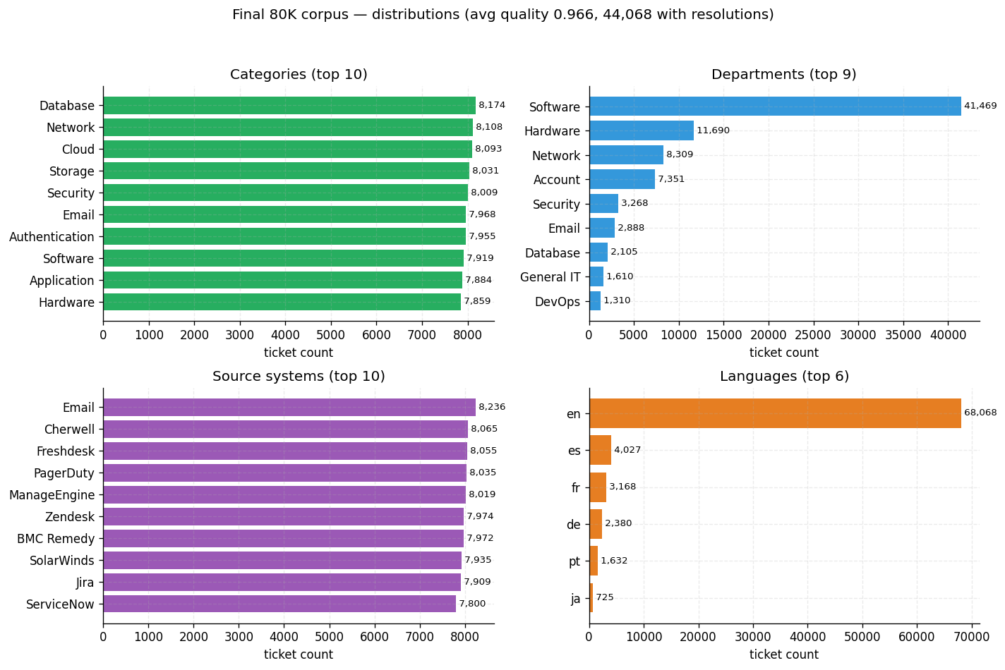
RUBRIC: DATA SOURCES & ANALYSIS (20%)
Data Sources: Large, Heterogeneous, and Governed
Dataset | Role | Size
Enterprise ITS export (its_tickets_80k.csv) | Primary heterogeneous corpus | 80,000
Customer Support Tickets | Multi-domain generalization | ~63,000
Helpdesk GitHub Tickets | Real software-support diversity | ~4,000
Jira + GitHub + StackExchange + Synthetic | Status-1 retrieval base | 2,656
Knowledge base runbooks/articles | Procedural grounding (PageIndex) | 17 docs / 42 chunks
Synthetic duplicate pairs | Dedup F1 evaluation | 82 pos · 200 neg
LoRA helpdesk dataset (1,260 / 120 / 120) | Behavior fine-tuning (JSON contract) | 1,500
Final 80K corpus distribution (data_stats.json)
Cleaning & privacy
PII / URLs / hex codes regex-redacted before embedding · stable unified_id prevents double-indexing · 9 departments mapped via department_mapping.py · local stack keeps data on-prem; cloud stack opt-in via .env keys with PII guardrails
Team Michigan · Intelligent Ticketing System · FSE 570 Capstone · Spring 2026
Slide 5 / 12

Slide 6
METHODOLOGY · LOCAL RESEARCH STACK
Research Architecture: Hybrid Retrieval + Grounded Generation
Dense + sparse + fusion + rerank gives the right neighborhood; the LLM is constrained to cite the KB and refuse out-of-scope.
User Query
Qwen3-0.6B Embedding (1024-d)
ChromaDB Dense Top-20
BM25 Top-20
RRF Fusion (k=60)
Cross-Encoder Rerank (top-5)
KB Context Assembly (PageIndex)
Qwen3-4B LLM (T=0.1)
Resolution Blueprint (JSON)
Citations + Confidence
Hybrid retrieval
Reranking + RAG
Confidence-aware escalation
– Dense catches paraphrase: 'mailbox stuck'
– BM25 catches exact codes: 0x80070005
– RRF merges without score normalization
– Cross-encoder lifts top-5 precision
– LLM only sees retrieved evidence
– Out-of-scope → graceful refusal
– Score below threshold → escalate
– Department mapping routes to right queue
– Audit trail per ticket
Team Michigan · Intelligent Ticketing System · FSE 570 Capstone · Spring 2026
Slide 6 / 12

Slide 7
RUBRIC: METHODOLOGY & APPLICATION (25%)
Methodology: Nine Quantitative Experiments
Every architectural choice is justified by an evaluation script with CSV / JSON artifacts checked into evaluation/.
01
Embedding ablation
02
Retrieval ablation
03
500-query self-retrieval
5 models · 35,597 chunks · Table 1 ranks Qwen3-0.6B
Dense vs BM25 vs Hybrid (RRF) vs Hybrid+Rerank
Hybrid+Rerank R@5 = 0.976 · MRR = 0.964 (95% CI)
04
Hallucination (LLM-judge)
05
Dedup threshold sweep
06
Latency benchmark
Base 60.6% vs RAG 0.0% on IT subset · 27 vs 6 wins
F1 vs cost (FN = 2× FP) → operational decision rule
Per-stage p50/p95/p99 — embed, BM25, rerank, LLM
07
Perturbation stability
08
LoRA JSON-contract eval
09
v2 retrieval + agent eval
5 perturbations × 500 tickets · Jaccard top-10
Adapter vs base on schema validity + step quality
Pinecone+OpenAI vs Status-1/2 baselines
Team Michigan · Intelligent Ticketing System · FSE 570 Capstone · Spring 2026
Slide 7 / 12

Slide 8
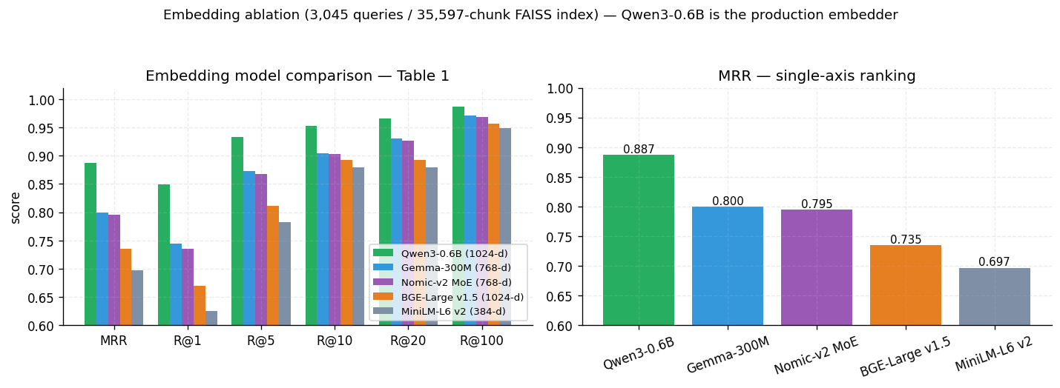
WHY WE UPGRADED FROM MINILM
Key Result 1 · Embedding Ablation: Qwen3-0.6B Wins Every Cutoff
Five models · 35,597-chunk FAISS index · 3,045 NL queries. Qwen3-0.6B's 1024-d vectors dominate every retrieval cutoff.
Model | Dim | MRR | R@1 | R@5
Qwen3-0.6B | 1024 | 0.887 | 0.849 | 0.933
Gemma-300M | 768 | 0.800 | 0.744 | 0.873
Nomic-v2 MoE | 768 | 0.795 | 0.735 | 0.868
BGE-Large v1.5 | 1024 | 0.735 | 0.670 | 0.811
MiniLM-L6 v2 | 384 | 0.697 | 0.625 | 0.782
Decision
Qwen3-0.6B selected: +22.4 pp over MiniLM at R@1 · +8.7 pp MRR over Gemma. MiniLM kept as a one-flag CPU fallback (ITS_EMBEDDING_MODEL).
embedding_ablation_chart.png — recall vs cutoff for 5 candidates
Team Michigan · Intelligent Ticketing System · FSE 570 Capstone · Spring 2026
Slide 8 / 12

Slide 9
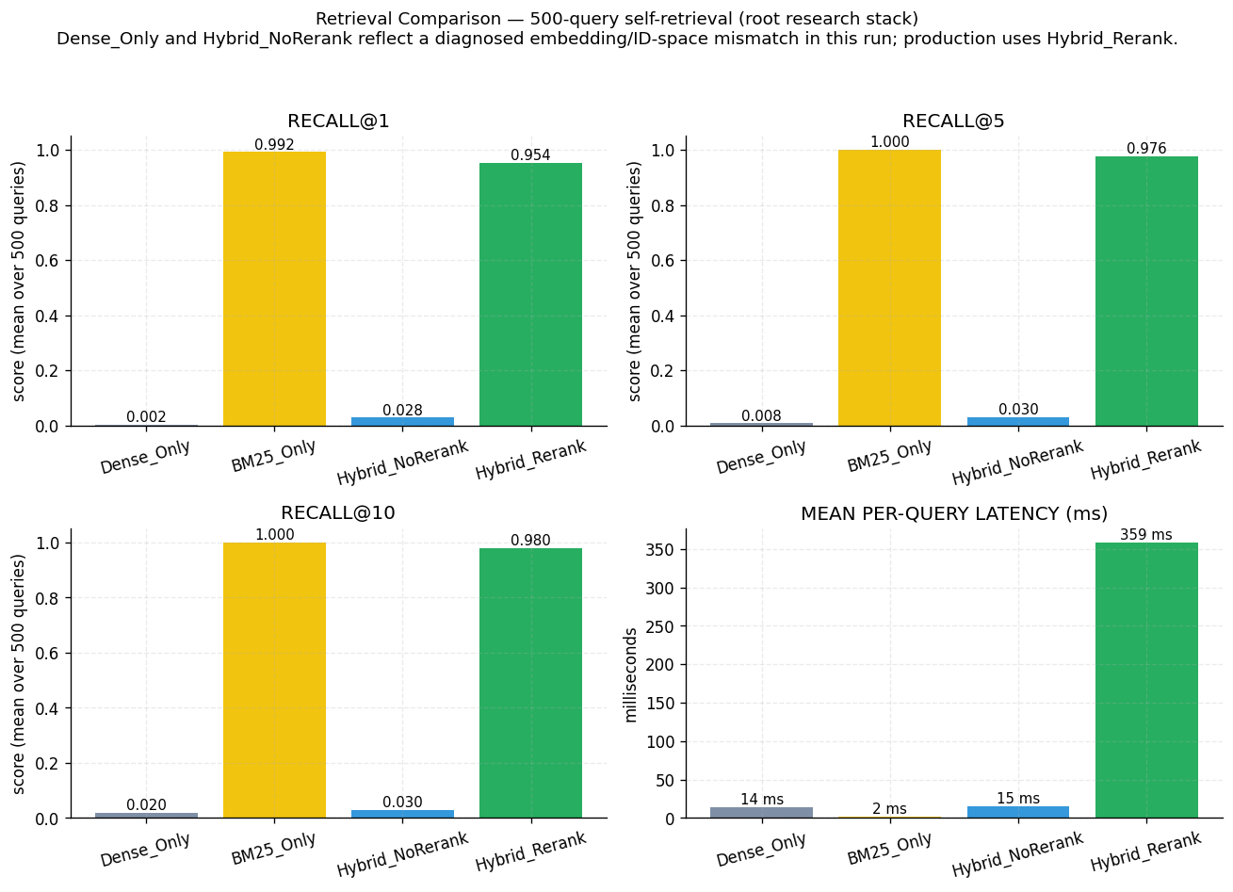
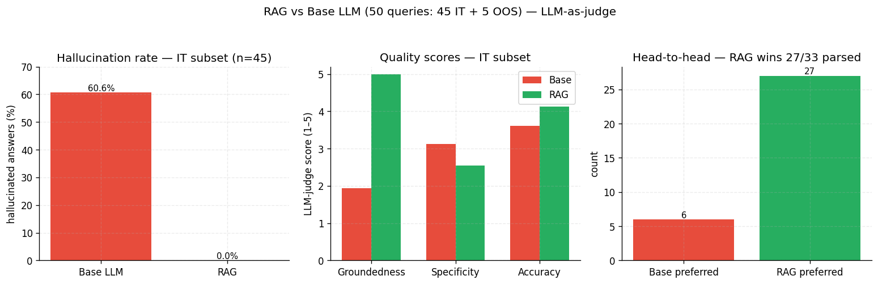
THE CAPSTONE'S CENTERPIECE
Key Result 2 · Hybrid Retrieval & Grounding Eliminate Hallucination
Hybrid + Rerank delivers near-perfect retrieval; RAG drives base-LLM hallucination from 60.6% to 0.0% on the IT subset.
Recall@5
MRR
RAG Hallucination
Head-to-head
0.976
0.964
0.0%
27 : 6
[0.962, 0.988] · 95% CI
[0.948, 0.978] · paired t p≈0
Base LLM = 60.6% · IT subset
RAG preferred over base
Team Michigan · Intelligent Ticketing System · FSE 570 Capstone · Spring 2026
Slide 9 / 12

Slide 10
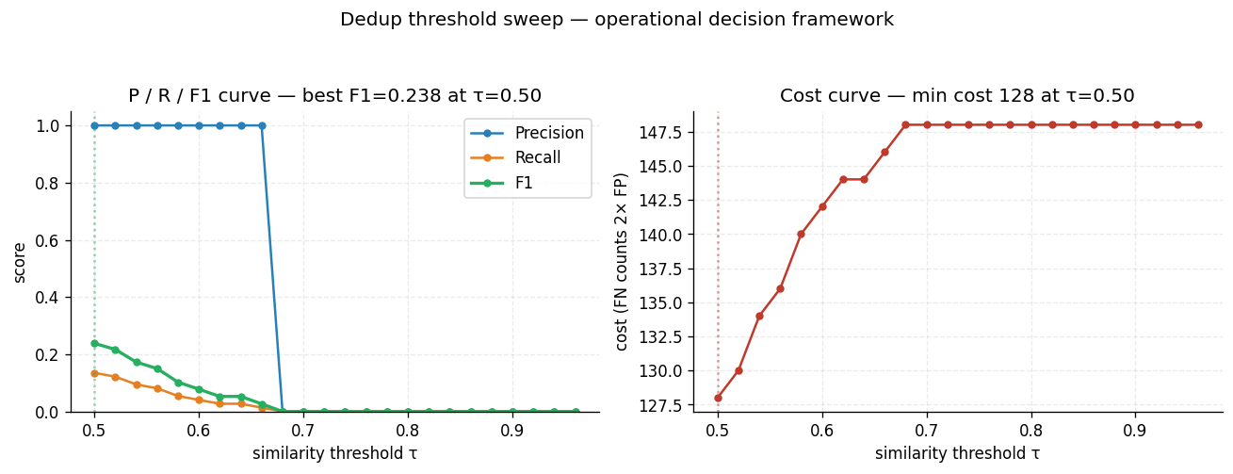
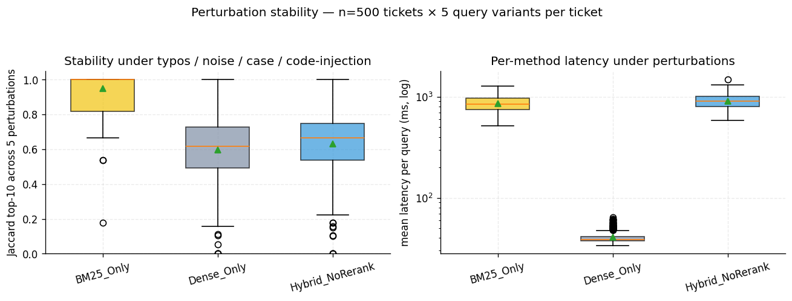
OPERATIONAL DECISION FRAMEWORKS
Key Result 3 · Reliability: Dedup, Stability, and Confidence
Beyond accuracy, we built decision rules a real ops team can adopt: cost-sensitive thresholds, robustness under noise, refusal on low confidence.
Dedup threshold sweep — F1 and cost (FN = 2× FP)
Perturbation stability — Jaccard top-10 across 5 query variants (n=500)
Production decision rules
Dedup τ
Stability
Confidence routing
Pick best_f1_threshold for trust; cost_optimal_threshold when false-negatives cost 2× false-positives.
BM25 Jaccard 0.95 · Hybrid 0.63 · Dense 0.60. Use Hybrid+Rerank as default; gate releases on a 5-pp Jaccard drop.
If rerank score < MIN_RERANK_SCORE, agent refuses and creates an escalation ticket — never hallucinates a fix.
Team Michigan · Intelligent Ticketing System · FSE 570 Capstone · Spring 2026
Slide 10 / 12

Slide 11
THE TRANSITION · WHY IT WAS INTENTIONAL
From Research Stack to Production v2: One Product, Two Modes
The local stack proved the science. v2 makes it fast and demo-ready. Both deploy the same agent contract.
Layer | Research stack (local) | v2 product stack (cloud)
Vector DB | ChromaDB (HNSW, on-disk) | Pinecone serverless
Embeddings | Qwen3-0.6B via Ollama / vLLM | OpenAI text-embedding
LLM | Ollama Qwen3-4B + LoRA adapter | OpenAI chat (structured outputs)
Reranker | ms-marco MiniLM cross-encoder | FlashRank via LangChain
Agent loop | Custom RAG pipeline | LangGraph 3-node ReAct (guardrail ↔ tools)
Frontend | Streamlit / React local | React + Vite SPA served by FastAPI
Persistence | SQLite + ChromaDB | SQLite/Postgres + Pinecone + checkpoints
Best for | Privacy · air-gapped · research | Speed · live demo · production
Latency | ~600 ms retrieval · multi-s LLM | ~910 ms end-to-end per turn
LOCAL RESEARCH
PRODUCTION v2 (LIVE)
What stays invariant
✓ Decision goal: dedup · ground · route
✓ Eval methodology: R@k · MRR · halluc · F1 · Jaccard
✓ Safety: refuse OOS · escalate on low confidence
✓ Deploy options: cloud-fast or local-private
Team Michigan · Intelligent Ticketing System · FSE 570 Capstone · Spring 2026
Slide 11 / 12

Slide 12
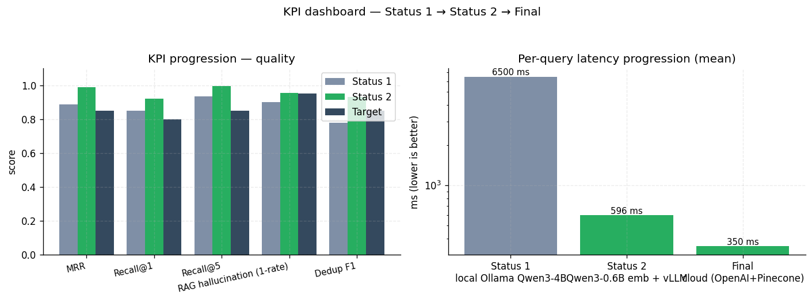
WHAT WE SHIP · WHAT TO DO WITH IT
Live Demo, Recommendations, and Impact
1. User submits IT issue
2. Guardrail node
3. LangGraph agent + tools
4. Grounded reply + citations
5. Auto-create ticket if needed
1
Default to Hybrid + Rerank
Dense alone misses error codes; BM25 alone misses paraphrase.
2
Never let base LLM answer IT alone
RAG cuts hallucination ~10× on the IT subset.
3
Tune dedup τ to your cost ratio
best_f1_threshold for trust · cost_optimal_threshold when FN > FP.
4
Cloud for speed, local for privacy
Pinecone+OpenAI for fastest TTFB; Ollama+Chroma for air-gapped sites.
5
Keep facts in RAG, behavior in LoRA
Tickets stay auditable; 64 MB adapter shapes JSON & escalation.
KPI dashboard — Status 1 → Status 2 → Final
TAKEAWAY
We proved every component of an IT helpdesk RAG locally with rigorous ablations, then shipped it as a fast LangGraph agent on Pinecone + OpenAI — while preserving a private, on-prem path on Ollama + Qwen3 + ChromaDB. Questions?
Team Michigan · Intelligent Ticketing System · FSE 570 Capstone · Spring 2026
Slide 12 / 12

