Slide 1
Aura: Air Quality Monitoring System Using Arduino

Slide 2

Air Pollution The Root Cause

Slide 3

The air inside your homes can be 10 times more polluted than the outdoors.

Slide 4
4.3 million people die annually from exposure to household air pollutants.
-W.H.O.(World Health Organization)

Slide 5

Ambient Indoor air Pollution causes:
Headaches, eye irritation and rashes
Frequent cold and sore throats
Skin infections, lethargy and dizziness
Increased risk of cancer
Chronic ailments like asthma, heart and lung diseases

Slide 6
What is Aura?
Aura is an IOT based air quality monitoring system that works on Arduino platform to sense the quality of air around you and project it on the respective mobile and desktop applications.
It is built to work indoor as well outdoor and keep you aware what air are you breathing.
aura

Slide 7

IOT
The Technology
of
future

Slide 8
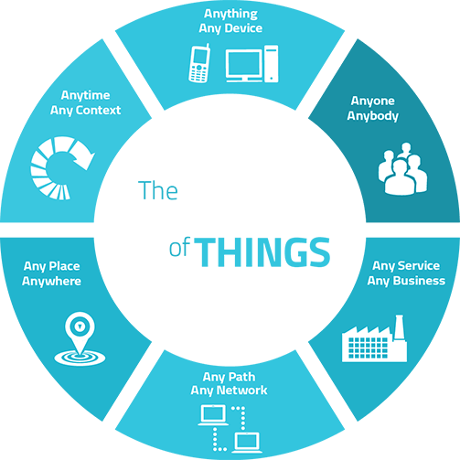
Advantage over Existing Systems
IOT based technology and compact design helps to overcome drawbacks of existing system
Older Bluetooth systems have shorter range and works only on a single device
GSM based systems face problem of signal loss and low operating speed
Meteorological agency services do not provide information about indoor air pollution
Meteorological agency services provide data from only few locations from over the city

Slide 9
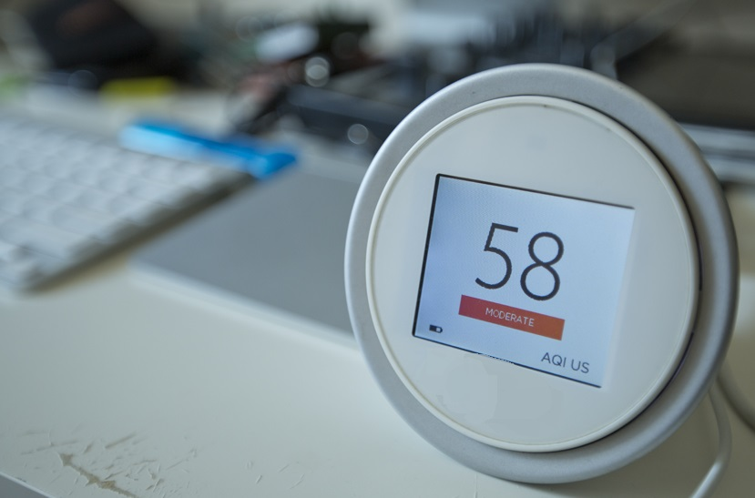
How To Use : PCM
Plug
Place the device at a suitable position and plug in the power supply.
Click
Use your device; mobile, tablet or PC and open the app.
Monitor
Monitor the air quality inside your house.

Slide 10
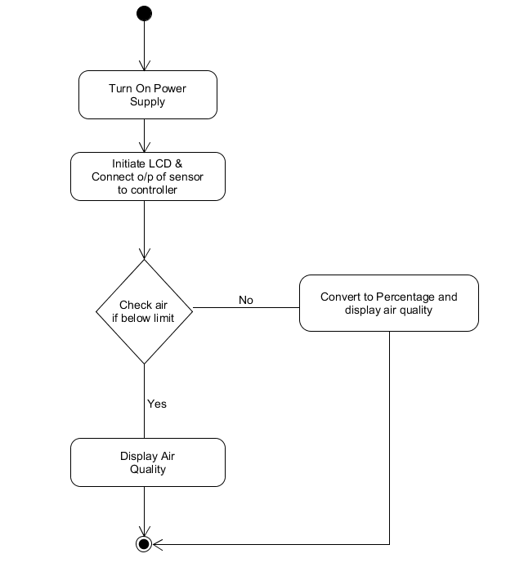
Figure.1: Activity diagram for AURA System

Slide 11
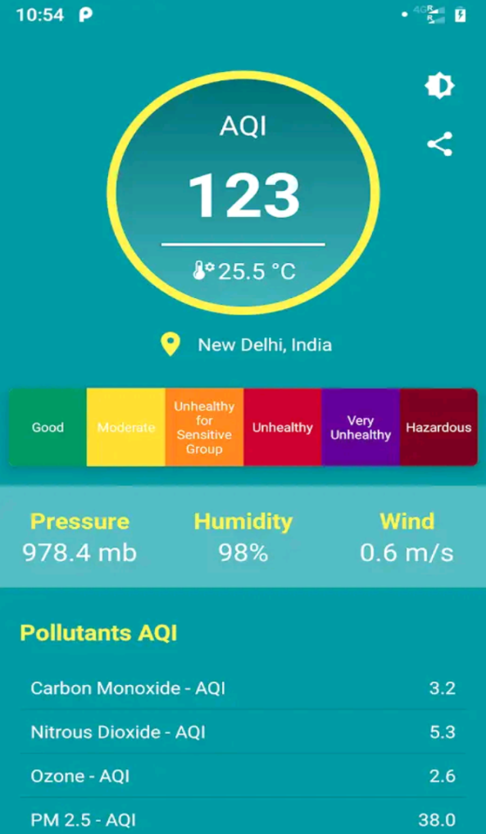
How does it work?
The sensors on the device sense the air and generate electronic signals.
The Arduino based processing module receives the signals from sensors, converts them to readable data and use this data to calculate AQI around you. It then sends the calculated AQI to your device over internet.
The device receives signals sent by the monitoring unit over the internet and displays AQI on an application interface.

Slide 12
Working Explanation :
The MQ135 sensor can sense NH3, NOx, alcohol, Benzene, smoke, CO2 and some other gases, so it is perfect gas sensor for our Air Quality Monitoring Project. When we will connect it to Arduino then it will sense the gases, and we will get the Pollution level in PPM (parts per million). MQ135 gas sensor gives the output in form of voltage levels and we need to convert it into PPM. So for converting the output in PPM, here we have used a library for MQ135 sensor.
Sensor was giving us value of 90 when there was no gas near it and the safe level of air quality is 350 PPM and it should not exceed 1000 PPM. When it exceeds the limit of 1000 PPM, then it starts cause Headaches, sleepiness and stagnant, stale, stuffy air and if exceeds beyond 2000 PPM then it can cause increased heart rate and many other diseases.
When the value will be less than 1000 PPM, then the LCD and webpage will display “Good Air”. Whenever the value will increase 1000 PPM, then the buzzer will start beeping and the LCD and webpage will display “Poor Air, Open Windows”. If it will increase 2000 then the buzzer will keep beeping and the LCD and webpage will display “Danger! Move to fresh Air”.

Slide 13
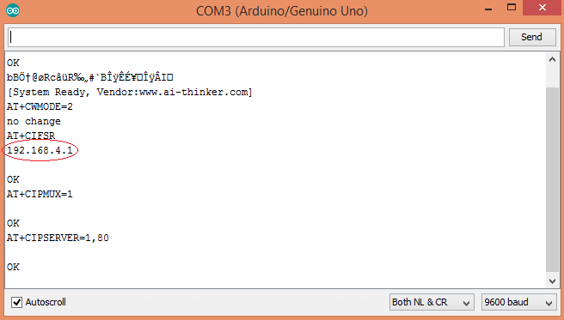
Testing and Output :
Before uploading the code, make sure that you should connected to the Wi-Fi of your ESP8266 device. After uploading, open the serial monitor and it will show the IP address like shown below.
Figure.2: To Show Output on a Webpage

Slide 14
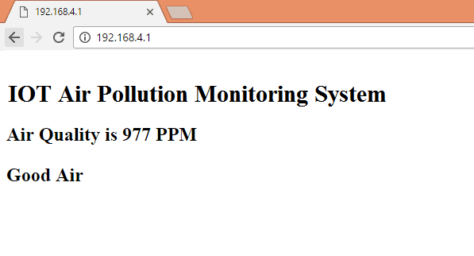
Type this IP address in your browser, it will show you the output as shown below. You will have to refresh the page again if you want to see the current Air Quality Value in PPM.
Figure.3: Output shown in the figure
We have setup a local server to demonstrate its working. But to monitor the air quality from anywhere in the world, you need to forward the port 80 (used for HTTP or internet) to our local or private IP address (192.168*) of our device. After port forwarding all the incoming connections will be forwarded to this local address and we can open above shown webpage by just entering the public IP address of our internet from anywhere.

Slide 15

Features
Compact
The device is compact and can be taken along and placed anywhere without occupying much space.
Energy effecient
The device requires very less power to operate without putting extra burden on your pocket.
Low Cost
The device is much cheaper as compared to other AQI monitoring devices available in market.
Compatibility
It can be used with almost every device which has access to internet whether it be mobile, tablet or laptop.
Simple to use
It can be used by everyone, even the elderly people of your family due to its simple plug and play operation.
Accesible
It can be accessed from anywhere inside and outside your house on any device with internet connectivity.

Slide 16

Future scope
The current device can be upgraded to provide much more functionalities
Addition of storage functionality to store daily data and statistics
Support for more devices such as virtual assistant based smart speakers.
Provide information on concentration of various pollutants and gases present in air.

Slide 17
THANKS!
Any questions?
You can find us at:
busin786@gmail.com

Slide 18
Credits
Supervised by:
Dr. Kamlesh Sharma, Associate Professor, CSE, FET MRIIRS
Ms. Neha Batra, Assistant Professor, CSE, FET, MRIIRS
Presented by:
Aniket 1/17/FET/BCC/045

