Slide 1

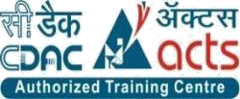
INSTITUTE FOR ADVANCED COMPUTING AND SOFTWARE DEVELOPMENT AKURDI, PUNE A
Software Composition Analysis using Software Bill Of Matterial
GROUP NO: 17
ANIKET POL (233432)
ROHIT MORBALE (233439)
MR. KARTIK AWARI MR. ROHIT PURANIK
CENTRE COORDINATOR PROJECT GUIDE

Slide 2
INTRODUCTION
Dependency-Track is an intelligent Component Analysis platform that allows organizations to identify and reduce risk in the software supply chain. Dependency-Track takes a unique and highly beneficial approach by leveraging the capabilities of Software Bill of Materials (SBOM). This approach provides capabilities that traditional Software Composition Analysis (SCA) solutions cannot achieve.
Dependency-Track monitors component usage across all versions of every application in its portfolio in order to proactively identify risk across an organization. The platform has an API-first design and is ideal for use in CI/CD environments

Slide 3
PURPOSE
In a modern DevOps or DevSecOps environment, SCA has galvanized the “shift left” paradigm. Earlier and continuous SCA testing has enabled developers and security teams to drive productivity without compromising security and quality.
SCA tools can also detect software licenses, deprecated dependencies, as well as vulnerabilities and potential exploits. The scanning process generates a SBoM, providing a complete inventory of a project’s software assets.

Slide 4
REQUREMENTS
Hardware Requirement :
RAM: 16 GB
HDD: 512GB
Software Requirement :
Operating System: Windows 10
Tool: VMWare Workstation Pro

Slide 5
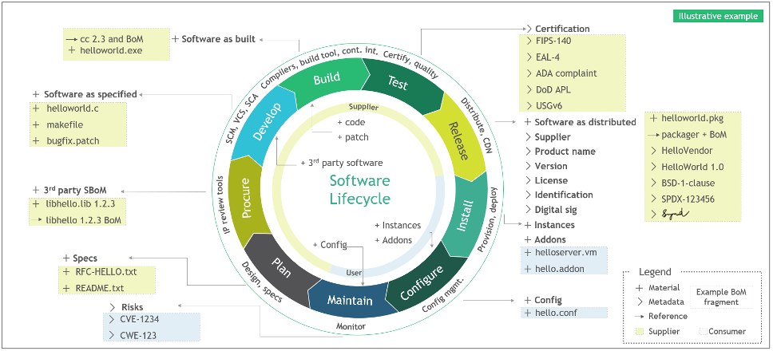
LIFECYCLE OF SBOM

Slide 6
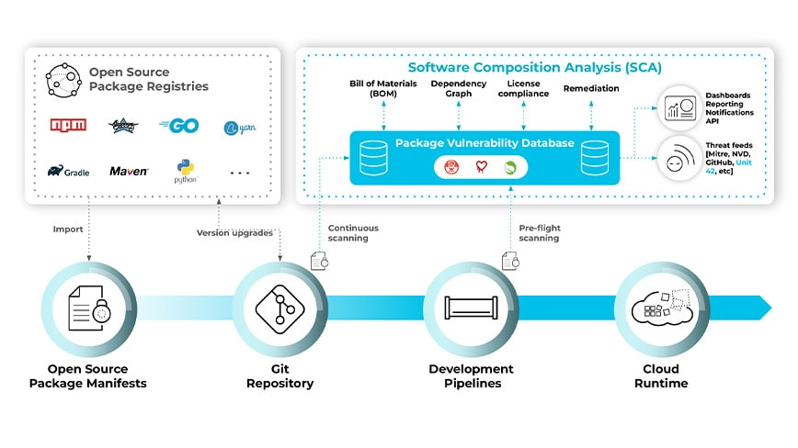
ARCHITECTURE OF SCA

Slide 7
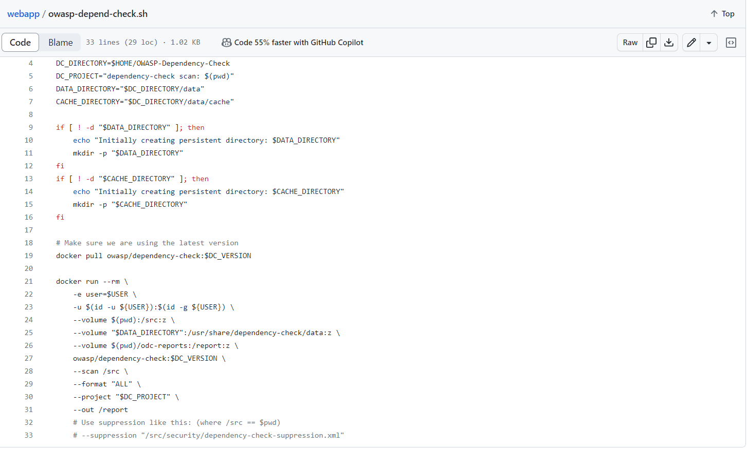
PROJECT EXECUTION

Slide 8
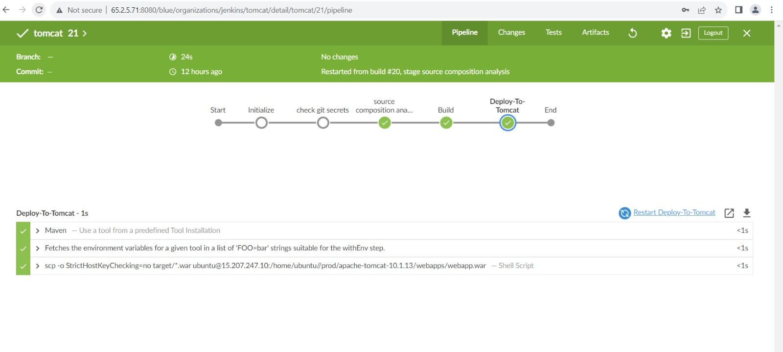

Slide 9
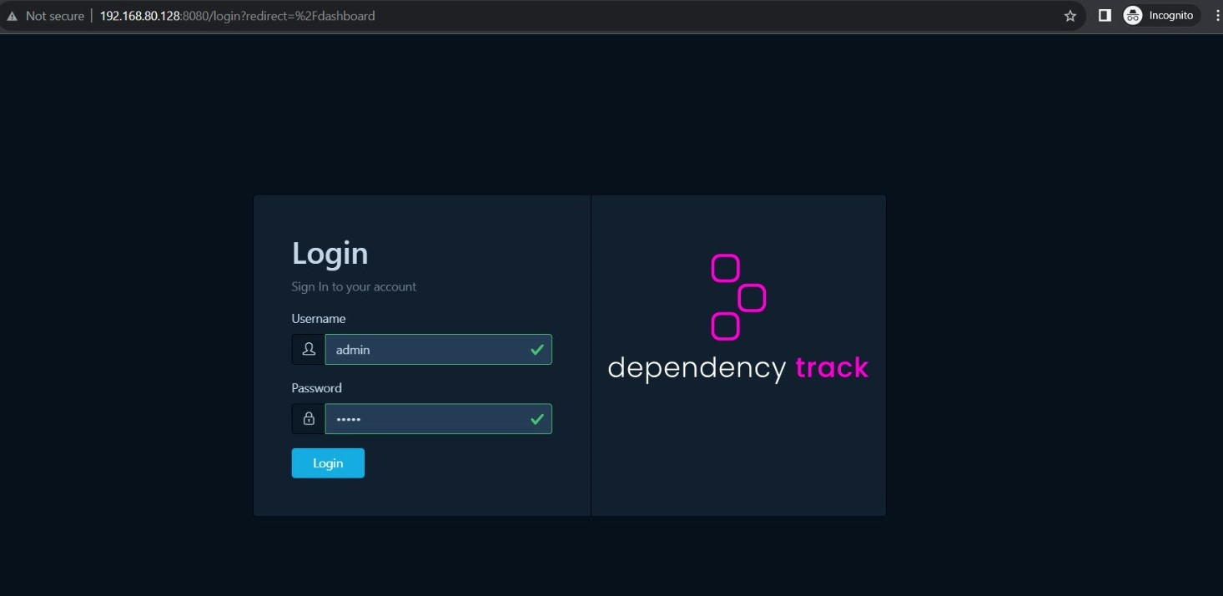
FRONTEND INTERFACE

Slide 10
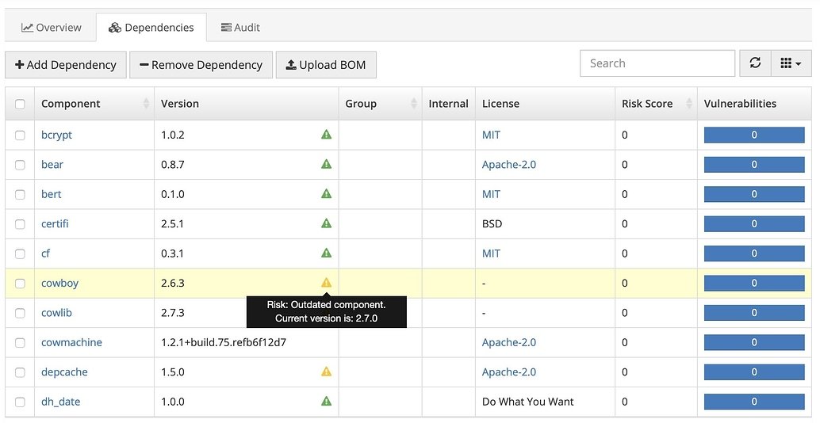
BACKEND INTERFACE

Slide 11
Features of SBOM
Lists all components for a clear software view.
Outlines relationships for better architectural understanding.
Supports compliance with clear software composition records.
Tracks versions to identify outdated or vulnerable software.

Slide 12
FEARURES OF SCA
Component Identification.
Vulnerability Assessment.
Severity Scoring.
Continuous Monitoring.
Integration.
Risk Assessment.

Slide 13
Using an SBOM tool
Creates comprehensive software inventories.
Maps dependencies for architectural clarity.
Tracks versions and enhances security.
Ensures transparency and risk management.
Supports compliance with clear records.

Slide 14
CONCLUSION
In conclusion, the exploration of Software Composition Analysis (SCA) and Software Bill of Materials (SBOM) tools highlights their pivotal role in modern software security and risk management. Identifying vulnerabilities in third-party components is crucial in the software supply chain.
SCA tools streamline component identification, vulnerability assessment, and risk prioritization. Real-time monitoring and automated scans address emerging security concerns. Incorporating severity scoring, license analysis, and continuous updates empowers efficient risk mitigation.
SBOM tools offer transparency with detailed software inventories, dependency mapping, version tracking, and supply chain insights. Compliance documentation and risk assessment aid in informed decisions.

Slide 15
THANK YOU

