Slide 1

Booktracker
By Bingo

Slide 2
AI for social cause
,,
“
What’s the problem we are solving
books are in declining phase ,now a days people prefer watching videos, which are few minutes long, so the amount of time which should be given to the while learning concepts

Slide 3
Good reviews?
If we search for reviews we end up getting spoilers for novels
Another Problem is that we can not change video tutorials from scratch it is too much time consuming to fix tutorials that’s why speed for making people aware will be less
Some time we only see one or two reviews which don’t gives whole idea about that

Slide 4
So here is our
solution
We made a webapp in which we can get to know about the engagement of Book with respect to its progress before hand…
But users wont to provide feedback for every single page so how we did that ?
We used webcam and AI which calculates the useful features from facial expression in real time and stored in Real time database

Slide 5
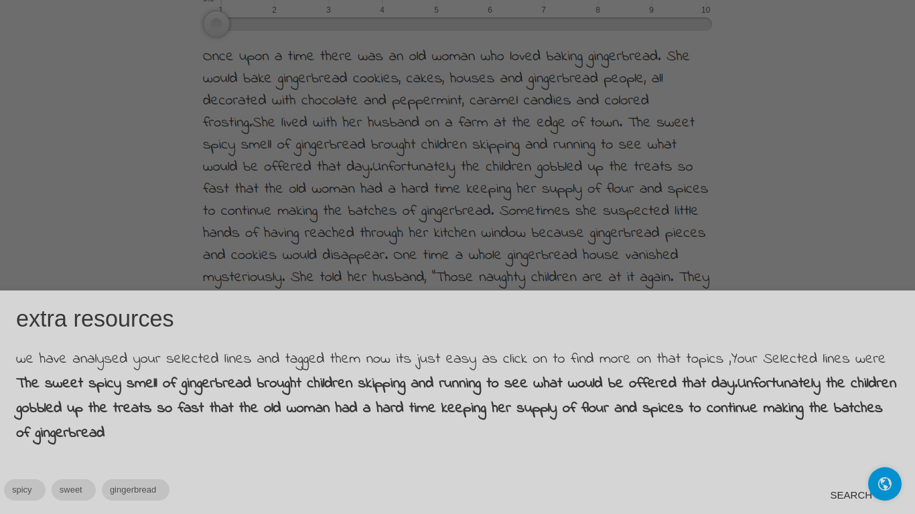
what
else
?
While reading books using our app
If readers want to know more about a certain paragraph they can simply click on that. This opens a popup with some reference links to the topics which are extracted from that paragraph.

Slide 6
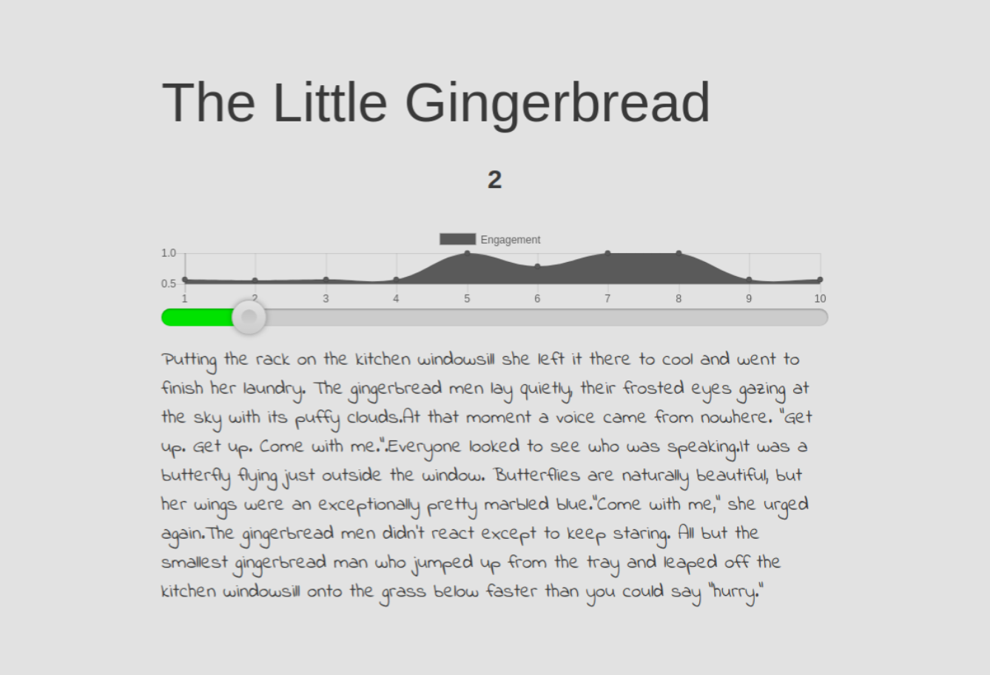
Demo
Slides

Slide 7
Future Add-ons
We are looking forward to making it’s impact bigger and widely accessible.
We will also be adding text-to-audio feature so that we can also reach blinds. We are looking forward to add IVR calling for those who don’t have access to internet. We are also looking forward to add translations so that we can target regional populations as well.

