Slide 1
EDA: Local Weather-Based Disease Prediction
Dataset: Weather-related disease prediction.csv
Prepared by: Aniket Bansod

Slide 2
Data snapshot & missing values
Explain file shape, missing values and data types.
See table: outputs/tables/missing.csv

Slide 3
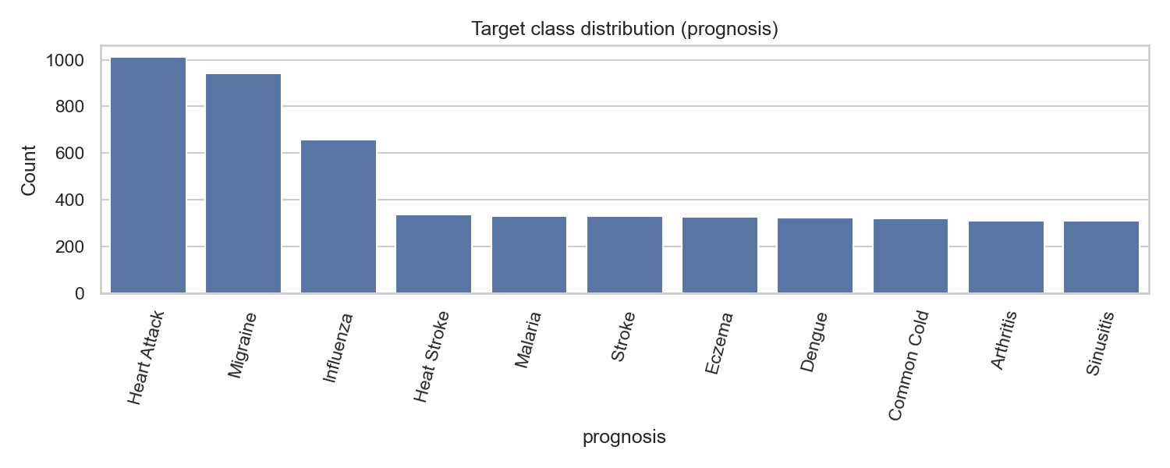
Target distribution

Slide 4
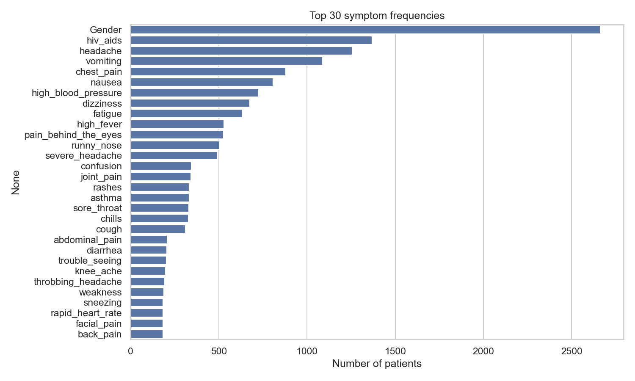
Top symptom frequencies

Slide 5
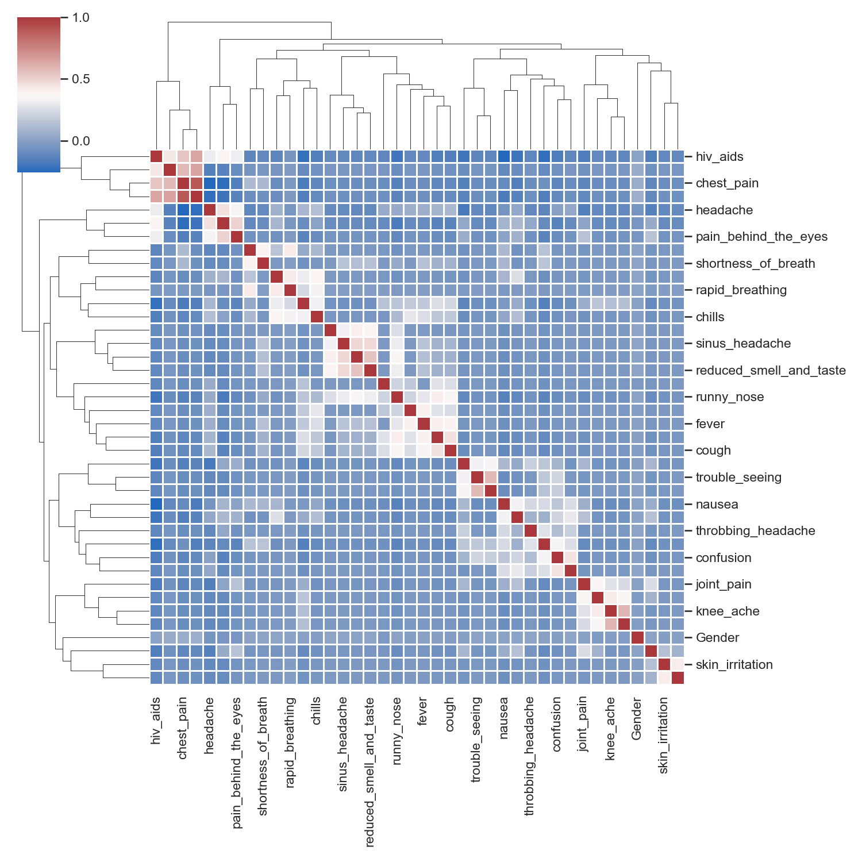
Symptom co-occurrence

Slide 6
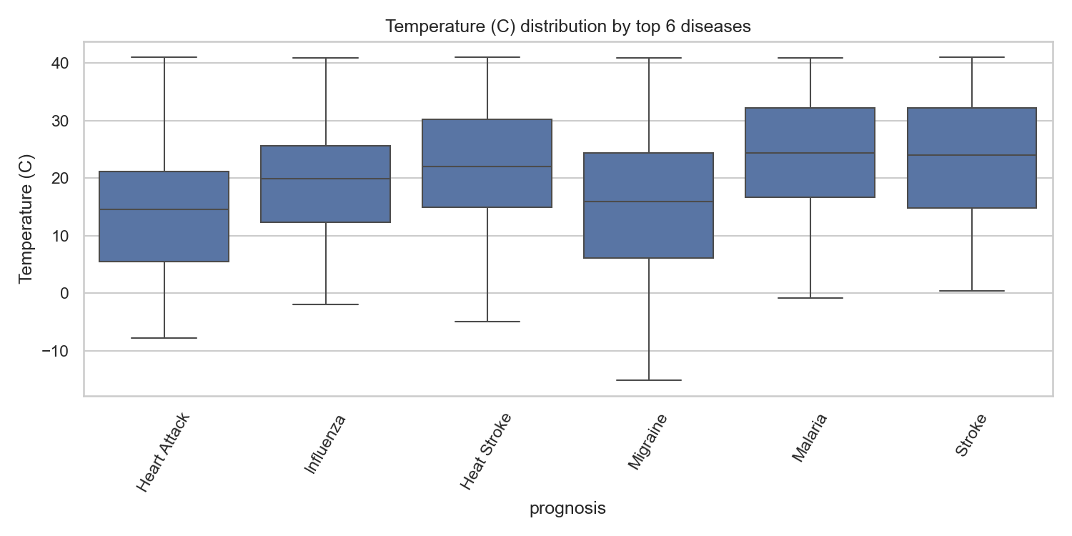
Weather distribution by disease

Slide 7
Statistical tests & key takeaways
1) Chi-square: symptom ~ disease (p < 0.05)
2) ANOVA/Kruskal: weather ~ disease (p < 0.05)
3) Next steps: preprocessing & predictive modeling

