Slide 1
Independent Component Analysis
Team Name - OmNiSiYaKrMa

Slide 2
What is ICA?
Independent component analysis is a method to separate a multivariate signal into its additive subcomponents.
It is generally used for signal processing, a common discussed example is
“cocktail party problem”
(To separate the speech signal from a sample data consisting of people talking simultaneously in a room)

Slide 3
ICA : Basic Assumption
In order to use ICA separation for mixed signals, we assume two things:
The source signals are independent of each other.
The values in each source signal have non-gaussian distributions (Actually, if just one of the independent components is gaussian, the ICA model can still be estimated.)
Based on above two assumptions, the effects that will follow after mixing of source signals are (i.e., expected properties of observed signals) :
No longer independent.
Induced normality (By CLT).
Increased complexity.

Slide 4
ICA : Algorithms
Based on the first two properties of mixed signals, there are two broad classes of ICA algorithms:
Class I : Minimization of mutual information.
Based on independence property (focus on finding independent components).
Uses measures like KL divergence and maximum entropy.
Class II : Maximization of non-Gaussianity.
Motivated by CLT.
Uses Kurtosis and negentropy.
The algorithm that we are going to use is from “Class II” and is going to use negentropy approximation.

Slide 5
Preprocessing the Data
Before applying an ICA algorithm on data, it is usually useful to do some preprocessing. So, we are going to do the following preprocessing techniques:
Centering the data (making the mean zero).
Whitening (linear transformation to make the data un-correlated).
PCA for dimensionality reduction (if necessary).
After preprocessing the data, we are now ready to apply the fastICA algorithm.
In this algorithm we are going to use negentropy as non-gaussianity measure.
For this, we are going to approximate the negentropy by non-quadratic functions.

Slide 6
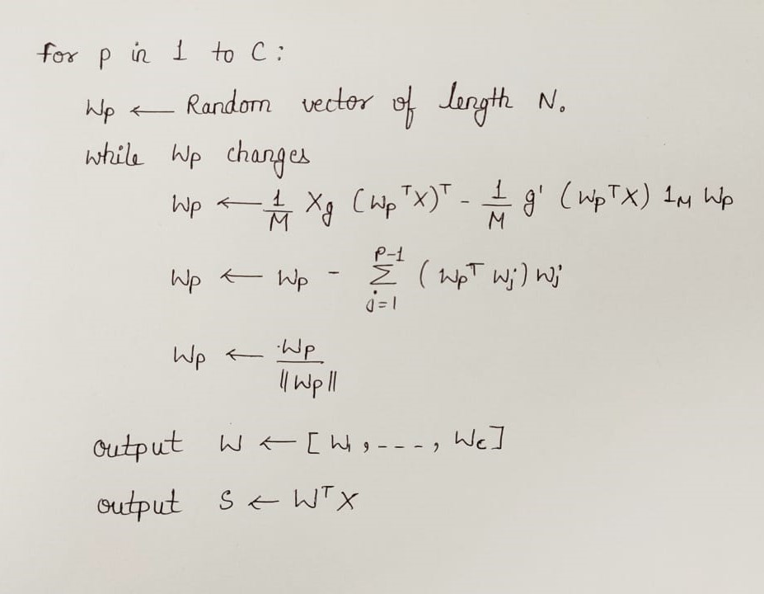
FastICA Algorithm
Input: С Number of desired components.
Input: 𝕏 ∈ ℝ^{ℕx𝕄} Prewhitened matrix, where each column represents an ℕ-dimensional sample, where ℂ <= ℕ.
Output: 𝕎 ∈ ℝ^{ℕxℂ} Un-mixing matrix where each column projects 𝕏 onto independent component.
Output: S ∈ ℝ^{ℂx𝕄} Independent components matrix, with 𝕄 columns representing a sample with ℂ dimensions.

Slide 7
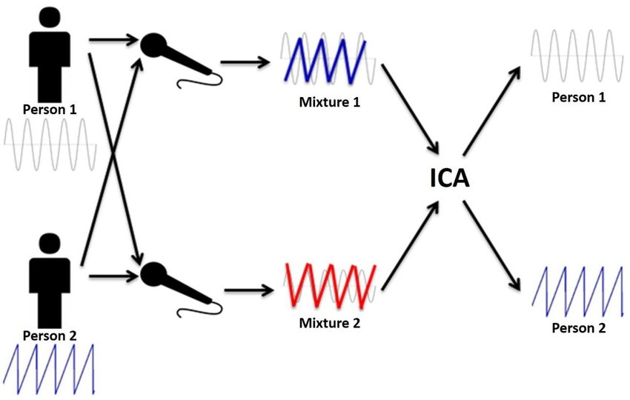
Implementation
We applied ICA algorithm in following two problems :
Cocktail Party Problem : In this problem, we took a mixture of two signals and recovered the source signals.
Image Separation : In this problem, we took some images of animals from internet, mixed them in some proportions. Then, we applied ICA on those mixed images and get back the original images. One popular application of this type is fingerprints separation.

Slide 8
Team Members
Name | Branch | Roll No.
Omkar Prasad Ramdas | MnC | 1903213
Nikhil Yuvraj | MnC | 1903211
Siddhant Yadav | MnC | 1903218
Yash Narnavare | MnC | 1903223
Kripendra Kumar | CSE | 1903141
Mahendra Kumar | MnC | 1903209

Slide 9
References
https://en.wikipedia.org/wiki/Independent_component_analysis#:~:text=In%20signal%20processing%2C%20independent%20component,statistically%20independent%20from%20each%20other.
https://en.wikipedia.org/wiki/FastICA
https://www.cs.helsinki.fi/u/ahyvarin/papers/NN00new.pdf
https://github.com/shantistewart/Independent-Component-Analysis/blob/master/Paper/Research%20Paper.pdf

