Slide 1
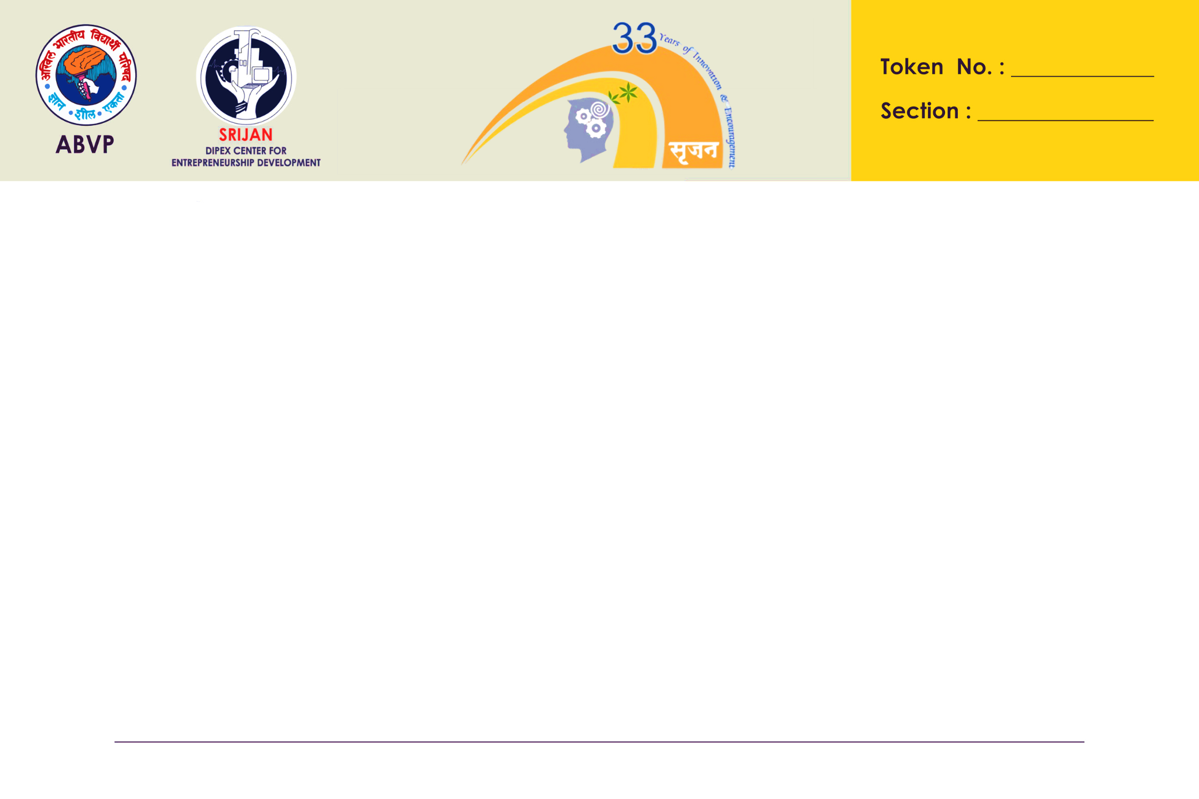

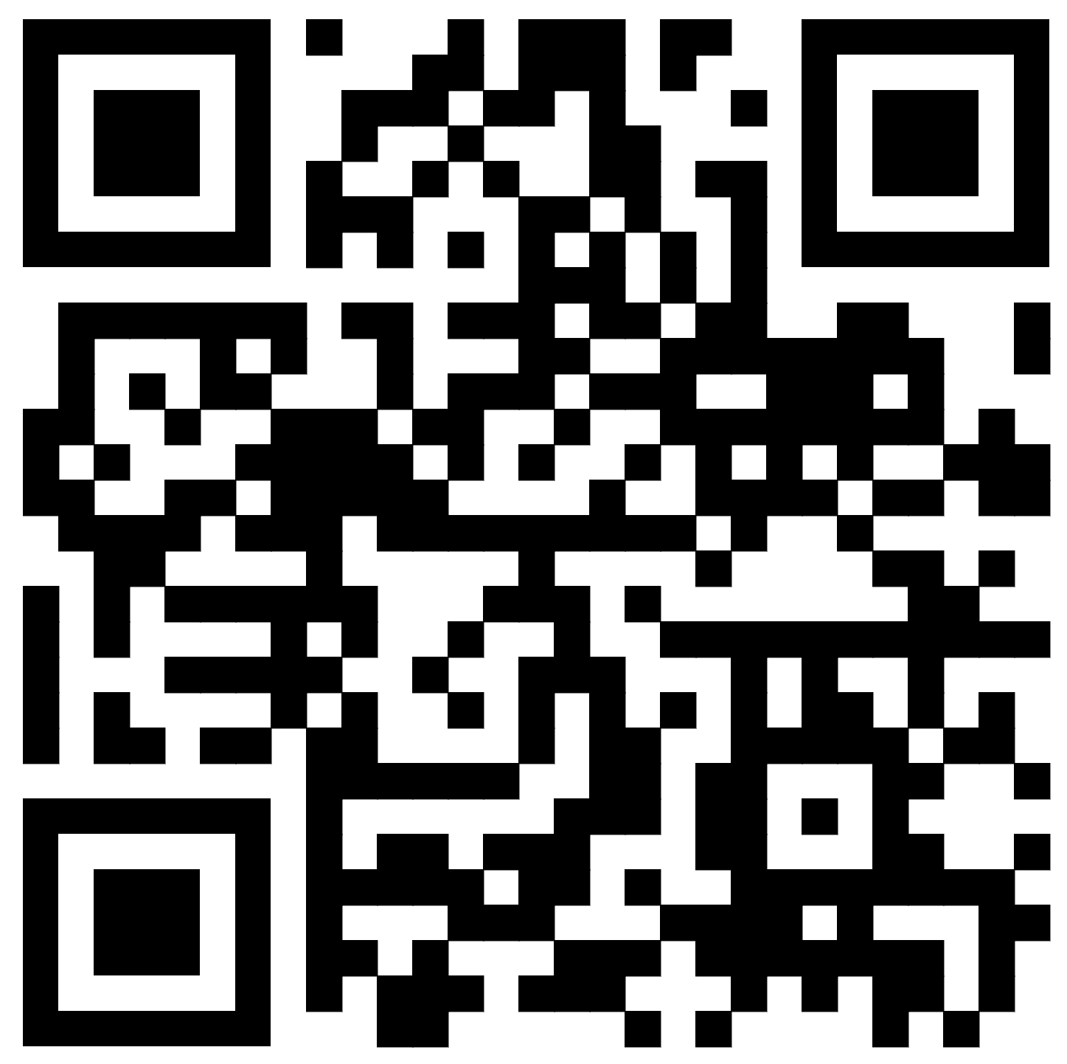

DIPEX2024-1753
Project Title : Smart Waste Management and Awareness System
Importance of the System
Key features / Components of the System
-“Lets give the trash a Smart Home”
Future Scope of the Systems
1. Smart Bins
Efficient Waste Management
Public Awareness
Remote Monitoring
and Management
Smart Bin contain various sensors for detecting the bin level, garbage temperature, humidity in the bins, and a gas sensor to detect harmful gases.
Technological Advancements
Smart Cities
Public Engagement
2. Awareness Website
🌐 Multilingual Excellence
📊 Real-Time Monitoring Dashboard
💬 Live Customer Support
🎥 Interactive Videos
3. Rasa Chatbot
Experience intelligent and interactive conversations with our Rasa-enabled chatbot, providing you with personalized assistance and information.
Our Website
(Scan to know more)

Slide 2
Our Website
(Scan to know more)

