Slide 1
Exploratory Data Analysis on Global Terrorism Dataset.
The global terrorism database is an open source database including information on terrorist attacks around the world from 1970 through 2017. The GTD includes systematic data on domestic as well as international terrorists incidents that have occurred during this time period and now includes more than 180000 attacks. The database in maintained by researchers at the national consortium for the "Study of Terrorism and Response to Terrorism (START)" headquartered at the university of Maryland.
The goal of this capstone project is to explore and analyze the data to discover key findings pertaining to terrorist activities.
Understand major causes behind terrorism throughout the world. To analyze casualties and number of attacks throughout the world and India over the period of time.
Business objective of this project is to understand vulnerable areas to attacks in India, active terrorism groups, there attack patterns , effectiveness. So that, decisions about the selection of areas from the perspective of upcoming investments in infrastructure and developments could be taken from the point of view of private businesses as well as state of India.

Slide 2
Dataset Information.
The features which has selected to achieve objectives from the original dataset with 157 features after doing feature selection and feature engineering are as follows.
Country, Region, City : Location of attack.
Crit1, Crit2, Crit3 : Nature of attacks (political, economical, social goal), Intention to humiliate larger crowd, Outside International Humanitarian Law.
Success : Weather attacks succeed or not.
Attack type, target type, target sub type
Gname : Perpetrator / terror attack group name
Weapon type, weapon sub-type: Details of weapons
Nkill, nwound : details about casualties
INT_ANY : weather domestic or international
Date : date of attack
Execution type : Weather attack is extended for more than 24 hours, weather attack is of multiple/single nature

Slide 3
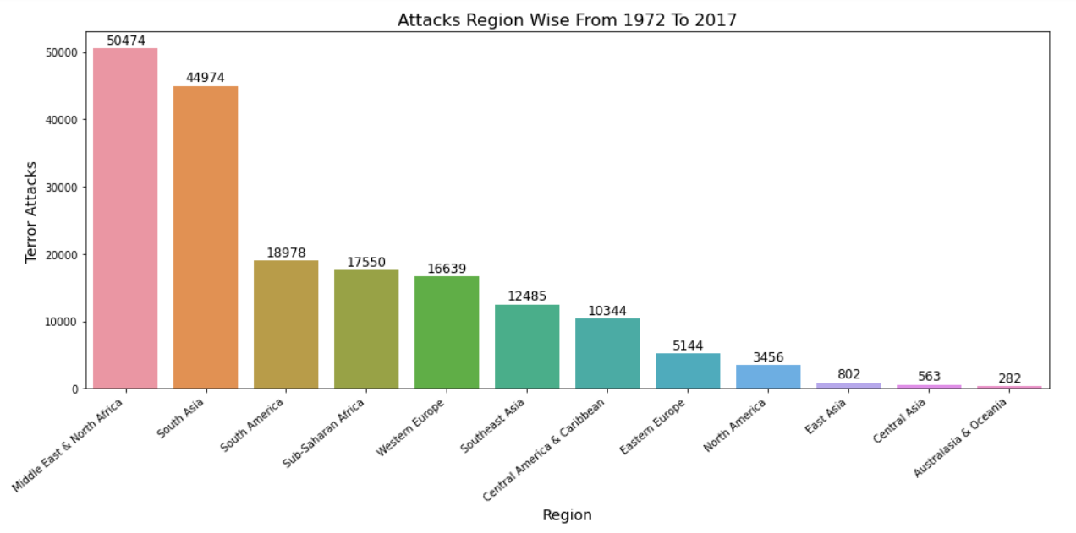
Geographical Analysis.

Slide 4
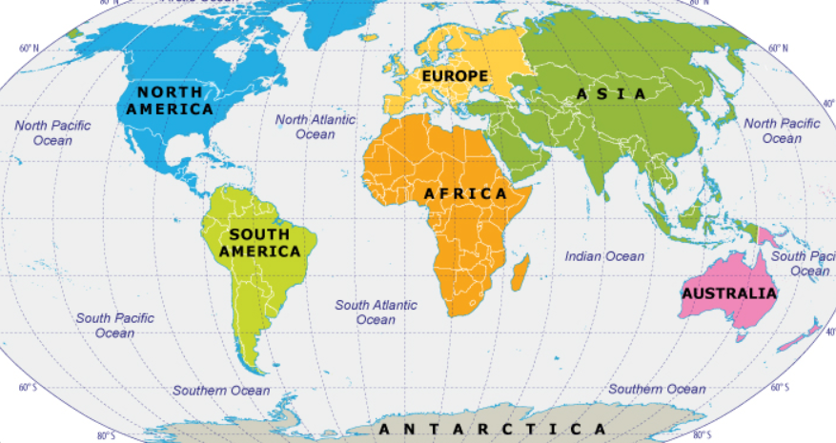
Geographical Analysis.

Slide 5
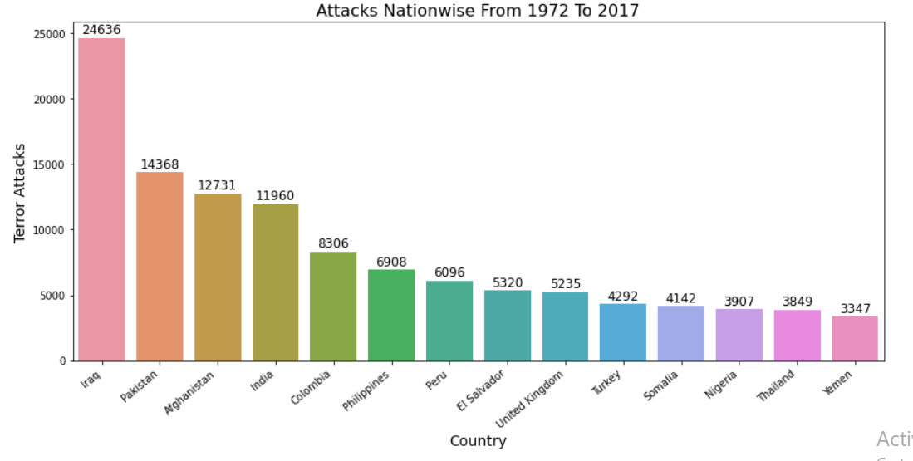
Geographical Analysis.

Slide 6
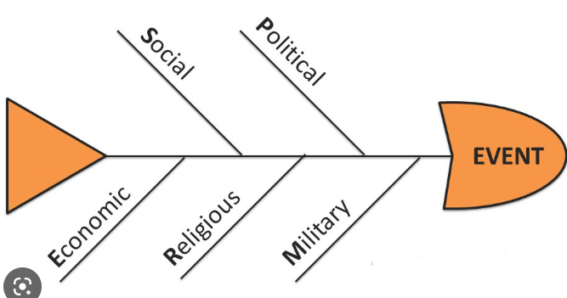
Motive & Intentions Of Terror Attacks
99 % terrorism attacks were carried out to achieve either Political or Economic or Religious or Social Goal.
In 99 % cases main intention was to COERCE, INTIMIDATE OR PUBLICIZE to larger audience.
In 98 % cases The action is outside the context of legitimate warfare activities, insofar as it targets noncombatants (i.e. the act must be outside the parameters permitted by international humanitarian law as reflected in the Additional Protocol to the Geneva Conventions of 12 August 1949 and elsewhere).

Slide 7
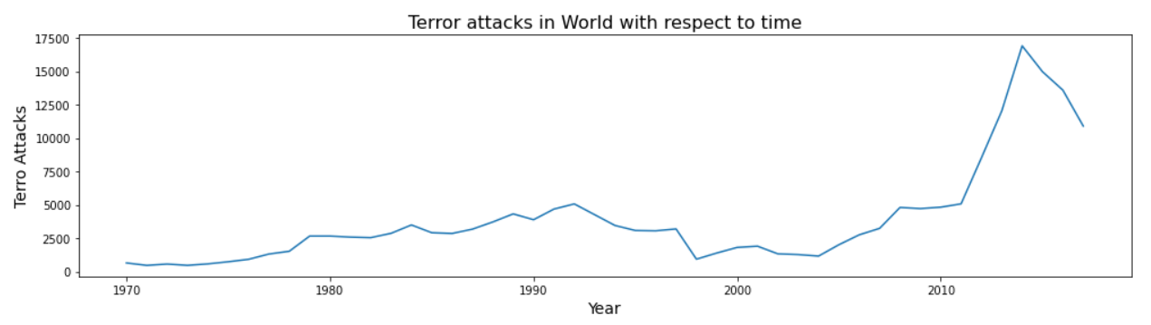
Terror Attack In The World w. r. t. Time
1.By analyzing above graph we conclude that terror attacks across the world are increasing w.r.t time consistently.
2.Specially there is sudden increase in terror attacks after 2005 to 2015, this decade has seen exponential increase terror attacks throughout the world.
3.From 2015 to 2017 there is decrease in terror attacks which is only positive note in above chart.

Slide 8
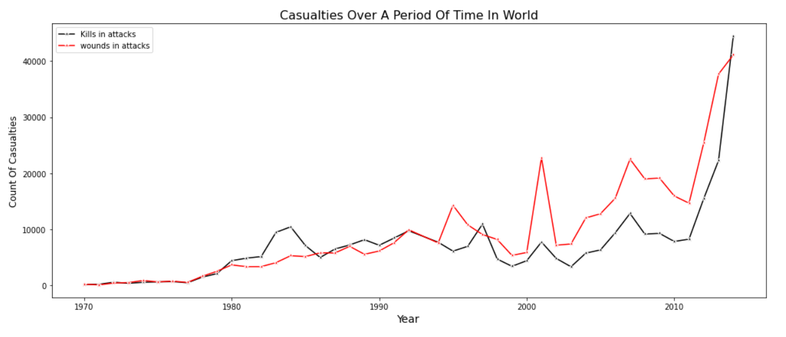
Terror Attack Casualties In The World w. r. t. Time
By analyzing above graph we conclude that casualties in terror attacks across the world are increasing w.r.t time consistently as it is obvious because we seen in above graph that there is sudden increase in attacks.
From 2015 to 2017 there is decrease in terror attacks but casualties happened in this period are so high.
On yearly basis average number of deaths that happen in world : 7084
On yearly basis average number of peoples get wounded in world : 9430
On yearly basis average number of casualties in world : 16513

Slide 9
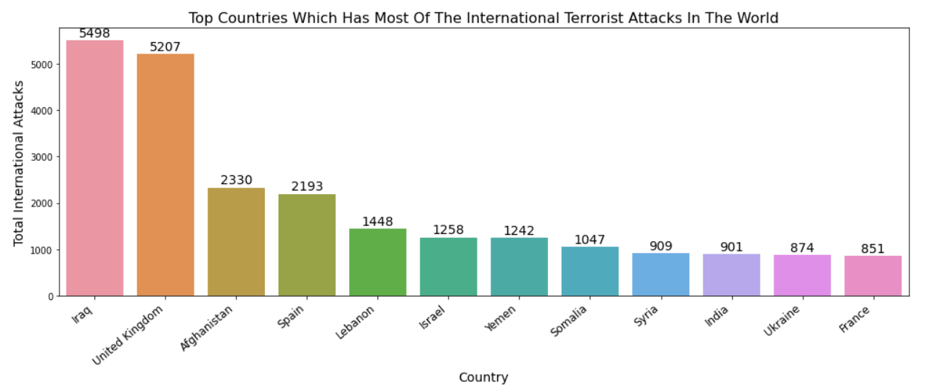
International Terror Attacks
As per available information 21% of the attacks are of International nature that means The attack was international on any of the dimensions described above logistically, ideologically or miscellaneous
By analyzing above graph we conclude Iraq, United Kingdom, Afghanistan are top countries which have International nature of terror attacks.
That is either target or perpetrator was outside of the country in which incident has happened.

Slide 10
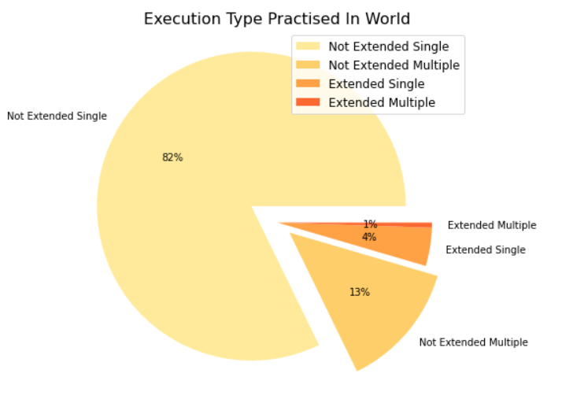
Nature Of Terror Attacks In Terms Of Execution Type
95% of the terror attacks happened in world has non-extended nature of attacks that means terror attacks happening in the globe usually doesn't extend beyond 24hrs.
Only 1% of the terror attacks in the world has extended-multiple nature which is obvious as such type of attacks should only be attempted by well-trained brats

Slide 11
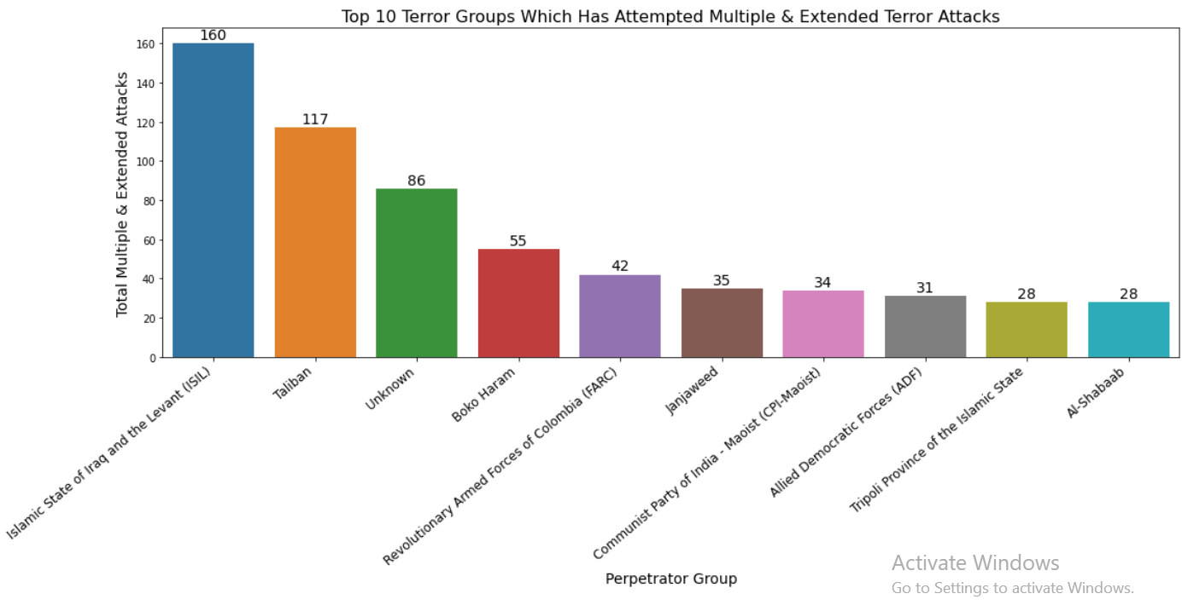
Multiple & Extended Terror Attacks In World

Slide 12
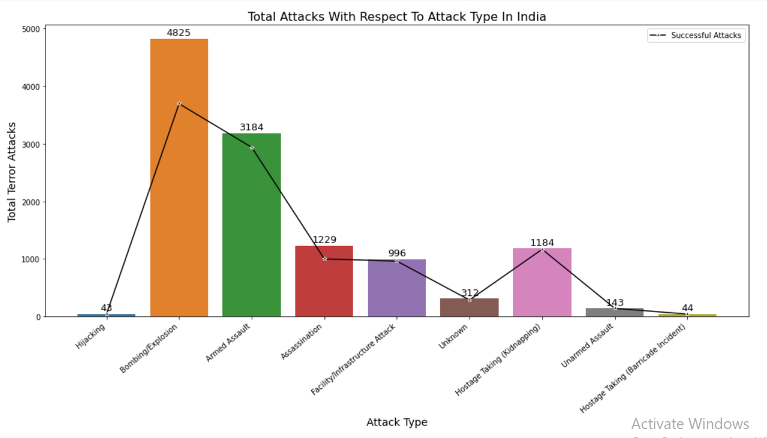
Attack Types & There Success Rates In India
I) Total 11960 terrorist attacks happened in India from 1972 to 2017, Out of which 92% attacks were successful.
II) Hostage Taking (Kidnapping),Unarmed Assault this type of attack types have highest success rate around 99%.
III) Bombing/Explosion and Assassination kind of activities has usually low success rates around 70%.

Slide 13
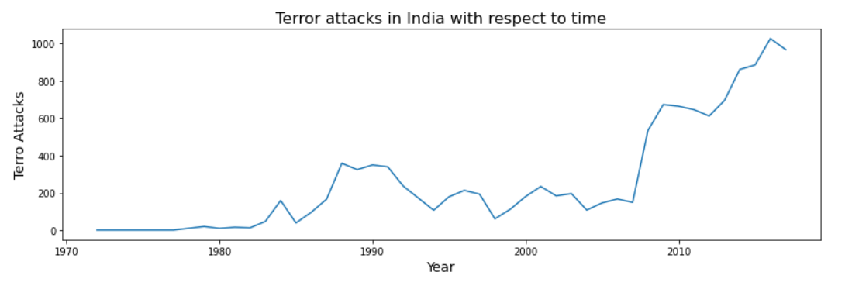
Terror Attacks In India w.r.t. Time
Chart shows attacks are increasing in India on yearly basis with time. It has positive trend which is not a good thing from the perspective of state of India. As a citizen of India we expect solid actions must be taken to prevent terror attacks by state.

Slide 14
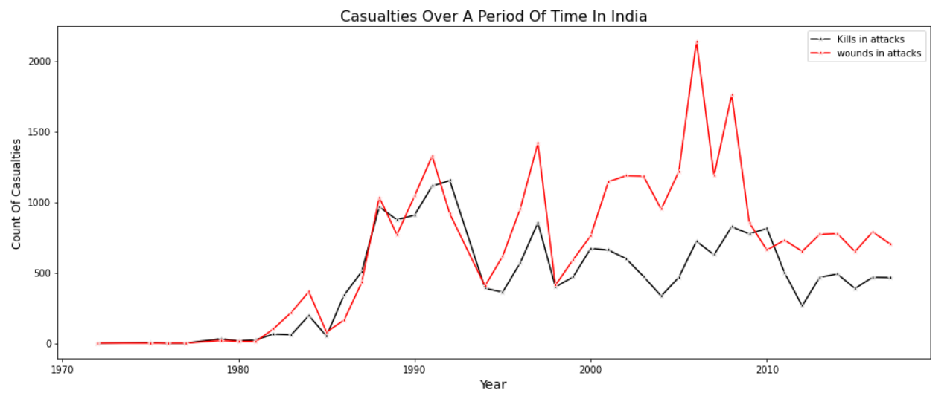
Casualties In India w.r.t. Time
1) Chart shows casualties were also increasing in India on yearly basis with time. It has positive trend which is not a good thing from the perspective of state of India.
2) There is one thing positive and that is from 2010 onwards number of casualties are constant irrespective of increasing attacks in our country. Which is positive side of our security forces and we could conclude here that our forces are very successful in terms of eliminating terror attacks in last decade.
3) On yearly basis average number of deaths that happen in India : 461
4) On yearly basis average number of peoples get wounded in India : 690
5) On yearly basis average number of casualties in India : 1150

Slide 15
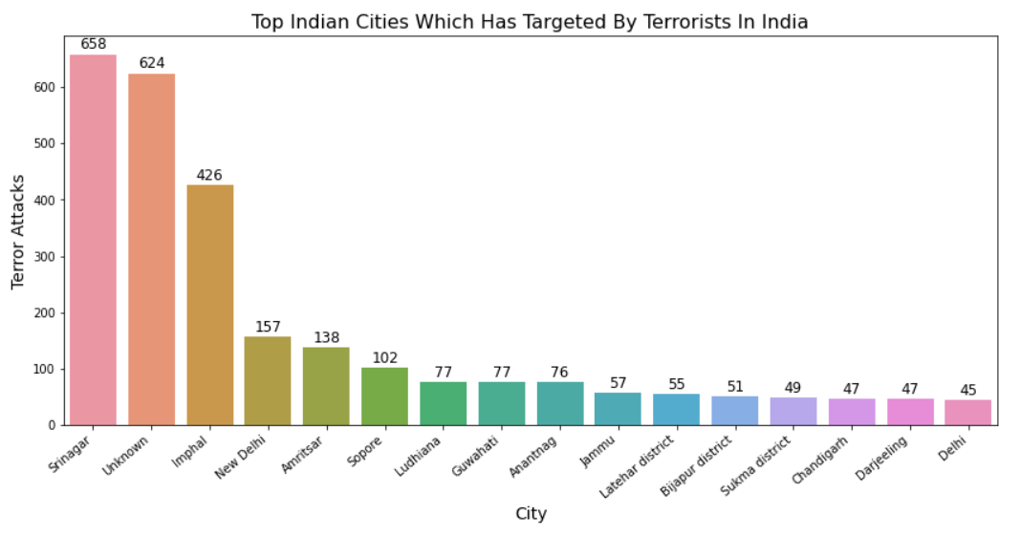
Vulnerable Areas To Terror Attacks In India
Chart shows cities in Kashmir & North East has been heavily attacked by terrorist consistently. There is wide scope for improvement from security & safety point of view in such cities, as this cities has been consistently attacked and targeted by terrorist organizations and still state is not able to find permanent solutions of such problems.

Slide 16
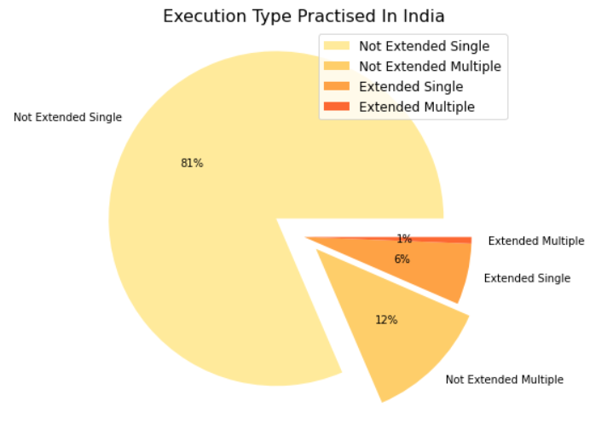
Execution Type & Terror Groups In India
1) Chart shows 82% of the terror attacks are Non Extended Single in nature, followed by Not extended multiple that is 12%.
2) Here also we can conclude that forces are quick enough to respond and eliminate attacks within 24 hours.

Slide 17
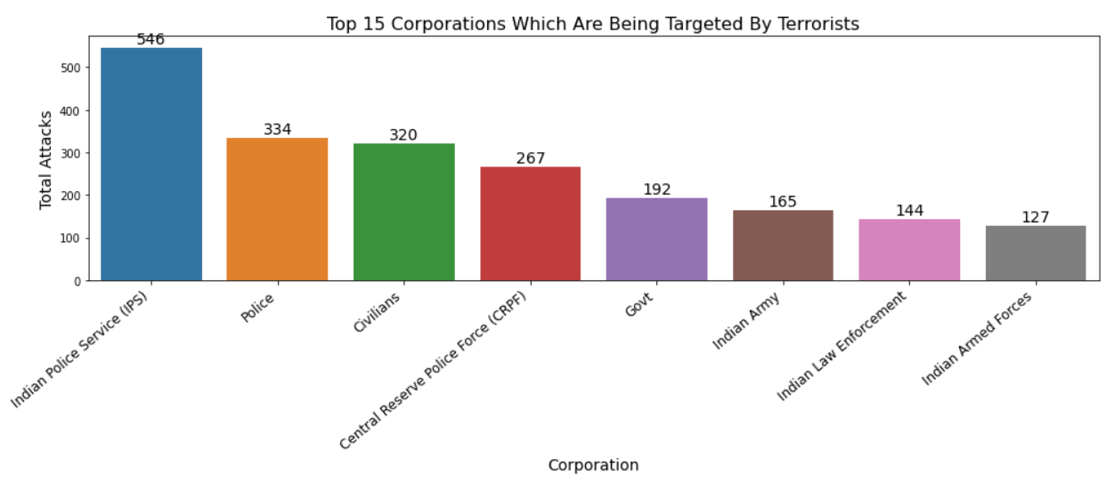
Top Corporations Under Attacks In India
By analyzing above graph we conclude that Indian Police, Army and peoples related with government institutions has been targeted most of the times by terrorists in India.

Slide 18
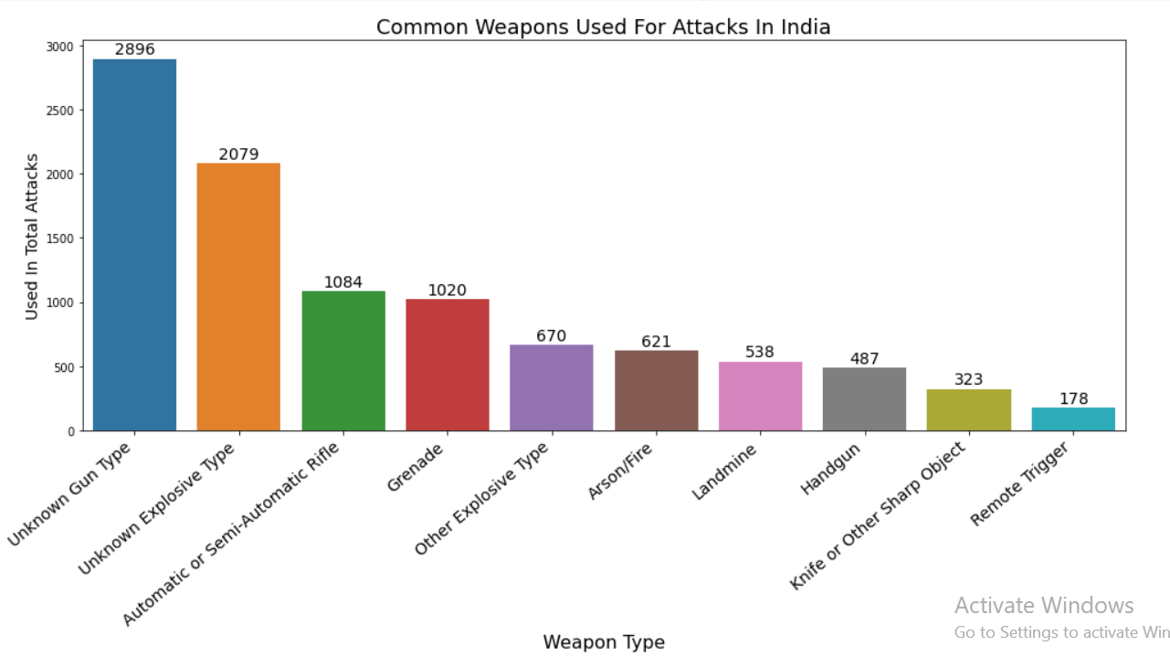
Weapons Used In India For Terror Attacks

Slide 19
Solution to Business Objective
Middle East and North Africa , South and East Asia, Sub-Saharan Africa, South America are top vulnerable regions to terror attacks and this are the regions which has most of the under-developed countries followed by developing countries which has high poverty and unemployment rates, so this are the regions which has become easy targets for extremist groups to operate and expand terrorism.
Apart form that state could expand its creditability in world by investing in such countries as, India is gaining importance at world stage and in united nations also and this could be one of the great initiatives which we could take to build and maintain good international relations.
Cities in Kashmir valley, some cities in north-east such as capital cities of seven sisters are very prone to terror attacks at the time of investing in infrastructure and other development projects private players needs to be more alert in such areas.
From the perspective of state of India this area should have well equipped healthcare facilities and alert emergency services as this areas are too vulnerable to terror attacks.
Special initiative should be taken by state of India to minimize terror attacks as number of attacks with respect to time in India are increasing as per line chart which is definitely a negative thing from the point of view of State and private businesses.

Slide 20
Conclusion
Major Causes Behind Terrorism Throughout The World :
ISIS (Islamic Statism), Taliban ,AL QAEDA, THE TALIBAN, AND OTHER EXTREMISTS GROUPS IN AFGHANISTAN AND PAKISTAN (Islamic fundamentalism, Deobandi Islamism Religious nationalism) has been responsible for the major terror attacks in the Iraq, Afghanistan and Pakistan.
The Communist Party of India (Maoist) (Naxalism), ULFA, Bode National, Nagaland (seeks to establish an independent sovereign nation states in North-East) has been responsible for the major terror attacks in India.
Colombia FARC-(Left-wing nationalism Revolutionary socialism ), Peru Shining path (Anti-revisionism, Revolutionary socialism) has been responsible for the major terror attacks in south American continents with far-left ideologies. Terrorism is a major social issue in the Philippines and it is linked to the Moro conflict and the communist rebellion.
Turkey- The Revolutionary People’s Liberation Party (Marxist-Leninist group espouses an anti-US, anti-NATO, and anti-Turkish establishment ideology) is root cause behind terrorism in Turkey.
90 % of the terror attacks that happened in the world has major cities as there targets out of which 70% attacks has been performed by using various explosives, which is clearly indicating that maximum collateral damage and casualties is one of the main aim of terrorists across the world.
There is major threat for security personals, army and police professionals, government officials and business tycoons throughout the world as they are the top targets of terror groups.
Explosives, armored vehicles and automatic and semi-automatic rifles are being widely used by terrorists throughout the world.
As per line graph of terror attacks happened casualties with respect to time has been increasing rapidly throughout the world and it is become a global challenge for all the countries in the world.

