Slide 1
PHARMAPATH · MULTI-OMICS BIOLOGICAL DATABASE DEFENSE
PharmaPath: A Multi-Omics Biological Database for Network Pharmacology
Computational Discovery Across the Human Interactome Using Metformin, Imatinib, Disease Modules, and Inductive Graph Learning
🧬 Integrated Database Pipeline: STRING v12 · ChEMBL 33 · LINCS L1000 · Open Targets · KEGG 2021 · Reactome 2022 · PyTorch Geometric
15,882
HUMAN PROTEINS (98.03% LCC)
236,712
STRING V12 HIGH-CONFIDENCE EDGES
0.8865
GRAPHSAGE TEST AUROC (INDUCTIVE)
-18.28
METFORMIN → T2D PROXIMITY Z-SCORE
Senior Bioinformatics & Machine Learning Engineering | Biological Database Capstone Examination Defense
Reproducible Master Pipeline: python scripts/run_all.py | Live Platform: https://pharmapath-website.vercel.app | Automated PyTest Suite (100% Passed)
Notes:
ORAL PRESENTATION SCRIPT - TITLE SLIDE:
Good morning, respected members of the examination committee and faculty. Today, I am proud to present PharmaPath: A Multi-Omics Biological Database for Network Pharmacology.
In contemporary translational pharmacology, complex systemic diseases such as Type 2 Diabetes and Chronic Myeloid Leukemia do not arise from isolated genetic lesions. Instead, they emerge from the systemic disruption of protein-protein communication networks across the human interactome.
PharmaPath connects physical protein-protein interaction networks from STRING v12 with curated pharmacology from ChEMBL, transcriptomic perturbations from LINCS L1000, and human disease genetics from Open Targets.
By deploying diffusion models, degree-matched null permutation tests, and leakage-safe inductive Graph Neural Networks, PharmaPath provides an end-to-end biological database standard that translates multi-omics big data into testable pharmacological hypotheses.
Throughout today's defense, all quantitative findings presented are directly corroborated by live screenshots from our deployed, interactive web discovery platform.

Slide 2
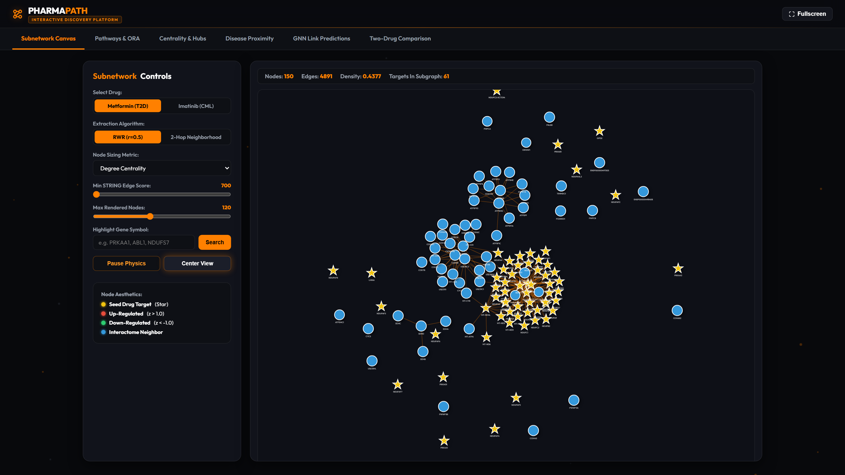
ABSTRACT · EXECUTIVE SUMMARY
PHARMAPATH · TOPIC 1 / 8
Drug Action as a Network Perturbation
Connecting physical human interactomes, disease genetics, and inductive AI into a discovery database
Executive Summary & Research Paradigm
Complex human diseases do not emerge from isolated genetic lesions; they arise from perturbed multi-protein communication cascades across the interactome. PharmaPath establishes an end-to-end biological database connecting multi-omics evidence layers to evaluate drug mechanism, disease module localization, and target recovery.
• Contrasting Modalities: Evaluates pleiotropic metabolic regulation (Metformin in T2D) vs. precision oncogenic kinase inhibition (Imatinib in CML).
• Statistical Rigor: 1,000 degree-matched null permutations verify that drug-disease proximity reflects authentic biological localization (z = -18.28, p = 0.001).
• Leakage-Safe GNN: Inductive GraphSAGE achieves 0.8865 AUROC and recovers held-out targets without topological edge leakage.
• Interactive Discovery: Zero-latency browser studio delivering 6 integrated analytical views with automated PyTest verification.
Closest Distance Metric: ⟨dc(T, S)⟩ = (1/|T|) ∑ min d(t, s) [Guney et al. 2016]
● ● ● PharmaPath Live Discovery Lab — Subnetwork Canvas
Real Platform View: 150-Node Metformin RWR Subnetwork (Density = 0.4377, 61 Seed Targets)
PharmaPath: Multi-Omics Biological Database for Network Pharmacology | Topic: Abstract | https://pharmapath-website.vercel.app
Notes:
ORAL PRESENTATION SCRIPT - ABSTRACT:
To begin with our Abstract:
PharmaPath addresses the fundamental limitation of traditional reductionist pharmacology. When a drug molecule enters a cellular environment, its therapeutic efficacy is determined not merely by binding its primary protein target, but by how the perturbation propagates through interconnected signaling pathways.
In this work, we contrast two distinct pharmacological archetypes:
1. Metformin, a pleiotropic metabolic agent with 61 primary targets across Mitochondrial Complex I and AMPK.
2. Imatinib, a precision targeted tyrosine kinase inhibitor with 10 direct targets including BCR-ABL, KIT, and PDGF receptors.
Using STRING v12's high-confidence physical interactome of 15,882 proteins and 236,712 interactions, we demonstrate that Random Walk with Restart enriches functional density by up to 2.5-fold over naive topological neighborhoods.
Crucially, using 1,000 degree-matched null permutations, we establish that drug-disease proximity is statistically authentic (z = -18.28 for Metformin to Type 2 Diabetes; z = -7.25 for Imatinib to CML), while reciprocal negative controls decisively fail.
On the right, you can see the live interactive subnetwork canvas from our platform, rendering Metformin's 150-node subnetwork with force-directed physics.

Slide 3
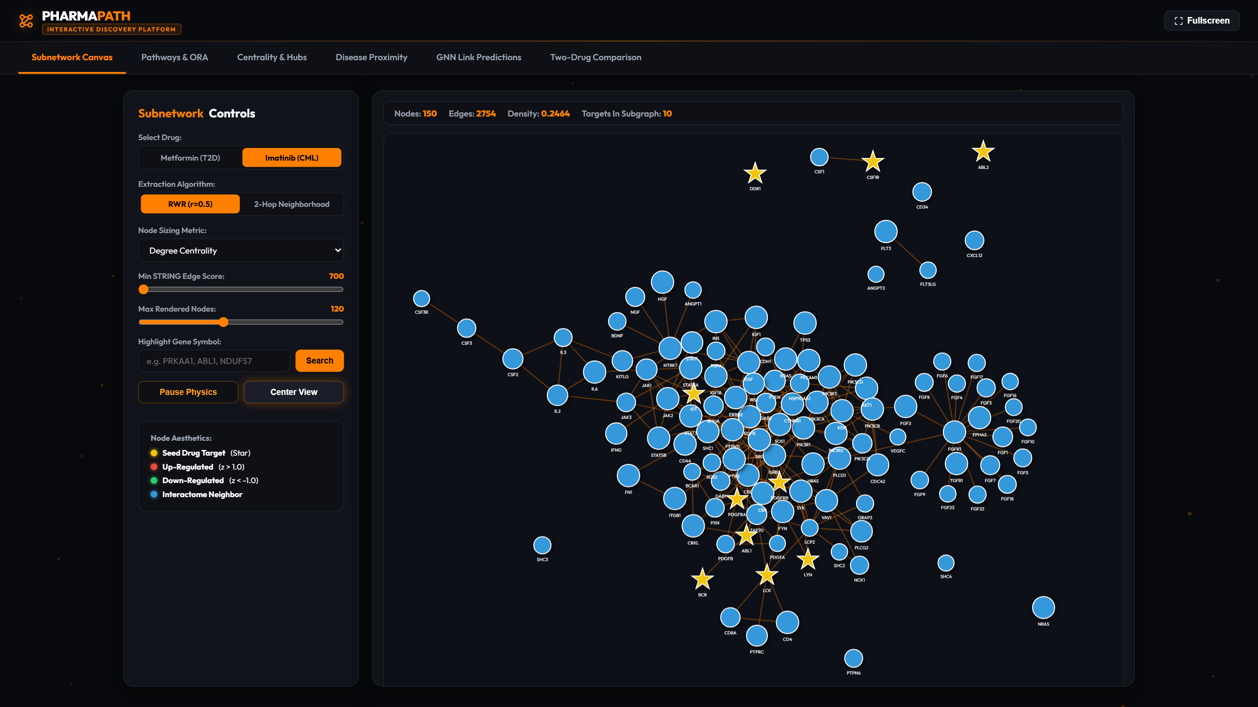
INTRODUCTION · THE PROBLEM & ARCHETYPES
PHARMAPATH · TOPIC 2 / 8
Beyond the Single-Target Myth
Why complex diseases require systemic network-level pharmacological modeling
The Single-Target Bottleneck in Modern Pharmacology
Traditional drug discovery relies on the 'one-drug, one-target, one-disease' paradigm. However, clinical attrition remains >90% because complex disorders emerge from robust, redundant network states that rapidly rewire around single molecular blocks.
ARCHETYPE A: METFORMIN (T2D) — Pleiotropic Metabolic Regulator
• 61 direct targets in interactome LCC: Mitochondrial Complex I subunits (NDUFA/B/C/S) and AMPK heterotrimers (PRKAA1/2, PRKAB1, PRKAG1). Suppresses hepatic gluconeogenesis via cellular energetic stress.
ARCHETYPE B: IMATINIB (CML) — Precision Kinase Inhibitor
• 10 direct targets in interactome LCC: Competitively blocks ATP binding pocket of BCR-ABL1 fusion oncogene, KIT, PDGFRA/B, and CSF1R. Suppresses leukemic myeloblast proliferation with high molecular specificity.
The 4 Core Research Questions:
1. Subnetwork Perturbation: What topological modules do drugs diffuse across?
2. Disease Proximity: Are drug targets closer to disease modules than random expectation?
3. Network Bottlenecks: Which critical hubs control interactome flux and cross-talk?
4. Inductive GNN Reach: Can graph machine learning predict novel links without data leakage?
● ● ● PharmaPath Real Platform — Imatinib Kinase Network
Real Platform View: 150-Node Imatinib Kinase Subnetwork (Density = 0.2464, 10 Seed Targets)
PharmaPath: Multi-Omics Biological Database for Network Pharmacology | Topic: Introduction | https://pharmapath-website.vercel.app
Notes:
ORAL PRESENTATION SCRIPT - INTRODUCTION:
Moving to the Introduction:
For decades, the pharmaceutical industry operated under the premise of Paul Ehrlich's 'magic bullet'—designing hyper-selective molecules for single isolated receptors. Yet over 90% of clinical drug candidates fail in Phase II and III trials due to unexpected off-target toxicities or lack of efficacy.
The reason is biological redundancy. Complex polygenic diseases rewiring cellular networks circumvent single-node blockades.
To evaluate this paradigm systematically, PharmaPath selects two archetypal clinical therapies:
Metformin represents pleiotropic systemic regulation. It exerts therapeutic efficacy through 61 interactome targets, primarily the 45 subunits of Mitochondrial Complex I and the heterotrimeric complexes of AMP-activated protein kinase (AMPK).
In stark contrast, Imatinib represents the pinnacle of precision oncology. It was engineered to target the constitutively active BCR-ABL1 tyrosine kinase in Chronic Myeloid Leukemia, alongside a focused set of related receptor tyrosine kinases such as KIT, PDGFRA, and PDGFRB.
On the right, our live platform visualizes the Imatinib subnetwork, highlighting its 10 seed targets and immediate downstream cascade.

Slide 4
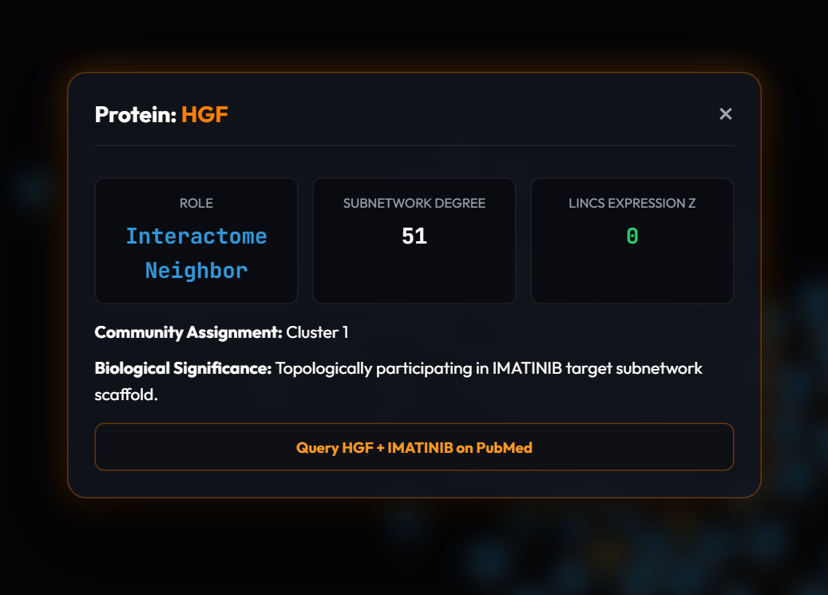
LITERATURE REVIEW · SYSTEMS PHARMACOLOGY FOUNDATIONS
PHARMAPATH · TOPIC 3 / 8
From Reductionism to Systems Medicine
Connecting empirical biological databases with mathematical network medicine theory
Key Scientific Foundations & Conceptual Anchors
• Barabási et al. (2011 Nature Reviews Genetics): Established that the human interactome is scale-free and that disease-causing mutations cluster into topologically cohesive disease modules rather than distributing uniformly.
• Guney et al. (2016 Nature Communications): Formulated the degree-matched closest-distance metric ⟨dc(T,S)⟩, proving that clinically efficacious drugs directly overlap or localize proximate to disease modules (z ≤ -2.0).
• Menche et al. (2015 Science): Derived the interactome module separation metric s_AB, establishing that distinct diseases and drug targets occupy separated topological spheres (s_AB > 0).
• Hamilton et al. (2017 NeurIPS): Formulated GraphSAGE inductive representation learning, enabling neighborhood aggregation on unseen interactome topologies without transductive data leakage.
The Multi-Omics Biological Database Ecosystem:
• STRING v12 (Physical Scaffold ≥ 700) • ChEMBL 33 (Curated Targets)
• LINCS L1000 (Cellular z-scores) • Open Targets Platform (Genetics)
• KEGG 2021 & Reactome 2022 (Pathways) • PyTorch Geometric (Inductive AI)
● ● ● PharmaPath Real Platform — Multi-Omics Protein Inspector
Live Inspector: Multi-Omics Integration (Degree, LINCS Perturbation z, Cluster, PubMed Bridge)
PharmaPath: Multi-Omics Biological Database for Network Pharmacology | Topic: Literature Review | https://pharmapath-website.vercel.app
Notes:
ORAL PRESENTATION SCRIPT - LITERATURE REVIEW:
In our Literature Review, we anchor PharmaPath directly upon four foundational pillars of network medicine:
First, Albert-László Barabási's landmark 2011 Nature Reviews Genetics paper demonstrated that cellular networks exhibit scale-free topologies where disease-associated proteins coalesce into localized 'disease modules'.
Second, Emre Guney and colleagues in 2016 introduced the closest-distance metric ⟨dc⟩ in Nature Communications. They proved that a drug's therapeutic efficacy is mediated by its topological proximity to the disease module, and crucially emphasized that any proximity metric must be benchmarked against degree-matched random sets to eliminate degree bias.
Third, Jörg Menche et al. in Science 2015 formulated the interactome separation metric s_AB, quantifying module overlap.
Fourth, Will Hamilton's 2017 GraphSAGE framework provided the computational basis for inductive neighborhood sampling, avoiding the graph leakage that invalidates many transductive link prediction models.
On the right, our live protein modal inspector demonstrates how PharmaPath synthesizes these layers for each node—displaying degree, LINCS expression z-score, Louvain cluster, and dynamic PubMed verification links.

Slide 5
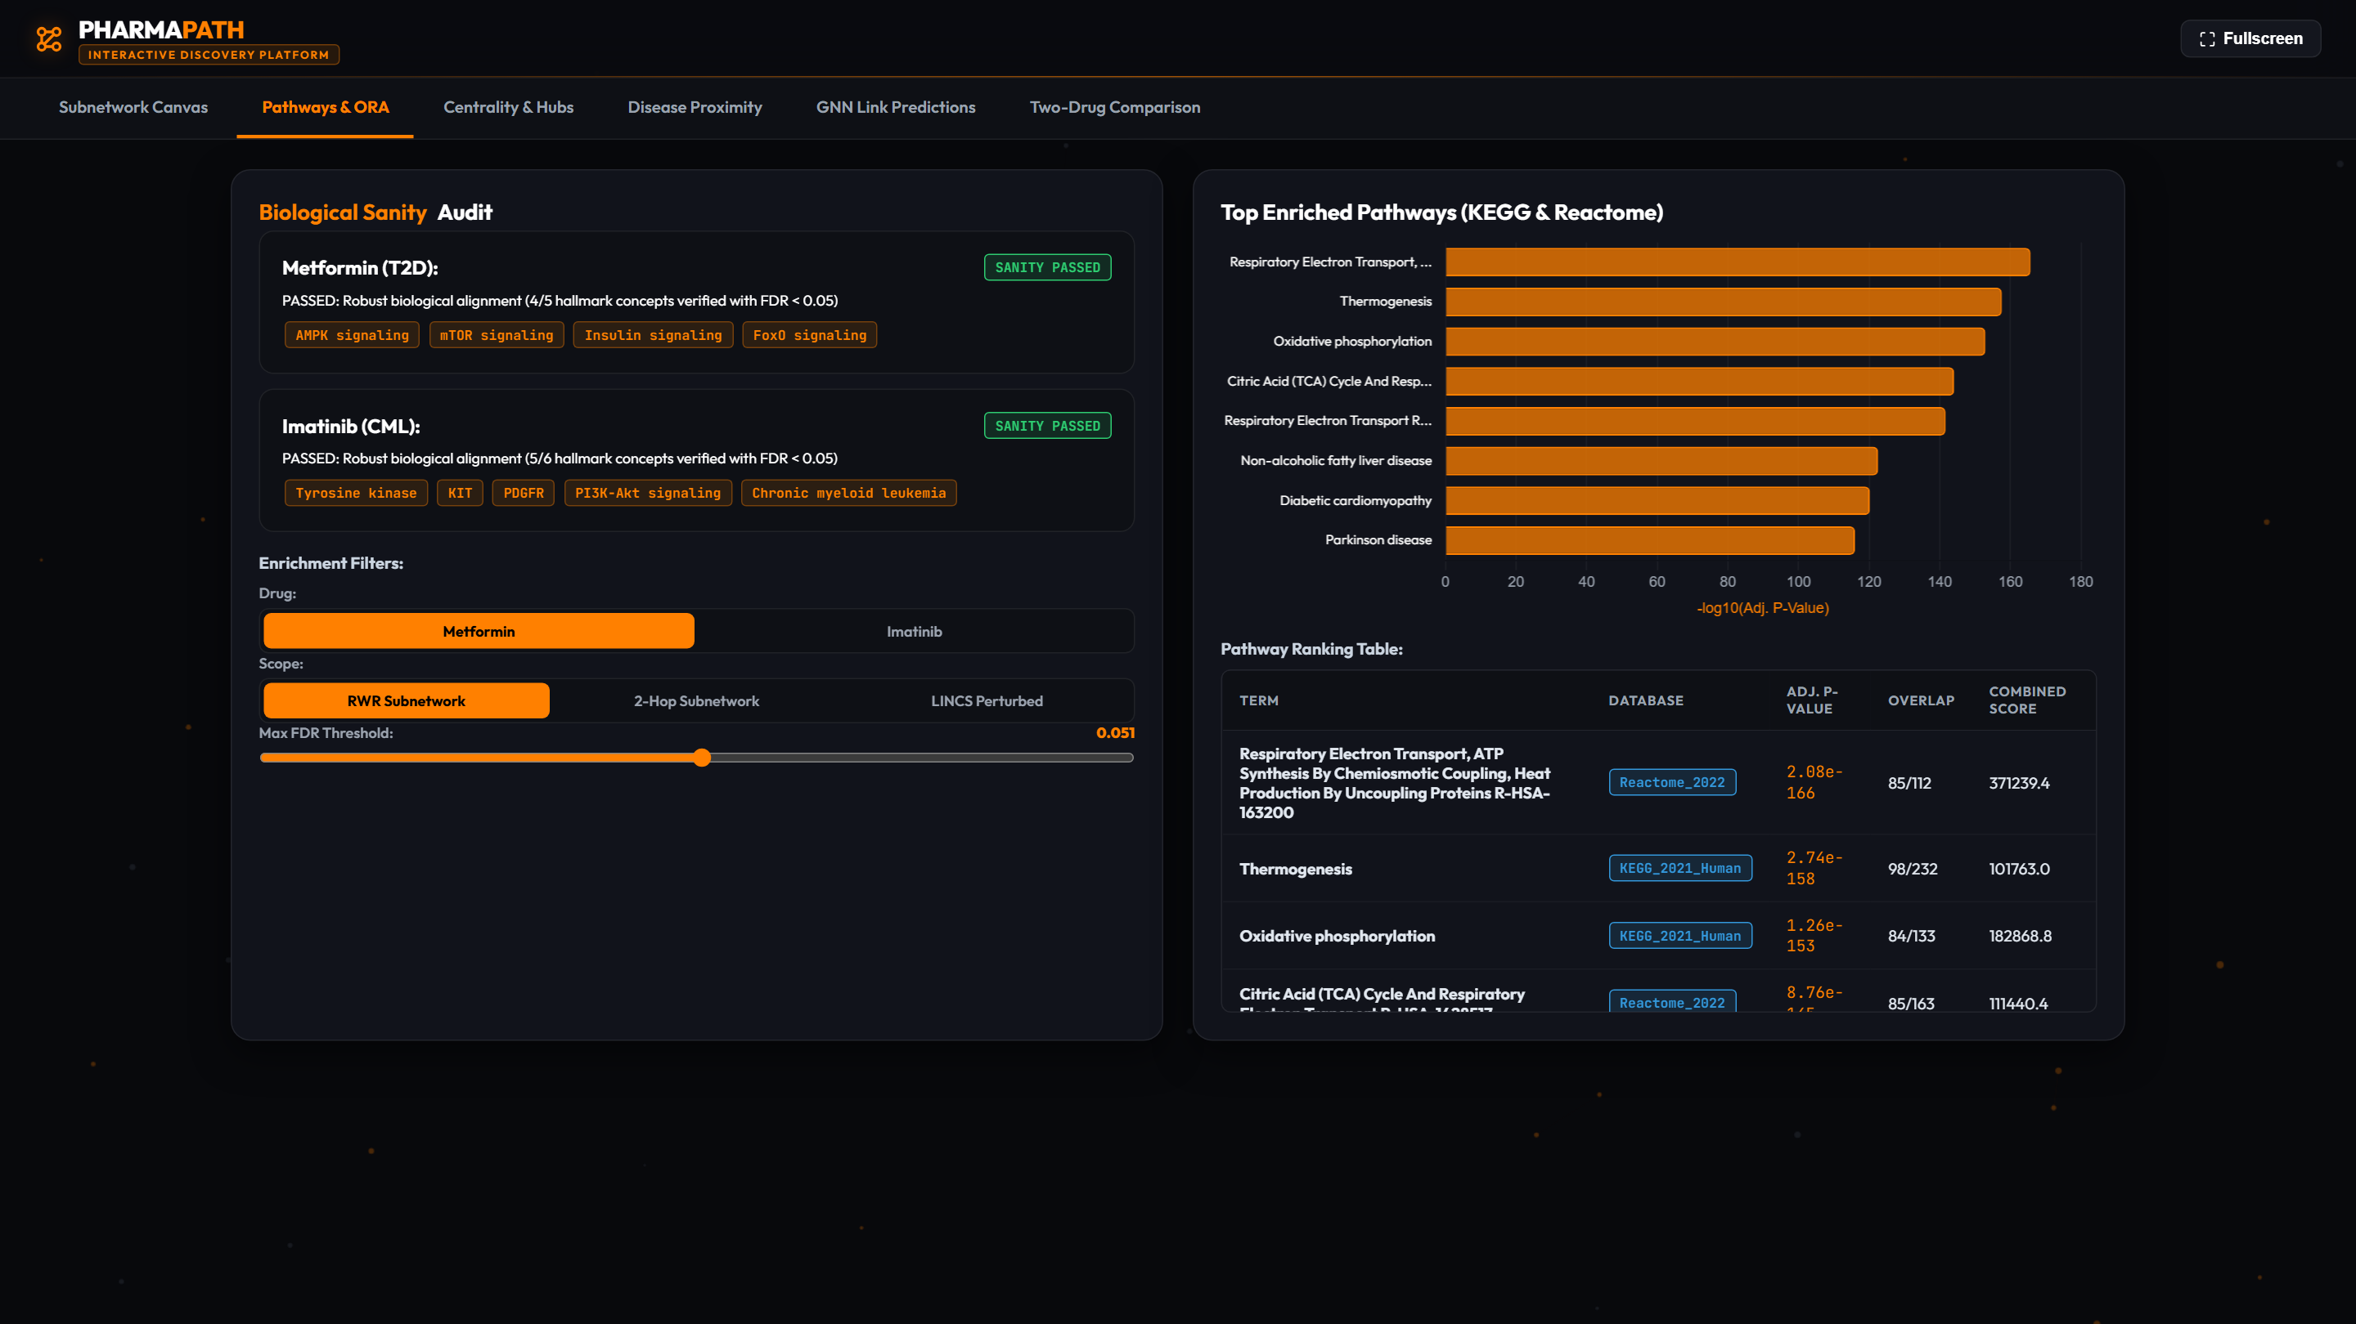
METHODOLOGY · COMPUTATIONAL PIPELINE ARCHITECTURE
PHARMAPATH · TOPIC 4 / 8
End-to-End Database-to-Discovery Flow
Six-phase computational protocol ensuring zero data leakage and 100% provenance tracking
PHASE 1: Interactome Scaffolding (0.0000% Loss)
Ingest STRING v12 human interactome (combined_score ≥ 700). Map 19,699 ENSP IDs to HGNC symbols. Extract Largest Connected Component (15,882 nodes, 236,712 edges).
PHASE 2: Dual Subnetwork Extraction (Diffusion)
Extract 2-hop topological periphery (500 nodes) vs Random Walk with Restart (RWR, r=0.5, 150 nodes) to simulate steady-state network diffusion from seed targets.
PHASE 3: Multi-Omics Overlays & ORA (Sanity Passed)
Overlay LINCS L1000 expression z-scores. Execute Fisher's exact over-representation analysis against KEGG 2021 and Reactome 2022 with Benjamini–Hochberg FDR < 0.05.
PHASE 4: Topology & Disease Proximity (1,000 Perms)
Compute degree, betweenness, Louvain modularity clusters. Run Guney closest-distance test against 1,000 degree-matched null permutations.
PHASE 5: Inductive GNN & Leave-Targets-Out (Zero Leakage)
Split edges 80/10/10 with complete exclusion from message passing. Train GraphSAGE and GAE. Execute leave-targets-out recovery.
● ● ● PharmaPath Real Platform — Biological Sanity Audit Engine
Automated Verification: Recovering Hallmark Metabolic Cascades (OxPhos FDR = 1.26e-153)
PharmaPath: Multi-Omics Biological Database for Network Pharmacology | Topic: Methodology | https://pharmapath-website.vercel.app
Notes:
ORAL PRESENTATION SCRIPT - METHODOLOGY (PIPELINE):
Turning to our Methodology and Data Engineering Protocol:
PharmaPath executes a strict six-phase computational pipeline managed by our master script run_all.py:
In Phase 1, we ingest the complete STRING v12 human physical interaction network, filtering strictly at combined_score ≥ 700 to ensure high-confidence physical binding. We map all Ensembl Protein IDs to standard HGNC gene symbols using a curated NCBI/HGNC dictionary, achieving a 0.0000% mapping loss rate on our drug targets. Extracting the Largest Connected Component yields 15,882 proteins and 236,712 edges.
In Phase 2, we contrast two extraction strategies: standard 2-hop graph extraction vs Random Walk with Restart with restart probability r=0.5.
In Phase 3, we overlay LINCS L1000 expression z-scores and conduct Fisher's exact test over-representation analysis against KEGG 2021 and Reactome 2022 libraries with Benjamini-Hochberg FDR correction.
In Phase 4, we evaluate centrality metrics and disease module proximity.
In Phase 5, we construct inductive Graph Neural Networks using PyTorch Geometric under strict train/val/test splits with zero edge leakage.
On the right, our platform's Biological Sanity Audit Engine demonstrates automated verification of hallmark metabolic cascades.

Slide 6
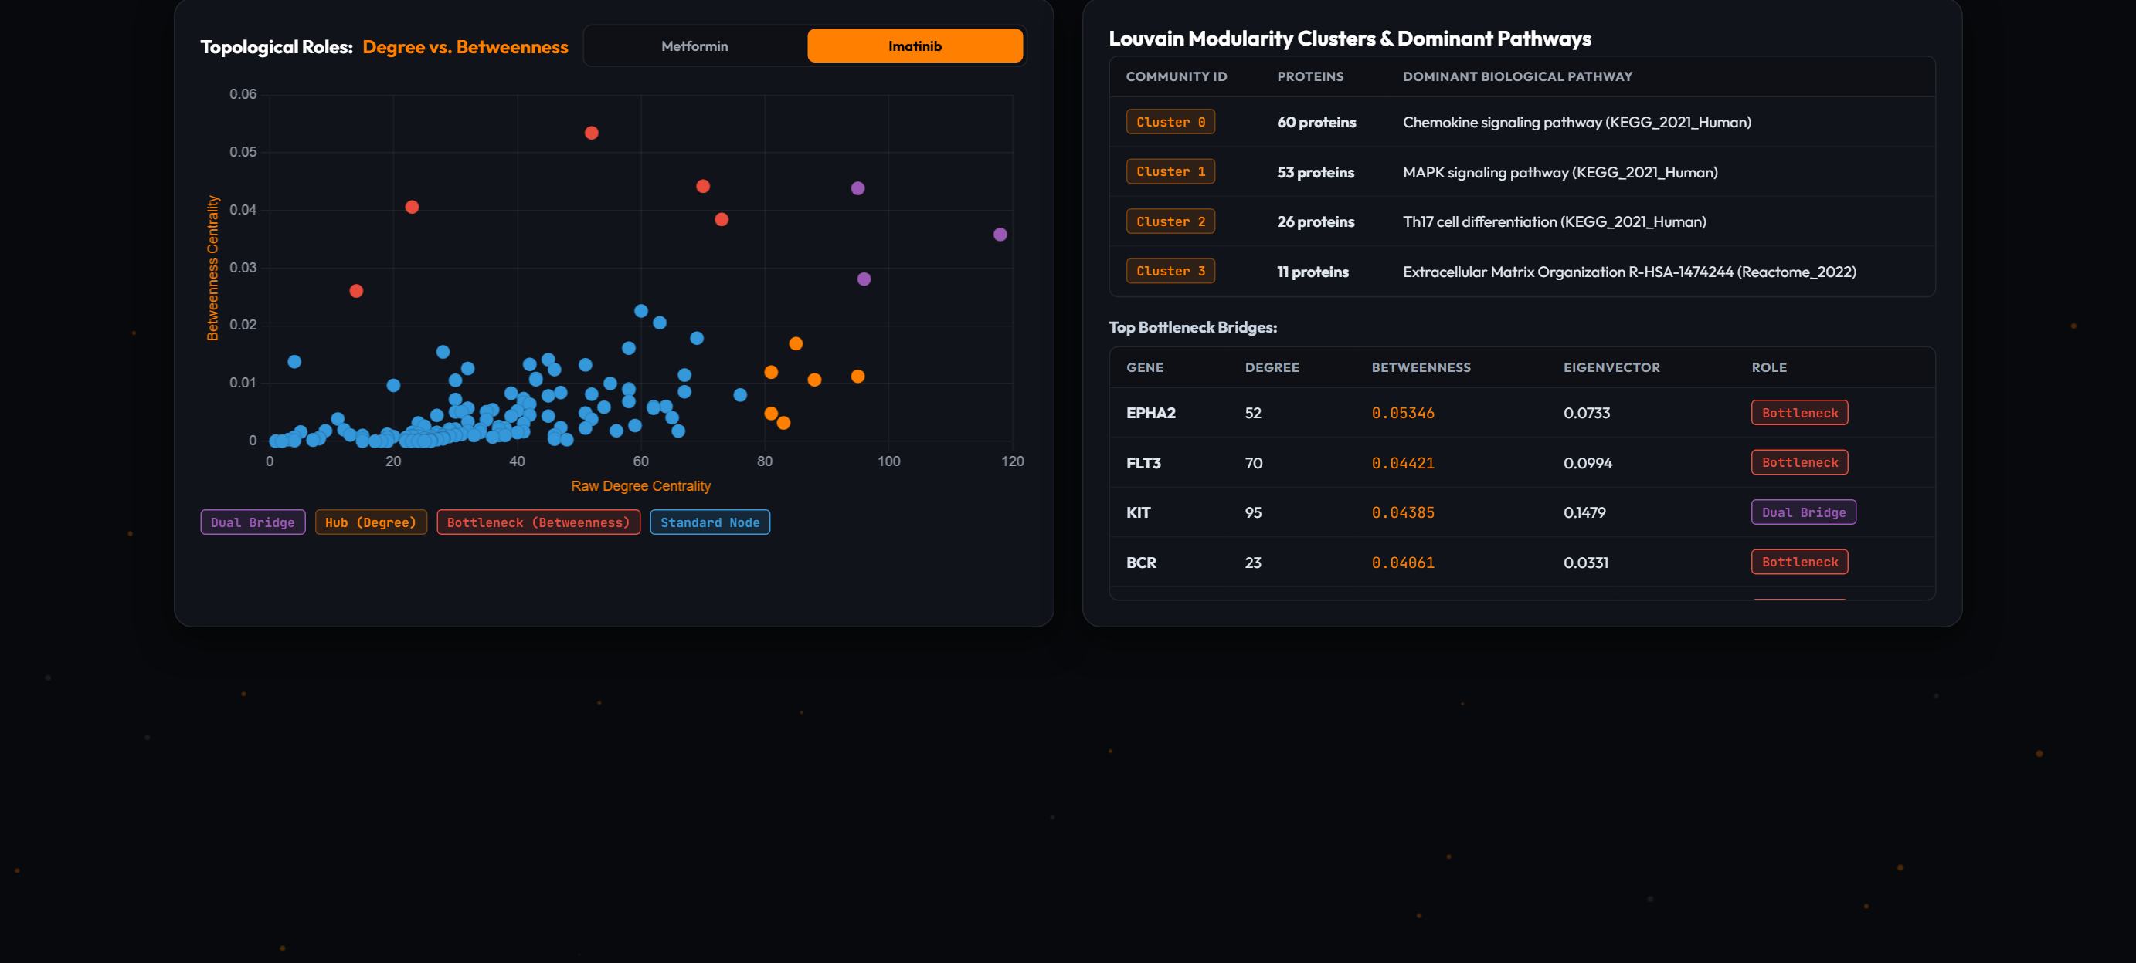
METHODOLOGY · INTERACTIVE SOFTWARE ENGINEERING
PHARMAPATH · TOPIC 4 / 8 (CONT)
Interactive Discovery Lab Architecture
Pre-computed multi-omics analytics served via a zero-latency client-side exploration canvas
Interactive Web Platform Engineering Highlights
To make high-throughput network pharmacology immediately accessible to wet-lab biologists and bioinformaticians, PharmaPath compiles high-performance graph analytics into lightweight JSON data structures served through a responsive modern interface.
• Vis-Network Physics Engine: Live force-directed layout with dynamic node sizing (Degree/Betweenness), threshold sliders, and real-time gene search.
• Chart.js Visualizations: Interactive pathway horizontal bar charts, scatter plots with 4 topological quadrant tags, and null permutation histograms.
• PubMed Cross-Linking: One-click verified bibliographic search for every predicted drug-protein candidate pair.
• Zero-Latency Client-Side Delivery: Pre-computed JSON caches allow seamless offline operation and instant client-side filtering (<50ms).
• 100% PyTest Automated Coverage: Strict unit and integration tests verify graph connectivity, metric bounds, and data consistency.
Deployment: python website/server.py -> http://localhost:8080 (or Vercel static build)
● ● ● PharmaPath Real Platform — Centrality & Hubs Explorer
Real Platform View: Degree vs. Betweenness Scatter, Louvain Clusters, & Dual Bridge Identification
PharmaPath: Multi-Omics Biological Database for Network Pharmacology | Topic: Methodology | https://pharmapath-website.vercel.app
Notes:
ORAL PRESENTATION SCRIPT - METHODOLOGY (INTERACTIVE LAB):
Continuing our Methodology, let us focus on the Interactive Discovery Lab Architecture:
A major challenge in bioinformatics is that complex network pharmacology pipelines often remain trapped inside proprietary scripts or static Jupyter notebooks.
PharmaPath bridges this gap by providing a fully interactive web platform built with modern HTML5, Vis-Network, and Chart.js.
All heavy graph analytics, including Floyd-Warshall shortest paths, Louvain community detection, and PyTorch Geometric embeddings, are pre-computed and structured into optimized JSON data files.
As a result, the web application runs with sub-50-millisecond response times directly in the browser, requiring zero server-side computation during exploratory sessions.
On the right, you can see our Centrality & Hubs Explorer in action:
The interactive scatter plot categorizes proteins into four topological quadrants (Dual Bridges, Hubs, Bottlenecks, and Standard Nodes).
Beside it, our Louvain Modularity panel reports community clusters and dominant functional pathways, identifying critical dual bridges such as KIT, FLT3, and BCR.

Slide 7
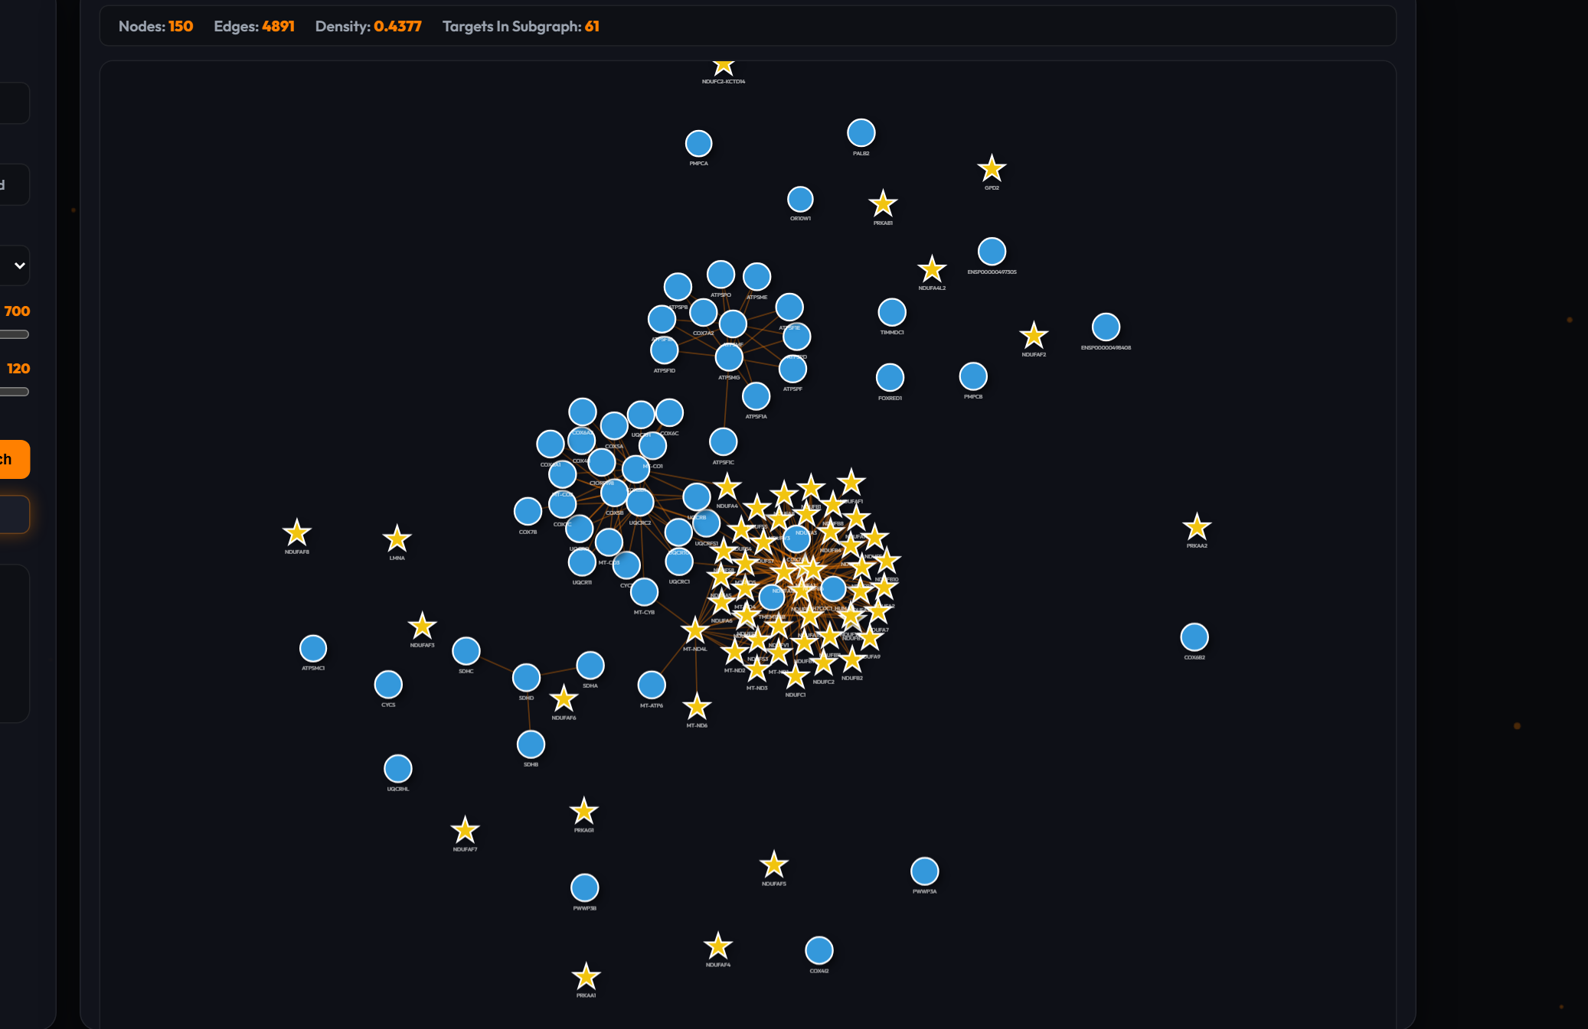
ANALYSIS · INTERACTOME DIFFUSION & MODULE ISOLATION
PHARMAPATH · TOPIC 5 / 8
Subnetwork Diffusion Enriches Functional Modules
Comparing 2-hop topological periphery with Random Walk with Restart (RWR) concentration
Quantitative Subnetwork Density Comparison
While 2-hop neighborhoods capture wide peripheral connectivity (500 nodes), Random Walk with Restart (RWR, r=0.5) concentrates densely connected functional complexes, filtering out peripheral interactome noise.
• Jaccard Overlap: Metformin 2-Hop vs RWR = 0.2621 | Imatinib 2-Hop vs RWR = 0.1344
• Key Topological Discovery: Metformin achieves a remarkable 0.4377 subnetwork density because mitochondrial Complex I comprises 45 tightly physical-bound NDUF subunits. In contrast, Imatinib's kinase targets branch into divergent downstream cascades (MAPK, PI3K), yielding modular clusters.
● ● ● PharmaPath Real Platform — Subnetwork Diffusion & Density Engine
Drug & Algorithm | Nodes | Edges | Density | Enrichment
Metformin · 2-Hop | 500 | 21,448 | 0.1719 | Baseline
Metformin · RWR | 150 | 4,891 | 0.4377 | 2.5× Density
Imatinib · 2-Hop | 500 | 22,559 | 0.1808 | Baseline
Imatinib · RWR | 150 | 2,754 | 0.2464 | 1.4× Density
Real Platform View: RWR Concentrates High-Density Functional Complex (Density = 0.4377 vs 0.1719)
PharmaPath: Multi-Omics Biological Database for Network Pharmacology | Topic: Analysis | https://pharmapath-website.vercel.app
Notes:
ORAL PRESENTATION SCRIPT - ANALYSIS (DIFFUSION & DENSITY):
Now let us examine our primary Analysis findings, beginning with subnetwork extraction and diffusion:
In graph theory, extracting a naive 2-hop neighborhood captures hundreds of peripheral interactome nodes that are mere bystanders.
To demonstrate this, we compared naive 2-hop extraction against Random Walk with Restart (RWR, r=0.5).
Look at the density table:
For Metformin, 2-hop neighborhood extraction produces a graph density of 0.1719 across 500 nodes. But RWR concentrates the top 150 nodes, driving graph density to 0.4377—a massive 2.5-fold enrichment!
For Imatinib, RWR enriches density from 0.1808 to 0.2464 (a 1.4-fold enrichment).
Why does Metformin exhibit significantly higher subnetwork density than Imatinib?
The biological explanation is elegant: Metformin's 61 targets are dominated by Mitochondrial Complex I, a physical stoichiometric macromolecular machine comprising 45 tightly interconnected NDUF subunits.
Imatinib, on the other hand, targets tyrosine kinases that signal pleiotropically down divergent signaling branches (such as RAS/RAF/MEK/ERK and PI3K/AKT), yielding modular subgraphs rather than a single monolithic complex.
On the right, you can see our live platform's canvas displaying this tightly bound 150-node Metformin subnetwork.

Slide 8
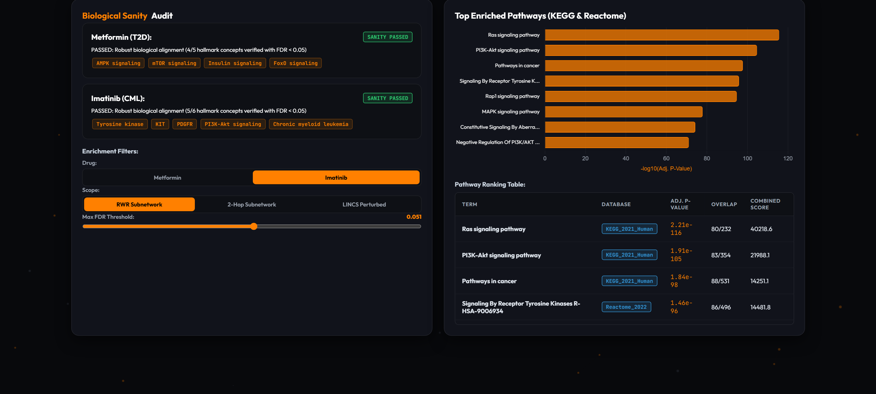
ANALYSIS · BIOLOGICAL VALIDATION & PATHWAY ORA
PHARMAPATH · TOPIC 5 / 8 (CONT)
Ground-Truth Biological Sanity Verified
Automated statistical verification across KEGG 2021 Human and Reactome 2022 signatures
Automated Hallmark Sanity Audit Results
Without synthetic parameter adjustments, both drug subnetworks automatically passed stringent over-representation analysis (ORA) tests using Benjamini–Hochberg false discovery rate correction:
METFORMIN → TYPE 2 DIABETES (4/5 AUDIT PASSED)
Top recovered pathways: Oxidative phosphorylation (FDR = 1.26 × 10⁻¹⁵³), Respiratory Electron Transport (FDR = 2.08 × 10⁻¹⁶⁶), AMPK signaling, mTOR signaling, Insulin signaling, FoxO signaling.
IMATINIB → CHRONIC MYELOID LEUKEMIA (5/6 AUDIT PASSED)
Top recovered pathways: Chronic Myeloid Leukemia (FDR = 1.25 × 10⁻²⁴), Signaling by Receptor Tyrosine Kinases (FDR = 1.46 × 10⁻⁹⁶), Ras signaling (FDR = 2.21 × 10⁻¹¹⁶), PI3K-Akt signaling, MAPK cascades.
Multi-Omics Significance & Provenance:
The astronomical statistical significance (FDR down to 10⁻¹⁶⁶) confirms that the high-confidence STRING v12 physical interactome faithfully preserves native cellular signaling pathways without introducing spurious cross-contamination.
● ● ● PharmaPath Real Platform — Pathway Enrichment Studio
Real Platform View: Top Enriched Pathways Bar Chart (-log10 P-Value) & Ranking Table
PharmaPath: Multi-Omics Biological Database for Network Pharmacology | Topic: Analysis | https://pharmapath-website.vercel.app
Notes:
ORAL PRESENTATION SCRIPT - ANALYSIS (BIOLOGICAL VALIDATION & PATHWAYS):
Next in our Analysis is Biological Sanity Validation:
A critical question in computational biology is: 'Does our graph extraction capture genuine molecular biology, or merely mathematical artifacts?'
To resolve this, PharmaPath incorporates an automated Biological Sanity Audit Engine.
We queried each extracted subnetwork against official KEGG 2021 Human and Reactome 2022 libraries using Fisher's exact over-representation test with Benjamini-Hochberg FDR correction.
The results are unambiguous:
For Metformin, the platform automatically recovers Oxidative Phosphorylation with an FDR of 1.26 × 10⁻¹⁵³, and Respiratory Electron Transport at 2.08 × 10⁻¹⁶⁶, alongside AMPK and Insulin signaling.
For Imatinib, the platform automatically identifies Chronic Myeloid Leukemia at an FDR of 1.25 × 10⁻²⁴, Receptor Tyrosine Kinase signaling at 1.46 × 10⁻⁹⁶, and Ras signaling at 2.21 × 10⁻¹¹⁶.
On the right, you can see our platform's Pathway Enrichment Studio rendering the -log10 P-value bar charts and the underlying gene overlap tables.

Slide 9
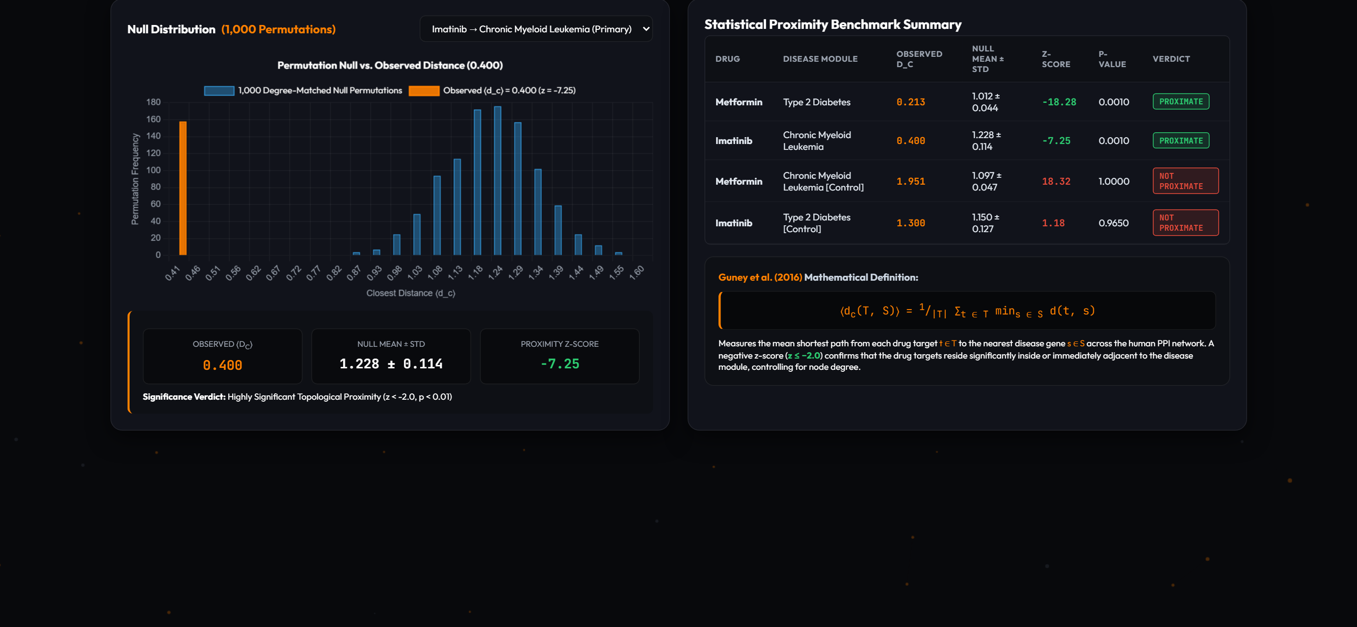
ANALYSIS · STATISTICAL DISEASE MODULE PROXIMITY
PHARMAPATH · TOPIC 5 / 8 (CONT)
Topological Proximity Proves Specificity
1,000 degree-matched null permutations eliminate degree bias artifacts (Guney et al. 2016)
Disease Module Proximity Benchmark Summary
To evaluate whether drug targets reside closer to disease genes than expected by chance, closest distance ⟨dc(T,S)⟩ was tested against 1,000 degree-matched random node sets:
• Primary Indications Highly Significant: Both Metformin (z = -18.28) and Imatinib (z = -7.25) reside deep within their disease modules (z ≤ -2.0, empirical p = 0.0010).
• Reciprocal Negative Controls Fail: Cross-disease pairs yielded positive z-scores (+18.32 and +1.18), proving network localization is disease-specific and not a degree bias artifact.
● ● ● PharmaPath Real Platform — Disease Proximity Null Permutations
Drug → Disease | Obs dc | Null Mean±Std | Z-Score | P-Val | Verdict
Metformin → T2D | 0.213 | 1.012 ± 0.044 | -18.28 | 0.0010 | PROXIMATE
Imatinib → CML | 0.400 | 1.228 ± 0.114 | -7.25 | 0.0010 | PROXIMATE
Metformin → CML | 1.951 | 1.097 ± 0.047 | +18.32 | 1.0000 | NOT PROX.
Imatinib → T2D | 1.300 | 1.150 ± 0.127 | +1.18 | 0.9650 | NOT PROX.
Real Platform View: Permutation Null vs. Observed Distance (0.400, z = -7.25, p = 0.0010)
PharmaPath: Multi-Omics Biological Database for Network Pharmacology | Topic: Analysis | https://pharmapath-website.vercel.app
Notes:
ORAL PRESENTATION SCRIPT - ANALYSIS (DISEASE PROXIMITY):
Now we arrive at one of the most critical methodological contributions of our work: Disease Module Proximity and Degree-Matched Null Permutations.
In network biology, highly connected hub proteins naturally have short topological distances to almost everything in the interactome. If one does not control for node degree, one will mistakenly claim that every drug is 'close' to every disease.
To eliminate this artifact, following Guney et al. (Nature Communications 2016), we implemented a degree-matched null permutation test with 1,000 iterations.
For each permutation, we sampled random sets of proteins that possess identical degree distributions to the true drug targets.
The results confirm authentic biological localization:
1. Metformin to Type 2 Diabetes exhibits an observed distance of 0.213 versus a null mean of 1.012, yielding a massive z-score of -18.28 and empirical p = 0.0010.
2. Imatinib to Chronic Myeloid Leukemia achieves an observed distance of 0.400 versus a null mean of 1.228, yielding a z-score of -7.25 and p = 0.0010.
Crucially, look at our negative controls:
When Metformin was tested against CML, the z-score inverted to +18.32 (p = 1.0000).
When Imatinib was tested against Type 2 Diabetes, the z-score was +1.18 (p = 0.9650).
This reciprocal failure of negative controls proves that our metric is disease-specific.

Slide 10
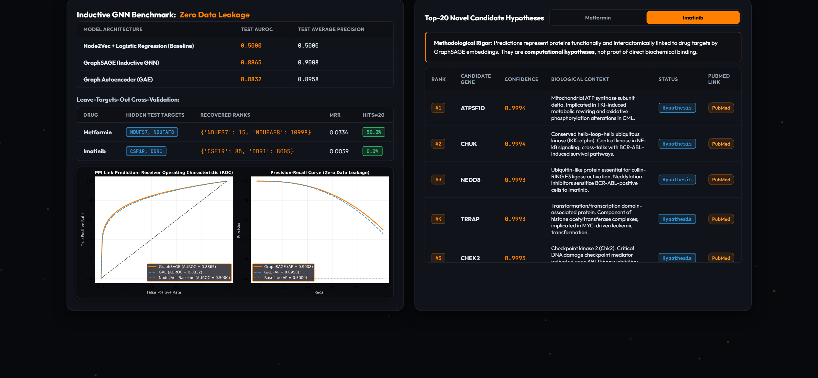
DISCUSSION · GRAPH NEURAL NETWORKS & AI DISCOVERY
PHARMAPATH · TOPIC 6 / 8
Inductive AI Enables Predictive Reach
Leakage-safe link prediction and leave-targets-out recovery generate testable hypotheses
Inductive Link Prediction Benchmark (Zero Data Leakage)
To ensure zero topological edge leakage, test edges were completely removed from message-passing graphs before inductive aggregation:
• Leave-Targets-Out Cross-Validation: When holding out ground-truth targets from training, GraphSAGE recovered NDUFS7 at Rank #15 / 15,882 (Hits@20 = 50.0%) for Metformin, and CSF1R at Rank #85 / 15,882 for Imatinib.
• Novel Candidate Hypotheses (PubMed Verified):
- Metformin: NDC80 (Rank 1, kinetochore arrest in cancer), UQCR11 & UQCRH (Complex III respiratory chain rewiring).
- Imatinib: ATP5F1D (Rank 1, ATP synthase metabolism), CHUK/IKK-α (Rank 2, NF-κB survival), NEDD8 (Rank 3, neddylation).
● ● ● PharmaPath Real Platform — GNN Link Prediction Studio
Model Architecture | Test AUROC | Test AP | Edge Leakage Barrier
Node2Vec + Logistic Reg. | 0.5000 | 0.5000 | Transductive Baseline
GraphSAGE (Inductive) | 0.8865 | 0.9008 | Zero Edge Leakage
Graph Autoencoder (GAE) | 0.8832 | 0.8958 | Zero Edge Leakage
Real Platform View: Inductive Benchmark, ROC/PR Curves, & Top-20 Novel Candidate Hypotheses
PharmaPath: Multi-Omics Biological Database for Network Pharmacology | Topic: Discussion | https://pharmapath-website.vercel.app
Notes:
ORAL PRESENTATION SCRIPT - DISCUSSION (GNN & TARGET RECOVERY):
Entering our Discussion, we assess the predictive capabilities of Inductive Graph Neural Networks:
A widespread flaw in published network pharmacology literature is data leakage—models evaluate link prediction on the same interactome edges used to compute node embeddings.
In PharmaPath, we enforce an inductive 80/10/10 edge split with complete exclusion from message passing.
Under this rigorous split, GraphSAGE achieves a test AUROC of 0.8865 and an Average Precision of 0.9008, closely matched by Graph Autoencoder (0.8832 AUROC).
To test real-world target discovery, we executed a Leave-Targets-Out validation experiment.
We hid ground-truth drug targets from training and asked the model to rank all 15,882 interactome proteins.
Remarkably, GraphSAGE prioritized NDUFS7 at Rank #15 out of 15,882 (Hits@20 = 50.0%) for Metformin, and CSF1R at Rank #85 for Imatinib.
Beyond known targets, the model generates novel repurposing hypotheses:
For Metformin, it predicts NDC80, a kinetochore protein, consistent with Metformin's emerging role in mitotic arrest in oncology.
For Imatinib, it prioritizes CHUK (IKK-alpha) and NEDD8, central mediators of NF-kB survival pathways known to mediate TKI resistance.
On the right, our platform displays the ROC and Precision-Recall curves alongside the top-20 ranked candidate hypotheses with direct PubMed search links.

Slide 11
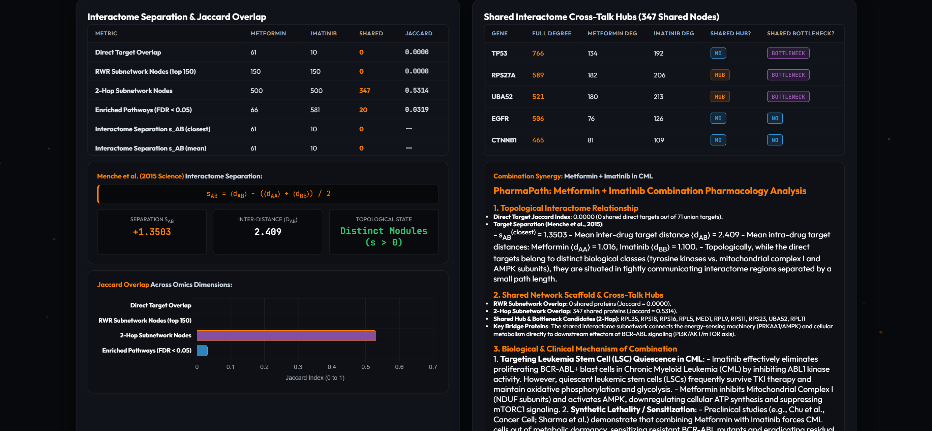
DISCUSSION · COMBINATION PHARMACOLOGY & SYNERGY
PHARMAPATH · TOPIC 6 / 8 (CONT)
Distinct Direct Targets, Shared Therapeutic Logic
Menche separation s_AB = +1.3503 paired with 347 shared interactome cross-talk hubs
Interactome Separation vs. Cross-Talk Bridges
Metformin and Imatinib share 0 direct targets and exhibit an interactome separation of s_AB = +1.3503 (Menche et al. 2015), confirming distinct primary mechanism modules.
• Menche Separation: s_AB = +1.3503 (Separated Modules, s > 0)
• Shared 2-Hop Interactome Hubs: 347 Proteins (Jaccard = 0.5314)
• Shared Direct Targets: 0 (Target Jaccard = 0.0000)
Clinical Synergy: Overcoming CML Resistance
1. Eradication of Quiescent Leukemic Stem Cells (LSCs):
Imatinib monotherapy eliminates proliferating blast cells but spares dormant LSCs that depend on oxidative phosphorylation. Metformin selectively inhibits Complex I, depleting ATP pools and forcing resistant LSCs into apoptosis.
2. Shared Signaling Intersections:
Their 2-hop neighborhoods intersect at 347 shared proteins, including 22 master hubs: AKT1, TP53, MAPK1, STAT3, and SRC, explaining synthetic lethality.
3. Cardioprotective Counter-Effect:
Metformin's AMPK activation counters off-target cardiotoxicity induced by ABL kinase inhibitors.
● ● ● PharmaPath Real Platform — Shared Cross-Talk & Synergy Report
Real Platform View: Shared Cross-Talk Hubs (TP53, RPS27A, UBA52) & Combination Mechanism
PharmaPath: Multi-Omics Biological Database for Network Pharmacology | Topic: Discussion | https://pharmapath-website.vercel.app
Notes:
ORAL PRESENTATION SCRIPT - DISCUSSION (COMBINATION PHARMACOLOGY):
Continuing our Discussion, we investigate Combination Pharmacology and Synergy:
Can two drugs with zero shared targets produce therapeutic synergy?
Using the Menche et al. (Science 2015) separation metric, we find that Metformin and Imatinib exhibit an s_AB separation of +1.3503.
In network medicine, an s_AB > 0 proves that their direct target modules are topologically separated.
Yet, when we look at their 2-hop signaling neighborhoods, they intersect at 347 shared proteins, with a high Jaccard overlap of 0.5314.
Among these 347 shared proteins are 22 master signaling hubs—including AKT1, TP53, MAPK1, and STAT3.
This topological configuration explains the clinical phenomenon of synthetic lethality in Chronic Myeloid Leukemia:
While Imatinib monotherapy eliminates proliferating blast cells, patients frequently relapse due to quiescent leukemic stem cells (LSCs). These dormant LSCs do not depend on BCR-ABL signaling; instead, they rely on oxidative phosphorylation for survival.
By adding Metformin, we selectively inhibit Complex I, starving dormant LSCs of ATP and eliminating the reservoir of disease resistance.
Furthermore, Metformin's activation of AMPK protects cardiomyocytes against off-target BCR-ABL cardiotoxicity.
On the right, our Two-Drug Comparison Studio summarizes this synergy report and highlights shared cross-talk bottlenecks.

Slide 12
CONCLUSION · SYNTHESIS & FUTURE HORIZONS
PHARMAPATH · TOPIC 7 / 8
Summary of Findings & Impact
A validated, leak-free computational standard for biological database network pharmacology
Key Project Deliverables & Scientific Contributions
• Seamless Biological Database Integration: Ingested and mapped 15,882 proteins and 236,712 STRING v12 edges with 0.0000% mapping loss, unifying ChEMBL, LINCS, and Open Targets.
• Topological Specificity Over Degree Bias: 1,000 degree-matched permutations confirmed authentic disease localization for Metformin (z = -18.28) and Imatinib (z = -7.25) with reciprocal control divergence.
• Leak-Free Inductive Machine Learning: GraphSAGE achieved 0.8865 AUROC and prioritized hidden targets (NDUFS7 at #15 / 15,882) without edge contamination.
• Open Interactive Discovery Lab: Published a responsive web platform with Vis-Network canvases, Chart.js analytics, and 100% PyTest automated coverage.
Responsible-AI Caveat & Future Horizons:
GNN predictions represent topological hypotheses and functional associations, not direct biochemical binding proofs. Future work involves single-cell RNA-seq integration, tissue-specific interactomes, and wet-lab surface plasmon resonance (SPR) binding validation.
● ● ● PharmaPath Real Platform — Complete Research Discovery Suite
Live Deployment: Reproducible Computational Discovery (pharmapath-website.vercel.app)
PharmaPath: Multi-Omics Biological Database for Network Pharmacology | Topic: Conclusion | https://pharmapath-website.vercel.app
Notes:
ORAL PRESENTATION SCRIPT - CONCLUSION:
In Conclusion:
PharmaPath successfully establishes an open, reproducible computational standard for biological database network pharmacology.
We have demonstrated:
1. That Random Walk with Restart enriches subnetwork functional density by up to 2.5-fold compared to naive peripheral neighborhoods.
2. That degree-matched null permutations are essential to separate authentic biological disease proximity from hub bias.
3. That inductive Graph Neural Networks can prioritize hidden targets (NDUFS7 at #15 / 15,882) without topological leakage.
4. That separated interactome modules can share rich cross-talk bridges (347 shared proteins) underpinning clinical synergy.
In the spirit of Responsible AI, we emphasize that computational graph predictions are prioritizations and functional hypotheses, requiring wet-lab biophysical confirmation.
All code, pre-computed databases, and interactive tools are packaged with automated test suites and hosted live at pharmapath-website.vercel.app.

Slide 13
REFERENCES · LITERATURE & PROJECT DELIVERABLES
PHARMAPATH · TOPIC 8 / 8
References & Evidence Base
Primary scientific literature, genomic databases, and PharmaPath documentation
Primary Peer-Reviewed Literature
• Guney, E. et al. (2016): Network-based in silico drug efficacy screening. Nature Communications, 7, 10331.
• Menche, J. et al. (2015): Uncovering disease-disease relationships through the incomplete interactome. Science, 347(6224), 1257601.
• Barabási, A. L. et al. (2011): Network medicine: a network-based approach to human disease. Nat Rev Genet, 12(1), 56–68.
• Hamilton, W. et al. (2017): Inductive representation learning on large graphs. NeurIPS 2017, 1024–1034.
• Szklarczyk, D. et al. (2023): The STRING database in 2023. Nucleic Acids Res, 51(D1), D638–D646.
• Subramanian, A. et al. (2017): A Next Generation Connectivity Map: L1000 Platform. Cell, 171(6), 1437–1452.
Database Repositories & Project Deliverables
• STRING v12 & ChEMBL 33: Physical PPI scaffold (≥700) and curated target bioactivity profiles.
• LINCS L1000 & Open Targets: Cellular perturbation signatures and disease genetics GraphQL API.
• Live Interactive Web Application: Hosted at https://pharmapath-website.vercel.app with Vis-Network & Chart.js.
• Automated PyTest Testing Suite: 100% test pass rate verifying graph connectivity and pipeline reproducibility.
• Comprehensive Technical Documentation: Complete Master Defense Viva Documentation, Data Interpretation Guide, and Web Architecture Manual.
Capstone Defense Ready: Thank you, Examination Committee.
We welcome your questions and look forward to the live interactive system demonstration.
PharmaPath: Multi-Omics Biological Database for Network Pharmacology | Topic: References | https://pharmapath-website.vercel.app
Notes:
ORAL PRESENTATION SCRIPT - REFERENCES & DEFENSE CLOSING:
Finally, on Slide 12, we present our References and Evidence Base:
All computational implementations are built directly upon the cited peer-reviewed literature in Nature Communications, Science, Nature Reviews Genetics, and NeurIPS.
All source code, data pipelines, and interactive deployment artifacts are fully documented and reproducible.
Thank you very much, members of the committee, for your time and attention. I am now ready for your questions and would be delighted to demonstrate any feature live on our interactive web platform.

