Slide 1
CT111-PROJECT
CHANNEL CODING
GROUP-20
t~ Prof. Yash Vasavada

Slide 2
HONOR CODE
We declare that :
The work that we are presenting is our own work.
We have not copied the work (the code, the results, etc.) that someone else has done.
Concepts, understanding and insights we will be describing are our own.
We make this pledge truthfully. We know that violation of this solemn pledge can carry grave consequences.
Signed by: all the members of the project group.

Slide 3
GROUP MEMBERS
201801210-Skand Vala
201801211-Pratikkumar Parmar
201801212-Akash Paramar
201801213-Shubham Makwana
201801214-Shyamkumar Vaghela
201801215-Aditya Padhiar
201801216-Maharshi Vaghela
201801217-Jenil Khandhara
201801218-Aniket Modi
201801219-Vyom Modi
201801220-Mihir Dangar

Slide 4
Technical Introduction
Motivation:: We are very thank full to Prof. Vasavada that he gave us this project so we understood the concept of decoding by tanner graph very deeply. This project also helped us to sharpen our coding skills and how to work in group.
Why it is important to solve this problem ?
It is important to solve this problem in order to have deep insight of the tanner graph decoding for product code and LDPC . This problem also helps us to develop logic.
Problems faced during solving this problem::
The main problem faced was that which bit to take when in majority vote at variable node when number of 0s and number of 1s are same for last row of product code as variable node at last row was connected to only one check node.

Slide 5
Encoding and Decoding
Encoding:: Channel Encoding provides protection against transmission errors by selectively inserting redundant bits.
Decoding:: When codeword bits are passed through transmission channel ,channel introduces noise and so codeword bits gets distorted and to recover original codeword bits some process is performed by receiver. This process is known as decoding.

Slide 6
BEC Channel and BSC Channel
BEC (Binary Erasure Channel) Channel:: When codeword bits are transmitted through channel and bits affected by the noise introduced by channel gets erased is known as BEC(Binary Erasure Channel) channel . Mathematically, number of bits erased are according to error probability P of the channel . If P is more than random variable x than receiver will get erased bit , otherwise it will get original bit.
BSC (Binary Symmetric Channel) Channel:: When codeword bits are transmitted through channel and bits affected by the noise gets flipped is known as BSC(Binary Symmetric Channel) channel. It means that receiver is not sure about received bit that the bit is original or error bit. Mathematically, bits flipped are according to error probability P. If P is more than random variable x than receiver will get flipped bit , otherwise it will get original bit.

Slide 7
LOGIC OF THE CODE
We had made our code in C++ language. The list of main functions in order to solve the problems are give below:
Generator Matrix
Parity Check Matrix
Codeword bit generator
BEC channel
BSC channel
Message Passing Decoder for BEC channel
Message Passing Decoder for BSC channel

Slide 8
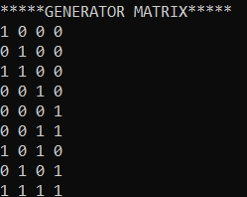
GENERATOR MATRIX
We explain the logic of Generator Matrix by taking the example of (9,4) product code.(Indexing starts from 0)
Each row in this matrix represents the sum of value of j(th) message bit modulo 2 .(where j is the index of column for which there is 1 in matrix For eg. Here for 2nd row the value of that codeword bit will be value of m0 bit + m1 bit modulo 2).So each row will represent a codeword bit.
We divide this into different conditions (where i is index of row):
1st case: codeword bit is equal to message bit (Eg. i=0,1,3,4)
2nd case: codeword bit is equal to sum modulo 2 of consecutive message bits.(Eg. i=2,5)
3rd case: codeword bit is equal to sum modulo 2 of message bits at the distance of root_k (Eg. i=6,7) as 1 in 6th and 7th row is at (j is index of column)j=0 and j=0+2 and j=1 and j=1+2=3 respectively.
4th case: Last row where codeword bit is sum modulo 2 of all message bits.

Slide 9


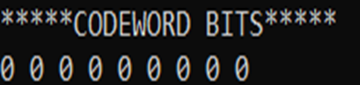
CODEWORD BITS
The value of codeword bits is obtained by the matrix multiplication of Generator matrix and message bits .
This is explained with the example of (9,4) product code.

Slide 10
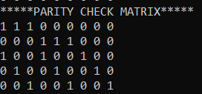
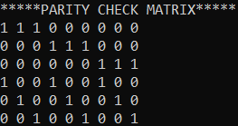
PARITY CHECK MATRIX
The logic to make Parity Check matrix is divided into two cases :
1st case : There will be consecutive 1s upto value of root_n columns and in next row 1s will start from next column of previous row and this will continue till root_k rows .(For Eg 0,1 i.e upto 2 rows = root(4)) (Figure. 1)
2nd case : And for remaining rows there will be 1s in each column with the increment of root_n value and in next row similar sequence 1s will get shifted by 1 towards right side. (For eg. 2,3,4 i.e. for 2nd row 1 is in 0th column next 1 is in (0+3)=3rd column and next 1 is in (3+3)=6th column) (Figure. 1)
NOTE : For BSC logic is same but one row is added for the parity check of the variable nodes which are connected to only 1 check node.(Figure. 2)
Each row in this matrix represents a check node.
Figure 1
Figure 2

Slide 11
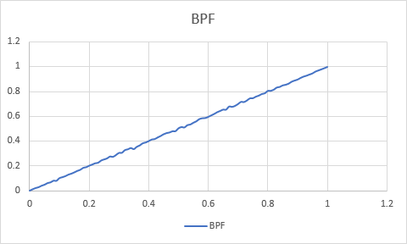
VERIFICATION THAT RANDOM FUNCTION GENERATOR IS UNIFORMLY DISTRIBUTED
We generated this graph by finding error vector 100 times as described in next slide for one value of probability and counting the number of ones for each time and dividing by the length of error vector i.e finding the probability of ones each time and taking sum of this values and dividing by 100.
So we should get the same value of probability .

Slide 12
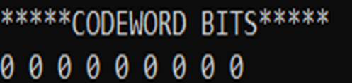


BEC AND BSC CHANNEL
In our code we used the rand( ) function of C++ standard library which generates uniformly distributed random values between 0 and 1.
User inputs the value of error probability ‘p’ and if the random value generated by the rand( ) is less than ‘p’ then it is considered as ‘1’ in the error vector else ‘0’.
If the channel is BSC then the bit gets flipped in the received vector at the index at which there is ‘1’ in error vector. (Figure 2)
And if the channel is BEC then the bit gets erased from the received vector at the index at which there is ‘1’ in the error vector. (Figure 3)
Figure 1
Figure 22
Figure 3

Slide 13
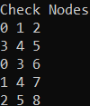
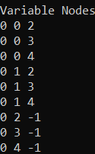
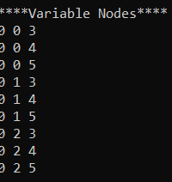
VARIABLE NODE AND CHECK NODE MATRIX
This check node matrix represents the index of the variable node to which that check node is connected.
This matrix is made from the parity check matrix by storing the index of column where there is 1 in parity check matrix for each row of parity check matrix .(Figure 1.)
NOTE: For BSC channel there will be 6 check node i.e. 6 rows in this matrix .
For variable node matrix first column will be received codewords and will be updated after every iteration and remaining columns represent the index of check node to which that variable node is connected.(-1 in last three rows means that 6,7 and 8 variable node are connected to only one check node)
NOTE: For BSC channel there will not be -1 for last three rows as we have taken one extra check node so it will represent the index of that check node.

Slide 14
MESSAGE PASSING DECODING FOR BEC
1,2,3
4,5,6
1,4,7
2,5,8
3,6,9
C1
C2
C3
C4
C5
R1
R2
R3
R4
R5
R6
R7
R8
R9
1,3
1,4
1,5
2,3
2,4
2,5
3
4
5
For first iteration we load received bits in variable node i.e we take received bits in first column of variable node matrix.
Here numbers displayed below circle(variable node) represents the index of check node which are connected with that variable node .
Numbers displayed above square represents the index of variable node which are connected with that check node.

Slide 15
MESSAGE PASSING DECODING FOR BEC
1,2,3
4,5,6
1,4,7
2,5,8
3,6,9
C1
C2
C3
C4
C5
R1
R2
R3
R4
R5
R6
R7
R8
R9
1,3
1,4
1,5
2,3
2,4
2,5
3
4
5
Now in our code first we will find that in which bit there is an error .
If an error is detected then it will receive message from connected check nodes and that message will be sent only if any of other connected variable nodes are not erasure(E) otherwise it will check next connected check node .If any of the bit in variable node are not erasure(E) than that message will be XOR of the value of bit of connected variable node. This algorithm will terminate if in any iteration no error is corrected.

Slide 16
MESSAGE PASSING DECODING FOR BSC
1,2,3
4,5,6
1,4,7
2,5,8
3,6,9
7,8,9
C1
C2
C3
C4
C5
C6
R1
R2
R3
R4
R5
R6
R7
R8
R9
1,3
1,4
1,5
2,3
2,4
2,5
3,6
4,6
5,6
The above diagram represents same as described for BSC.
Here we have added extra check node(yellow colored) for the variable node that was previously connected to only one check node so now there will be no variable node that is connected to single check node .

Slide 17
MESSAGE PASSING DECODING FOR BSC
1,2,3
4,5,6
1,4,7
2,5,8
3,6,9
7,8,9
C1
C2
C3
C4
C5
C6
R1
R2
R3
R4
R5
R6
R7
R8
R9
1,3
1,4
1,5
2,3
2,4
2,5
3,6
4,6
5,6
For decoding in BSC channel variable node will receive messages from its connected check nodes and that message will be XOR of the value of the bit of other connected variable nodes.
After receiving messages from all connected check nodes it will store the value of the majority bit of the received messages from connected check nodes and value stored in the first column of the variable node matrix.
After one complete iteration it will update the value of 1st column of variable node matrix by the value of majority bit for each variable node.

Slide 18
TERMINATION CONDITIONS OF BSC CODE
We have taken three termination conditions:
If the value of majority bit obtained in that iteration is equal to the values of 1st column of variable node matrix .
If the value of majority bit is equal to received bit for each variable node.
Iterations will run maximum 100 times.

Slide 19
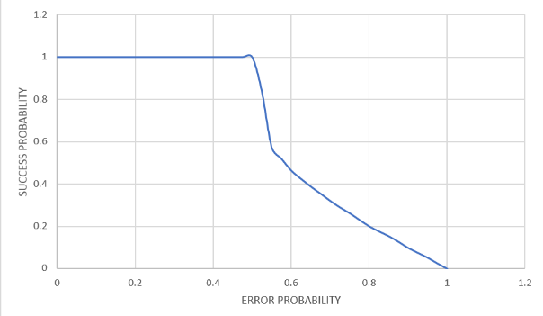
ANALYSIS
hh
SUCCESS PROBABILITY BEC (5000,2000)
LDPC
By comparing these two graph between product code and LDPC code for BEC channel we could conclude that LDPC encoding is more efficient than product code encoding because as seen in graph for product code success probability drops from 0.2 error probability while in LDPC code success probability drops from 0.5 error probability for the same BEC decoder. As there are more check nodes in LDPC code and less in product code. Thus LDPC code can correct more errors.
NOTE : Here we are getting rough edges in the graph of LDPC code because we have taken probability in the steps of 0.1 because of limited computing power of our device .

Slide 20
BSC (16,9) PRODUCT CODE
Why for the same BSC product code for different values of k’s decoding success probability is different ?

Slide 21
For (9,4) Product Code
1 | 0 | 1
0 | 1 | 1
1 | 1 | 0
0 | 1 | 0
1 | 0 | 0
0 | 0 | 1
BSC(p=1)
Majority Decoding
0 | 1 | 0 | 1 | 0 | 0 | 0 | 0 | 1
1 | 0 | 1 | 0 | 1 | 1 | 1 | 1 | 0
1 | 0 | 1 | 0 | 1 | 1 | 1 | 1 | 0
Decoded codeword
1 | 0 | 1 | 0 | 1 | 1 | 1 | 1 | 0

Slide 22
For (16,9) Product Code
1 | 1 | 0 | 0
1 | 1 | 1 | 1
0 | 1 | 0 | 1
0 | 1 | 1 | 0
0 | 0 | 1 | 1
0 | 0 | 0 | 0
1 | 0 | 1 | 0
1 | 0 | 0 | 1
BSC(p=1)
Majority Decoding
0 | 0 | 1 | 1 | 0 | 0 | 0 | 0 | 1 | 0 | 1 | 0 | 1 | 0 | 0 | 1
0 | 0 | 1 | 1 | 0 | 0 | 0 | 0 | 1 | 0 | 1 | 0 | 1 | 0 | 0 | 1
0 | 0 | 1 | 1 | 0 | 0 | 0 | 0 | 1 | 0 | 1 | 0 | 1 | 0 | 0 | 1
Decoded codeword
0 | 0 | 1 | 1 | 0 | 0 | 0 | 0 | 1 | 0 | 1 | 0 | 1 | 0 | 0 | 1

Slide 23
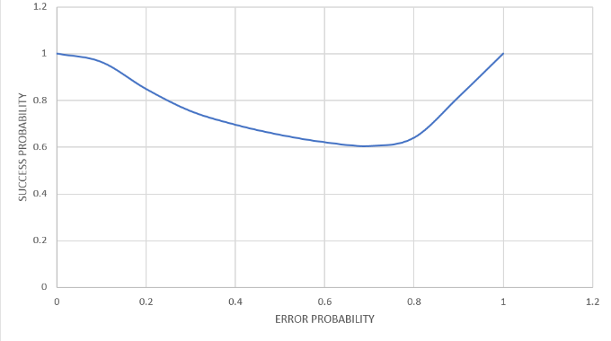
BSC(5000,2000) LDPC CODE
From this graph we could conclude that for error probabilities from 0.1-0.5 success
probabilities for (5000,2000)LDPC code decreases answer from 0.5-1 error
probabilities, success probabilities increases .

Slide 24
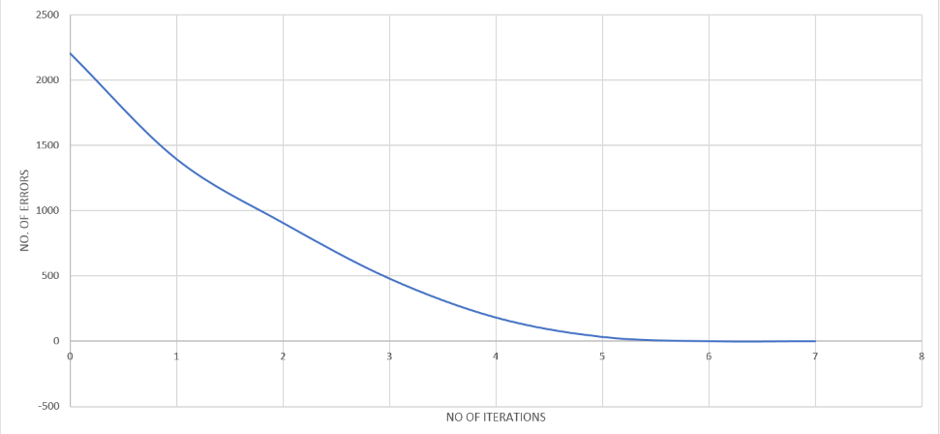
ERRORS SOLVED PER ITERATION LDPC(5000,2000) FOR P=0.44
Here from the graph we could see that number of errors decreases with each iteration.

Slide 25
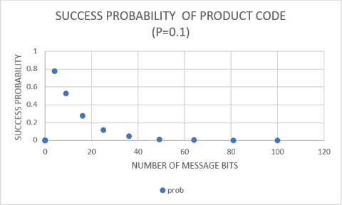
PRODUCT CODE ANALYSIS
Here from graph we could observe that as the value of message bits increases
the value of success probability (error probability =0.1) decreases.
Message bits Parity bits
4 5
9 7
16 9
25 11

Slide 26
PRODUCT CODE ANALYSIS
From the table given in previous slide we observed that the value of message bits increase in the form of k^2 while comparatively parity increases by 2 only. So the number of check node compared to message bits decreases .
Also there will be error in more bits for p=0.1 in (16,9) product code compared to (9,4) product code. Because for (9,4) arbitrarily there will be error in 1 bit and for (16,9) it will be arbitrarily 2 bits in error.(It is not necessary that there will be always 1 bit in error(9,4) because it is just probability)
So for same value of error probability the value of error bits increases as the number of codeword bits increases.
Codeword bits(n) |  | Approx. error in bits.
9 | 9*0.1=0.9 | 1
16 | 16*0.1=1.6 | 1-2
25 | 25*0.1=2.5 | 1-2-3
36 | 36*0.1=3.6 | 2-3-4

Slide 27
LIMITATIONS OF PRODUCT CODE
Product code:
As product code has less number of parity bits so it can correct less bits of errors.
For BEC channel in product code if erasure bits are in following pattern then it won’t be able to decode. For eg (9,4)
E | 1 | E
1 | 1 | 0
E | 0 | E
E | E | 1
E | E | 0
1 | 0 | 1

Slide 28
LIMITATION OF LDPC CODE
In LDPC code there will be more number of parity bits .So it can correct more number of error bits. But we also have to transmit that parity bits which didn’t provide any information and we also need more power to transmit those bits.

Slide 29
THANK YOU

