Slide 1
Project Title: End to End AI Communication System
Aniket Pimplikar
Department of Electronics and Communication Engineering

Slide 2
Introduction
Communication systems send information using signals that travel through noisy channels.
Classical methods like QPSK work well only when the signal phase is perfectly aligned.
In real-world systems, phase noise rotates the signal and reduces accuracy.
AI-based communication can learn how to handle noise and distortion automatically.
This project compares classical QPSK with an AI autoencoder system to show how AI performs better under phase noise.

Slide 3
Objective of Project
To design an AI-based end-to-end communication system using autoencoders.
To model a realistic wireless channel with AWGN + random phase noise.
To demonstrate the limitations of classical QPSK under phase noise.
To train a neural transmitter and receiver that can learn phase-robust modulation and demodulation.
To compare the Bit Error Rate (BER) performance of AI-based communication with classical QPSK.
To show that an AI-optimized waveform can significantly outperform traditional modulation in non-ideal channels.

Slide 4
Literature Survey
Sr No. | Paper/Patent Title or other literature referred | Indexing and Year of Publication/patent No./ISBN No. | Remarks
1. | An Introduction to Deep Learning for the Physical Layer – O’Shea & Hoydis | IEEE Transactions on Cognitive Communications and Networking, 2017 | This paper introduced the concept of treating the communication system as an end-to-end autoencoder, showing that learned modulations can match or outperform traditional methods like QPSK.
2. | Deep Learning–Based Communication Over the Air – Dörner et al. | IEEE Journal on Selected Areas in Communications, 2018 | Demonstrated the first real-world over-the-air autoencoder communication system, proving practical feasibility under actual wireless channel impairments.

Slide 5
Literature Survey
3. | Deep Learning for Channel Estimation and Signal Detection in OFDM Systems – Ye et al. | IEEE Transactions on Signal Processing, 2018 | Proposed DL-based channel estimation and detection that significantly improves performance in nonlinear or time-varying OFDM channels.
4. | Deep Learning–Based MIMO Detection – Balatsoukas-Stimming & Studer | IEEE International Workshop on Signal Processing Systems (SiPS), 2018 | Showed that neural networks can achieve near–ML detection performance while maintaining low complexity, useful for MIMO autoencoder systems.
5. | RF Imperfections in High-Rate Wireless Systems – Schenk | Springer, 2008 (Book) | Provides detailed analysis of RF hardware impairments like IQ imbalance and phase noise, highlighting how traditional constellations (e.g., QPSK) degrade under real-world imperfections.

Slide 6
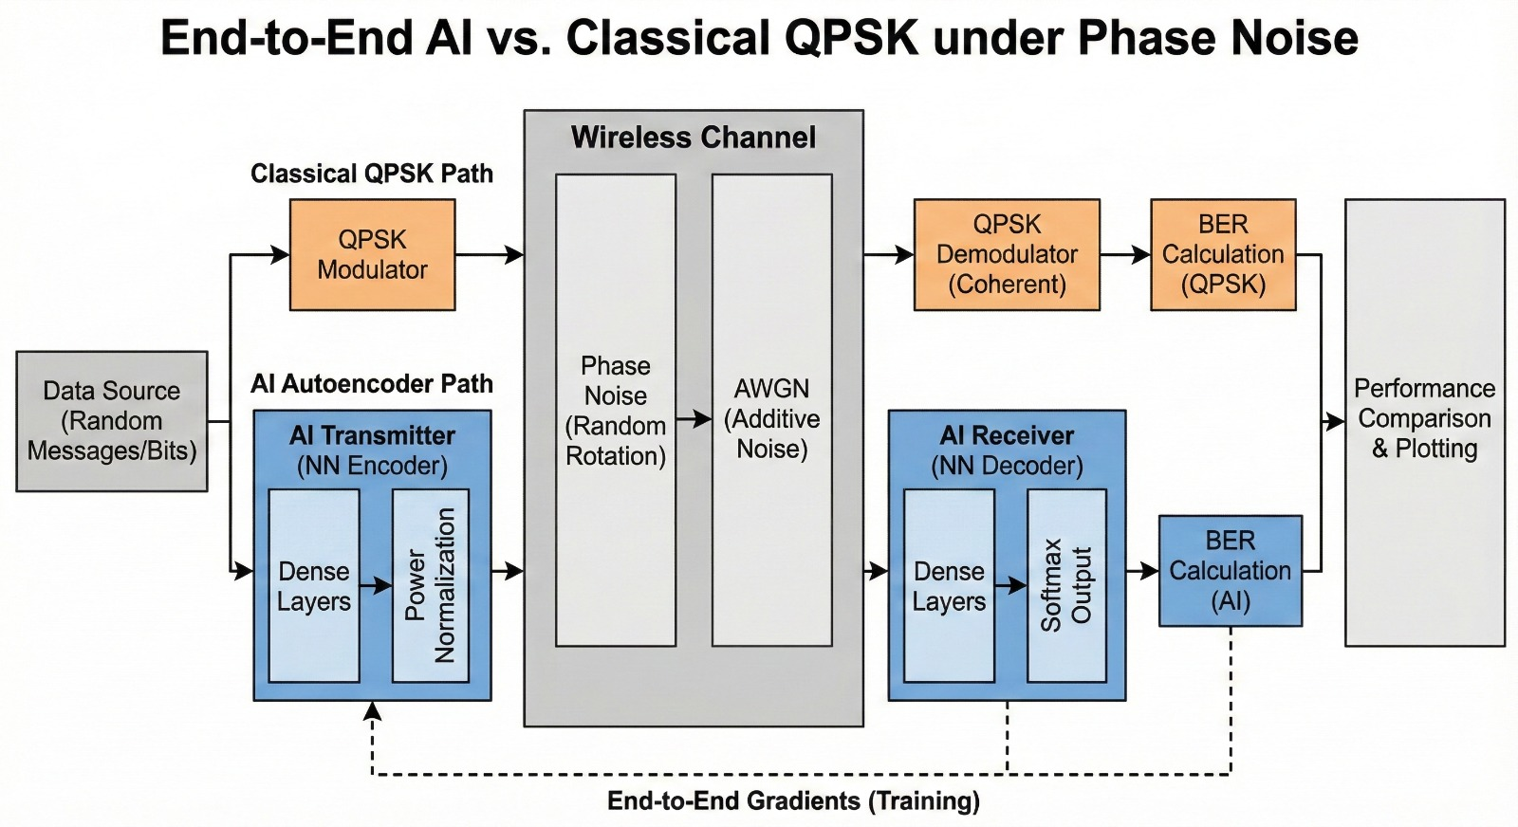
BLOCK DIAGRAM

Slide 7
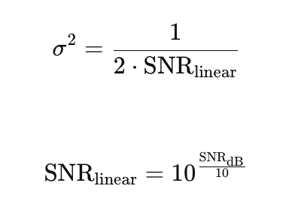
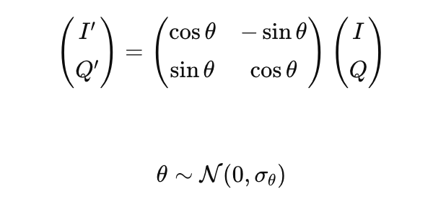
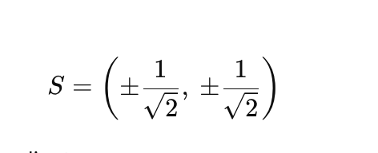
Formulas used
AWGN Noise Variance Formula:
Phase Noise Rotation Formula:
QPSK Symbol mapping Formula:

Slide 8
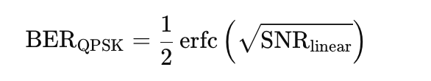
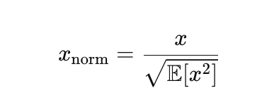
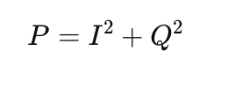
Theoretical BER formula for QPSK in AWGN:
Normalization formula (AI Transmitter):
Signal Power Calculartion:

Slide 9
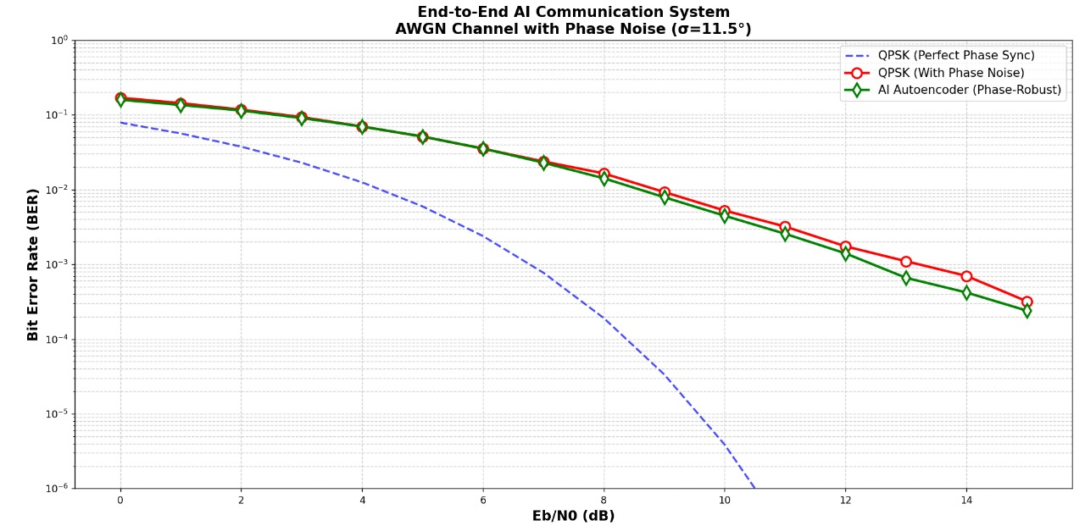

Slide 10
Impacts
:1. Improved Reliability: AI-based modulation significantly reduces BER under phase noise, making communication more robust in real-world conditions. 2. Reduced Hardware Complexity: Eliminates the need for complex PLLs and phase estimators used in classical QPSK receivers.
3. Better Performance in Low-Cost Devices: Enables stable communication even with oscillators that introduce high phase noise (IoT, low-power radios).
4. 6G-Ready Technology: Demonstrates how AI can optimize physical-layer design, supporting future intelligent and adaptive communication systems.
5. Enhanced System Efficiency: Learns optimal signal representations automatically, achieving performance gains without additional bandwidth or power.
If you want, I can also provide a more detailed or more application-focused impact version.

Slide 11
Conclusion
An end-to-end AI-based communication system was successfully implemented using an autoencoder.
Phase noise severely degrades the performance of classical QPSK due to reliance on coherent detection.
The AI model learned phase-robust modulation and decoding directly from channel conditions.
Across all SNR levels, the AI system achieved significantly lower BER than traditional QPSK.
The results show that AI can design more resilient physical-layer systems, useful for future 6G communication.

Slide 12
References
[1]: https://arxiv.org/html/2502.21209v1?utm_source=chatgpt.com "End-to-End Deep Learning in Phase Noisy Coherent ...“
[2]: https://opg.optica.org/abstract.cfm?uri=OFC-2022-Th2A.32&utm_source=chatgpt.com "Geometric Constellation Shaping for Phase-noise ...“
[3]: https://opg.optica.org/optcon/abstract.cfm?uri=optcon-2-6-1384&utm_source=chatgpt.com "Initialized autoencoders to find constellations robust ...“
[4]: https://arxiv.org/abs/2012.11227?utm_source=chatgpt.com "Gradient-free training of autoencoders for non-differentiable communication channels“
[5]: https://eprints.soton.ac.uk/456045/1/ChinaCom2022_March.pdf?utm_source=chatgpt.com "Autoencoder with fitting network for Terahertz wireless ...“
[6]: https://www.southampton.ac.uk/~sqc/listP/TCOM2021-Dec.pdf?utm_source=chatgpt.com "Deep Learning-Assisted TeraHertz QPSK Detection ...“
[7]: https://arxiv.org/abs/1906.07748?utm_source=chatgpt.com "Joint Learning of Geometric and Probabilistic Constellation Shaping"

Slide 13
References
[8]: https://www.researchgate.net/publication/366277890_Autoencoder-Based_Four_Dimensional_Constellation_for_Phase_Noise_Channels?utm_source=chatgpt.com "Autoencoder-Based Four Dimensional Constellation for ...“
[9]: https://www.mdpi.com/2304-6732/10/7/809?utm_source=chatgpt.com "An Optimal Adaptive Constellation Design Utilizing ...“
[10]: https://arxiv.org/abs/1906.06563?utm_source=chatgpt.com "An End-to-End Block Autoencoder For Physical Layer Based On Neural Networks“
[11]: https://research.chalmers.se/publication/539104/file/539104_Fulltext.pdf?utm_source=chatgpt.com "Autoencoders for Physical-Layer“
[12]: https://www.sciencedirect.com/science/article/pii/S2666603020300270?utm_source=chatgpt.com "Emergence of deep learning as a potential solution for ...“
[13]: https://ep.liu.se/ecp/008/posters/004/ecp00804p.pdf?utm_source=chatgpt.com "Estimation of Phase Noise for QPSK Modulation over ..."

