Slide 1
START

Slide 2
BLOCK DIAGRAM OF CPU SND GENERAL REGISTER ORGANIZATION
SUB:- COMPUTER ORGANIZATION.
CLASS:- BCA (B)
NAME:- MISS SANDESHA S. SAWANT.
ROLL NO:-120.

Slide 3
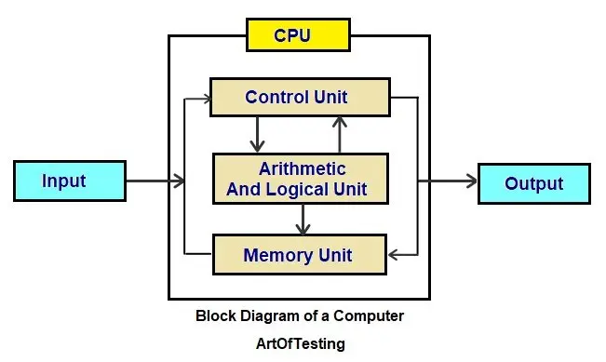

Slide 4
CPU:- Central Processing Unit
The Central Processing Unit (CPU) is the primary component of a computer that acts as its “control centre.” The CPU, also referred to as the “central” or “main” processor, is a complex set of electronic circuitry that runs the machine’s operating system and apps. The CPU interprets, processes and executes instructions, most often from the hardware and software programs running on the device.
The CPU performs arithmetic, logic, and other operations to transform data input into more usable information output. While the CPU must contain at least one processing core, many contain multiple cores. A server with two hexa-core CPUs, for example, will have a total of 12 processors.

Slide 5
INPUT
The Input Unit means the data we write on a computer which data the computer receives and the Output Unit means that the data which is sent by the computer. The processing unit is the device that handles all the instructions which are given by the human for the input unit or the output unit.
The Input Unit: Computer Input unit means the device of the input and a part of the computer hardware which is used for the transport of the data processing system involves the information devices of the computer with the control and data signals of the computer.
Example – Mouse, Camera, and Keyboard

Slide 6
ALU:- Arithmetic Logic Unit.
In computing, an arithmetic logic unit (ALU) is a combinational digital circuit that performs arithmetic and bitwise operations on integer binary numbers.^{[1][2][3]} This is in contrast to a floating-point unit (FPU), which operates on floating point numbers. It is a fundamental building block of many types of computing circuits, including the central processing unit (CPU) of computers, FPUs, and graphics processing units (GPUs).^{[4]}
The inputs to an ALU are the data to be operated on, called operands, and a code indicating the operation to be performed; the ALU's output is the result of the performed operation. In many designs, the ALU also has status inputs or outputs, or both, which convey information about a previous operation or the current operation, respectively, between the ALU and external status registers.

Slide 7
CU:-Control Unit.
A control unit, or CU, is circuitry within a computer’s processor that directs operations. It instructs the memory, logic unit, and both output and input devices of the computer on how to respond to the program’s instructions.There are two types of control units: hardwired and microprogrammed. A hardwired control unit translates the instructions it receives from the CPU’s memory into control signals via logic circuits.
An instruction from the computer’s main memory is sent to the instruction register, which identifies its operation code (“opcode”); the opcode is written in assembly language. The opcode is passed along to the instruction decoder, which uses the opcode to interpret what control signals to generate.
The logic circuit then creates these signals, accounting for any external input and conditional codes. The whole process is synchronized by a system clock, which generates regular pulses that continuously switch between a low (“0”) and high (“1”) state.
CPUs and GPUs are examples of devices that use control units

Slide 8
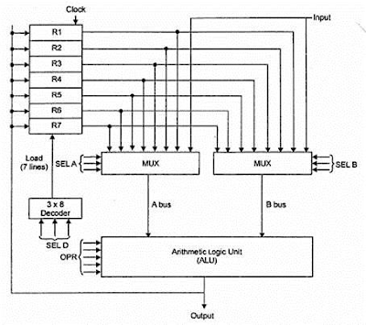
GENERAL REGISTER ORGANIZATION

Slide 9
WHAT IS GENERAL RESGISTER ORGANIZATION?
A set of flip-flops forms a register. A register is a unique high-speed storage area in the CPU. They include combinational circuits that implement data processing. The information is always defined in a register before processing. The registers speed up the implementation of programs.
Registers implement two important functions in the CPU operation are as follows −
It can support a temporary storage location for data. This supports the directly implementing programs to have fast access to the data if required.
It can save the status of the CPU and data about the directly implementing program.

Slide 10
THE END

