Slide 1
HATEOAS
Implementing HATEOAS for RESTful Services
Name-Aniket

Slide 2
HATEOAS
HATEOAS acronyms for
Hypermedia as the Engine of Application State. [HATEOAS]
The term hypermedia refers to content that contains a link to other forms of media like images, movies, and text. It is a component of the REST application that distinguishes it from other network architecture. Using HATEOAS, a client interacts with a network application, whose application server provides information dynamically through Hypermedia.

Slide 3
Spring-HATEOAS
Spring-HATEOAS is the library of APIs. We can use these APIs for creating REST representations that follow the HATEOAS principle while working with Spring MVC.
In the Spring HATEOAS project, we do not require Servlet Context and concatenate the path variable to the base URI. Instead of this, Spring HATEOAS offers three abstractions for creating the URI: ContrrollerLinkBuilder, Link, and Resource Support. We can use these abstractions to create metadata, which associates with the resource representation

Slide 4
Features
It supports hypermedia formats like HAL.
It provides Link builder API to create links pointing to MVC controller methods.
Model classes for the link, resource representation models.

Slide 5
Suppose, we have requested a GET request for localhost:8080/users/1, it returns the details of user id 1. Along with this, it also returns a field called link that contains a link (localhost:8080/users) of all users so that consumers can retrieve all the users. This concept is called HATEOAS.
Let's implement the HATEOAS in the project.

Slide 6
Step 1
Step1: Open the pom.xml and add the spring-boot-starter-hateoas dependency.
<dependency>d
<groupId>org.springframework.boot</groupId>
<artifactId>spring-boot-starter-hateoas</artifactId>
</dependency>

Slide 7
package com.javatpoint.server.main.user;
import static org.springframework.hateoas.mvc.ControllerLinkBuilder.*;
import java.net.URI;
import java.util.List;
import javax.validation.Valid;
import org.springframework.beans.factory.annotation.Autowired;
import org.springframework.hateoas.Resource;
import org.springframework.hateoas.mvc.ControllerLinkBuilder;
import org.springframework.http.ResponseEntity;
import org.springframework.web.servlet.support.ServletUriComponentsBuilder;
@RestController
public class UserResource
{
@Autowired
private UserDaoService service;
@GetMapping("/users")
public List<User> retriveAllUsers()
{
return service.findAll();
}
@GetMapping("/users/{id}")
public Resource<User> retriveUser(@PathVariable int id)
{
User user= service.findOne(id);
if(user==null)
//runtime exception
throw new UserNotFoundException("id: "+ id);
//"all-users", SERVER_PATH + "/users"
//retrieveAllUsers
Resource<User> resource=new Resource<User>(user); //constructor of Resource class
//add link to retrieve all the users
ControllerLinkBuilder linkTo=linkTo(methodOn(this.getClass()).retriveAllUsers());
resource.add(linkTo.withRel("all-users"));
return resource;
}
//method that delete a user resource
@DeleteMapping("/users/{id}")
public void deleteUser(@PathVariable int id)
{
User user= service.deleteById(id);
if(user==null)
//runtime exception
throw new UserNotFoundException("id: "+ id);
}
//method that posts a new user detail and returns the status of the user resource
@PostMapping("/users")
public ResponseEntity<Object> createUser(@Valid @RequestBody User user)
{
User sevedUser=service.save(user);
URI location=ServletUriComponentsBuilder.fromCurrentRequest().path("/{id}").buildAndExpand(sevedUser.getId()).toUri();
return ResponseEntity.created(location).build();
}
}

Slide 8
package com.javatpoint.server.main.user;
import java.util.Date;
import javax.validation.constraints.Past;
import javax.validation.constraints.Size;
public class User
{
private Integer id;
@Size(min=5, message="Name should have atleast 5 characters")
private String name;
@Past
private Date dob;
//default constructor
protected User()
{
}
public User(Integer id, String name, Date dob)
{
super();
this.id = id;
this.name = name;
this.dob = dob;
}
public Integer getId()
{
return id;
}
public void setId(Integer id)
{
this.id = id;
}
public String getName()
{
return name;
}
public void setName(String name)
{
this.name = name;
}
public Date getDob()
{
return dob;
}
public void setDob(Date dob)
{
this.dob = dob;
}
@Override
public String toString()
{
//return "User [id=" + id + ", name=" + name + ", dob=" + dob + "]";
return String.format("User [id=%s, name=%s, dob=%s]", id, name, dob);
}
}

Slide 9
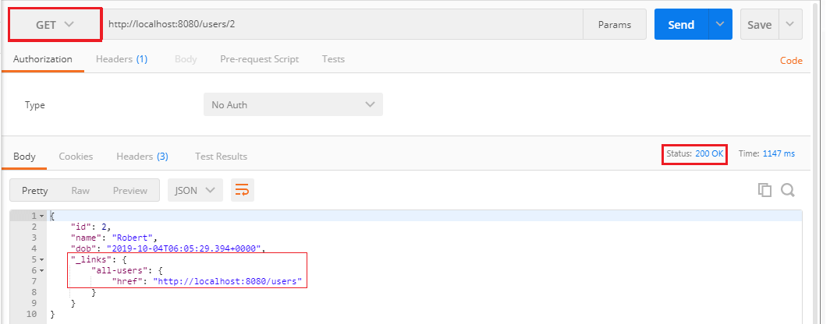
Step 4: Open the REST client Postman and send a GET request.

Slide 10
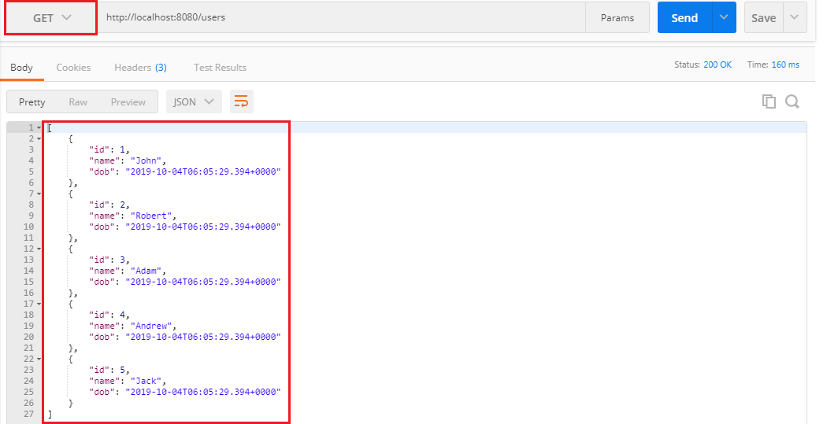

Slide 11
Refrence -→
https://www.javatpoint.com/restful-web-services-hateoas
THANK-YOU

