Slide 1
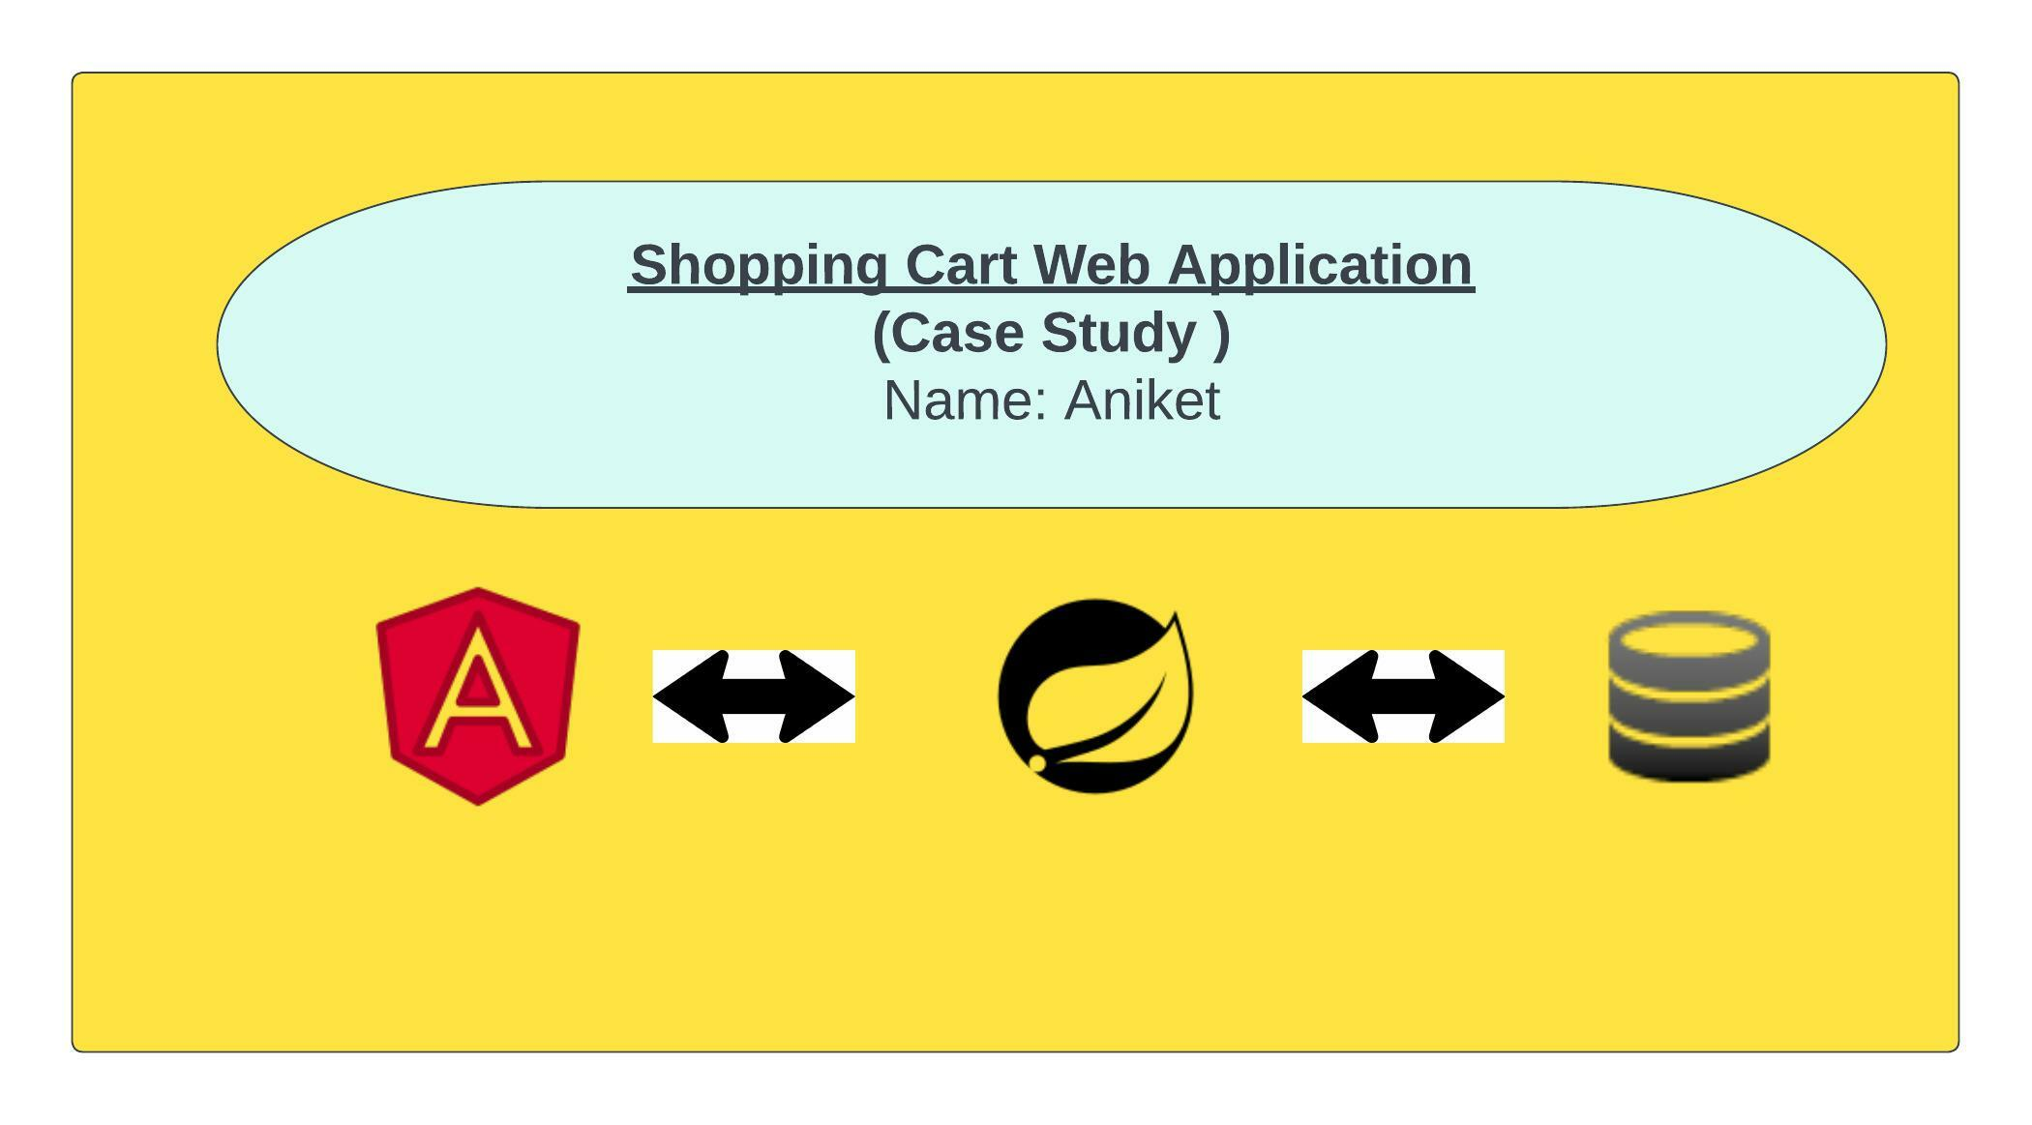

Slide 2
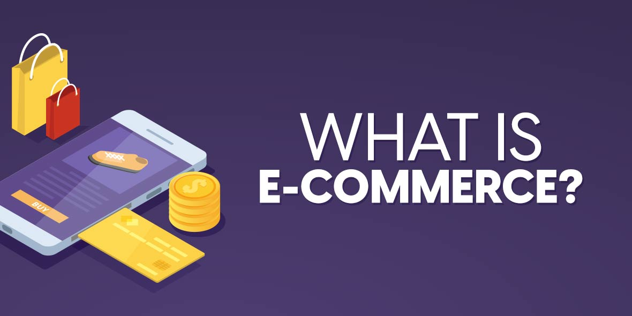
E-Shopping Zone
The name of my Web Application is E-Shopping Zone.
E-Shopping Zone is an E-Commerce Web Application.

Slide 3
There are two role in this Web Application –
Login/Signup
Add to Cart
Buy Prod
1.Merchant
2.Customer
Add Prod
Delete Prod
Update Prod

Slide 4
Technology Stack
Backend : 1. Spring boot micro service
2. Eureka Server
3. Spring Cloud API Gateway
4. Swagger
5. Mongo DB
Frontend : 1. Angular
2. Bootstrap

Slide 5
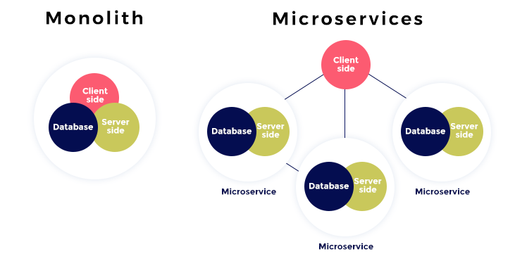
Large Code Base
Small Code Base
technology barriers.
Flexibility in technology
Scalability
Better Scalability
Tight coupling
Loose coupling
Complicated to understand
Easier understanding
Why use Micro services

Slide 6
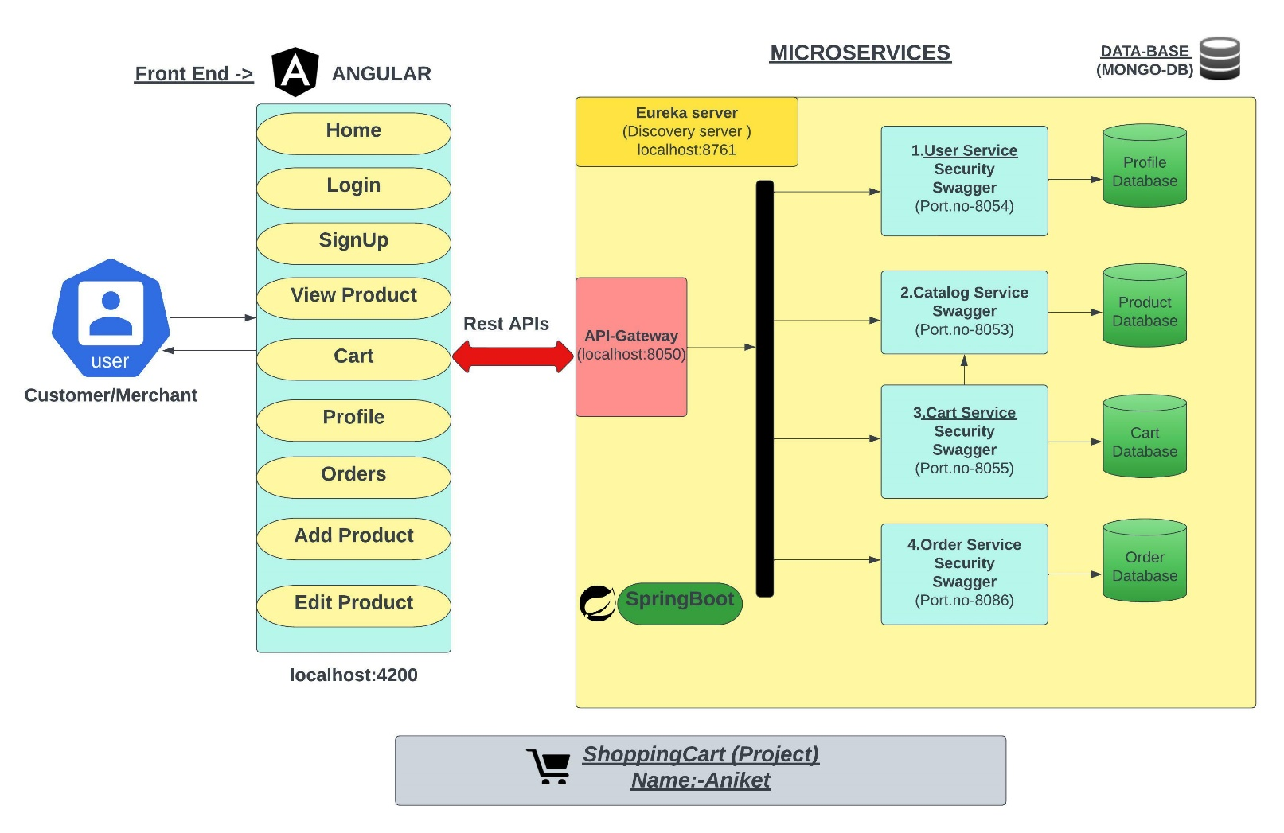
System Architecture of Project :

Slide 7
LET’S MOVE TOWARD UI PART ->

