Slide 1
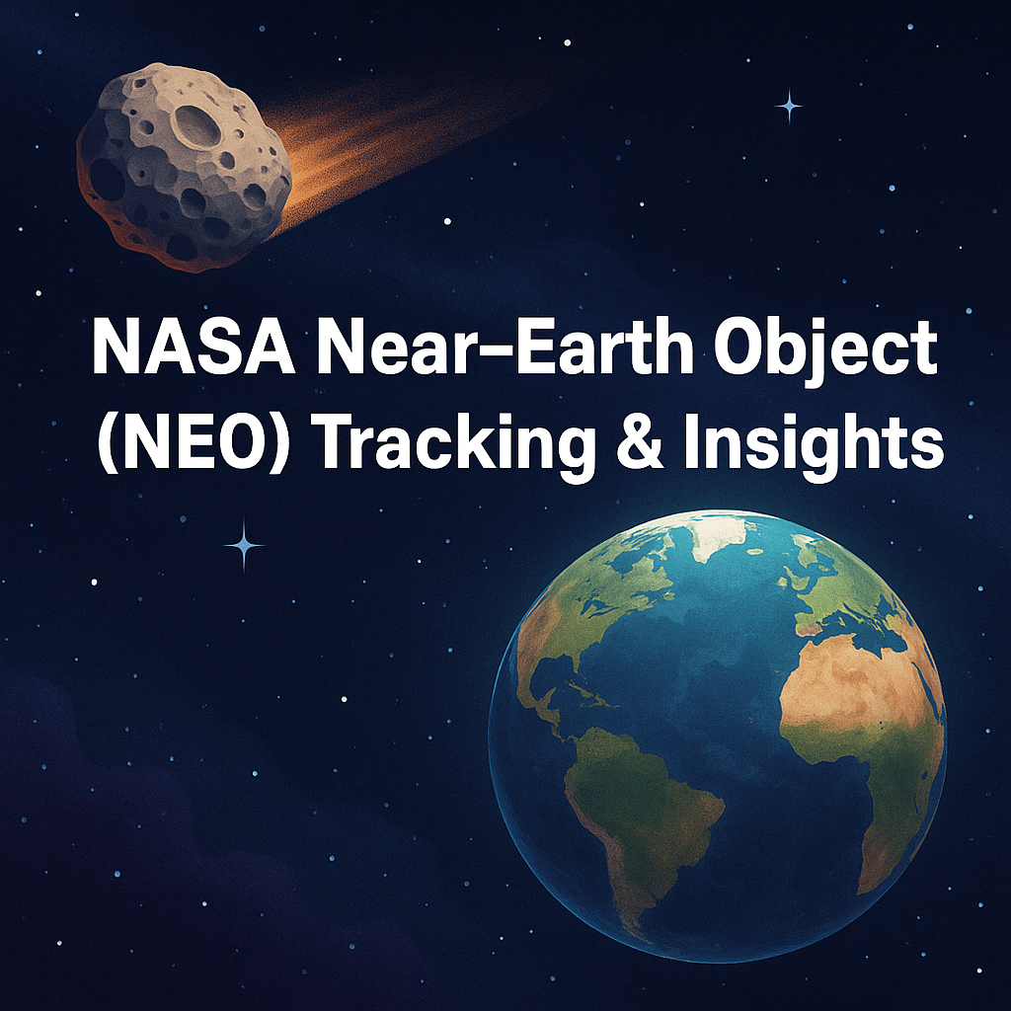
🚀 NASA Near-Earth Object (NEO) Tracking & Insights using Public API
Space Research & Astronomical Data Analysis
API Integration, SQL, Streamlit Dashboard
Aniket Sonone

Slide 2

Overview
Project Insights
Project Overview & Business Use Cases
Project Approach
Tools & Technologies
Final Outcomes

Slide 3
Project Insights
This project leverages NASA's public API to analyze and visualize data on asteroids approaching Earth. It focuses on identifying potentially hazardous objects, tracking their velocity and distance, and providing a user-friendly dashboard for exploration.

Slide 4

🌍 Project Overview & Business Use Cases
Objective: Analyze and visualize asteroid data from NASA's NEO API.
Track potential threats using velocity, size, and proximity data.
Explore asteroid frequency and approach patterns by date.
Filter insights by size, distance, and orbiting body.
Create a user-friendly interface for educators and researchers.

Slide 5

🛠 Project Approach
Get NASA API Key from https://api.nasa.gov.
Fetch data from the NEO Feed using 7-day intervals.
Use sequences via data['links']['next'] to get next records.
Loop until 10,000 records are collected.
Parse and store the data into SQL tables.
Build analytical queries to extract insights.
Create an interactive dashboard using Streamlit.

Slide 6

🧰 Tools & Technologies
Python: Data fetching, parsing, and transformation.
MySQL / SQLite: Data storage and analysis.
Streamlit: Dashboard development.
Pandas & Requests: JSON parsing and handling.
NASA NEO API: Asteroid data source.

Slide 7

🏁 Final Outcomes
Over 10,000 NEO records extracted from NASA API.
Data parsed, transformed, and stored using SQL.
Interactive dashboard developed using Streamlit.
Useful insights for threat analysis and education.

Slide 8
Thank You!

