Slide 1

GISMA University of Applied Sciences EcoPack Business Expansion in Germany
Project Management (M502)
Submission Date: 26 – Jun – 2026
Submitted to: PROF. Peter White
GitHub Project Link - AniketSonu/Project-Management-Repo: All Jira link and screen shots will add here\
Submitted by:
Aniket Sonu - GH1048274
Shravani Amit Borkar - GH1058569
Sukhdeep Singh- GH1041755
Heli Vijaybhai Kanpariya - GH1057191

Slide 2
Introduction
This Presentation will demonstrate a project management plan for ECOPACK Business, a packaging company focused on producing environmentally friendly packaging products for restaurants, cafés, and food delivery businesses. This project objective is to expand the business in Germany within a 24-month project duration and an allocated budget of €900,000.
We include a pure agile project management methodology where all the digital platform development will happen to allow complete cloud-based operations and flexibility, iterative improvements, and customer feedback integration.
The main purpose of the study is to develop a concrete project management plan for a business like EcoPack's expansion into the German market. In which we include investors, suppliers, employees, customers, technology developers, and government. Effective communication and stakeholder engagement strategies are required to manage expectations and maintain project.
Structure of the Presentation
Project Overview and Objectives
Purpose of the Study
Project Scope and Key Milestones
Agile Project Management Approach
Cost Management and Resource Allocation
Stakeholder and Communication Management
Sustainability Strategy
Risk Management and Mitigation Plans
Market Expansion Strategy
Critical Evaluation and Reflection
Conclusion and Recommendations

Slide 3
Project Overview
Ecopack is a packaging company that operates on delivering workable, innovative, and environment friendly packaging solutions. As global demand for eco-friendly products continues to increase, expanding operations into Germany makes a strategically important growth initiative for the company.
The scope of this project is to establish Ecopack’s business in Germany through market entry planning, regulatory compliance, operational setup, partnership development, and customer purchase. This project will analyze the market opportunities, identify key industries and customers, to develop a best strategy to enter in market with alignment of Germany’s trade policies.
Agile also has certain limitations. Continuous stakeholder involvement requires significant time and commitment from users and project sponsors. In addition, frequent changes in requirements may create challenges in cost estimation and long-term planning. Agile projects can also experience scope expansion if changes are not managed carefully.However, these limitations can be mitigated through effective sprint planning, prioritization of requirements, and regular communication between stakeholders and the project team.
Objective | Measurement Target
Complete manufacturing facility setup | By Month 6
Develop and launch digital ordering platform | By Month 12
Recruit operational workforce | 25 employees by Month 15
Acquire initial customer base | 100 business customers within 6 months after launch
Maintain budget performance | Remain within €900,000 budget
Achieve production readiness | Full operational status by Month 20

Slide 4
Strategic Relevance
EcoPack becoming a leading provider for food packaging service.
Company's international expansion and digital transformation goals.
EcoPack's commitment to environmental sustainability and innovation.
Value Proposition
Provides environment-friendly packaging to restaurants, cafés, and food delivery businesses.
Customer experience through a digital ordering platform.
Expected Impact
Establishes a strong market presence in Germany, one of Europe's largest economies.
Brand Recognition, global expansion, customer satisfaction and revenue growth.

Slide 5
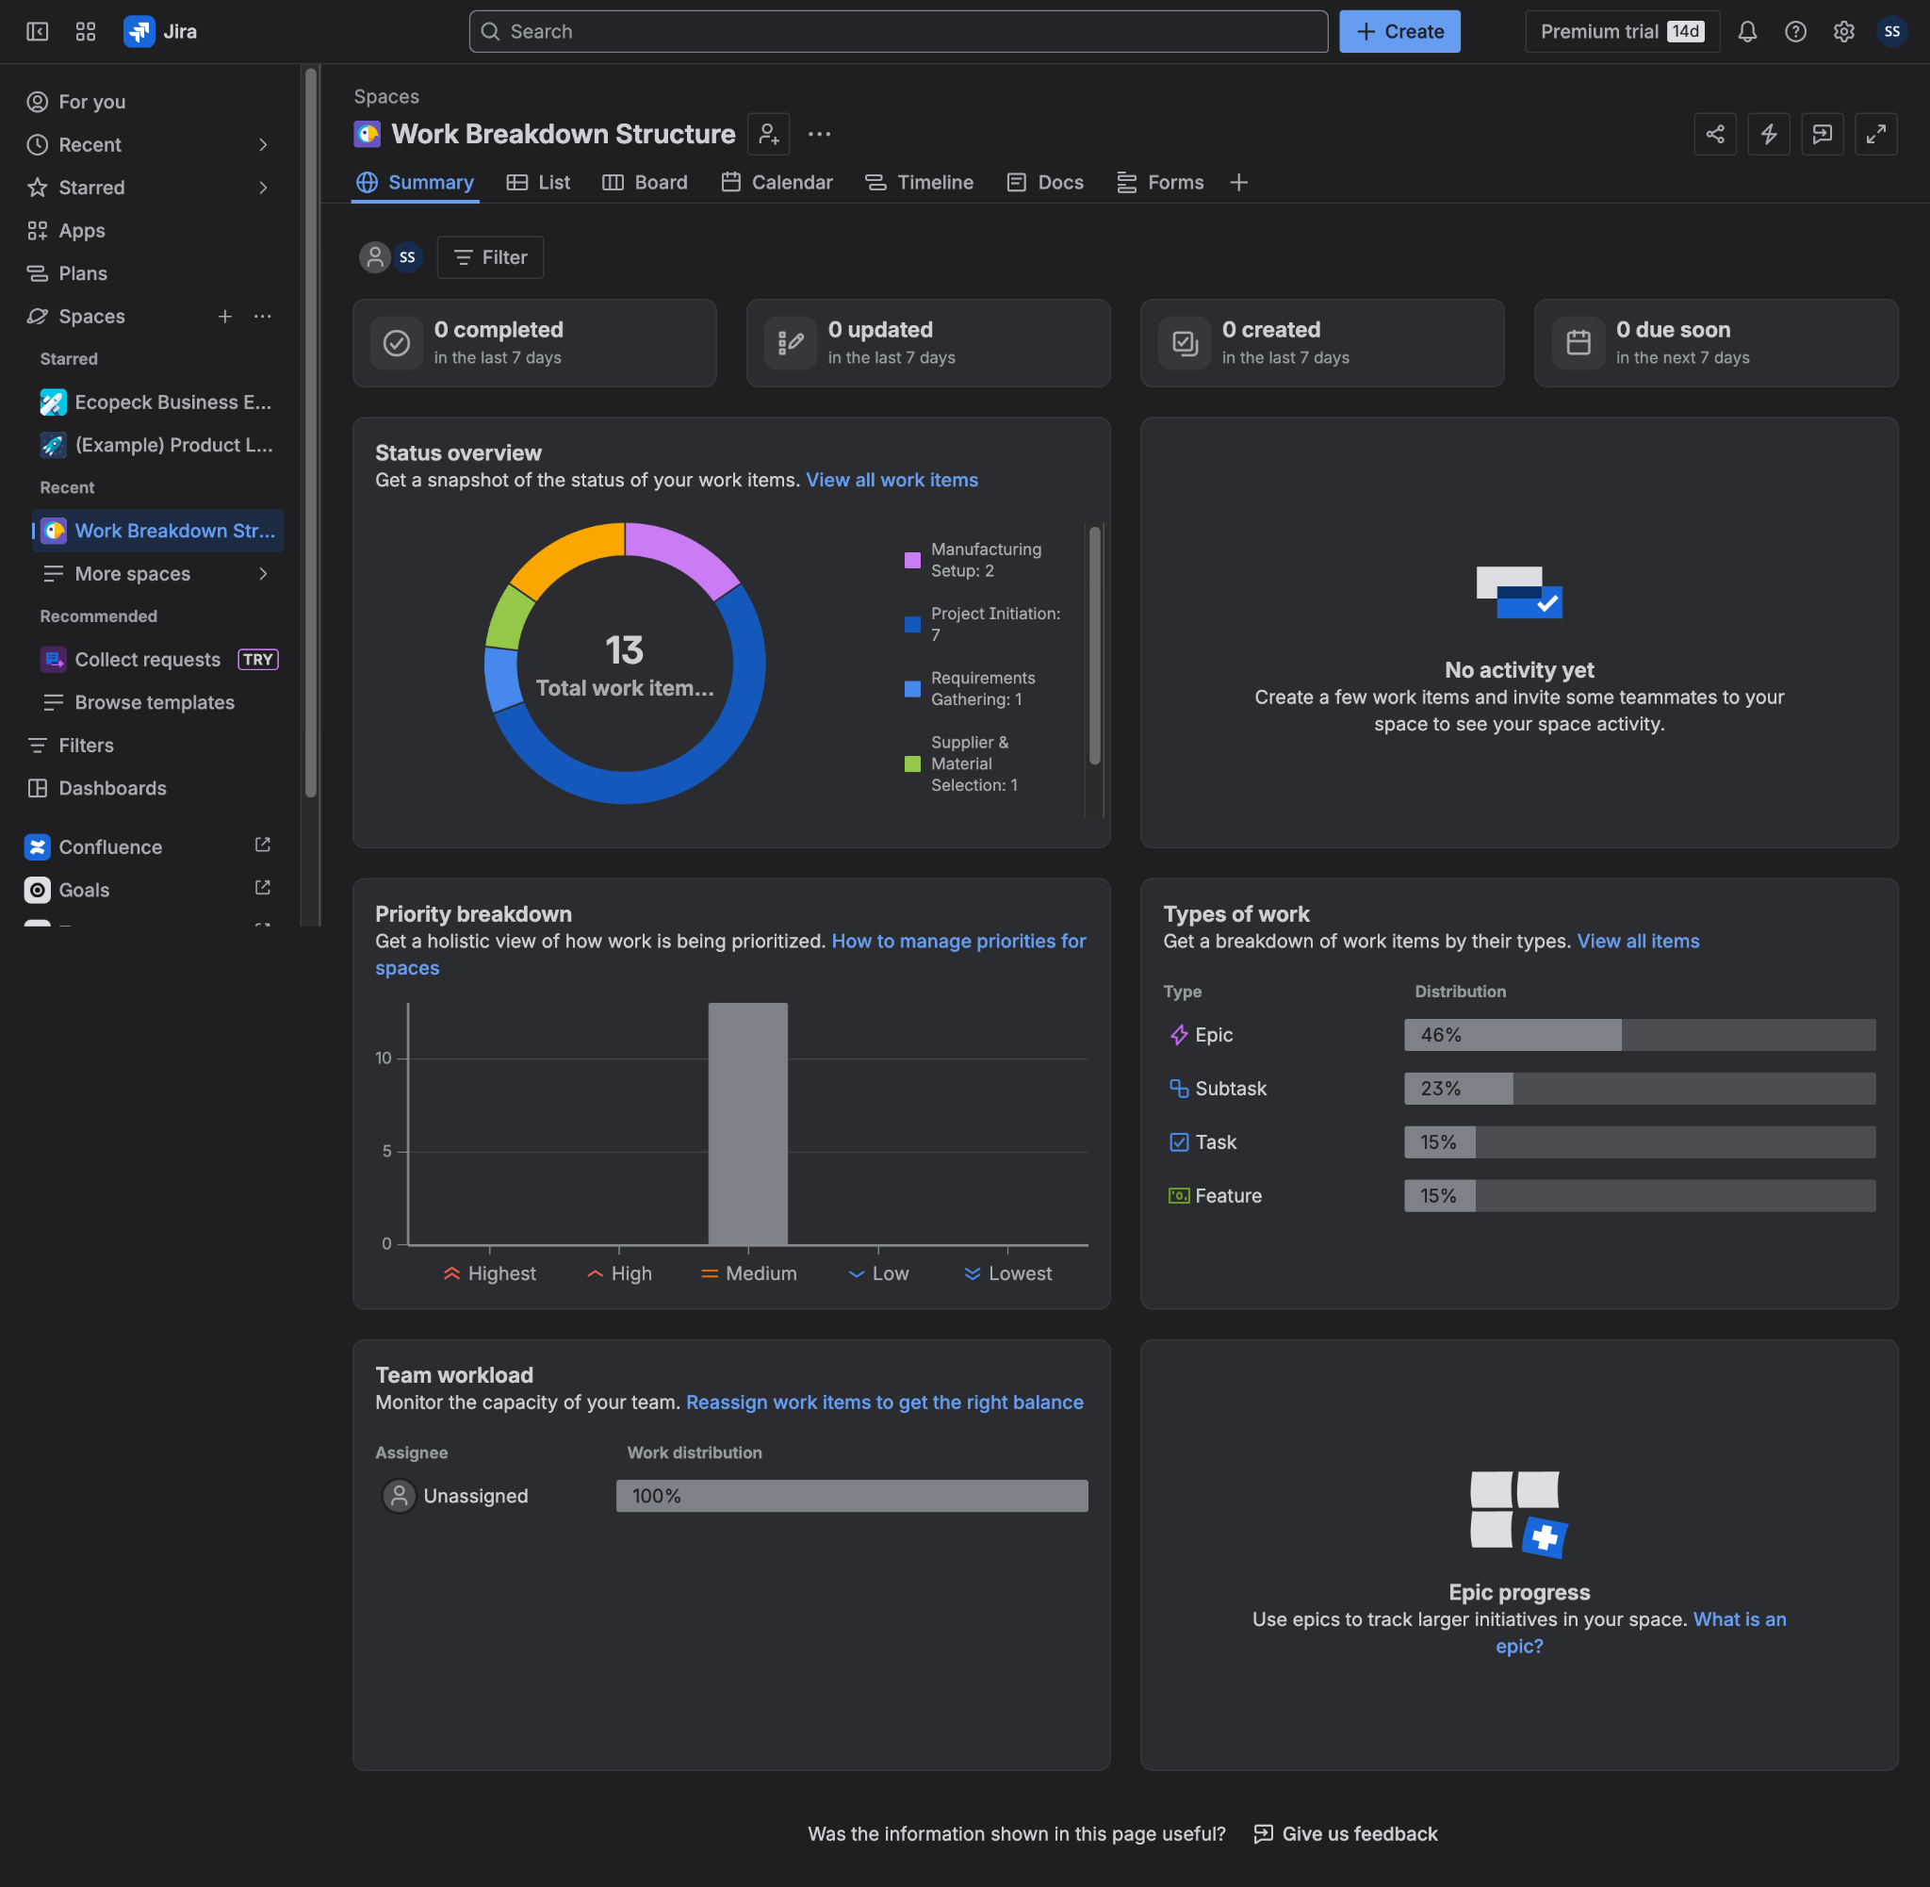
Work Breakdown Structure (WBS)
Jira WBS for managing Epics, Tasks, and Subtasks.
Project Structure involves Initiating, Planning, Developing, Expanding, and Closing phases.

Slide 6
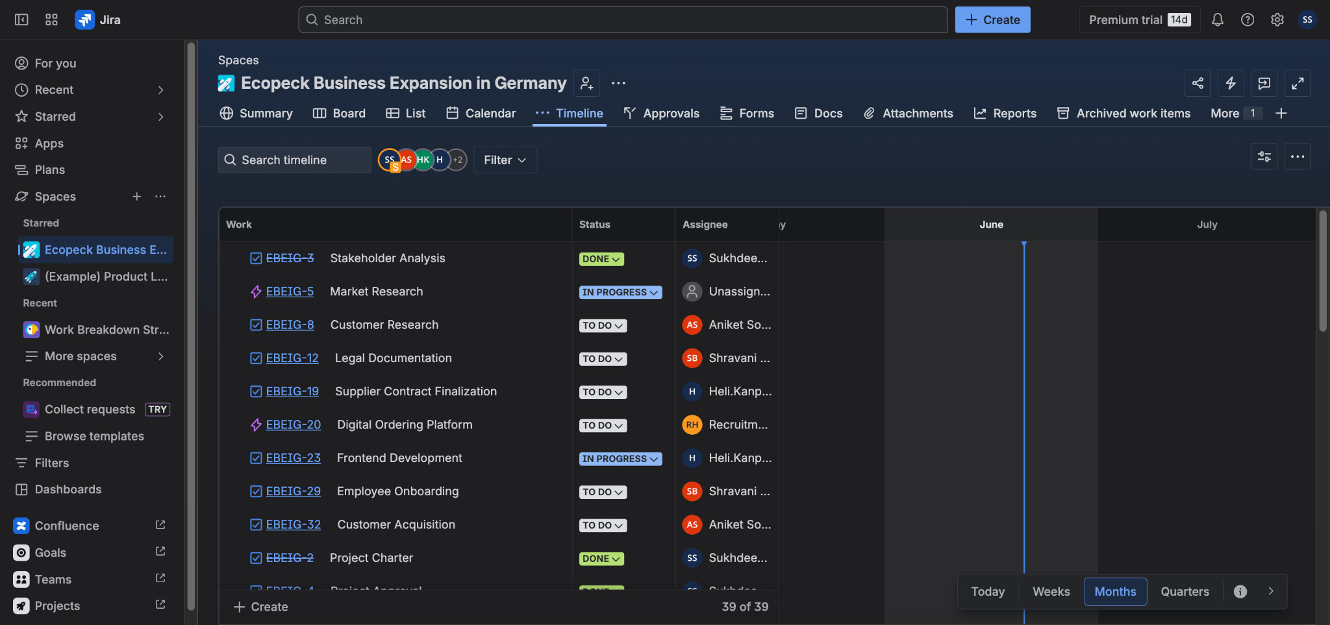
Project Schedule
Duration of the project is 24 months, as determined on Jira timeline.
Milestones have been identified from Initiating phase to Operational Readiness phase.

Slide 7
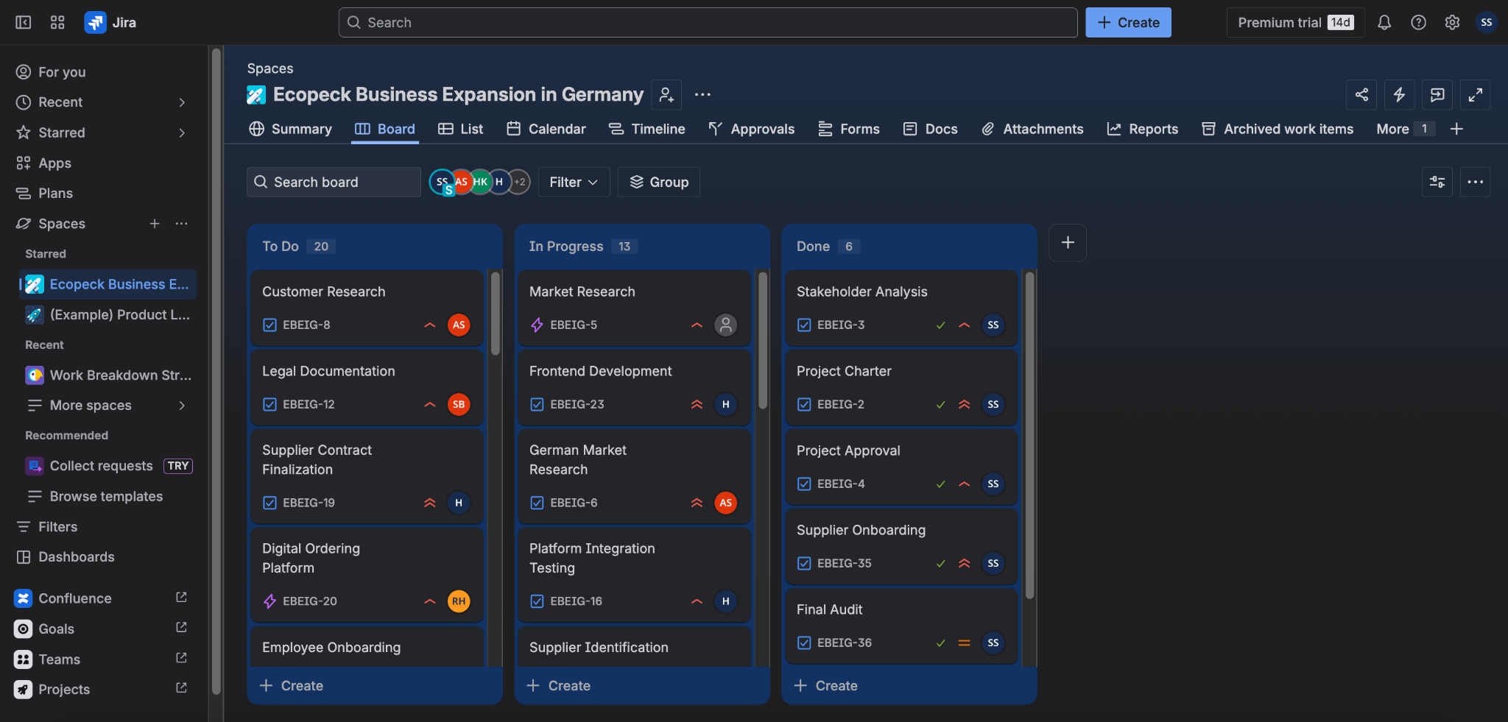
Critical Path Analysis
Key activities involve Research, Compliance, Development, Hiring, and Acquisition.
Tasks tracking using Jira Board.

Slide 8
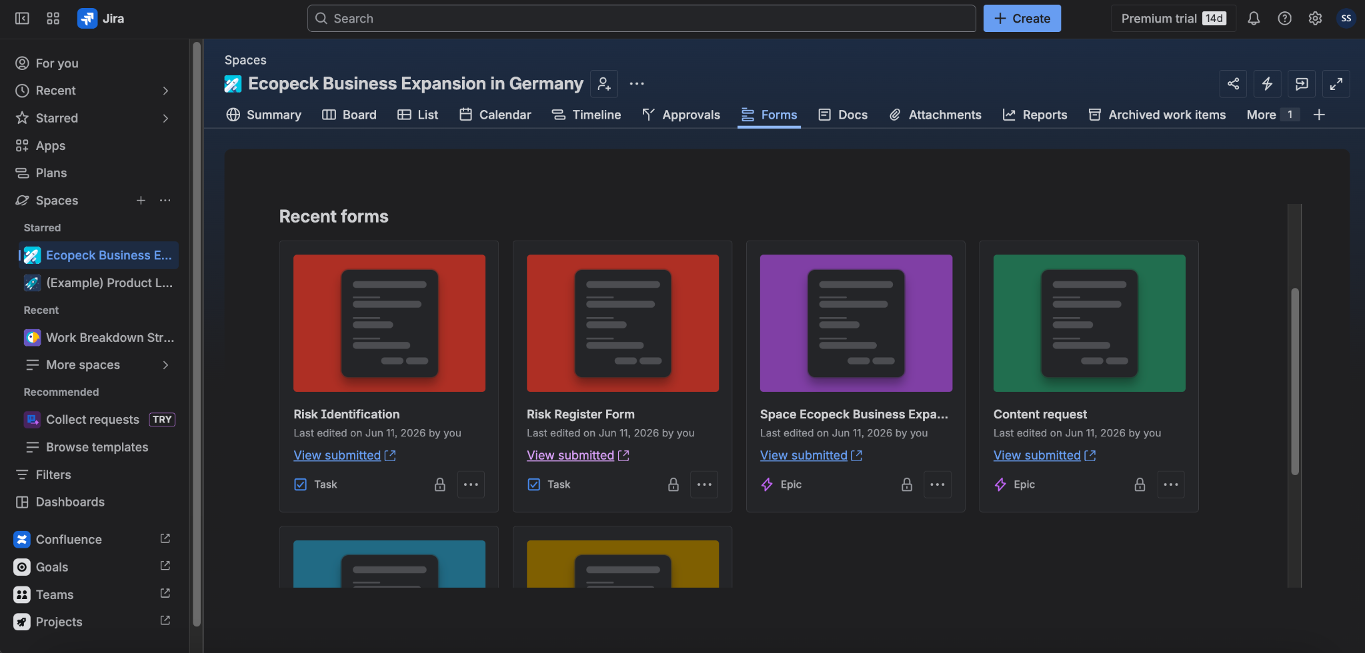
Communication Strategy
Communications with the stakeholders via Jira Forms and Docs.
Sprints weekly and meetings monthly.

Slide 9


Project Management Approach- AGILE
Why Agile for EcoPack?
Suitable for digital platform development.
Allows continuous stakeholder feedback
Improves product quality through regular reviewing and testing
Helps to respond quickly to changing customer and supplier needs
Advantages
Faster delivery of functional platform features
Better teamwork and collaboration
Early identification and resolution of technical issues
Limitations
Requires continuous stakeholder involvement
Difficult to estimate costs and timelines accurately
Frequent changes may affect long-term planning

Slide 10
Stakeholder Identification and Analysis
Power interest matrix
Project Sponsor : Provides funding and expect high-
Quality project on time and within budget.
Project Manager : Leads and controls project, want
clear communication and goal achievement.
Project Team Members : Execute project tasks, require
clear instructions & fair workloads
Functional Managers : Provide necessary resources &
Team Support
Government / Regulatory Authorities : Ensure all legal
requirements
Client / Customers : Receives the final product needs
Suppliers / Vendors : Deliver goods & services
and expects fair contracts & on-time payments
 | LOW INTEREST | HIGH INTEREST
HIGH POWER | KEEP SATISFIED Functional Managers Government / Regulatory Authorities | MANAGE CLOSELY Project Sponsor Project Manager Client / Customer
LOW POWER | MONITOR Local Community / Public Suppliers / Vendors | KEEP INFORMED Project Team Members End Users

Slide 11
Risk Assessment
Risk Register Summary
Total Project Scope
Methodology Alignment
Risk Evaluation
Core Risks
Probability-impact matrix
Severity = Probability x Impact
4 x 5 =20 (High Priority)
Critical Threat : Continuous active monitoring & immediate mitigation.
Key project risks
Regulatory Delays (Business & Environmental Permits)
Digital Platform Delays & Cybersecurity Breaches
Budget Overruns Beyond €900,000
Low Customer Adoption & Strong Local Competition
Supply Chain & Supplier Failures

Slide 12
Risk Mitigation and Resource Allocation
Mitigation strategies & Contingency plan
 | Mitigation Strategies | Contingency Plan
Business Registration Delay | Hire experienced legal consultants & prepare documentation in advance | Escalate to legal firm & prioritise tasks not requiring final registration
Environmental Compliance Approval Delay | Thorough compliance reviews before submitting | Using external consultants or finding temporary operational alternatives
Equipment Procurement Delays | Order machine early, build supplier relationships and track shipments | Sourcing from secondary suppliers or lease temporary equipment
Supplier Contract Failure | Multiple suppliers & including penalty clauses in contract | Having safety stocks & backup vendor contracts
Digital Platforms & Budget Constraints | Use agile sprint reviews and monthly budget monitoring | Pause non-essential development & priortize Minimum Viable Product

Slide 13
Resource Allocation
Human Resources
Operational Staff : Onboard 25 employees
Core Leadership : Managed by Project Sponsor and Project Manager
Execution Team : Functional Managers and Project Team Members supported by Legal Consultants
Financial Resources
Market & Customer Research : €100,000 (Months 1-6)
Agile Digital Platform Development : €300,000 ( Months 6-12)
Workforce Recruitment & Training : €200,000 (Months 10-15)
Production Testing & Operational Readiness: €100,000 ( Months 16-20)
Market Launch & Customer Acquisition : €200,000 ( months 21-24)
Technical and Material Resources
Digital ordering platforms : “EcoPack Connect” link suppliers with business clients
Automated Production system : to optimize material usage and reduce paper waste
Jira platforms : Manages workflows, tasks, backlogs and sprint tracking

Slide 14
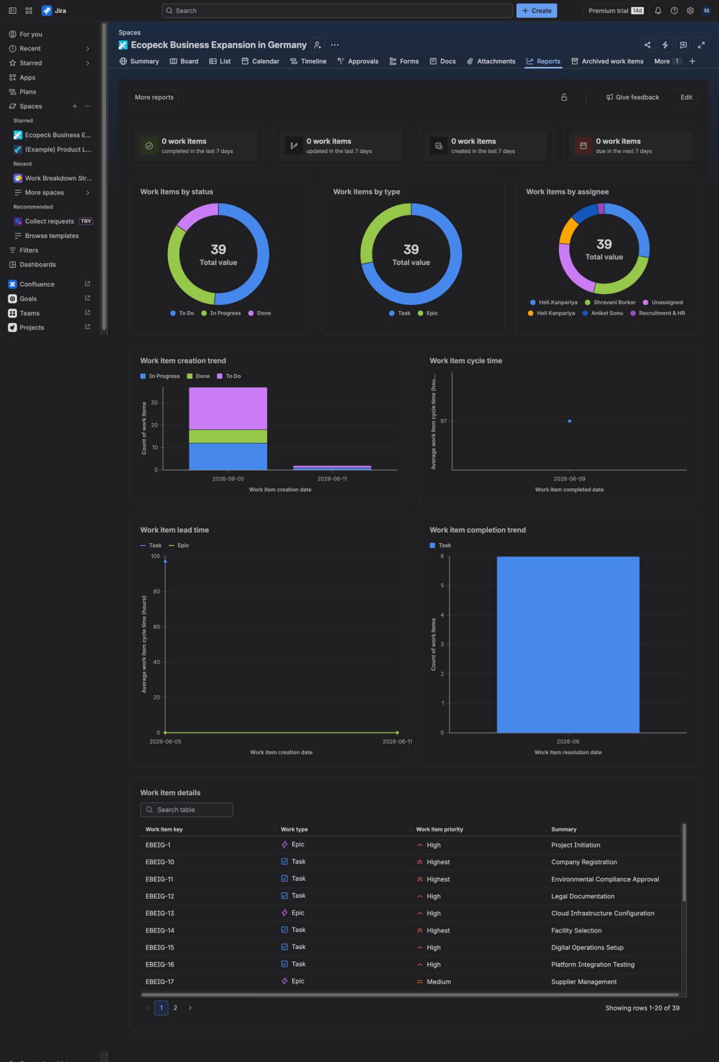
Critical Evaluation
Analysis of performance of the project using Jira Reports.
Workload analysis and project status tracking.

Slide 15
Conclusion
In conclusion, the successful delivery of the Ecopack project will depend on strong leadership, stakeholder partnership, continuous development, and adaption of changing market conditions. The project has the potential to strengthen Ecopack's competitive position, achieve sustainable business growth, and establish a strong foundation for future international expansion.
In this report & Presentation, main project management principles have been applied to define project objectives, scope, stakeholder engagement strategies, risk management processes, resource allocation, schedule planning, and cost control measures. Agile project management methodology provides the flexibility required to manage changing business requirements, particularly during the development of the digital ordering platform.

